Slide 1


Pho$: A Case for Shared Optical Cache Hierarchies
Haiyang Han†,Theoni Alexoudi‡, Chris Vagionas‡, Nikos Pleros‡, and Nikos Hardavellas§
†ECE, Northwestern University
‡Aristotle University of Thessaloniki, Greece
§CS & ECE, Northwestern University
ACM/IEEE ISLPED, July 26, 2021
haiyang.han@u.northwestern.edu, {theonial, chvagion, npleros}@csd.auth.gr, nikos@northwestern.edu
Notes:
Hi, today I will be presenting our work Pho$: A Case for Shared Optical Caches. I am an ECE PhD student at Northwestern University.
This is a work in collaboration with Theoni Alexoudi, Chris Vagionas, and Nikos Pleros from Aristotle University of Thessaloniki, Greece. I am advised by the Prof. Nikos Hardavellas.

Slide 2
Conventional caches are a bottleneck
L1s must be fast, which forces them to be
  Small (32-64KB), leading to many misses
  Private, requiring coherence (complex, area-, latency- and energy-intensive)
  Wasteful (may keep many identical copies of the same data)
L2 caches face similar problems
Notes:
To mitigate the memory wall problem, modern computer systems have resorted to deep, multi-level cache hierarchies.
However, conventional electronic caches are intrinsically limited, and bottleneck modern architectures.
They need to be small to maintain a fast access speed, leading to many slow misses.
The need for speed forces higher levels, L1 and L2, to be private, requiring complex and area-, latency- and energy-intensive coherence protocols, and complicated on-chip networks.
They are wasteful, as private caches may keep multiple copies of the same data.

Slide 3
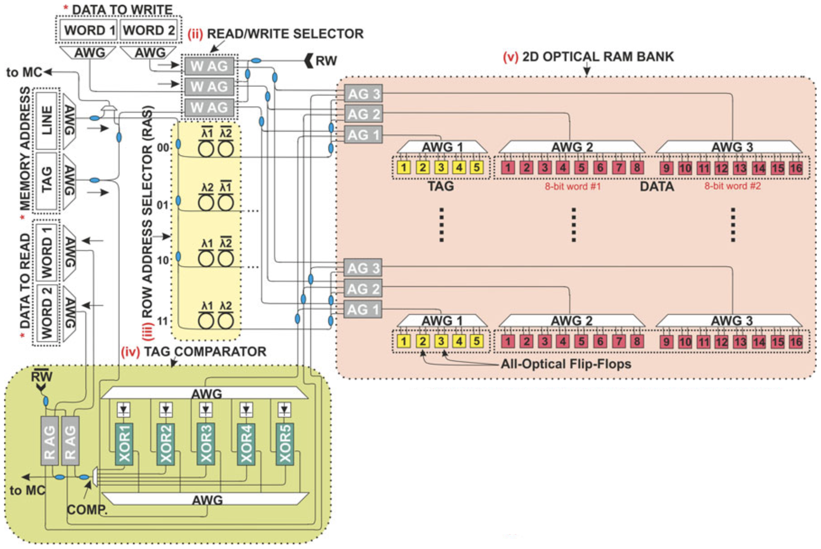
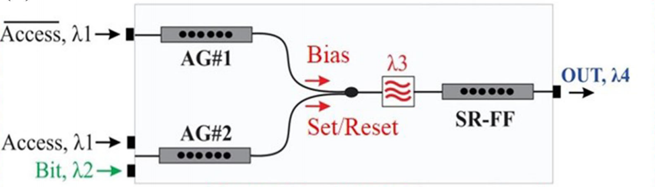
Pho$ builds caches using optical technology
Simple optical cache:
Access Gates
Passive Micro-Ring
matrix
Arrayed Waveguide Grating
Multiplex and de-multiplex
Optical Flip-Flops
Images credit to [1, 2]
Notes:
To tackle these problems, we introduce Pho$, which uses emerging optical technologies to build caches.
Here we show the layout of a basic optical cache.
Optical FFs with an access time less than 50ps make up the bit cells in cache bank
Arrayed Waveguide Gratings act as optical multiplexers and de-multiplexers of different wavelengths of light
Access Gates control the direction of data flow to allow for reading or writing operations; they can be controlled to pass or block incoming signals.
The tag comparator determines the hit/miss status of a cache request.
Passive MRs are used for row-decoding, and select the cache line to read or write according to the requesting memory address

Slide 4
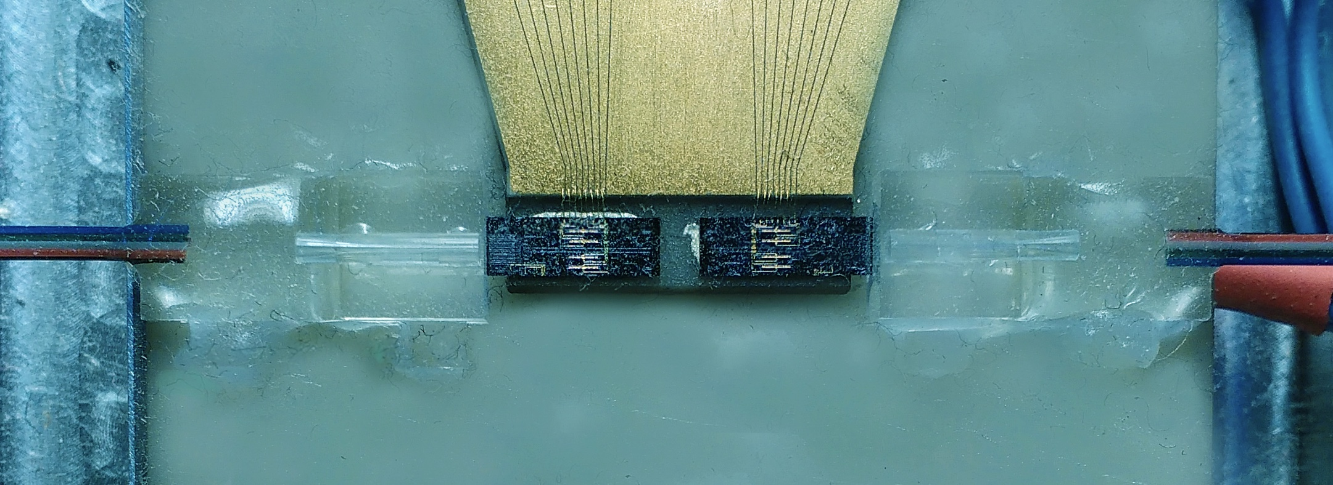
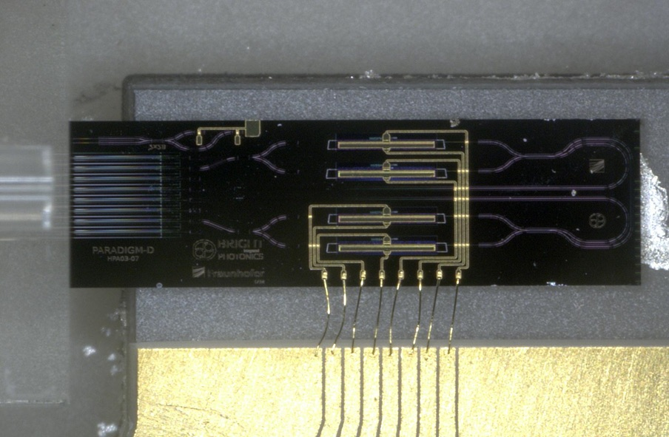
Optical cache technology is real
Devices have been built and verified/characterized in our lab
Packaged optical memory
Monolithic InP Flip-Flop
Notes:
The technology of optical caches is real.
These pictures show the packaged optical memory and monolithic Indium phosphide optical Flip-Flops that we verified in our lab.
These form the storage blocks of an optical cache, proving its feasibility.

Slide 5
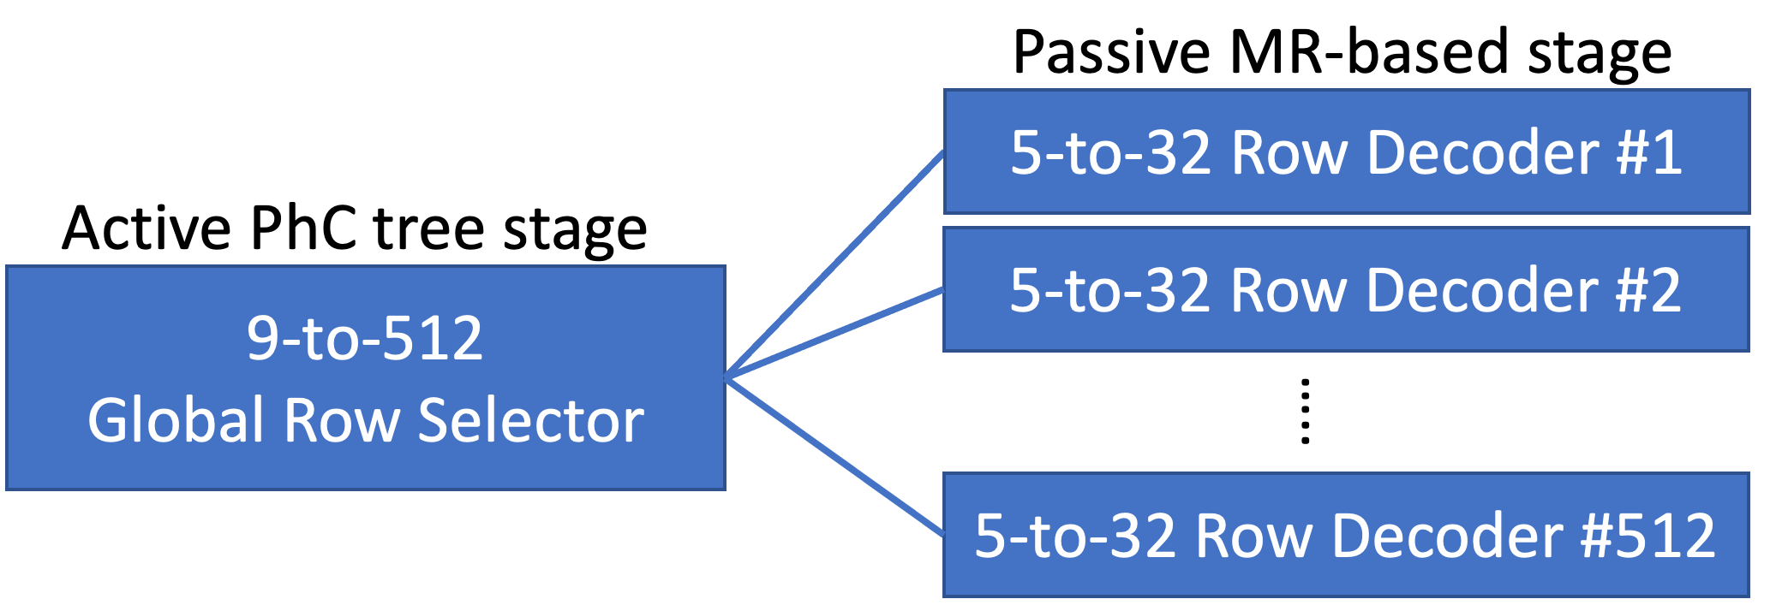
Pho$ is the first practical optical cache design
Previous attempts were infeasible:
  100s—1000s of Watts for optical cells
  High optical loss on the decoder
  TDM optical bus not practical @50-80GHz
Arrayed Waveguide Grating
Multiplex and de-multiplex
Access Gates
Passive Micro-Ring
matrix
InGaAsP Photonic Crystal (PhC) nanocavities^{[3]}
30nW, 44ps read time
2-level decoder
active 1st stage
passive 2nd stage
Optical Flip-Flops
Images credit to [1, 2]
Notes:
Previous attempts for optical caches were impractical:
First, the InP optical cells require 100uW per bit, and lead to 100s of Ws for a reasonably sized cache of a few kBs; MBs would require kWs.
Second, with a larger cache, the MRs needed in the decoder also grow, resulting in high optical loss and laser power.
Third, the time-division-multiplexing optical bus used for communication requires the entire optical system to operate at 50-80GHz, which is impractical.
To solve for the 1st two impracticalities, in Pho$ we turned to Indium gallium arsenide phosphide PhC nanocavities, which require only 30nW static power to operate, while having a fast read time of 44ps. We also use a two-level cascaded row decoder with active components to reduce optical loss

Slide 6
Pho$ Highlights
Uses emerging optical technology
Completely replaces all electronic private L1 and L2 caches with a single L1 cache
Fast: two-cycle access for processors up to 5GHz
Large: multi-MB
Shared: alleviates need for cache coherency
  Eliminates coherency-related latency and energy overhead
  No hardware needed for cache directory
  Overcomes constraints for private caches when scaling to more cores
  Simplifies network design
Notes:
Pho$ completely replaces electronic private L1 and L2 caches in a manycore processor with a single L1 cache
The Pho$ cache has a fast access time of two cycles for processors up to 5GHz.
It boasts a large capacity at multiple MBs
And finally it alleviates the need for cache coherency by being shared amongst the cores, leading to simpler and more efficient processors

Slide 7
Novel optical network: Pho$Net
No cache coherence → no need for inter-core traffic
Decoupled request/reply networks minimize laser power, area, cost
  Request (blue): Multiple Writer (cores) Single Reader (cache bank)
  Reply (orange): Single Writer (cache bank) Multiple Reader (cores)
Fast cache access ensured via novel concurrent arbitration across both subnets
Optically connected memory (OCM)
Notes:
We solve the TDM bus problem of prior proposals by designing Pho$Net, a novel optical Network-on-Chip
We have an electronic processor die on the left and a 3D stacked opto-electronic hybrid die on the right.
Communication between the core and caches is entirely in the optical domain and uses Dense Wavelength Division Multiplexing so that each waveguide carries up to 64 wavelengths, with each wavelength supporting 10 Gbps data transfers.
Because a shared L1 removes the need for cache coherency and inter-core traffic, we can implement a hybrid network to decouple the request and reply networks, each with a dedicated laser power source.
The blue waveguides represent the request network, which is only responsible for sending requests to the caches. Each request subnet forms a multiple writer single reader crossbar where all the cores are writers and one cache bank is the reader.
The orange waveguides represent the reply network, which is only responsible for carrying data replies back to the cores. Each reply subnet forms a single writer multiple reader crossbar where all the cores are readers and one cache bank is the writer.
By decoupling the two networks, we shrink the network size by avoiding full connectivity among all nodes, saving laser power, area, cost with minimal performance overhead.
Finally, an optically connected memory optimizes for low-latency high-bandwidth communication between the electronic LLC and DRAM.
Fast cache access in Pho$ is ensured by a novel arbitration protocol that concurrently arbitrates across both subnets.

Slide 8
Pho$Net Arbitration Protocol
Prevents the conflict of photonic signals from different senders
One protocol arbitrates for both request and reply subnets
Optimize the common case: requesting core automatically wins arbitration of reply subnet to get data from cache hit
(a)
(b)
(c)
(d)
(e)
(f)
Notes:
Pho$Net’s arbitration protocol ensures that requests from different cores and replies to different cores do not conflict by co-arbitrating both subnets. Each optical crossbar includes a data channel, a token arbitration channel and a reservation channel. The protocol optimizes for the common case of cache hits by allowing the requesting core to automatically reserve the reply chanel for the data. More details can be found in our paper.

Slide 9
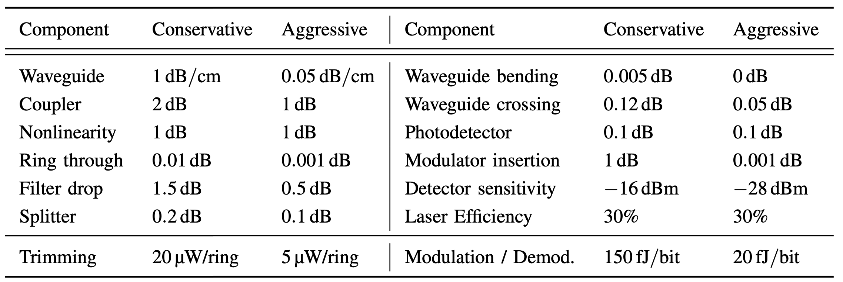
Evaluation vs. Skylake, min/max projections
Power projections:
  We sweep literature for min/max values of nanophotonic parameters
Performance:
  Sniper simulator
  Baseline: Intel Skylake
Nanophotonic Parameters
Notes:
To evaluate Pho$,
We sweep the literature, collect the maximum and minimum nanophotonic parameters, and use them to derive conservative and aggressive network power consumption projections.
We use a modified version of the Sniper simulator to compare Pho$ with and without OCM against a Baseline electronic processor modeled after Intel Skylake.

Slide 10
Pho$ obtains significant speedup
Performance Speedup
  Average 1.37× (1.48× with OCM) performance speedup over baseline
  Max speedup: 3.89×
Larger multicores, sharing-heavy workloads (server) should yield even higher speedups
SPEC-CPU
Parsec
Notes:
Our simulation results show that Pho$ achieves an average 1.37 times speedup over the baseline and 1.48 times with OCM. We see a maximum speedup of 3.89 times.
We expect that larger multicores and sharing-heavy workloads, such as server workloads, will yield even higher speedups

Slide 11
Pho$ is also more energy-efficient
Average energy savings: 12% EPI and 31% EDP
SPEC-CPU
Parsec
For each benchmark, the three bars represent Baseline, Pho$, Pho$_OCM
Notes:
For energy, when compared with the baseline, Pho$ saves on average 12% energy per instruction. More importantly, it achieves a 31% lower energy delay product.

Slide 12
Pho$Net consumes the least power
Network power projections
  Conservative: Pho$Net lowest, still demands high power
  Aggressive: Pho$Net lowest, very practical
6.52 W
Notes:
We compare the network power of Pho$Net with a full-blown MWSR network, a Reservation assisted SWMR network, and a one-channel network that does not segregate the request and reply channels.
With conservative parameters: Pho$ has the lowest relative power but still consumes 100s of Watts due to the conservative numbers used for optical losses.
With aggressive parameters: Pho$ still beats all other configurations and has a very practical 6.52W total network power consumption.

Slide 13
Conclusion
Pho$ is an opto-electronic memory hierarchy architecture for multicores
  Replaces all L1, L2 caches with a single large, fast, shared optical cache
Pho$ is the first practical optical cache design
  Novel decoder and cell design optimizes for performance and power efficiency
  Novel hybrid Network-on-Chip optimizes for power and cost
  Novel network arbitration protocol optimizes for performance
We solved problems that make previous designs impractical, and achieve leads
in both performance and energy consumption
[1] P. Maniotis et al., “Optical buffering for chip multiprocessors: a 16GHz optical cache memory architecture,” J. Lightw. Tech., vol. 31, 2013.
[2] T. Alexoudi et al., “III–V-on-Si photonic crystal nanocavity laser technology for optical static random access memories,” IEEE J. Sel. Topics Quantum Electron., vol. 22, 2016.
[3] K. Nozaki et al., “Ultralow-power all-optical RAM based on nanocavities,” Nature Photonics, vol. 6, 2012.
Thank you!
Notes:
In conclusion, we propose Pho$, an opto-electronic memory hierarchy architecture for multicores.
It stands out among cache designs with three distinct characteristics: It replaces all L1 and L2 caches of a manycore processor with a single large, fast, and shared optical L1 cache
(emphasize “Large, Fast, and Shared” when you speak)
To the best of our knowledge Pho$ is the first practical optical cache design
The decoder and cell design allow for low-power operation
The segregated optical Network-on-Chip maximizes power savings and minimizes cost at minimal performance overhead
And the novel and unique network arbitration protocol facilitates cache requests and replies and optimizes for the common case of cache hits
Through Pho$ we solved the problems that render previous designs impractical, and achiece leads in both performance and energy consumption
Thank you for your attention!

