Slide 1
Wireless & Network Security Integration Solution Overview
Offense – FTM
March 6th, 2010

Slide 2
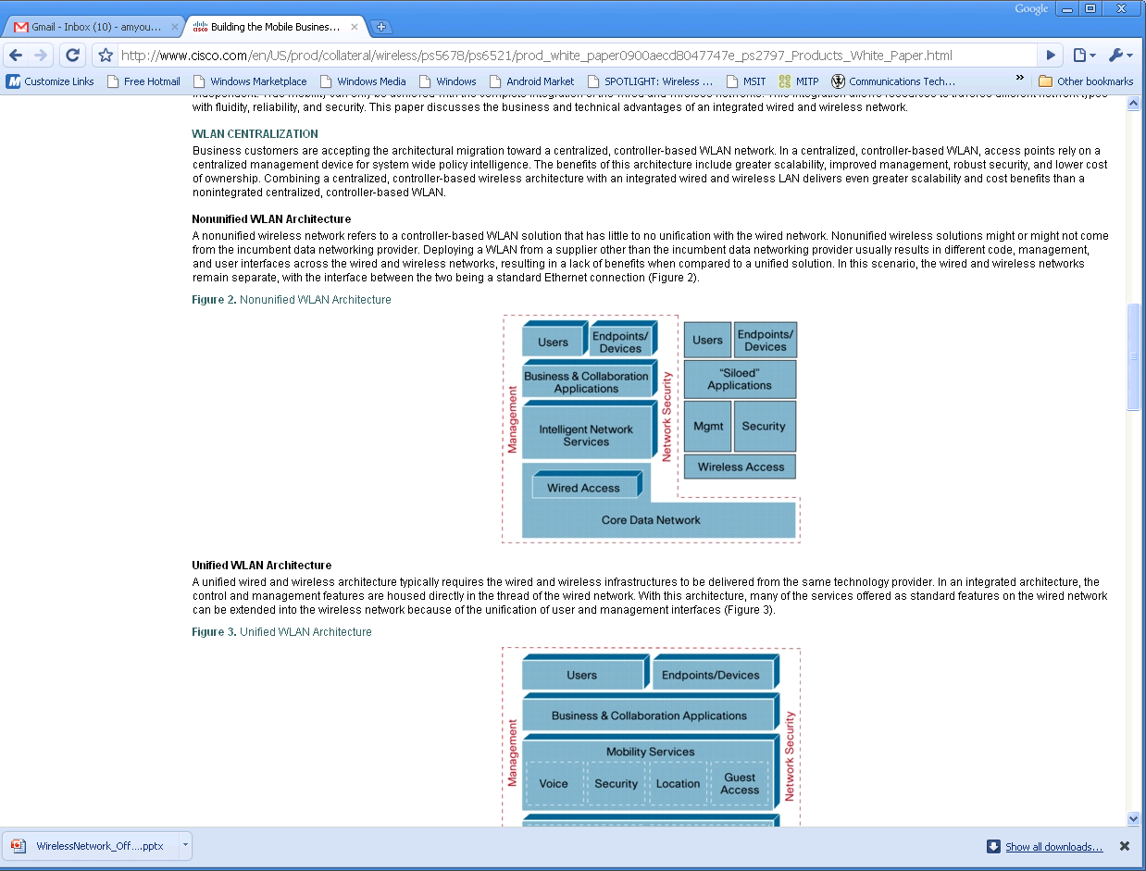
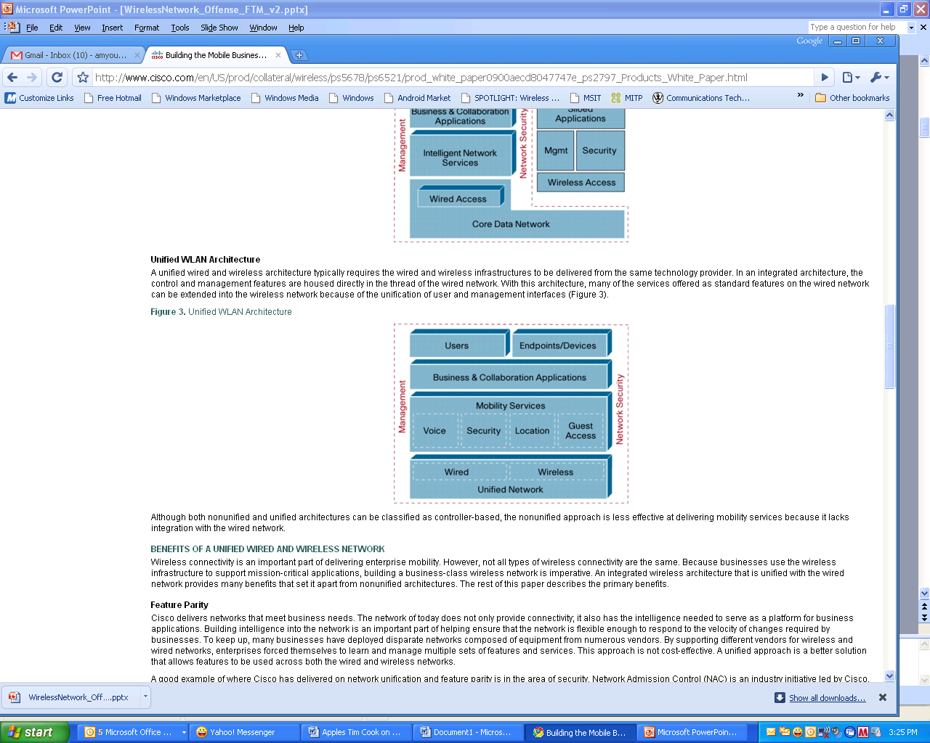
Unified vs. Non-Unified WLAN
Non - Unified
Unified
The paper claims that the Unified System will save costs, but this claim is unsubstantiated
Notes:
Unified WLAN Architecture
A unified wired and wireless architecture typically requires the wired and wireless infrastructures to be delivered from the same technology provider. In an integrated architecture, the control and management features are housed directly in the thread of the wired network. With this architecture, many of the services offered as standard features on the wired network can be extended into the wireless network because of the unification of user and management interfaces
Nonunified WLAN Architecture
A nonunified wireless network refers to a controller-based WLAN solution that has little to no unification with the wired network. Nonunified wireless solutions might or might not come from the incumbent data networking provider. Deploying a WLAN from a supplier other than the incumbent data networking provider usually results in different code, management, and user interfaces across the wired and wireless networks, resulting in a lack of benefits when compared to a unified solution. In this scenario, the wired and wireless networks remain separate, with the interface between the two being a standard Ethernet connection (Figure 2).

Slide 3
Total Cost of Ownership
To determine cost savings, a company must evaluate:
Is there a savings in acquiring the new infrastructure?
Will the savings be achieved in ongoing maintenance and upgrades?
What is the ROI and Payback Period?
Is the project in line with the company’s strategic priorities, for example, supporting a growing mobile population?
How does a diverse workforce or global presence impact the decision?

Slide 4
Total Cost of Ownership
Acquisition cost is a fraction of the total cost of ownership
Initial acquisition cost of IT technologies usually represents only 20 percent of the TCO over a five-year period.
The remaining 80 percent of the cost-the ongoing upgrades, maintenance, and support-are often overlooked during the initial phases of a new technology rollout.
Both areas must be evaluated in the context of ROI before purchasing Unified Network Equipment

Slide 5
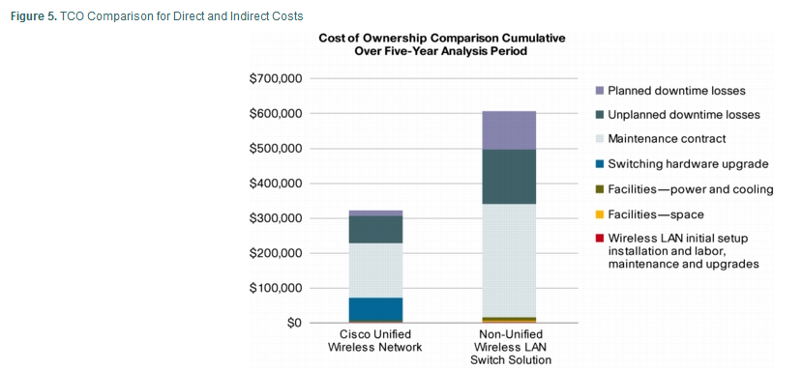
TCO for Unified vs. Non Unified

Slide 6
Cost Savings is Not Substantiated
  Unified WLANs can save money in the following areas, not defined in the paper:
Vendor Negotiations
Vendor Management
Reduced Training Costs
Streamlined Reports
Improved Security
Lower Labor Costs
Lower Infrastructure and Energy Costs
Less Unplanned Downtime
Notes:
Vendor Negotiations
Only have to negotiate a single contract, which means less money spent internally on procurement
Vendor Management
Single point of contact for support and not having to manage several separate software liscences and service contracts
Reduced Training Costs
Staff only has to be trained on one network console
Streamlined Reports
Improved Security
Having a single box means no interoperability issues
Lower Labor costs
Less money spent on experts due to simpler technology
Lower Infrastructure Costs
Less Power
More Rack Space
Reduced unplanned downtime with a Unified system
Will save on costs, and also have happier customers

Slide 7
Secure Communications
Cisco Article states:
“…, a network-wide security solution that only addresses WLAN-related attacks is dangerously unbalanced.”
Yet…
03/06/2010
MSIT 458 - FTM Group
7
Notes:
7

Slide 8
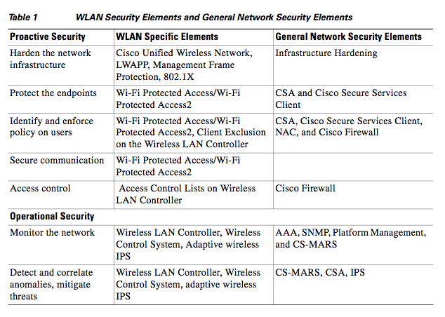
Secure Communications
No Recommended Cisco Feature ?!?!?!?
03/06/2010
MSIT 458 - FTM Group
8
Notes:
The purpose of this table, according to the article, is to show how Cisco’s security solution works together w/ WLAN standards to secure a network.
Yet….. No recommendation for “Secure Communications” in the General Network Security.
If the purpose of this table is to show how Cisco components and WLAN Standards combined can secure a network, then why is there a gap in the secure communications section of the General Network Security components? Apparently, Cisco does not have a specific component to address communication security. Cisco could have recommended using AES or even triple DES here.
(Click) The Cisco Article points out that WPA / WPA2 are recommended elements used in a Wireless network to achieve a few of the proactive security roles. Many routers – even non-Cisco routers – can be configured to use WEP or WPA / WPA2.
Although WPA has come under fire recently with the identification of some cracks:
Eric Tews and Martin Beck found a weakness in WPA’s Temporal Key Integrity Protocol (TKIP). Some experts would actually say this is more of a “pinhole” than an actual crack. Although the hack doesn’t seem to allow the attacker to obtain data from the packets, it does allow the attacker to act as an access point and possibly insert malicious packets into the network. The key to avoid this type of attack is to use AES with WPA or WPA2 and a robust network key. http://www.itbusinessedge.com/cm/blogs/weinschenk/wpa-vulnerability-bad-but-not-catastrophic-news/?cs=13772
8

Slide 9
Intrusion Detection
The Cisco Security Agent (CSA):
- uses “Signature-based anti-virus protection to identify and remove known malware
- The operative word here is “known”
- No mention of a Statistical-based detection method for DDoS type attacks.
- What is “Zero Update Protection”
Notes:
The next weakness of the article circles around Cisco’s Intrusion Detection capability. The article identifies a Signature-based detection system as part of the Cisco Security Agent (CSA).
The article does not clearly identified if Zero Update Protection is equivalent to statistical-based detection.

Slide 10
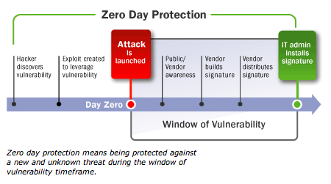
Intrusion Detection
Notes:
Zero Update Protection is the protection method against attacks that are known but do not have a patch or fix available for installation. These types of attacks are referred to as Day-Zero attacks.
According to additional Cisco white papers, the CSA has the ability to “reduce emergency patching of systems in response to vulnerability announcements and minimizes patch-related downtime and IT person-hour expenses”. Cisco’s Zero Update Protection may actually be a benefit considering many emergency patches or “hot fixes” are not fully regression tested by the manufacturer nor the network administrator. But, Configurable thresholds are not discussed in the CSA to allow the administrator to set and monitor the validity of abnormal network activity.
There are also many software manufacturer websites that provide information about day zero attacks and their behaviors, such as Microsoft, and other Security-related websites, SearchSecurity and ZDNet. This information provided by these sites could be helpful to network administrators when monitoring or configuring thresholds for detection.

Slide 11
Security Policy Challenges
Bad Passwords
  Low complexity password policies can allow malicious users to guess passwords and gain access to network resources regardless of well-crafted policy.
Central Authentication/Configuration
  One must not only be concerned with user authentication, but also authenticated access point configuration and management.
  Remove telnet access from devices and move to SSH or better remote access.
  Use non-public version of SNMP for both read/write access.

Slide 12
Segmenting Networks
Network Admission Controller Configuration
  Implement NAC to establish baseline of secure access before wired/wireless nodes connects to network.
  Does node have updated virus signatures? Doses this node show symptoms of an infection?
  NAC can be single point of failure if authentication server is compromised.
Notes:
No mention of VLAN tagging of network.
Used to limit access to “sandbox” of wireless nodes.

Slide 13
Mobile Device Intrusion
WLAN Access
  Mobile devices frequently obtain access to business resources either to mitigate cellular data use or increased speeds on WLAN.
  Due to proprietary OS phones may not be able to implement Cisco Security Agent on all network nodes.
Flash-disk Access
  Phones are frequently charged and synced via USB.
  Can be used to bypass IDS, Firewalls, NAC, and CSA.
Malicious Applications
  Application marketplaces offer a possible vector for attack in the guise of legitimate software.

Slide 14

Why do I need Cisco Boxes?
A slew of Cisco boxes are mentioned but their unique “functional purposes” in the overall enterprise security framework is not clear
  More boxes: CSA, NAC, Firewall, IPS, MARS, etc.
  What combination of devices is needed (bare essential)?
  How can I avoid the dangers of overlaps vs. gaps (must haves)?
Notes:
Key point: confusing!
What combo needed for true “end-to-end” security?
Danger: overkill vs. enough?

Slide 15
Enterprise WLAN Security: Defense-In-Depth
“Defense-In-Depth” is mentioned but the article lacks explaining what that constitutes and more importantly, how their products map.
“Defense-In-Depth” is a ring architecture which has multiple unique layers of security functions that in unity provide a robust solution.
Notes:
The definition according to the SANS (SysAdmin, Audit, Network, Security) Institute

Slide 16
Defense-In-Depth: what is missing?
1. Security Policy
2. Network Level Security
3. Host Level Security
4. Application Level Security
5. Logging and Auditing
Notes:
SANs organization: this is a general model (non-proprietary, vendor neutral)
Missing: Cisco products do not cover 3 & 4 in detail

Slide 17

Defense-In-Depth: what is missing cont.
Weakest link in the chain
  Host Level Security
    Access Point- SSIDs, encryption, MAC, IP
  Application Level Security
    OS: hot fixes/patches/updates
    Applications: essential vs. non-essential
    Access: “least privilege principle”
    Protection: accounts, passwords, anti-virus, spyware, firewalls
Notes:
Host:
AP- firmware, drivers
don’t bcast SSIDs, change SSIDs frequently
encryption type/strength (WPA1/2/802.11i=AES)
Strong Authentication protocols: digital certificate, username/passwords, secure token: <Wired> <FW> <RADIUS> <AP>
Encrypt traffic (VPN, IPSEC, etc.)
L2/L3: MAC filter/ IP pool = more effort (i.e discourage): Access Control List
App:
OS: Up to date race
App: Remove unnecessary services, applications, and network protocols
Access: configure resources properly, remove/disable default/unneeded accounts (esp. inactive) [INSIDE & OUTSIDE ATTACKS]
Protection: password (length, complexity, aging, reuse, authority) anti-virus, anti-spyware/malware, software firewalls

Slide 18




Some Powerful Wireless Exploitation Tools
According to “sectools.org” top 5 wireless cracking tools:
Wardriving, warwalking, war-*, etc.
Aircrack-ng – one of the fastest WEP/WPA crack tool available
A) Computing resources
B) KEY complexity
C) Dictionary
Youtube Demo
Kismet | NetStumbler | Aircrack-ng | AirSnort | KisMAC
Notes:
Combine: lack of host/application level security + powerful wireless cracking tools = TROUBLE!
War*- is the act of searching for WI-FI wireless network by a person
Examine one tool
AIRCRACK
Aircracking is an 802.11 WEP and WPA-PSK keys cracking program that can recover keys once enough data packets have been captured. It implements the standard FMS attack along with some optimizations like KoreK attacks, as well as the all-new PTW attack, thus making the attack much faster compared to other WEP cracking tools.
1 CPU or many
Key length (8-63 characters), complexity (uppercase, lowercase, numbers, special characters, etc)
Dictionary file-size, etc.
WPA-PSK Keys cracking brute force (dictionary dive)
WAP attack 50-300 keys/sec up to day or longer
Demo
Enable listening on interface
Passively listen & dump packets in a file
Fake authentication with AP (spoofed MAC address)
Match check: captured & dictionary file

Slide 19

QUESTIONS

