Slide 1
Wireless Network Security

Slide 2
The Current Internet: Connectivity and Processing
Cable
Modem
Access
Networks
Premises-
based
LAN
Transit Net
LAN
Private
Peering
LAN
Premises-
based
Core Networks
WLAN
Transit Net
WLAN
WLAN
NAP
Analog
Public
Peering
Transit Net
Operator-
based
RAS
DSLAM
Regional
Wireline
Regional
Cell
H.323
Data
Cell
Data
H.323
Cell
PSTN
Voice
Voice
Notes:
The ISP likely has banks of many modems multiplexed onto a high capacity telephone cable that transports a large number of phone calls simultaneously (such as a T1, E1, ISDN PRI, etc.). This requires a concentrator or "remote access server" (RAS).

Slide 3
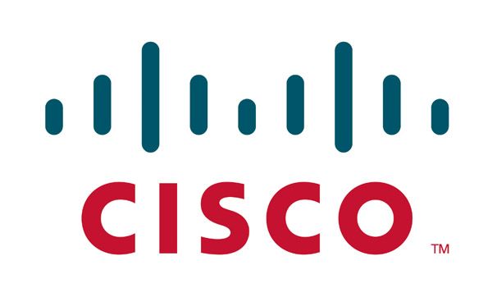
Agenda
The Cisco Unified Wireless Networks
  Cisco Security Agent (CSA)
  Cisco NAC Appliance
  Cisco Firewall
  Cisco IPS
  CS-MARS
Common wireless threats
  How Cisco Wireless Security protects against them

Slide 4
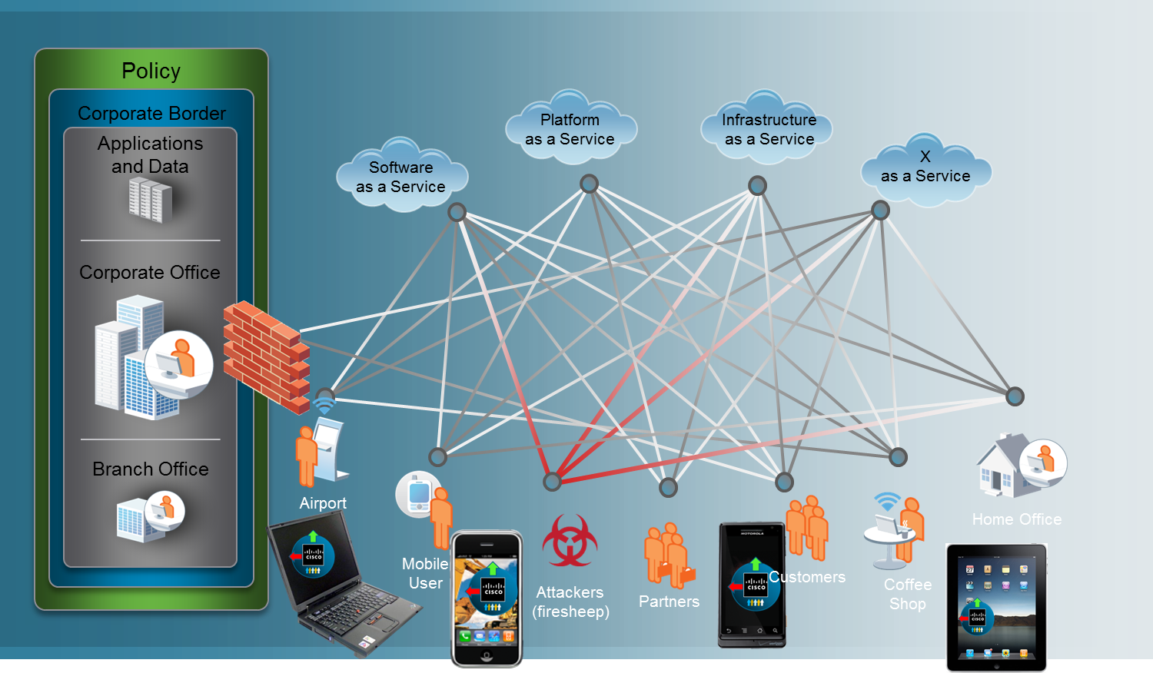
Today’s wireless network

Slide 5
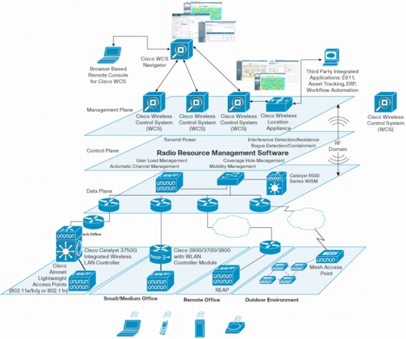
Cisco Unified Wireless Network
The following interconnected elements work together to deliver a unified enterprise-class wireless solution:
Client devices (CSA)
Access points (NAC)
Wireless controllers
  (Firewall, and NIPS)
Network management
  (CS-MARS)

Slide 6
CSA – Cisco Security Agent
Full featured agent-based endpoint protection
Two components:
  Managed client - Cisco Security Agent
  Single point of configuration - Cisco Management Center

Slide 7
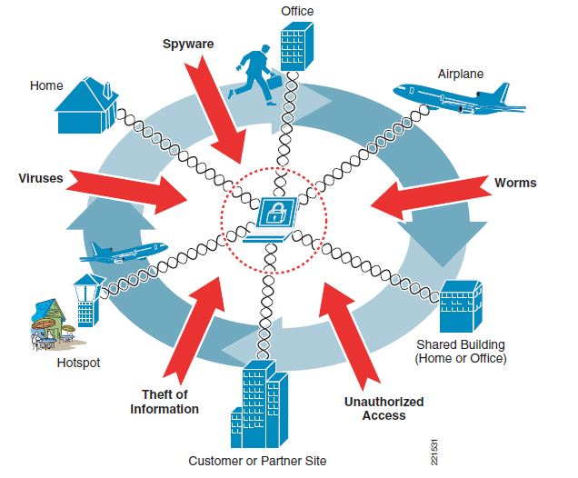
CSA - Purpose

Slide 8
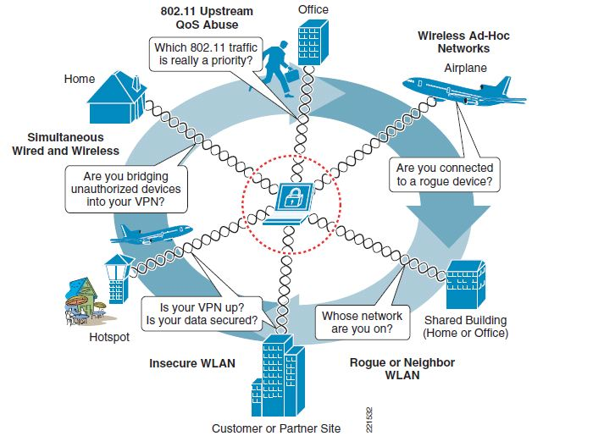
CSA – Wireless Perspective

Slide 9
CSA – Combined Wireless Features
General CSA features
  Zero-day virus protection
  Control of sensitive data
  Provide integrity checking before allowing full network access
  Policy management and activity reporting
CSA Mobility features
  Able to block access to unauthorized or ad-hoc networks
  Can force VPN in unsecured environments
  Stop unauthorized wireless-to-wired network bridging

Slide 10
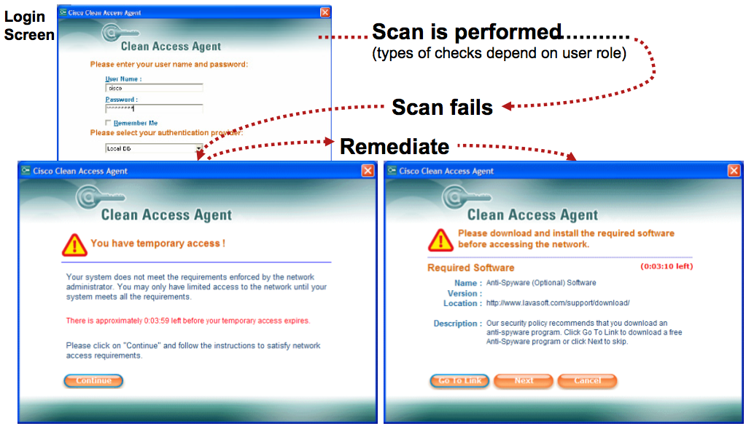
CSA – End User View

Slide 11
Cisco Network Admission Control (NAC)
Determines the users, their machines, and their roles
Grant access to network based on level of security compliance
Interrogation and remediation of noncompliant devices
Audits for security compliance

Slide 12
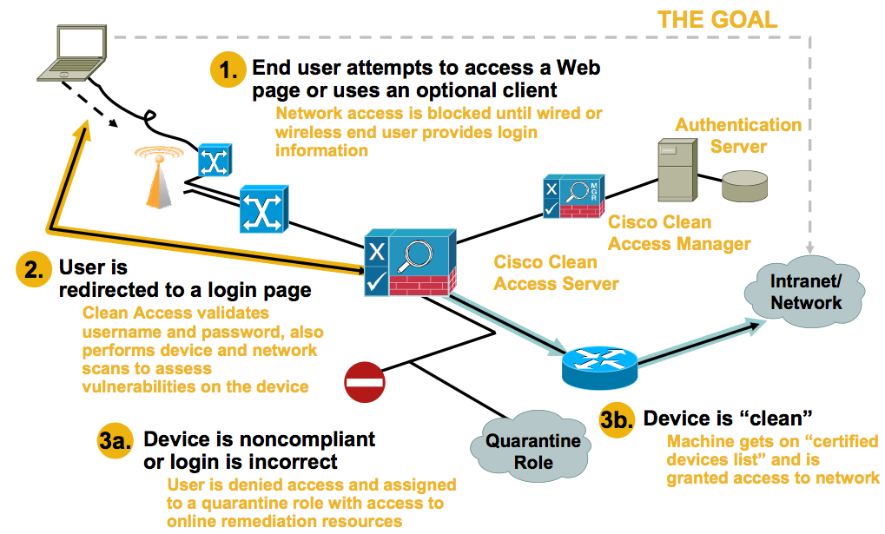
NAC - Overview

Slide 13
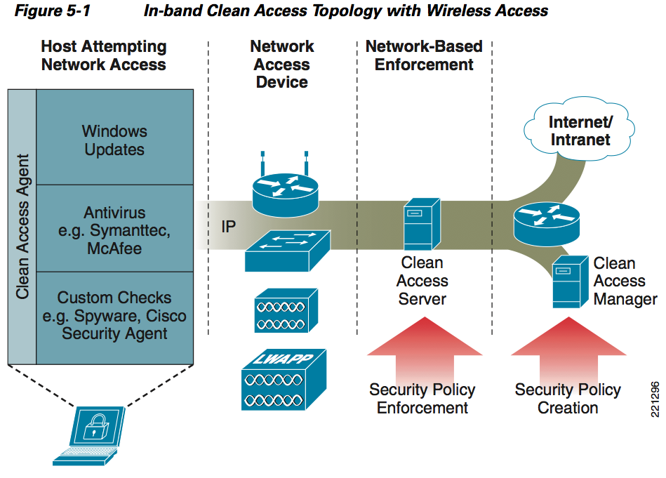
Cisco NAC Architecture

Slide 14
Cisco NAC Features
Client identification
  Access via Active Directory, Clean Access Agent, or even web form
Compliance auditing
  Non-compliant or vulnerable devices through network scans or Clean Access Agent
Policy enforcement
  Quarantine access and provide notification to users of vulnerabilities

Slide 15
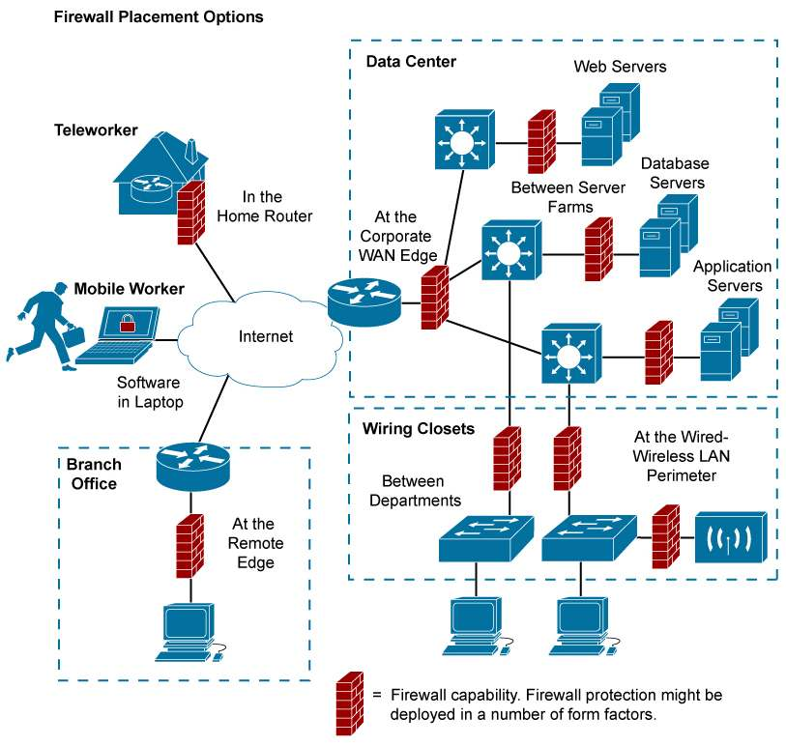
Cisco Firewall (Placement Options)
Source: Cisco, Deploying Firewalls Throughout Your Organization

Slide 16
Why Placing Firewalls in Multiple Network Segments?
Provide the first line of defense in network security infrastructures
Prevent access breaches at all key network junctures
WLAN separation with firewall to limit access to sensitive data and protect from data loss
Help organizations comply with the latest corporate and industry governance mandates
  Sarbanes-Oxley (SOX)
  Gramm-Leach-Bliley (GLB)
  Health Insurance Portability and Accountability Act (HIPAA)
  Payment Card Industry Data Security Standard (PCI DSS)
Notes:
-The rise of internal threats has come about by the emergence of new network perimeters that have formed inside the corporate LAN.
16

Slide 17
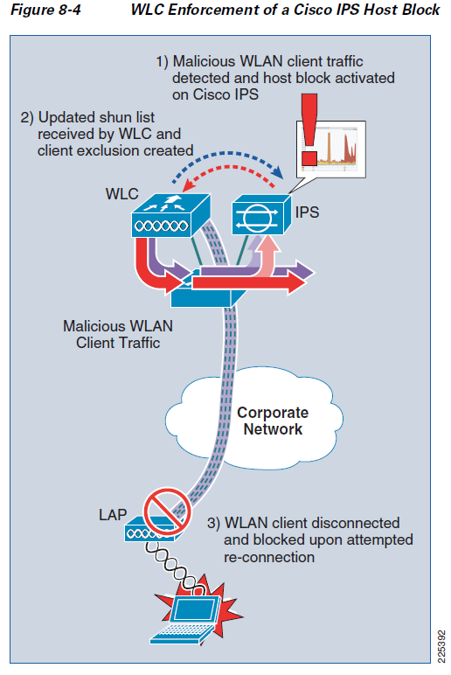
Cisco IPS
Designed to accurately identify, classify and stop malicious traffic
  Worms, spyware, adware, network viruses which is achieved through detailed traffic inspection
Collaboration of IPS & WLC simplifies and automates threat detection & mitigation
Notes:
LAP: lightweight access point
WLC: wireless LAN controller

Slide 18
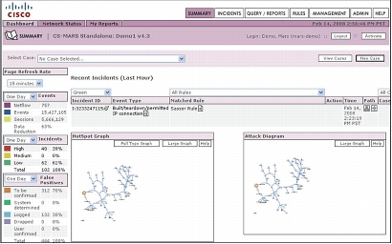
CS-MARS:Cisco Security Monitoring, Analysis and Reporting System
Monitor the network
Detect and correlate anomalies (providing visualization)
Mitigate threats

Slide 19
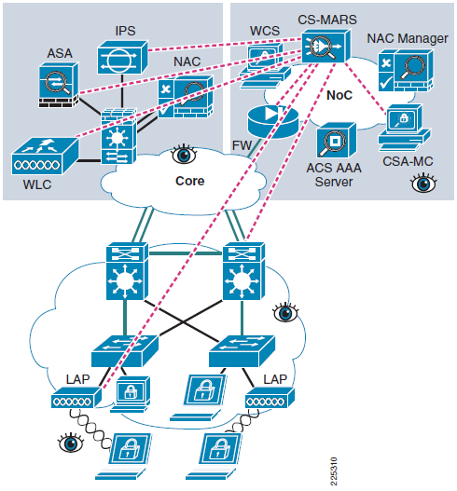
Cross-Network Anomaly Detection and Correlation
MARS is configured to obtain the configurations of other network devices.
Devices send events to MARS via SNMP.
Anomalies are detected and correlated across all devices.
Notes:
ASA: Adaptive Security Appliance
ACS: Access Control Server
LAP LWAPP Access Point.
LWAPP Lightweight Access Point Protocol.
Configuration Notes
SNMP community strings on MARS must match those on the devices.
First add devices that detect attacks and false positives.
Then add devices that can block an attack.
Next add hosts such as critical database servers.
Layer 3 devices can be discovered by CS-MARS.
19

Slide 20
Group Quiz
For each of the business challenges below, which component(s) of CUWN protect against them
Mitigate network misuse, hacking and malware from WLAN clients by inspecting traffic flows
Identify who is on the network and enforce granular policies to prevent exposure to viruses and “malware”
Streamline user experience, consolidate accounting, and improve password management
Standardize on wireless client connection policies while protecting them from suspect content and potential hackers
Supporting and maintaining a diverse range of security products, correlating events and delivering concise reporting
Offer secure, controlled access to network services for non employees and contractors
Notes:
IPS
Cisco NAC
NAC and CSA
CSA
CS-MARS
NAC and firewall

Slide 21
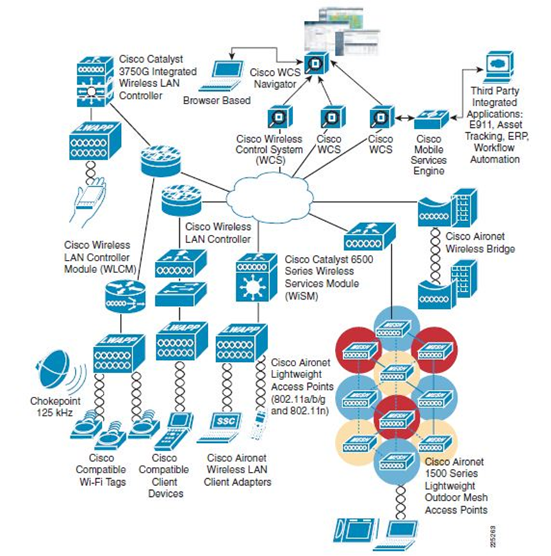
Conclusions
Present unparalleled threats
The Cisco Unified Wireless Network Solution provides the best defense against these threats

Slide 22
Agenda
The Cisco Unified Wireless Networks
  Cisco Security Agent (CSA)
  Cisco NAC Appliance
  Cisco Firewall
  Cisco IPS
  CS-MARS
Common wireless threats
  How Cisco Wireless Security protects against them

Slide 23

Rogue Access Points
Rogue Access Points refer to unauthorized access points setup in a corporate network
Two varieties:
  Added for intentionally malicious behavior
  Added by an employee not following policy
Either case needs to be prevented

Slide 24

Rogue Access Points - Protection
Cisco Wireless Unified Network security can:
  Detect Rogue AP’s
  Determine if they are on the network
  Quarantine and report
CS-MARS notification and reporting
Locate rogue AP’s

Slide 25
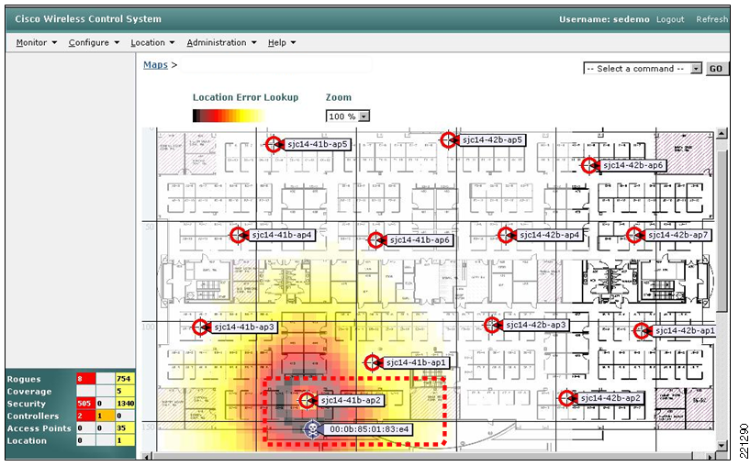
Cisco Rogue AP Mapping

Slide 26
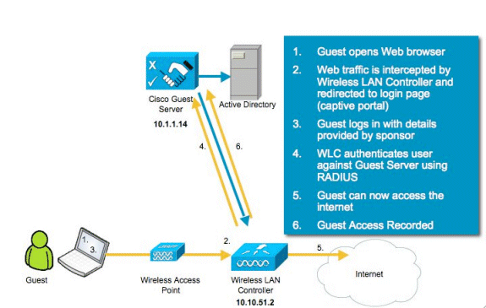
Guest Wireless

Slide 27
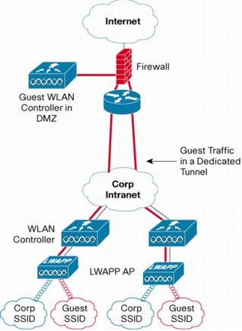
Guest Wifi Benefits
Network segmentation
Policy management
Guest traffic monitoring
Customizable access portals

Slide 28
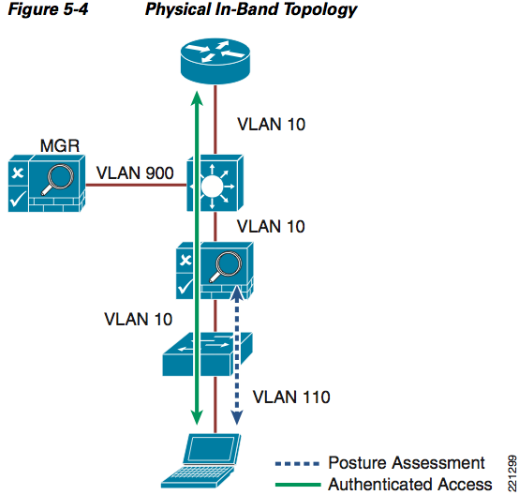
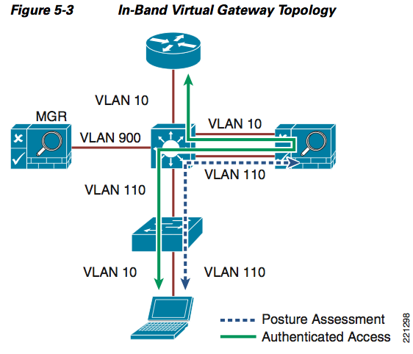
In-Band Modes
Notes:
When the NAC appliance is deployed in-band, all user traffic, both unauthenticated and authenticated, passes through the NAC appliance, which may be positioned logically or physically between end users and the network(s) being protected.
When the NAC appliance is configured as a virtual gateway, it acts as a bridge between end users and the default gateway (router) for the client subnet being managed.
When the NAC appliance is configured as a "real" IP gateway, it behaves like a router and forwards packets between its interfaces.
28

Slide 29
Compromised Clients
Wifi Threat | Security Concern | CSA Feature
Ad-hoc Connections | Wide-open connections Unencrypted Unauthenticated Insecure | Pre-defined ad-hoc policy
Concurrent wired/wifi connection | Contamenating secure wired environment | Concurrent wired/wifi pre-defined policy Disable wifi traffic if wired detected
Access to unsecured wifi | May lack authentication / encryption Risk of traffic cracking, rogue network devices | Location based policies Restrict allowed SSIDs Enforce stronger security policies

Slide 30
Monitoring, Anomalies, & Mitigation
Discover Layer 3 devices on network
  Entire network can be mapped
  Find MAC addresses, end-points, topology
Monitors wired and wireless devices
  Unified monitoring provides complete picture
Anomalies can be correlated
  Complete view of anomalies (e.g. host names, MAC addresses, IP addresses, ports, etc.)
Mitigation responses triggered using rules
  Rules can be further customized to extend MARS

