Slide 1
Insider Threat
Adnan Sheikh
Claudio Paucar
Osezua Avbuluimen
Bill Fekrat

Slide 2
Agenda
Insider Threat Overview
Enabling Technologies
Governance, Risk & Compliance

Slide 3

Insider Threat Overview
Insider threat: Employees, Customers, Partners or Suppliers

Slide 4
Statistics and Recent Incidents
58% Information Security incidents attributed to insider threat.
75% of insiders stole material they were authorized to access and trade secrets were stolen in 52% of cases.
54% used a network – email, a remote network access channel or network file transfer to remove the stolen data.
Most insider data theft was discovered by non-technical staff members.
http://www.indefenseofdata.com, http://www.infosecurity-magazine.com

Slide 5
Statistics and Recent Incidents
Former Fed supervisor succeeds in downloading about 70 of the 300 confidential computer files on his last day of work.
Edward Snowden NSA Leak

Slide 6

Average Cost – Financial Services
Detection or discovery
Escalation
Notification
Ex-post response
Turnover of existing customers
Diminished customer acquisition
=================================
$500 * 10,000 customers = ($5M)

Slide 7
Evolution of Security Threats
Computer Intrusion
1980 - 2005
Advanced Persistent Threat (APT)
2002 - 2011
Insider
2008 - 2013
Protection:
Network perimeter
firewalls, IDS, proxies, AntiVirus,
DHCP, DNS
Detection technique:
Signature based
Protection: +
Internal network, host
AntiVirus, OS, application
logs, email, net flow
Detection technique: Signature based + Network anomaly
Protection: +
Data Leak Protection (DLP),
DRM, Personnel
data, data object
interaction, non-network data
Detection technique:
Signature based + Network anomaly +
Data mining, behavioral
Notes:
Insider Threat – the most costly and damaging

Slide 8


Security Framework
OR
Without a planned framework
With a planned framework
“Adnan, Bill where you at?”
Notes:
msn, Cisco

Slide 9
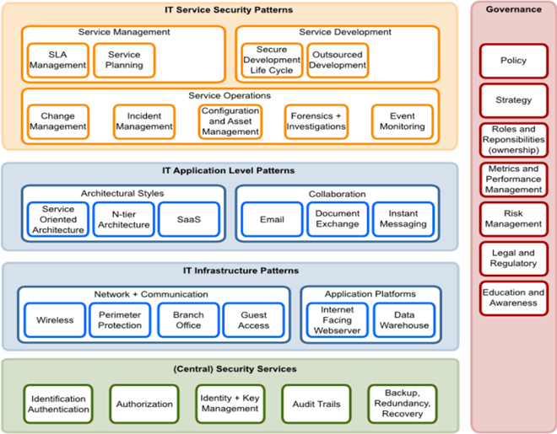






Enterprise Security Architecture
Notes:
https://www.ictstandard.org/article/2010-10-28/creating-enterprise-security-architecture

Slide 10
Enabling Technologies to Detect/Deter Insider Threats

Slide 11
Protecting Service Operations
What is the threat?
  Employees downloading large amounts of sensitive data, potentially stockpiling before they leave the company
How to address it
  Employ SIEM (Security Information and Event Management) technology to analyze log files, then define and monitor for particular events
  Allows you to look for unusual patterns in data access and use, such as an employee extracting large amounts of data from internal systems
Benefits
  Real-time and historical auditing of system access and data usage
Drawbacks
  Commercial options more expensive to implement
  Need to invest in time to learn the tools and understand your data to determine what systems and patterns you need to monitor

Slide 12
SIEM Capabilities
Scalable architecture and deployment flexibility
Real-time event data collection
Event normalization and taxonomy
Real-time monitoring
Behavior profiling
Threat intelligence
Log management and compliance reporting
Analytics
Incident management support
User activity and data access monitoring
Application monitoring
Deployment and support simplicity

Slide 13
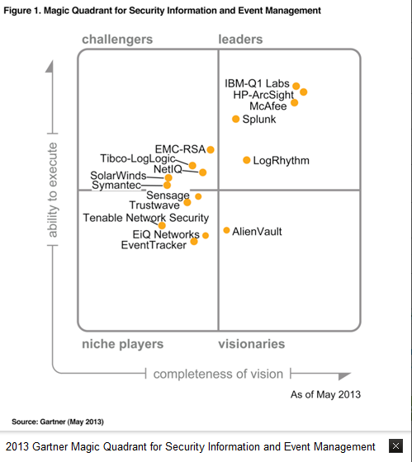
SIEM Vendors

Slide 14
SIEM Vendor Analysis
Vendor | Strengths | Weaknesses
IBM QRadar | Behavior analysis Threat analysis Compliance use cases | Cost
HP ArcSight | Comprehensive solution More prebuilt adapaters for ERP, SaaS tools More prebuilt reports & dashboards | Complex to deploy
Splunk | Log management Application monitoring Analytic capabilities Customization capabilities | Complex to configure and deploy

Slide 15
SIEM Cost: Splunk Enterprise
License cost: $1M perpetual license to analyze 1TB / day
Annual support: $250,000
Services & training: $75,000
Total: $1.325M first year

Slide 16
Recommendation
Choose Splunk Enterprise Edition
  SIEM provides the right functionality for log management and analysis so that we can monitor inside threats against critical information
  More cost-effective than other vendors considered
  Need to invest in dedicated resources to ensure we get greatest value from the technology and the best protection of our sensitive data
  Leader in Gartner’s latest magic quadrant

Slide 17
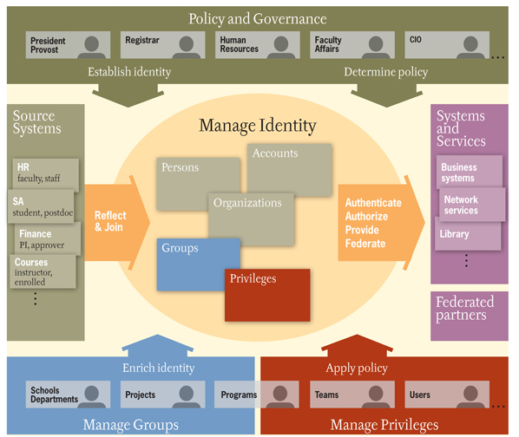
Identity/Access Management Systems
Description
Identity management systems manage the identity, authentication, and authorization of individual principals within or across system or enterprise boundaries.
Methodology
Centrally manage the provisioning and de-provisioning of identities, access and privileges
Provide personalized, role-based, online, on-demand presence-based services to users and their devices
Ensure use of a single identity for a given user across multiple systems

Slide 18
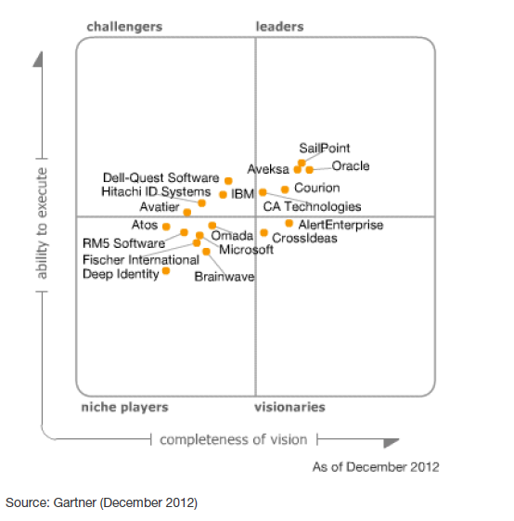
Identity/Access Management Systems

Slide 19
Oracle Identity Management Suite
License cost: $2.25M for 10000 employees installed on servers running up to four processors
Annual Support: $500k
Services and training: $100k
Total: $2.85M for first year

Slide 20
Governance, Risk & Compliance

Slide 21
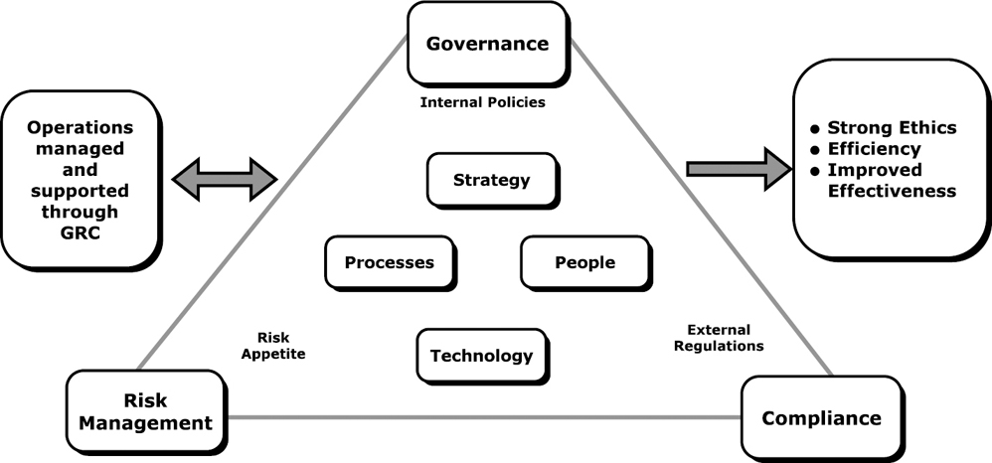
.
GRC Landscape

Slide 22
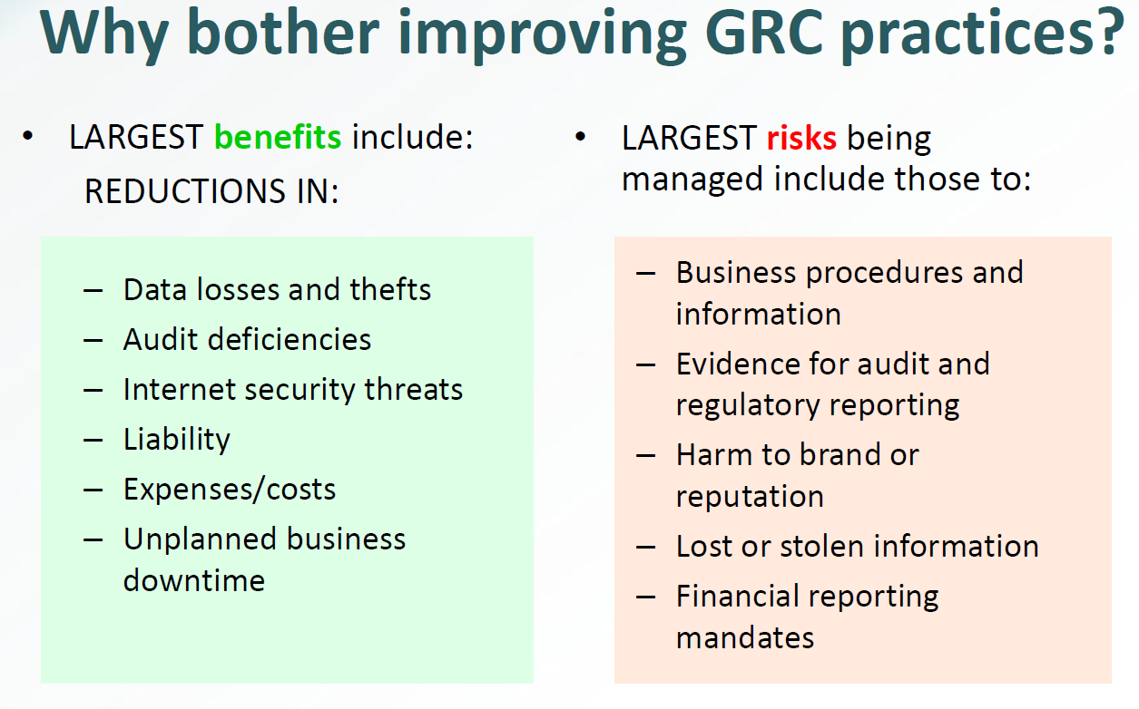

Slide 23
Enterprise GRC Platforms

Slide 24
GRC Vendor Analysis
Vendor | Strengths | Weaknesses
MetricStream | Top rated in content/risk and control management tools Flexible collaboration features Customization capabilities Strong consulting services arm | No Mobile interface
BWise | Robust platform Flexible Risk & Control features Standalone control monitoring features | Less support from consulting firms. Complex solution
IBM OpenPages | Strong analytics features Leverages Cognos reporting capabilities with mobile features | Not fully integrated with other products
RSA Archer | Acquired by EMC Easy to navigate interface RSA acquisition | Cost

Slide 25
Recommendation
Choose MetricStream Enterprise Edition
Out-of-the-box functionality: Pre-configured workflows and embedded reports provide a "plug and play" capability that reduces the time needed for implementation.
  Pre-loaded content: Pre-loaded industry regulations and libraries provide access to industry best practices. 2000 IT control statements to more than 400 regulations. Standard framework such as COBIT, ISO 27002 and ITIL for implementing best practices.
Simple to use: Intuitive user interfaces and minimal clicks per functionality enable customers to quickly access information while also reducing the time required to train system users.
GRC via Cloud: MetricStream's hosting model can be implemented quickly, and takes the pressure off banks who have limited resources to manage IT hardware and software.
Flexible pricing: In addition to an on-premise solution, MetricStream also provides a subscription license model option that eliminates the need for up front capital expenditures.
Scalability through an integrated platform: MetricStream solutions are built on an underlying GRC platform which allows customers to extend the solution from one functional area to another (e.g. risk management, internal audit, IT-GRC) without having to invest in expensive system integration initiatives.

Slide 26
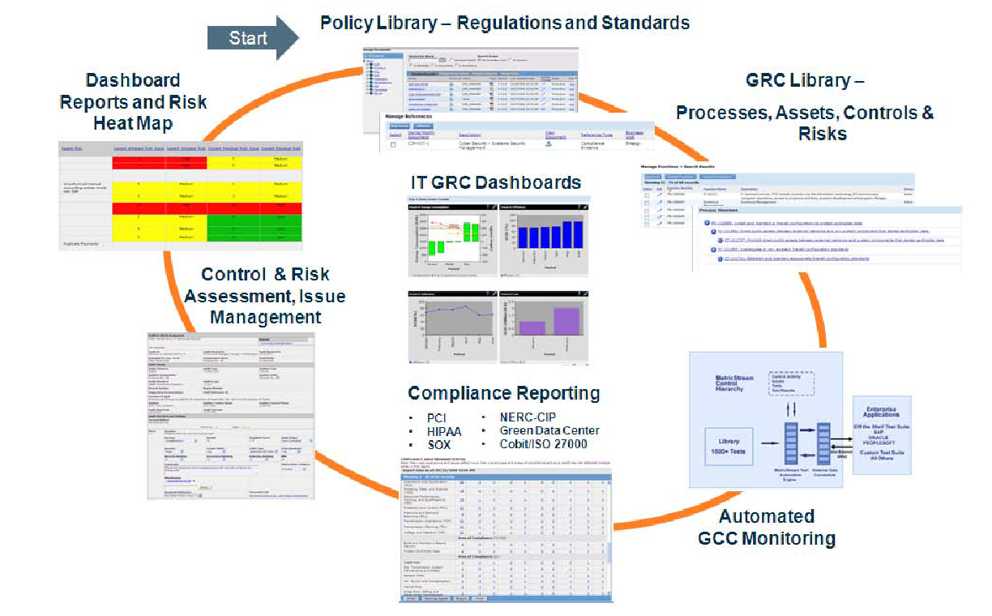
MetricStream IT GRC Solution
License cost: $500,000 perpetual license
Annual support: $100,000
Services & training: $100,000
Total: $700,000 first year

Slide 27
Thank You!

Slide 28
Backup Slides

Slide 29
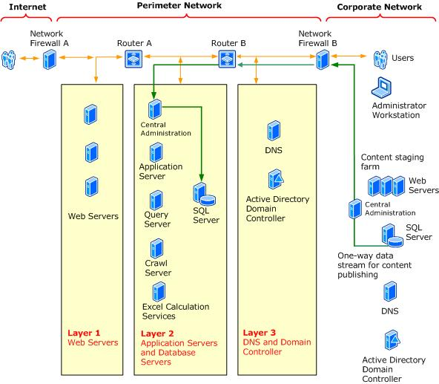
Network Segmentation and Device Configuration
Description
Strategically employ firewalls, routers and switches to route and filter packets within and across zones in the the enterprise network
Methodology
Employ stateful inspection of packets and application-aware firewalls
Whitelist each connection (deny by default)
Internal firewalls may be configured to protect portions of the network from each other
Use ACLs on routers and firewalls to provide a basic layer of security

Slide 30
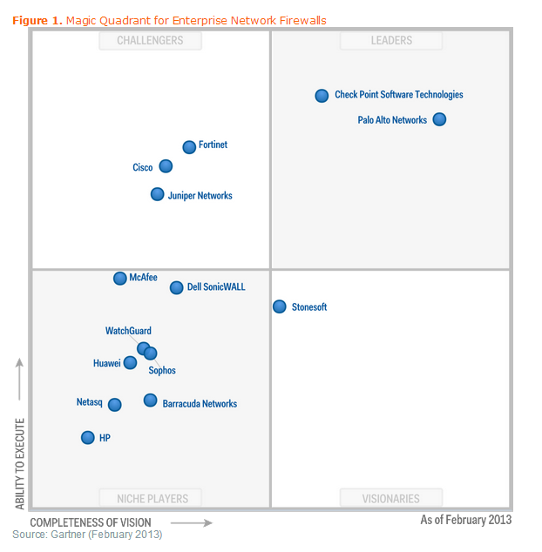
Network Segmentation and Device Configuration

Slide 31
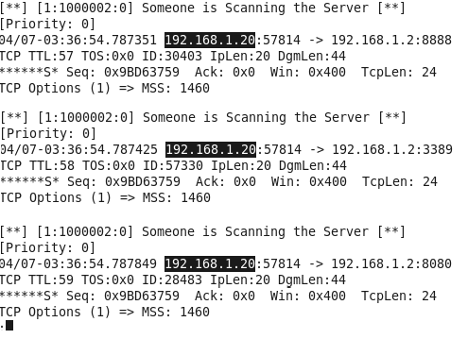
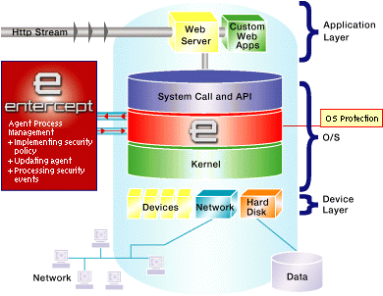
Network and Host-based IDS/IPS
Description
These gather and analyse information from the network traffic and host systems to identify possible threats posed from crackers inside and/or outside the network.
Methodology
Employ IDS to alert suspicious inbound/outbound traffic
Detect malicious code changing properties of files such as their sizes.

Slide 32
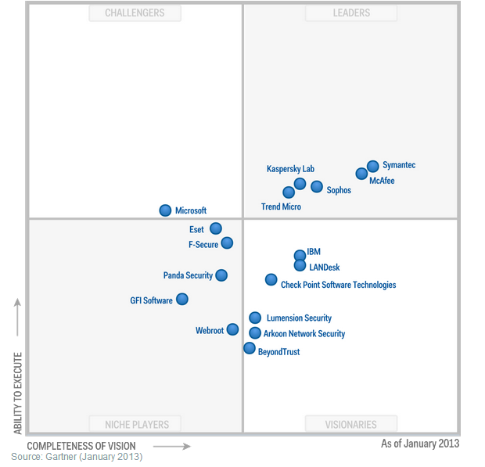
Endpoint Protection Platforms (EPP) Gartner Rankings

