Slide 1
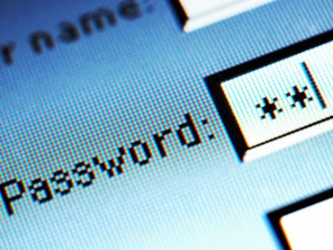
Authentication through Password Protection
Team: SuperBad Cats
MSIT 458 – Dr. Chen

Slide 2
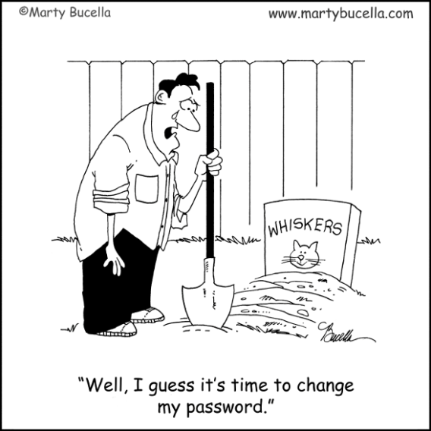
Background to the Problem:
Companies require password protection on many important systems within their company
Various systems may have differing password requirements
Requiring users to create and recall different passwords for different systems
Various systems may be used only sparingly by certain users
Users may forget their password after a period of non-use
Companies often require a new password after a given period of time
Requiring users to create and recall different passwords for different systems
Notes:
Mention the Difference between Single Sign-On and Single Credential
Discuss the issues around multiple user IDs, multiple passwords and securing appropriate access for users in companies

Slide 3
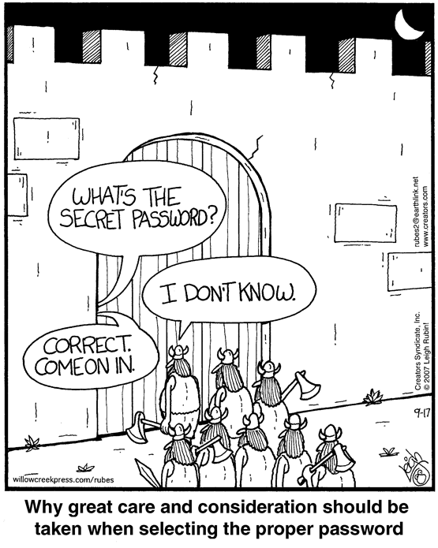
Password Reset User Support:
Call support Metrics (authenticity and validation)
Time Spent on Resets
Quantity of Resets per Year
Cost per call
Why they call
Web-based password reset advantages
(setup by users with challenge questions)
Confidentiality
Authenticity
Integrity
Availability
Notes:
Discuss company resources and efforts to allow users to reset passwords, including expenses and time

Slide 4
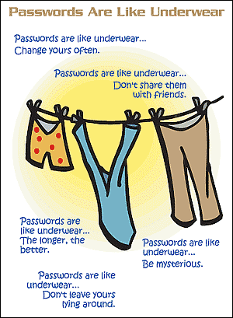
Problem:
In Summary:
Maintaining multiple passwords for a single user to access necessary systems results in excessive work time lost and cost to the company
Problems at the Company Level
Too many different passwords
Can’t remember passwords
Lack of Support
Too easy
Problems at the user level
Can't remember answers to challenge questions
Don't know the password complexity rules
Notes:
State the problem and discuss further talking points related to the problem

Slide 5
Password Complexity: Sample Company
Enforce password history 24 passwords remembered
Maximum password age 90 days
Minimum password age 1 days
Minimum password length 8 characters
Password Dictionary Blacklist "%Company Name%”
Password must meet complexity requirements Enabled (next slide)
Notes:
Discuss password complexity and review a set of standards setup by a company related to the passwords and users

Slide 6
Password Complexity: Sample Company
Not contain the user's account name or parts of the user's full name that exceed two consecutive characters
Be at least eight characters in length
Contain characters from three of the following four categories:
English uppercase characters (A through Z)
English lowercase characters (a through z)
Base 10 digits (0 through 9)
Non-alphabetic characters (for example, !, $, #, %)
Complexity requirements are enforced when passwords are created or changed.
Notes:
Discuss password complexity and a sample set of requirements put in place by a company to setup and modify passwords

Slide 7
Order of Magnitude
By adding character complexity and length requirements, an administrator increases the amount of time a brute force attack will take on a system by orders of magnitude.
This should be taken into consideration when setting up corporate passwords standards and requirements.
Notes:
Discuss the order of magnitude factor in regards to passwords and how it can aide in defending against various hacking attacks

Slide 8
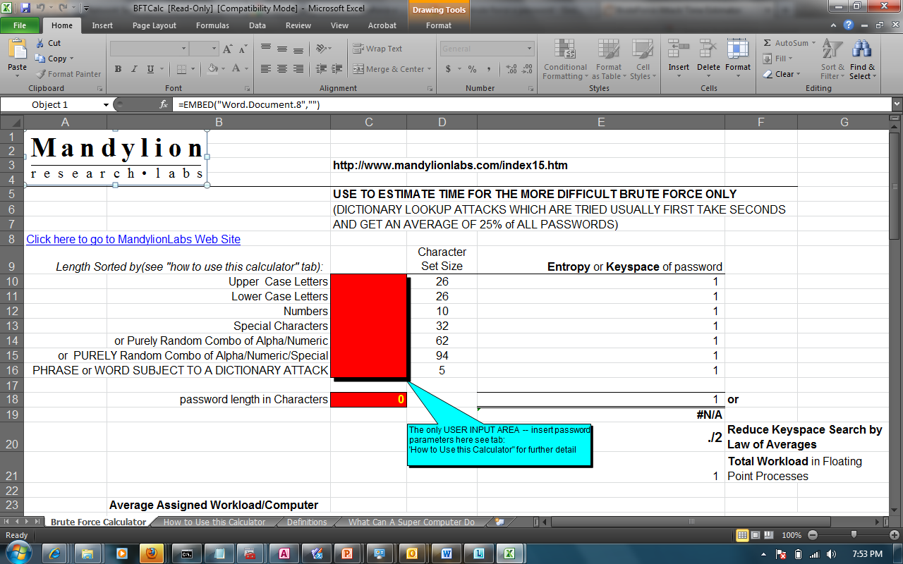
Order of Magnitude
Notes:
Review an order of magnitude program that will take in various factors and calculate the order of magnitude related to that password requirement set

Slide 9
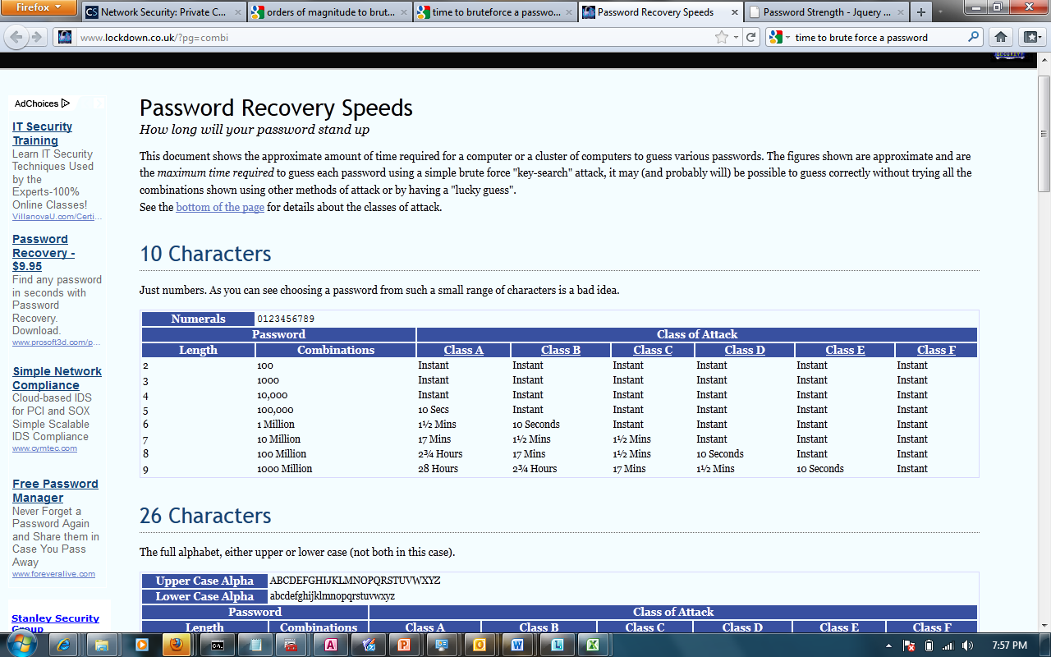
Order of Magnitude
Notes:
Definitions related to the order of magnitude that shows a magnitude breakdown based on size of a passowrd

Slide 10
Potential Solutions:
Identity Management Software
Leverage a unified Directory Service
Password Synchronization
Other Options:
Single Sign, On, Biometric, RSA Token, Near Field Communication (NFC), RFID, Social Media
Notes:
Review the outline of potential solutions to the problem outlined in previous slides

Slide 11
Identity Management Software
IdM solutions provide automated creation, provisioning and projection of user accounts to a directory services solution.
Examples: Forefront Identity Mgr, Novell Identity Mgmt Solution, Oracle
Notes:
Discuss the Identity Management software option in depth

Slide 12
Leverage a Unified Directory Service
A unified directory service is a single location where all user objects reside. This streamlines the management and control of access and authorization.
Microsoft Active Directory
Active Directory Federation Services (ADFS)
Notes:
Discuss the Unified Directory Option in depth

Slide 13
Password Synchronization
PCNS and other synchronization services leverage replication services and API’s to update and synchronize user passwords in unmanaged systems or environments
Password Change Notification Service (PCNS)
Notes:
Discuss the Password Synchronization option in depth

Slide 14
Case Study
Company X was looking into implementing a solution to improve their security while simplifying their password setup, maintenance and customer support.
Here’s how they achieved this objective….
Notes:
Provide an introduction to the case study which will be reviewed in the upcoming slides

Slide 15
Company X Business Requirements
Legacy domain was an older version of Active Directory
Company X is a typical enterprise company, with approximately 100k users.
The directory services would need to accommodate approximately 500k objects
Large number of Windows based clients in the current infrastructure
Integration capability with current communication technology being implemented
Notes:
Outline the business requirements for Company X in this case study

Slide 16
Company X Decision
There are many ways to select a Directory Services (DS) platform:
The reason for selecting Active Directory focused around the number of existing Windows based clients and the communication technology being implemented.
Company’s that sell DS products offer several different pricing models, and can vary in cost from as little as $500k, to upwards of $10 million.
Notes:
Company X decided to implement Active Directory for their Directory Services technology, as the model allowed for centralized management of user identities and security policy, while providing speed of implementation for their new (cloud based) email communication suite. The Active Directory initially served as the identity repository for users to authenticate into their email. Since implementation, several other applications now leverage the DS of Active Directory due to its extensible, yet secure platform.
Active directory is a stable and mature platform that was initially released in 1999, and is considered the premiere platform of DS for enterprise organizations around the globe. Based on the wide adoption of this product, and large support base, it was the natural choice for Company X.

Slide 17
Company X Project Financials
Active Directory = $3.5 million amortized over a three year period
FIM = $4 million amortized over a three year period
Costs include Licensing and CALs for all users in the directory structure (licensing is per user)
Operating Costs (hosting & maintenance) = Approximately $400k per year.
Development/Implementation Costs (typically incurred during the first two years of the product life cycle) = $2.5 million
Notes:
Review the financials related to this project at company X, point out the annual costs as opposed to the upfront, or setup costs

Slide 18
Global AD
Global AD provides the ability to have one set of credentials for all applications that leverage the resource.
Allows for centralized administration of the domain.
Reduces complexity for MIS mangers to administer user objects
Notes:
Discuss the Global Active Directory in depth

Slide 19
Global AD
Current State
User population driven by a flat file feed processed once each week
Data not accurate nor timely
Infrequent action taken Internationally
Future State (Post-PeopleSoft Upgrade)
Clean, Timely Data
Processed twice daily
Improved security
Notes:
Discuss the Global Active Directory in depth

Slide 20
Global AD
User Objects are the Global ID (7-digit number)
Currently leveraged for:
FIM
BPOS Email
Office Communicator
Sharepoint
POS System(Beta)
Reservation System(Beta)
Service Desk Ticketing System
Group Billing Project
Workforce Management System
Associate Learning Network
Company Benefits Application
Planned Applications:
BI System
Financial Applications
…and more to come
Notes:
Discuss the Global Active Directory in depth

Slide 21
FIM
FIM stands for Forefront Identity Manager
Allows for granular user object management through a GUI interface
Provides approval workflow and audit trail
User friendly and easy for everyone to use
Empowers the end user
Notes:
Discuss the FIM in depth

Slide 22
FIM
Self Service Exception List requests
Dynamic Distribution List Membership
Attributes on the HR Feed drive DL membership and dynamic deprovisioning
Dynamic Application Provisioning
Provision account based on attributes in HR data or during on-boarding through FIM
Dynamic Email Account Provisioning
HR Director can set a flag in the on-boarding system to automatically provision an email account for specific users, or this can be done with attribute criteria
Notes:
Discuss the FIM in depth

Slide 23
FIM
Dynamic De-provisioning of:
Group Memberships
Security Groups
User Accounts
Leveraged Application User Accounts
Self Service On-Boarding of Contractor Type Users
Allows hiring manager to on-board and create email, provision accounts, and join memberships all with full audit trail and workflow approval
Notes:
Discuss the FIM in depth

Slide 24
FIM & Global AD
Consider FIM the GUI for the Active Directory
The two tools together are the heartbeat of the enterprise, and allow for a secure and controlled environment, while streamlining the on-boarding process, and the need for remembering multiple passwords by the end user.
Flexible and extensible, the tool can work with other email systems if international chooses not to move to Microsoft’s Cloud Service Offering
However, it will be much cheaper if cloud exchange is selected
Notes:
Discuss the combined solution related to using both the Global AD and the FIM options

Slide 25
Current Process Flow
Provisioning
Applications
HLN
FIM
AD
Email
Local HR System
Authorization
Notes:
Review the process flow used in the company prior to the project implementation efforts

Slide 26
Future Process Flow
Provisioning
Applications
PeopleSoft
FIM
AD
Email
Authorization
Notes:
Review the process flow used in the company after to the project implementation efforts

Slide 27
Migration from the current to the future FIM and BPOS setup
Notes:
Review the migration scheme for the FIM and BPOS setup

Slide 28
Production Setup
Notes:
Review the server setup and the organization chart in the image

Slide 29
Authentication through Password Protection
Team: SuperBad Cats
MSIT 458 – Dr. Chen

