Slide 1
Android Permission
Presenter: Zhengyang Qu

Slide 2
Roadmap
Background
Related Topics
VetDroid
Whyper
Conclusion

Slide 3
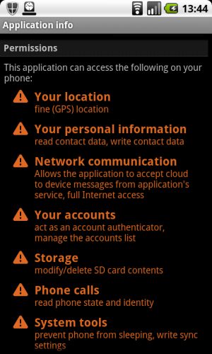
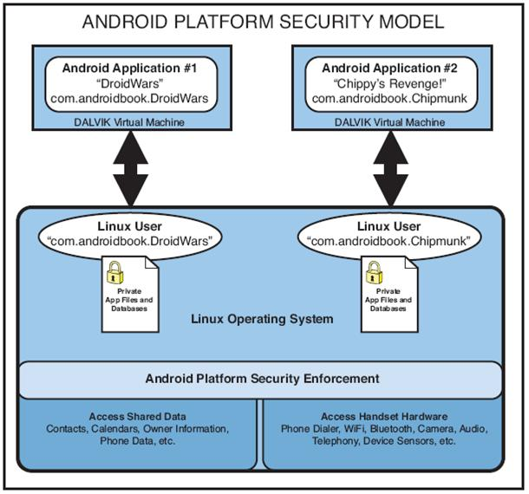
Background
In Android, API allows the access to security-sensitive resource (e.g., location, address book).
APIs are guarded by permissions
Enforcement:
User agreement upon installation
API invocation calls permission check

Slide 4
Background
In Android 4.2, there are 130 permissions:
Normal permissions: control access to API calls that could annoy but not harm the user
SET_WALLPAPER
Dangerous permissions: control access to potentially harmful API calls
CALL_PHONE
Signature/System permissions: grant only to applications only signed with the device manufacturer’s certificate
BRICK

Slide 5
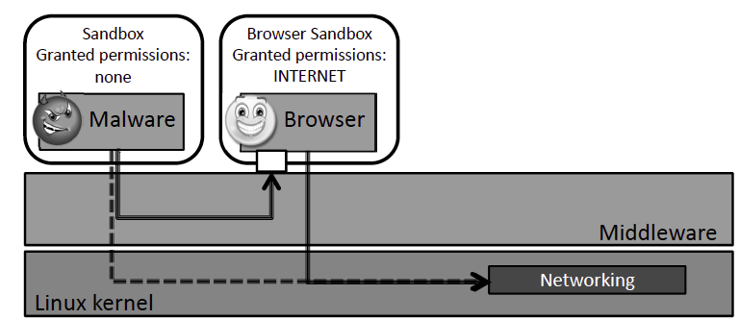
Related Topics
Overprivilege
Application requests permissions more than it needs by functionality (e.g., camera app requests calendar)
Confused Deputy
An application performs a sensitive action on behalf of a malicious application
Invoke browser to download malicious malicious files (Lineberry et al., BlackHat 2010)

Slide 6
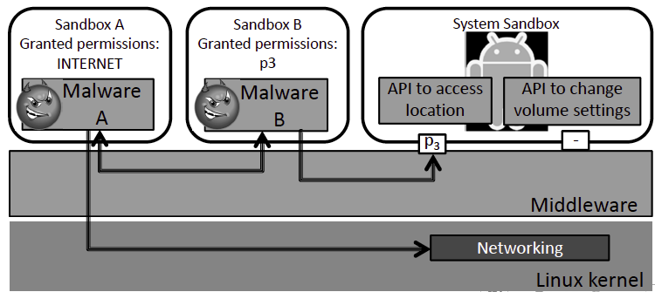
Related Topics
Collusion Attack
Divide necessary permissions among two (or more) malicious applications
Privacy Leakage
User is unaware of the action of sending user’s privacy to 3rd party
Inferring user’s interest, identity …
Monitor location, call history…
Upload call recording

Slide 7
VetDroid
Motivation
Approach

Slide 8
Motivation
Reconstruct Android application behavior to detect privacy leakage
Limitation of traditional analysis techniques
Mostly leverage system calls, limited by Android’s specific security model
Android Framework Managed Resource: Applications do not directly use system calls to access system resources
Binder Inter-Process Communication
Event Trigger (e.g., callback for location change)
Notes:
Android Framework Managed Resource: Applications do not directly use system calls to access system resources. Instead,
most system resources in Android are managed and protected by the Android framework, and the application-system interactions occur at a higher semantic level (such as accessing contacts, call history) than system calls at the Linux Kernel level. Instead, most system resources in Android are managed and protected by the Android framework, and the application-system interactions occur at a higher semantic level (such as accessing contacts, call history) than system calls at the Linux Kernel level.
Binder IPC: First, traditional solutions would only intercept a lot of system calls used to interact with the Binder driver, hiding the real actions performed by the application. Second, the use of IPC in Android apps breaks the execution flow of an app into chains among multiple processes, making the evasion of traditional syscall-based behavior monitoring
Event Trigger:
Asynchronous feature:
A key observation is that application registered callbacks are application code, so they could evade system call interception.

Slide 9
Motivation
Not able to analyze app internal behavior logic in fine-granularity
Where does the permission check happen and how is the privacy guarded by permission used.
Extensibility
Need to predefine which kind of privacy leakage to be monitor

Slide 10
Approach
E-PUP Identification
Invocations of Android APIs calling permissions check
I-PUP Tracker
Delivery point for each resource requested at E-PUP
Notes:
I-PUP Tracker: permission based taint tracking

Slide 11
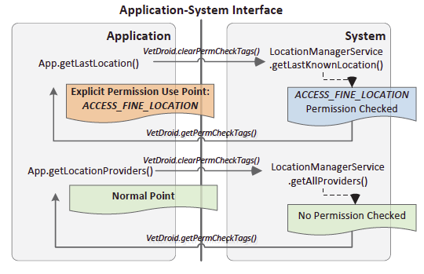
E-PUP Identification
Incomplete (Felt et al. Stowaway) and Inaccurate (Au et al. PScout)
Identify boundary between application code and system code, Intercept all calls to Android APIs
Monitor permissions check events in permission enforcement system during execution of API
Cover Java reflection and Java Native Interface
Notes:
Stowaway [27] uses Java reflection to execute Android APIs and monitors what permissions are checked by the system. To create appropriate arguments for each API, Stowaway uses API fuzzing to automatically generate test cases. Although Stowaway’s API-permission list is accurate, it is quite incomplete due to the fuzzer’s inability to generate complete inputs for all Android APIs. PScout [12] adopts static analysis to extract API-permission lists from Android source code. Although PScout’s API-permission list is relatively complete, it is not accurate enough, because an Android API could use different permissions at runtime according to its arguments.
The application-system interface is recognized at every function call site by checking whether the caller is application code and the callee is system code. As Android apps are mostly developed in the Java language and run on the Dalvik virtual machine, we instrument Dalvik to monitor all function calls.
In this example, App.getLastLocation() invokes getLastKnownLocation() API of LocationManagerService to get the last known location. Before invoking this API, VetDroid clears the permission check information in the thread-local storage using VetDroid.clearPermCheckTags(). During the execution of this API, Android’s permission enforcement system performs a permission check on ACCESS_FINE_LOCATION permission. At last, after the execution of getLastKnownLocation() API, VetDroid invokes VetDroid.getPermCheckTags() to propagate the permission check information from the enforcement system to the application side.

Slide 12
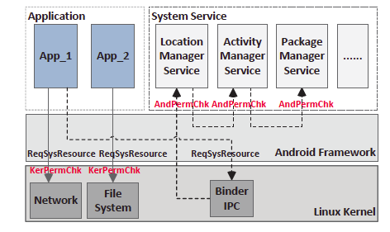
Acquire Permission Check Information
Acquire permission check information to judge whether a callsite is an E-PUP and what permission is checked
Android Permission Check
Extend the Binder driver and protocol to propagate permission check information from Service
Kernel Permission Check
Instrument the GID isolation logic to record the checked GID into a kernel thread-local storage
Two system calls are added to access and clear the checked GID in the kernel thread-local storage
Notes:
Acquire permission check information at the application side to judge whether a callsite is an E-PUP and what permission is used by an E-PUP.
Figure 3 gives an example of AndPermChk. App_1 tries to acquire the current location by invoking an interface of LocationManagerService via Binder. LocationManagerService first checks whether App_1 has been granted ACCESS_FINE_LOCATION permission by invoking the general permission check interface of ActivityManagerService. The AndPermChk requests are finally redirected to PackageManagerService except the permission requests from the system itself are granted immediately. PackageManagerService handles the permission check request by looking up a table that records all the granted permissions for each application when it is installed.
In Android, a unique GID is assigned to each kernel-enforced permission. An app is checked to verify whether it has the corresponding GID before accessing the protected resource.
With a unique GID assigned to every kernel-enforced permission, KerPermChk is enforced by the GID isolation mechanism. We instrument the GID isolation logic to record the checked GID into a kernel thread-local storage.

Slide 13
I-PUP Tracker
Recognize Resource Delivery Point
Types of callbacks
BroadcastReceiver, PendingIntent, Listener.BroadcastReceiver
Monitor APIs register callbacks
BroadcastReceiver: only one API could register or in AndroidManifest.xml
PendingIntent, Listener.BroadcastReceiver, automated selection algorithm to find all potential APIs whose arguments may contain a PengdingIntent or a Listener
Notes:
Android’s programming model feature: Callbacks are source delivery points in application
Since BroadcaseReceiver can be registered by the manifest file, we parse the manifest file of each analyzed app to collect declared BroadcastReceivers and mark their onReceive() functions as the resource delivery points.
We observe that Listeners can be invoked from a separate/remote process, so they are Binder objects. Our selection algorithm first finds all the subclasses that extend android.os.Binder. As an API may declare an interface as the argument type, our algorithm further collects a list for the interfaces that each Binder subclass implements. At last, our filtering method
looks up PScout’s API list to select those APIs with an argument type contained in the subclass list or the interface list.

Slide 14
Permission-based Taint Analysis
Tag Allocation
Automatic Data Tainting
Add a wrapper around each registered callback to taint the delivered protected data
Identify I-PUPs
At function-level
Tag of function is calculated by a bitwise OR operation on the taint tags of its parameter values
Application Driver: Monkey & fake event injection
Notes:
A taint tag is allocated at each E-PUP to mark the requested resource with corresponding permission check information. information. The taint tag is represented as a 32-bit integer.
The automatic data tainting occurs at the resource delivery point for each E-PUP. For APIs that register callbacks, a wrapper is added around each registered callback to taint the delivered protected data according to the concrete type of the callback so that the related data gets tainted only when the callback is triggered. For other APIs, two kinds of data are automatically tainted according to the signature of the API: 1) The return value of the API at each E-PUP should be tainted with the corresponding tag. 2) As Java is an object-oriented language, the state of an object may be modified by instance methods. For instance APIs, we also taint the invoked object with the tag allocated at the E-PUP

Slide 15
Whyper
Motivation
Problem Statement
Approach
Discussion

Slide 16
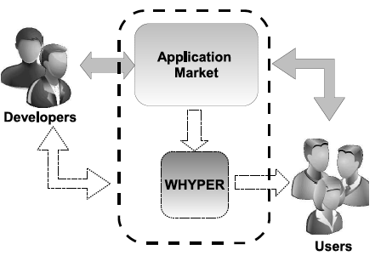
Motivation
Rich techniques to detect misbehavior of application via static/run-time analysis. No way to evaluate whether application oversteps the user expectation.
Bridge the gap between what user expects and what the application really does
GPS Tracker: record and send phone’s geographic location to the network; Phone-Call Recorder: record audio the phone call

Slide 17
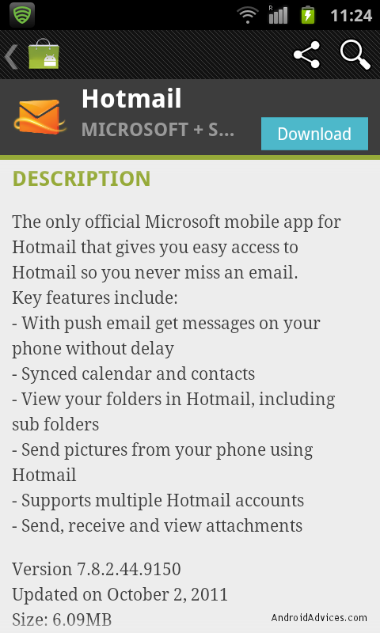
Problem Statement
Where does the user’s expectation on an application come from?
Google Play gives the metadata of application (description, requested permissions…) at download time.
Description gives user a direct and easy access to the functionalities of the application. Implemented functionalities rely on permission.
Validate whether the description state the need of the permission

Slide 18
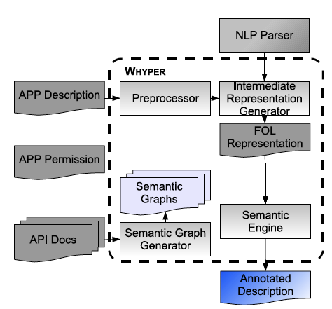
Approach
Limitation of keyword-based searching
Confounding effect
“Display user contacts” vs “contact me at ‘abc@xyz.com’”
Leverage NLP techniques
Semantic Inference
“Share … with your friends via email, sms”
Use API documents as a source of semantic information for identifying actions and resources related with a sensitive permission.

Slide 19
NLP
Preprocessor
Period handling
Differentiate (1) decimal, (2) ellipsis, (3) shorthand notations (e.g., “Mr.”, “Dr.”)
Sentence boundaries
Enumeration list, placements of tabs, bullet points, “:”, “!”
Named entity handling
Maintain a static lookup table containing the entity phrases, such as “Google Maps”
Notes:
Sometimes a sequence of words correspond to the name of entities that have a specific meaning collectively. Further resolution
of these phrases using grammatical syntax is unnecessary and would not bring forth any semantic value.
Detecting such abbreviations is achieved by using the common structure of abbreviations and encoding such structures into regular expressions

Slide 20
NLP (cont’d)
Abbreviation handling
“Instant Message (IM)”
NLP Parser (Stanford Parser)
Named entity recognition
Stanford-Typed Dependencies
Part-Of-Speech tagging, Logic dependencies among various parts of sentences
Intermediate-Representation Generator
Notes:
The FOL representation helps us effectively deal with the problem of confounding effects of keywords as described before.
Relation (dependent, governor)

Slide 21
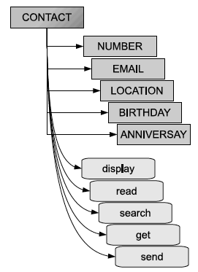
Semantic Engine
Given the Semantic Graph (SG) for one permission and FOL representation of sentence, Semantic Engine (SE) decides whether the sentence implies the permission.
Example SG for ‘CONTACT’
Resource name with its synonym
paired with actions (Use WordNet)

Slide 22
Semantic Engine (cont’d)
Matching algorithm
Check whether a leaf node of FOL representation is the resource name or its synonyms
If no:
return false
If yes:
Traverse the tree from the leaf node to root
if either parent predicate or intermediate child predicate match with action in SG:
return True
return False

Slide 23
Semantic Graphic
Leverage Android API documents
Assumption: Mobile applications are predominantly thin clients, and actions and resources provided by API documents can cover most of the functionality performed by these thin clients
Use output of PScout (Au et al.) to find API document of the class/interface mapping with each permission
Find resource name by class name
“CONTACTS” “ADDRESS BOOK” from ContactsContract.Contacts class

Slide 24
Semantic Graphic (cont’d)
Extract noun phrases from member variables and investigate types for deciding whether they are resource names
Member variable ‘email’ with type ‘ContactsContract,CommonDataKinds.Email’
Extract both noun phrases and verb phrases from API public methods (noun phrase → resource, verb phrase → action)
‘ContactsContract.Contacts’ defines Insert, Update, Delete…

Slide 25
Discussion
Limitation:
False negative:
Limited semantic information in API document
“Blow into the mic to extinguish the flame like a real candle” → RECORD_AUDIO
False Positive:
Incorrect matching of semantic actions against a resource
“You can now turn recordings into ringtones” → RECORD_AUDIO

Slide 26
Discussion (cont’d)
Advantage over keyword-based matching
Confounding effect: “Contact me if there is a bad translation or you’d like your language to be added”
Name entity recognition: “To learn more, please visit our Checkmark Calendar web site”
Context: “That’s what this app brings to you in addition to learning number!”
Synonym: “address book” → “contact”, “mic” → “microphone”

Slide 27
Thank you!

