Slide 1
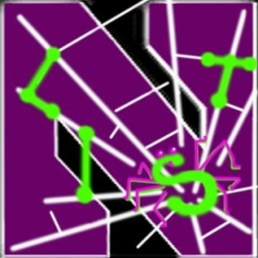
Hummingbird: Privacy at the time of Twitter
Emiliano De Cristofaro
Claudio Soriente
Gene Tsudik
Andrew Williams
Presented by Hongyu Gao, Northwestern University

Slide 2
Motivation
Recall the three types of OSN privacy breaches?
Breach from the service provider
Breach from other user
Breach from 3rd party apps
Facts:
Now Twitter boasts over 100 million subscribers
Users have very little control over privacy
Notes:
Second, we target at designing a system that can be deployed and protect OSNs in real-time.
….
In addition, we want it to be tolerant for incomplete training data, since we can never collect all spam campaigns to train the system.
At last, the system doesn’t need frequent re-training, which lowers the maintenance cost after deployment.
There is an abundance of work in OSNs spam study.
Ourselves did a offline spam analysis more than 1 year ago. It received wide media coverage.
Grier et.al. did a similar study and reached similar conclusion.
Thomas et.al deveoped the Monarch system that classifies URLs in real-time to identify spam messages. Our approach is complementary to theirs in the sense that we mainly use information in the messages and the senders, rather than the landing pages.
…
, featured in Wall Street Journal, MIT Technology Review, and ACM Tech News

Slide 3
Motivation, cont’d
Motivating examples
Looking for tweets with #TeaParty might expose one’s political views.
Search for #HIVcure might reveal one’s medical condition.
What could happen if data is stored in the server in clear text?
Mining by service provider
Hacker break-in
Insider attack
Notes:
Second, we target at designing a system that can be deployed and protect OSNs in real-time.
….
In addition, we want it to be tolerant for incomplete training data, since we can never collect all spam campaigns to train the system.
At last, the system doesn’t need frequent re-training, which lowers the maintenance cost after deployment.
There is an abundance of work in OSNs spam study.
Ourselves did a offline spam analysis more than 1 year ago. It received wide media coverage.
Grier et.al. did a similar study and reached similar conclusion.
Thomas et.al deveoped the Monarch system that classifies URLs in real-time to identify spam messages. Our approach is complementary to theirs in the sense that we mainly use information in the messages and the senders, rather than the landing pages.
…
, featured in Wall Street Journal, MIT Technology Review, and ACM Tech News

Slide 4
Related Works
A Lot different!
xBook, protects user privacy from 3rd party apps
Hummingbird, protects user privacy from the server
Quite different
De-centralized OSNs [7,15]
Hummingbird preserves the central server to guarantee availability
Notes:
Second, we target at designing a system that can be deployed and protect OSNs in real-time.
….
In addition, we want it to be tolerant for incomplete training data, since we can never collect all spam campaigns to train the system.
At last, the system doesn’t need frequent re-training, which lowers the maintenance cost after deployment.
There is an abundance of work in OSNs spam study.
Ourselves did a offline spam analysis more than 1 year ago. It received wide media coverage.
Grier et.al. did a similar study and reached similar conclusion.
Thomas et.al deveoped the Monarch system that classifies URLs in real-time to identify spam messages. Our approach is complementary to theirs in the sense that we mainly use information in the messages and the senders, rather than the landing pages.
…
, featured in Wall Street Journal, MIT Technology Review, and ACM Tech News

Slide 5
Related Works, cont’d
Other designs that keep the central server
#h00t [6] encrypts/decrypts tweets and the contained hashtag with secret shared within a user group.
Facecloak [38] provides fake info to the server.
VPSN [17] also provides fake into to the server.
…
Notes:
Second, we target at designing a system that can be deployed and protect OSNs in real-time.
….
In addition, we want it to be tolerant for incomplete training data, since we can never collect all spam campaigns to train the system.
At last, the system doesn’t need frequent re-training, which lowers the maintenance cost after deployment.
There is an abundance of work in OSNs spam study.
Ourselves did a offline spam analysis more than 1 year ago. It received wide media coverage.
Grier et.al. did a similar study and reached similar conclusion.
Thomas et.al deveoped the Monarch system that classifies URLs in real-time to identify spam messages. Our approach is complementary to theirs in the sense that we mainly use information in the messages and the senders, rather than the landing pages.
…
, featured in Wall Street Journal, MIT Technology Review, and ACM Tech News

Slide 6
Privacy Goals
Server: learns minimal information beyond that obtained from performing the matching function.
Tweeter: learns who subscribes to its hashtags but not which hashtags have been subscribed to.
Follower: learns nothing beyond its own subscriptions. It learns no information about other subscribers or any tweets that do not match its subscriptions.
Notes:
Second, we target at designing a system that can be deployed and protect OSNs in real-time.
….
In addition, we want it to be tolerant for incomplete training data, since we can never collect all spam campaigns to train the system.
At last, the system doesn’t need frequent re-training, which lowers the maintenance cost after deployment.
There is an abundance of work in OSNs spam study.
Ourselves did a offline spam analysis more than 1 year ago. It received wide media coverage.
Grier et.al. did a similar study and reached similar conclusion.
Thomas et.al deveoped the Monarch system that classifies URLs in real-time to identify spam messages. Our approach is complementary to theirs in the sense that we mainly use information in the messages and the senders, rather than the landing pages.
…
, featured in Wall Street Journal, MIT Technology Review, and ACM Tech News

Slide 7
Privacy Non-Goals
Server learns who follows whom.
Server learns whenever multiple tweets from a given tweeter contain the same hashtag.
Server learns whenever multiple followers are subscribed to the same hashtag of a given tweeter.
Notes:
Second, we target at designing a system that can be deployed and protect OSNs in real-time.
….
In addition, we want it to be tolerant for incomplete training data, since we can never collect all spam campaigns to train the system.
At last, the system doesn’t need frequent re-training, which lowers the maintenance cost after deployment.
There is an abundance of work in OSNs spam study.
Ourselves did a offline spam analysis more than 1 year ago. It received wide media coverage.
Grier et.al. did a similar study and reached similar conclusion.
Thomas et.al deveoped the Monarch system that classifies URLs in real-time to identify spam messages. Our approach is complementary to theirs in the sense that we mainly use information in the messages and the senders, rather than the landing pages.
…
, featured in Wall Street Journal, MIT Technology Review, and ACM Tech News

Slide 8
Roadmap
Key System Design
System Prototype
Performance Overhead
Discussions and Conclusions
8
Notes:
8
Next in this talk, I will first give our detailed system design, followed by the experimental evaluation of the system.
After that, I’d like to share some potential future work, and finally conclude this talk.

Slide 9
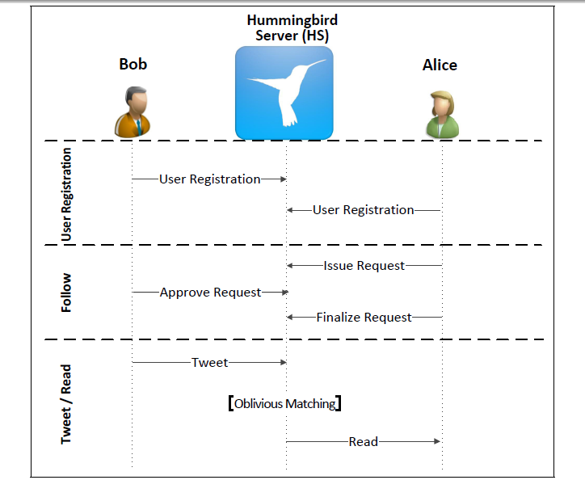
Hummingbird Protocol
Notes:
After deployment, the system sees a stream of incoming messages. There is one new message, and a set of messages that have been observed in the past. The past messages have already been organized into clusters.
The system performs incremental clustering, to update the clustering result given the new message.

Slide 10
Crucial Background: OPRF
Name: Oblivious PseudoRandom Functions
Effect: Securely compute f_{s}(x)
Input: s from sender and x from receiver
Guarantee:
Sender learns nothing about x
Receiver only learns the value of f_{s}(x)
Notes:
Incremental clustering requires that the clustering result of (k+1) messages can be obtained by updating the result of the first k messages with the k+1th message. There’s no need to repeat the whole clustering process.

Slide 11
Key Design
Bob encrypts a message and Alice decrypts it
Bob and Alice share the secret fs(ht)
fs(ht) is a cryptographic primitive that prevents Bob from learning ht (OPRF technique)
The server forwards Bob’s message to Alice
Both Bob and Alice submit a cryptographic token, H₂(f_{s}(ht)), to the server
Notes:
Incremental clustering requires that the clustering result of (k+1) messages can be obtained by updating the result of the first k messages with the k+1th message. There’s no need to repeat the whole clustering process.

Slide 12
Privacy Goals, re-visit
Server: learns minimal information beyond that obtained from performing the matching function.
Tweeter: learns who subscribes to its hashtags but not which hashtags have been subscribed to.
Follower: learns nothing beyond its own subscriptions. It learns no information about other subscribers or any tweets that do not match its subscriptions.
Notes:
Second, we target at designing a system that can be deployed and protect OSNs in real-time.
….
In addition, we want it to be tolerant for incomplete training data, since we can never collect all spam campaigns to train the system.
At last, the system doesn’t need frequent re-training, which lowers the maintenance cost after deployment.
There is an abundance of work in OSNs spam study.
Ourselves did a offline spam analysis more than 1 year ago. It received wide media coverage.
Grier et.al. did a similar study and reached similar conclusion.
Thomas et.al deveoped the Monarch system that classifies URLs in real-time to identify spam messages. Our approach is complementary to theirs in the sense that we mainly use information in the messages and the senders, rather than the landing pages.
…
, featured in Wall Street Journal, MIT Technology Review, and ACM Tech News

Slide 13
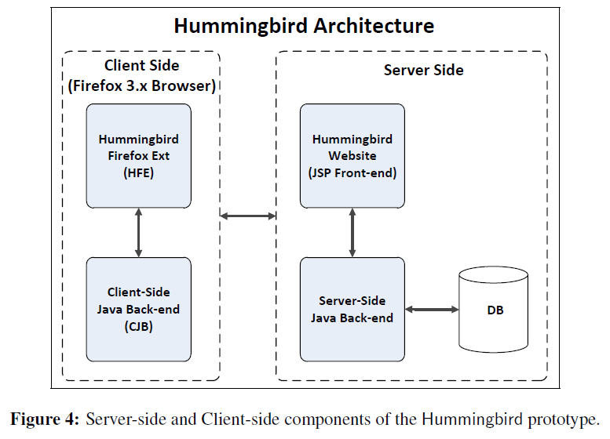
System Prototype
Notes:
Another key component of our system is the trained classifier, which requires a careful selection of features.
It ensures that it is relatively hard for spammers to manipulate the campaigns to evade detection.
The reason is that some campaigns may be absent in the training set. In addition, after the training phase, new campaigns will emerge. Given these two problems, the features that are specific to any campaigns would have limited effectiveness.

Slide 14
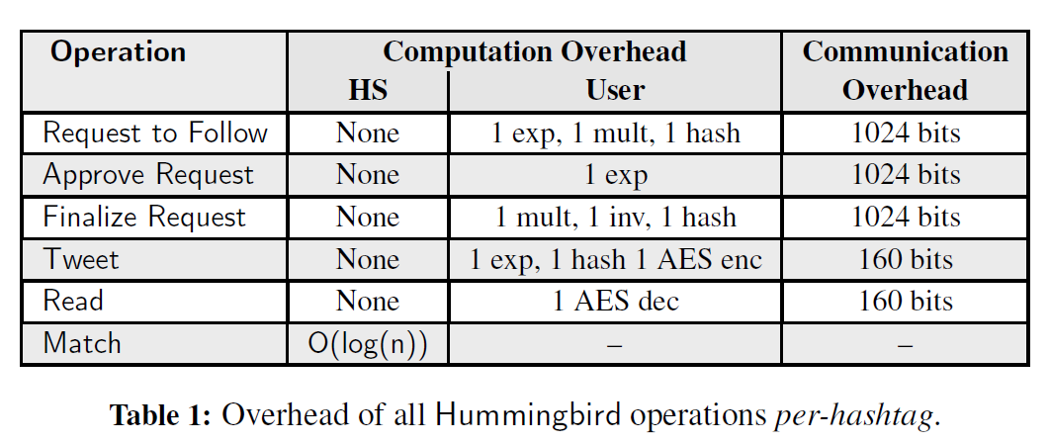
Performance Overhead
<1ms
Also negligible comparing to web transactions
Comparable to current Twitter
14
Notes:
14

Slide 15
Discussions
The collusion disaster:
By colluding with Alice, for all hashtags that Alice follows, the server can learn H₂(f_{s}(ht)), thus learn the identify of all other followers on ht.
By colluding with Bob, the server can learn the interest (the subscribed hashtag) of all Bob’s followers.
Notes:
Incremental clustering requires that the clustering result of (k+1) messages can be obtained by updating the result of the first k messages with the k+1th message. There’s no need to repeat the whole clustering process.

Slide 16
Discussions
BIG (??) sacrifice of functionality:
No retweets.
No replying.
No tweets without hashtags.
No following a user (must follow a (user, hashtag) pair).
Do you still want to use Hummingbird?
Notes:
Incremental clustering requires that the clustering result of (k+1) messages can be obtained by updating the result of the first k messages with the k+1th message. There’s no need to repeat the whole clustering process.

Slide 17
Conclusions
One the first efforts to mitigate privacy breach from service providers.
Propose Hummingbird architecture.
Implemented a prototype and demonstrated its low performance overhead
Notes:
Incremental clustering requires that the clustering result of (k+1) messages can be obtained by updating the result of the first k messages with the k+1th message. There’s no need to repeat the whole clustering process.

Slide 18
Thank you!

