Slide 1
Windows Low-Level System Monitoring Data Collection
Yan Chen
Northwestern University

Slide 2
Outline
Overview
Motivation and Design
System Implementation
Data Provided
Performance and Status
Conclusion

Slide 3
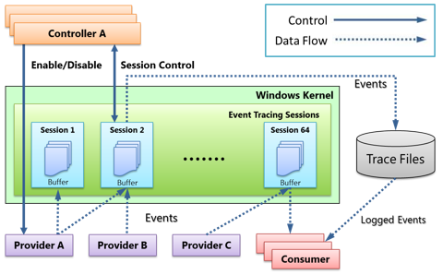
Using ETW
Robust, Lightweight, Built-in, Dynamic
Kernel Providers Used
  Process, Thread
  Registry
  Network
  File
  Stackwalk

Slide 4
Advantages of Low-Level Windows Data
Detect APT attack behavior that are missed from 5D Windows event data:
  Screen grab / remote desktop
  Remote shell
  Key logger
  Audio recording

Slide 5
Status of Our Data Collection System
Windows kernel events
API information which can be very useful for detection
  Reveal characteristics of programs
  Provide accurate causality data
  Detect camouflaged attack
Notes:
[1] R. Sekar, Mugdha Bendre, Dinakar Dhurjati, and Pradeep Bollineni. A fast automaton-based method for detecting anomalous program behaviors. In Security and Privacy, 2001. S&P 2001. Proceedings. 2001 IEEE Symposium on Security and Privacy
[2] S. Ma, K. H. Lee, C. H. Kim, J. Rhee, X. Zhang, and D. Xu, “Accurate, Low Cost and Instrumentation-Free Security Audit Logging for Windows,” presented at the Proceedings of the 31st Annual Computer Security Applications Conference, 2015, pp. 401–410.
[3] Z. Gu, K. Pei, Q. Wang, L. Si, X. Zhang, and D. Xu, “LEAPS: Detecting Camouflaged Attacks with Statistical Learning Guided by Program Analysis,”, In Proceedings of the Annual IEEE/IFIP International Conference on Dependable Systems and Networks, pages 491–502, 2014.

Slide 6
Outline
Overview
Motivation and Design
System Implementation
Data Provided
Performance and Status
Conclusion

Slide 7
System Call Based Approach Issues
Benign applications also capture screen, such as Windows built-in Snippingtool.exe
These syscalls could occur together occasionally in benign application without capturing screen because of the diverse nature of syscalls
Solution: Detect malicious behavior using stack trace
NtUserGetDC
NtGdiGetDeviceCaps
NtGdiGetDeviceCaps
NtGdiCreateCompatibleDC
NtGdiCreateCompatibleBitmap
NtGdiSelectBitmap
NtGdiStretchBlt
Screen Capture

Slide 8
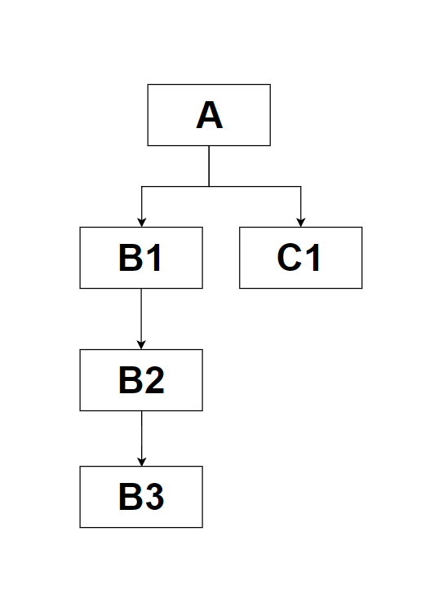
Callstack-Based: How Does Callstack Work?
We construct a tree from code:
A(){
B1()
C1()
}
B1(){
B2()
}
B2(){
B3()
}
A -> B1 -> B2 -> B3
A -> C1
Source Code
Callstack
Tree

Slide 9
Motivation 2: Provide Accurate Causality Data
A process running which reads input object and creates output
    Each output will be considered casually dependent on all preceding inputs
    Only objects in the same loop have causal relationships
    Therefore, it is important to find loops
Using call stack we can divide a sequence into several loops

Slide 10
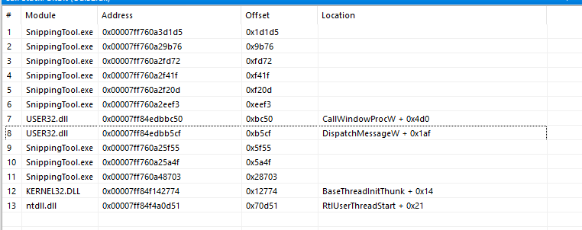
API + System Call Based Approach
Benign program usually receive human actions message (mouse click) and invoke DispatchMessage API to do the corresponding functions, such as capture the screen.
Thus the core syscall of screen capture should be invoked by DispatchMessage and we can get this info from the stack trace.

Slide 11
Motivation: Closely Reveal the Characteristics of Programs
Filling semantic gaps between API and system call
  Syscall is so low-level that one high-level API can invoke tens of APIs which invoke hundreds of syscalls:
NtQuerySystemInformation
NtQuerySystemInformation
NtQuerySystemInformation
NtWaitForSingleObject
NtReleaseMutant
…
NtQueryKey
NtQueryKey
NtOpenKeyEx
NtAllocateVirtualMemory
NtCreateMutant
gdiplus.dll@GdipSaveImageToStream

Slide 12
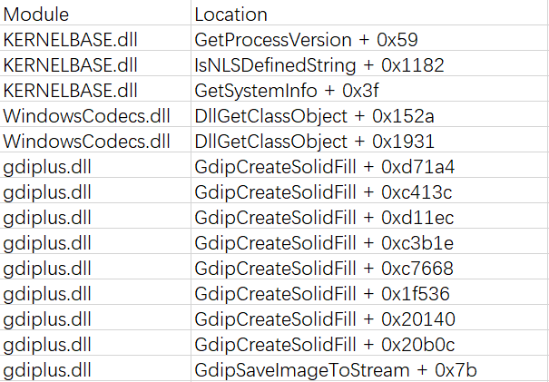
Motivation (contd.)
Stack trace can fill the semantic gap between syscalls and APIs
The stack trace of NtQuerySystemInformation:
NtQuerySystemInformation
NtQuerySystemInformation
NtQuerySystemInformation
NtWaitForSingleObject
NtReleaseMutant
…
NtQueryKey
NtQueryKey
NtOpenKeyEx
NtAllocateVirtualMemory
NtCreateMutant

Slide 13
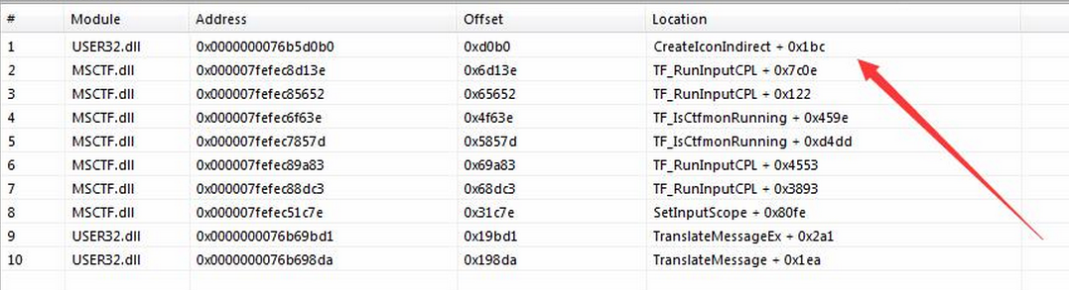
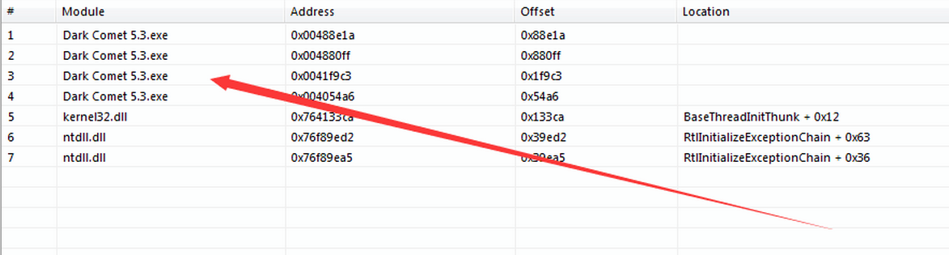
Motivation (contd.)
Although the core syscall of screen capture can occur together occasionally, these syscalls usually invoked by system native dlls.
The stack of GdiBitBlt from notepad. We can see that this API is invoked by system dll USER32.dll, an API to create icon
The stack of GdiBitBlt from malware. We can see that this API is invoked by the malware itself.

Slide 14
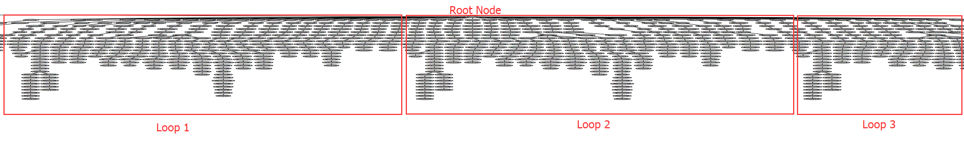
Motivation 2 (contd.)
Zoom out the tree:
Each loop is an independent unit which contains input and output.
That is, we can connect each input to a corresponding output.

Slide 15
Motivation 2 (contd.) A loop extracted from 7 zip.exe
"user32.dll:GetMessageW"
"user32.dll:SetWindowTextW",
"user32.dll:SystemParametersInfoW",
"user32.dll:DialogBoxParamW",
"KernelBase.dll:FindFirstFileW",
"kernel32.dll:CreateFileW",
"kernel32.dll:CloseHandle",
"user32.dll:CallWindowProcW",
"user32.dll:FillRect",
"user32.dll:SetPropW",
"user32.dll:GetWindowPlacement",
"user32.dll:MoveWindow",
"user32.dll:SetPropW",
"user32.dll:MoveWindow",
"user32.dll:GetSystemMetrics"
Receive user input
Process user input.
E.g. Search file and show the file in the GUI window

Slide 16
Motivation 3: Detect camouflaged attack
Detect camouflaged attack
  These attacks tend to execute under the cover of benign applications
  Learning based detection will be misled due to noisy training data
  Use callstack to build CFG both on benign and mixed application
    If a path does not exist in CFG of benign application, it belongs to malicious payload

Slide 17
Outline
ETW Overview
Motivation and Design
System Implementation
Data Provided
Performance and Status
Conclusion

Slide 18
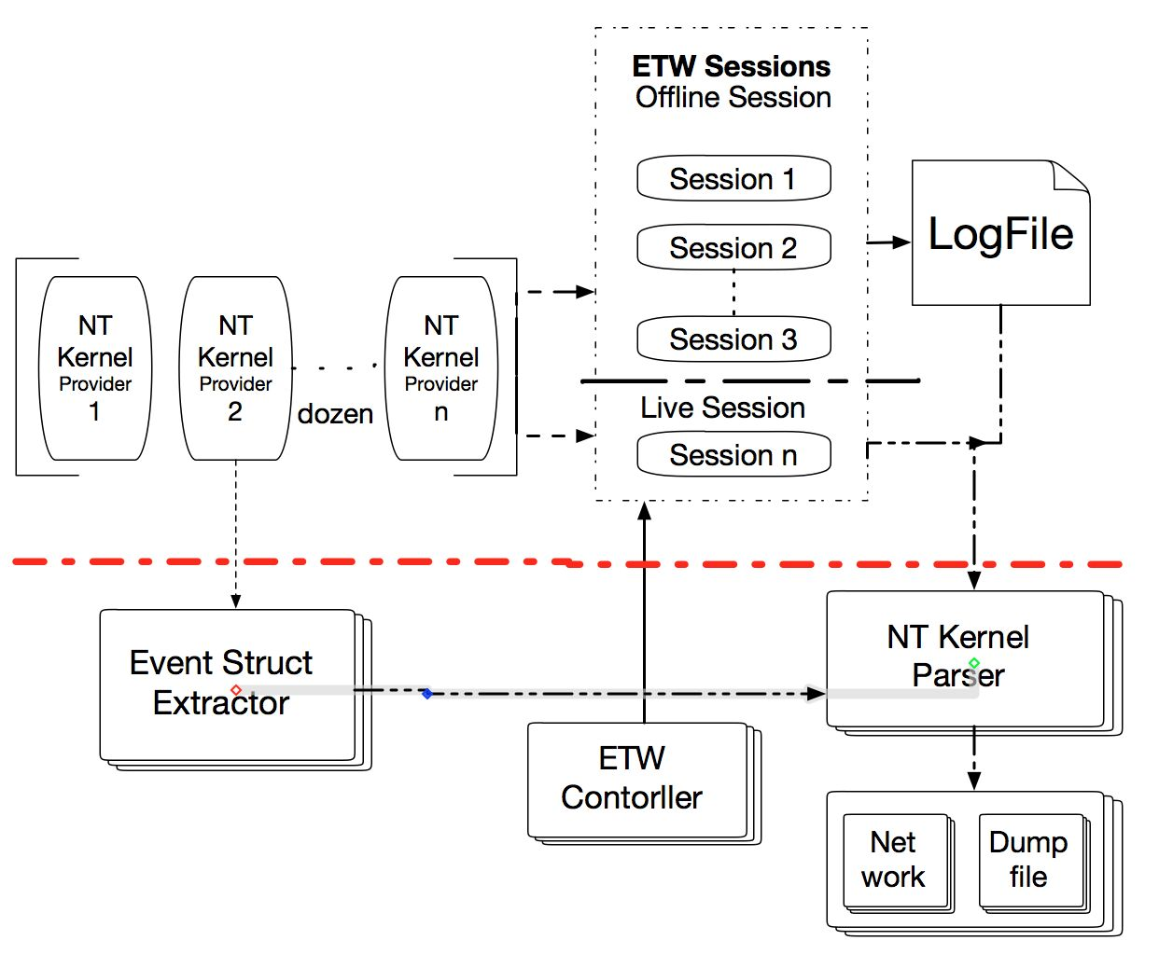
Data Collection Overview
Notes:
NT Kernel
2/2 Which processor is calling which address
Context Switch
One processor is being used by which thread
A system call (actually API) of NTDLL.dll -> image message (NT Kernel is loaded, current loaded)
System calls stored in Windows Kernel (Win32k.sys, NTOSKNL.exe)
Output: which thread invokes which system call?

Slide 19
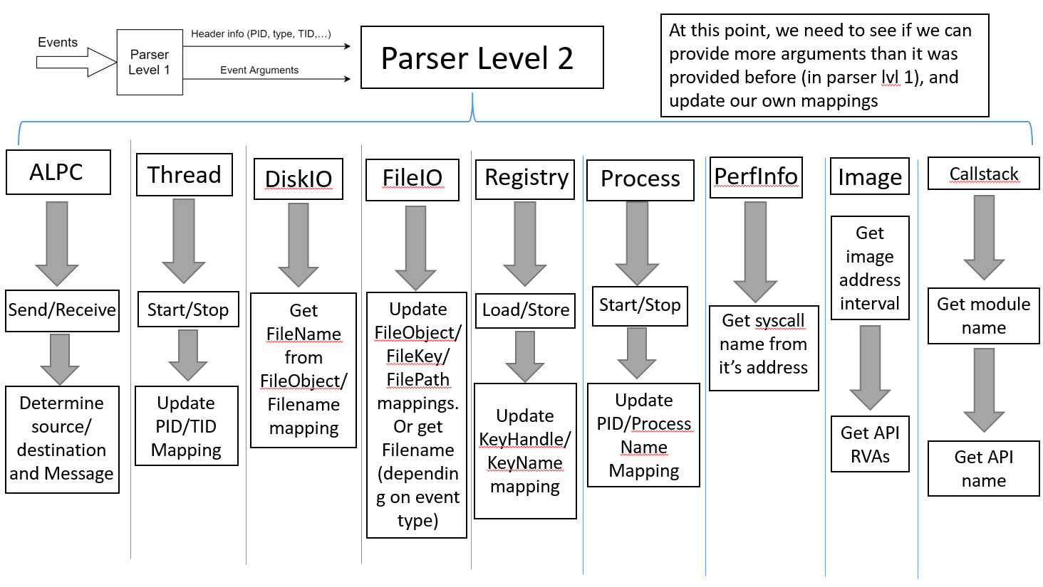

Slide 20
How to Parse Call Stack in a Nutshell
We can enable stackwalk event for kernel events using TraceSetInformation C++ API.
Call Stack(Return Address) = Entry Address+ offset
Entry Address(Relative Virtual Address) = Relative Address + Module Base Address
Notes:
The call stacks we get are return address. While the address we get from DLL export table or symbol table are entry address. So we can not parse the address to function name directly. We can divide the parse work into two steps, first determine which module Is in, and then determine which function
To address this problem, we build a two-layer binary search tree. With such two-layer tree, we can control the size of the tree and guarantee query efficiency.

Slide 21
Correlate Call stacks with Events
Call stacks are provided by a separate ETW provider – “stackwalk”.
Call stack event contains the “Call address sequence”
We match the timestamp to determine the relationship between a call stack and a kernel event.
We maintain two list sequences.
  We align the call stack and event.
  If we can infer callstack.timestamp==event.timestamp, We can pop the two sequences in order. The time complexity of this step is negligible

Slide 22
Performance
Parsing call stack brings in non-trivial overhead
This is mainly because there are too many call stacks (almost 10x more than events)
Two parts of performance overheads:
The cost of parsing call stack to API name is not trivial. Takes about 1/3 of total time.
Serializing and sending API names takes about half of time. (We can barely achieve real time parsing full call stack)
So we provide top API for detection. It means that we will only parse one level of call stack and send one API name per event. It makes real time collection feasible.

Slide 23
Different Levels of Callstack Data

Slide 24
Challenges and Proposed Solutions
How to parse callstack data efficiently?
  Use trees to keep module and API intervals
  Use LRU caches inside trees to increase speed when parsing sequential addresses
Memory challenge: A lot of information to keep about the processes
  Delete the data we don’t need anymore (finished processes, closed network connections,…)
  Don’t keep the information for too long. We cannot keep track of every object in the OS inside the memory (so we may assign a new UUID to the same object).
CPU overhead: Process huge amount of events
  Filtering events and sending out the ones useful for detection
  We may want to ignore loops using callstack information
Not enough data in some ETW events
  Combine some events to fulfill the data
Network overhead
  Combining multiple APIs related to a thread as one CDM record.
Notes:
For the last one: combine fileio events go get the operations done on the same file

Slide 25
Outline
ETW Overview
Motivation and Design
System Implementation
Data Provided
Performance and Status
Conclusion

Slide 26
1: Windows Event Data from NT Kernel Logger
Category | Operations
Process | start, end
Thread | start, end
File | name, create, delete, enumeration, notification, set, rename, query, read, write, cleanup, close, flush
Registry | create, delete, enumerate
Image | load, unload, free
Network | accept, connect, disconnect, receive, reconnect, retransmit, send, fail, copy
Stackwalk | API function calls
Notes:
There are many interested providers in the NT Kernel Logger session, such as the process, thread, image load, system call, and so on. Some of us allow us to provide thread-level system call data.

Slide 27
2: API Data Provided, by Category (Examples)
System Information | \\Windows\\SysWOW64\\ntdll.dll:ZwQueryInformationProcess
 | \\Windows\\System32\\ntdll.dll:ZwQuerySystemInformation
 | \\Windows\\System32\\KernelBase.dll:GetSystemInfo
Network | \\Windows\\Microsoft.NET\\Framework64\\v2.0.50727\\mscorwks.dll:InitializeFusion
 | \\Windows\\Microsoft.NET\\Framework64\\v2.0.50727\\mscorwks.dll:CertCreateAuthenticodeLicense
 | \\Windows\\Microsoft.NET\\Framework64\\v2.0.50727\\mscorwks.dll:StrongNameTokenFromPublicKey
Audio | \\Windows\\System32\\MMDevAPI.dll:DllGetClassObject
 | \\Windows\\SysWOW64\\winmm.dll:mciSendStringW
Graphic | \\Windows\\winsxs\\x86_microsoft.windows.gdiplus_6595b64144ccf1df_1.1.7601.17514_none_72d18a4386696c80\\GdiPlus.dll:GdipCloneBitmapAreaI
 | \\Windows\\SysWOW64\\gdi32.dll:GdiReleaseDC
 | \\Windows\\winsxs\\x86_microsoft.windows.gdiplus_6595b64144ccf1df_1.1.7601.17514_none_72d18a4386696c80\\GdiPlus.dll:GdipGetImageThumbnail
 | \\Windows\\winsxs\\x86_microsoft.windows.gdiplus_6595b64144ccf1df_1.1.7601.17514_none_72d18a4386696c80\\GdiPlus.dll:GdipCreateSolidFill
User Interaction | \\Windows\\System32\\user32.dll:EnumDisplayMonitors
 | \\Windows\\System32\\user32.dll:SetScrollInfo
 | \\Windows\\System32\\user32.dll:EnumWindows
 | \\Windows\\System32\\user32.dll:GetWindowTextW

Slide 28
Changes to CDM 19
CDM does not have mappings for every type of data we provide
Space and bandwidth waste using CDM18 format
EVENT_OTHER was inefficient for frequently produced data (e.g. APIs)
We combine several APIs related to one thread to one CDM record to reduce bandwidth:

Slide 29
Outline
ETW Overview
Motivation and Design
System Implementation
Data Provided
Performance and Status
Conclusion

Slide 30
Performance for Syscall and Windows Events (REVISE)
Physical Machine
  Computer Specification
    CPU: Intel® Core™ i5-7500 CPU @3.40GHz
    RAM:8GB
    Operation System: Windows 7 SP1 64-bit
  Timing
    Running for over 5 days
  Status
    Data amount: 1.6 billion records
    Speed: 20-200 KB/s
    CPU: 1-4%
    Memory: 30-40 MB

Slide 31
Performance with Call Stack Trace Collection (REVISE)
~10K records + ~10K callstack records per second, taking 25% of CPU usage (2.2GHz, 4 cores)
400-800MB of memory usage; 400MB for ETW session, 400MB for record queue
We are improving the performance to provide callstack information in real time
  Implement proposed improvements into the collector code

Slide 32
Comparison with FiveDirections
 | MARPLE | 5D
API | √ | ×
API & Event correlation | √ | ×
Thread Information | √ | √
User Level Events | × | √
Real-time Parsing | √ | √
Notes: 5D is mainly user-level data, has to be saved to logs before reading from it.
We read directly from providers, have no disk access (save resource, small load on the system).
Notes:
5D is mainly user-level data,
Marple: we have no disk access (save resource, small load on the system), real-time data output
NT Keylogger session is the only real-time

Slide 33
Conclusion
We provide all API data from ETW, kernel-level Events and their correlation
Such data are very helpful for detection and forensics
  E.g., the RAT behaviors such as keylogging.
Data is sufficient for our TA2 system (see slides in our TA2 talk)
Performance, stability and testing has been successful

Slide 34
The End

Slide 35
Why not Get API by Hooking?
API information can only be received by hooking
User-Level hooking: Unstable, easy to evade
Kernel-Level hooking: Not allowed in windows 10

Slide 36
Function Thunk
Function thunk is another problem. To optimize performance, the compiler has the part that is not commonly used in branch statements at the end of the module. Which cause parsing errors. According to our statistics, this will result in 2% APIs parsing errors.
Fortunately, we can find such information in PDB (Program Debug Database) files.
The disassembly tool IDA can also help analyse DLL and return thunk location.

Slide 37
Correlate Call stacks with Events
When events are generating too fast. Some event may be lost, which will make the match be wrong. So we need to do alignment periodic. Sometimes two events will share the same timestamp. Maintain sequences for every process or thread will help a lot.

