Slide 1
Windows Low-Level System Monitoring Data Collection and APT Detection
Yan Chen and Runqing Yang
Northwestern University

Slide 2
Outline
MARPLE TA1 System Design and Implementation
MARPLE TA1 Data Provided
MARPLE TA2 APTShield Results for Engagement 4
APTShield System Design
Future Work and Conclusions

Slide 3
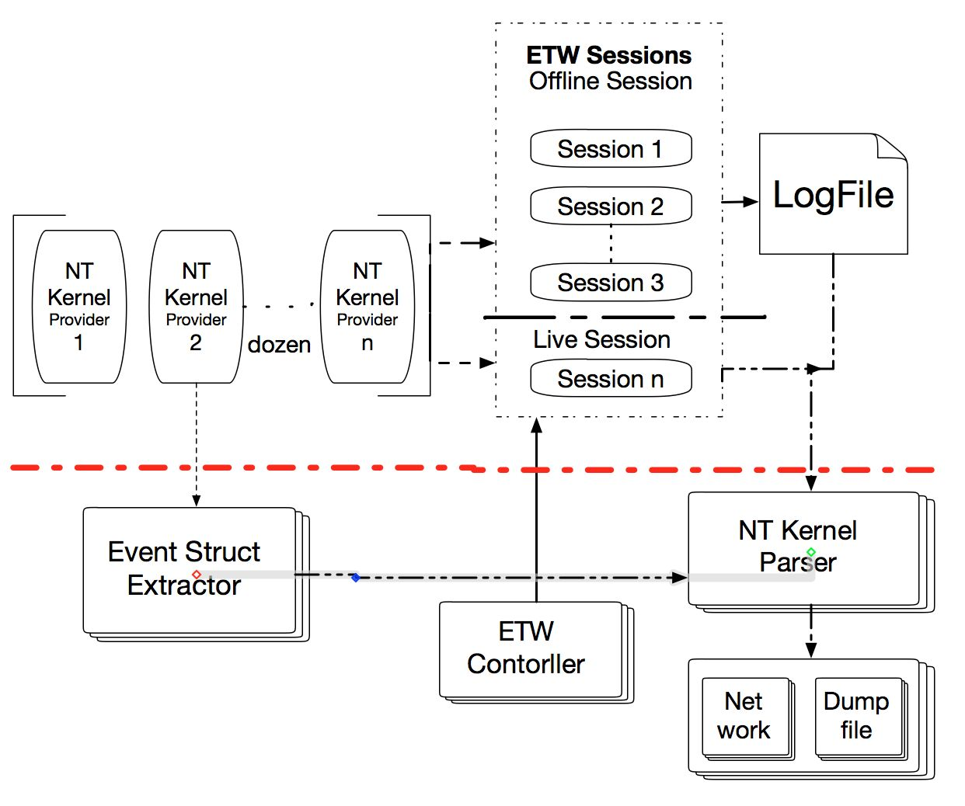
Data Collection Overview
ETW is Robust, Lightweight, Built-in, Dynamic
Kernel Providers Used
Process, Thread
Registry
Network
File
Stackwalk
…
Notes:
NT Kernel
2/2 Which processor is calling which address
Context Switch
One processor is being used by which thread
A system call (actually API) of NTDLL.dll -> image message (NT Kernel is loaded, current loaded)
System calls stored in Windows Kernel (Win32k.sys, NTOSKNL.exe)
Output: which thread invokes which system call?

Slide 4
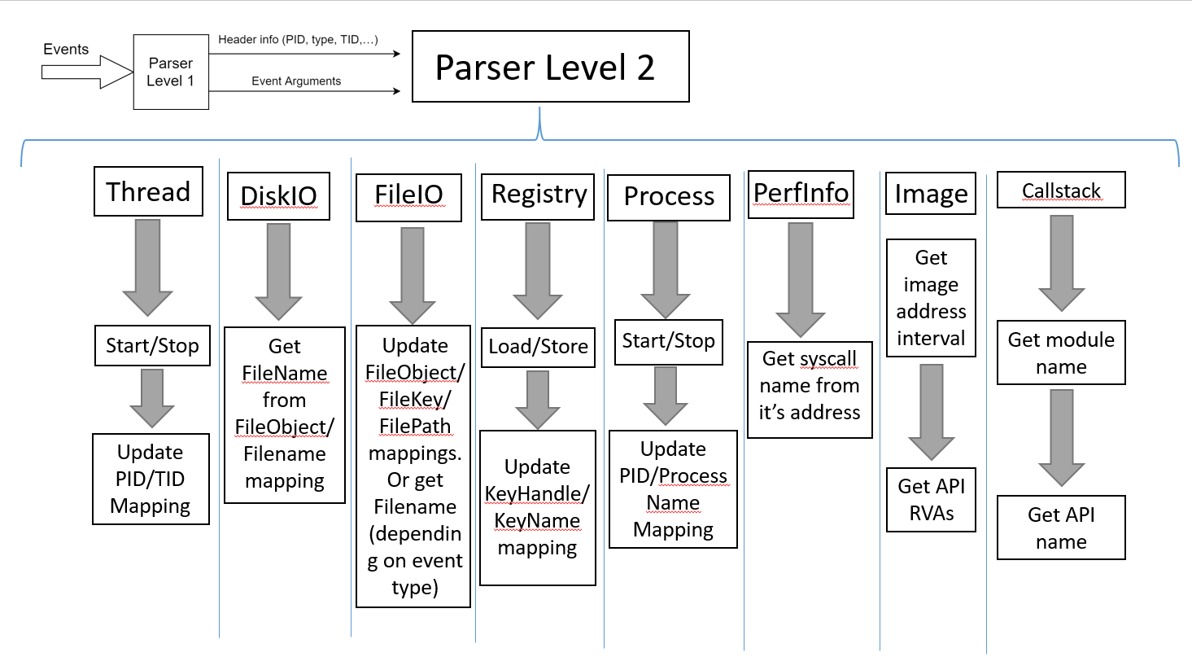

Slide 5
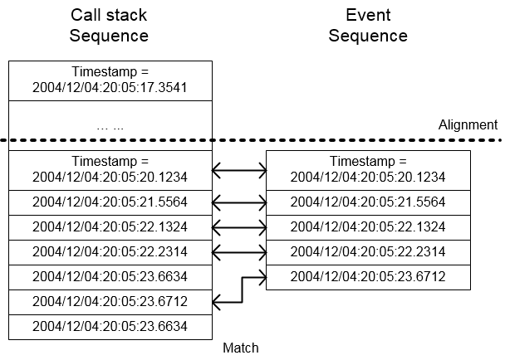
Correlate Call stacks with Events
Call stacks are provided by a separate ETW provider – “stackwalk”.
Call stack event contains “call address sequence”
Match the timestamp to correlate a call stack and a kernel event
The time complexity is negligible
Notes:
We maintain two list sequences.
Align call stack and events
If callstack.timestamp== event.timestamp, We can pop the two sequences in order.

Slide 6
Dealing with Performance Overhead
There are too many call stacks (almost 10x more than events), big performance overhead:
Parsing call stack to API name -- 1/3 of total time.
Serializing and sending API names -- about half of time.
We can barely achieve real time parsing full call stack
So we only provide top API data.
Only parse one level of call stack and send one API name per event.
Makes the real time collection feasible

Slide 7
1: Windows Event Data from NT Kernel Logger
Category | Operations
Process | start, end
Thread | start, end
File | name, create, delete, enumeration, notification, set, rename, query, read, write, cleanup, close, flush
Image | load, unload, free
Network | accept, connect, disconnect, receive, reconnect, retransmit, send, fail, copy
Stackwalk | API function calls （for PHF detection)
Notes:
There are many interested providers in the NT Kernel Logger session, such as the process, thread, image load, system call, and so on. Some of us allow us to provide thread-level system call data.

Slide 8
2: API Data Provided, by Category (to be changed to PHFs)
System Information | \\Windows\\SysWOW64\\ntdll.dll:ZwQueryInformationProcess
 | \\Windows\\System32\\ntdll.dll:ZwQuerySystemInformation
 | \\Windows\\System32\\KernelBase.dll:GetSystemInfo
Network | \\Windows\\Microsoft.NET\\Framework64\\v2.0.50727\\mscorwks.dll:InitializeFusion
 | \\Windows\\Microsoft.NET\\Framework64\\v2.0.50727\\mscorwks.dll:CertCreateAuthenticodeLicense
 | \\Windows\\Microsoft.NET\\Framework64\\v2.0.50727\\mscorwks.dll:StrongNameTokenFromPublicKey
Audio | \\Windows\\System32\\MMDevAPI.dll:DllGetClassObject
 | \\Windows\\SysWOW64\\winmm.dll:mciSendStringW
Graphic | \\Windows\\winsxs\\x86_microsoft.windows.gdiplus_6595b64144ccf1df_1.1.7601.17514_none_72d18a4386696c80\\GdiPlus.dll:GdipCloneBitmapAreaI
 | \\Windows\\SysWOW64\\gdi32.dll:GdiReleaseDC
 | \\Windows\\winsxs\\x86_microsoft.windows.gdiplus_6595b64144ccf1df_1.1.7601.17514_none_72d18a4386696c80\\GdiPlus.dll:GdipGetImageThumbnail
 | \\Windows\\winsxs\\x86_microsoft.windows.gdiplus_6595b64144ccf1df_1.1.7601.17514_none_72d18a4386696c80\\GdiPlus.dll:GdipCreateSolidFill
User Interaction | \\Windows\\System32\\user32.dll:EnumDisplayMonitors
 | \\Windows\\System32\\user32.dll:SetScrollInfo
 | \\Windows\\System32\\user32.dll:EnumWindows
 | \\Windows\\System32\\user32.dll:GetWindowTextW

Slide 9
Additional Security Related Data Collected
Case | Data Source
User input (Keyboard and Mouse) | Low-Level Windows Message Hooking
Window Creation (invisible win) | Traverse open windows with their properties
Scan Microsoft Macros | Use OleTools library in Python we scan documents at creation/modification
PowerShell Command Recording | Enabling user-level provider “Microsoft-Windows-Powershell”
Binary File Certificate | Calling Windows APIs to check for certificate on EVENT_LOADLIBRARY events

Slide 10
Comparison with FiveDirections
 | MARPLE | 5D
API | √ | ×
API & Event correlation | √ | ×
Thread Information | √ | √
User Level Events | √ | √
Additional security data | √ | limited
Real-time Parsing | √ | √
Notes: 5D is mainly user-level data, has to be saved to logs before reading from it.
We read directly from providers, have no disk access (save resource, small load on the system).
Notes:
5D is mainly user-level data,
Marple: we have no disk access (save resource, small load on the system), real-time data output
NT Keylogger session is the only real-time

Slide 11
Case Study 1: RIPE Provenance Tests
RIPE tests consist of the following sub-operations (to be updated)
So, API-Level data is important to detect operations (see next slide)
Operation | 5D can detect? | MARPLE?
Clipboard | ❌ | ✅ (API- Level)
Shared Memory | ✅ | ❌
MailSlot | ❌ | ✅ (API- Level)
Pipe | ✅ | Next version ☺
Registry | ❌ | ✅
Socket | ✅ | ✅

Slide 12
Case Study : Keylogger Operations
Process of
Keylogging
Data
MARPLE TA1 Data（API）
5D Data
GetKeyState
GetKeyboardState
GetKeyboardLayout
ToUnicodeEx
GetForegroundWindow
GetWindowTextW
GetWindowThreadProcessId
WriteFile
Capture
keystrokes
Missing
Capture
foreground
window
information
Missing
Save results
to file
WriteFile

Slide 13
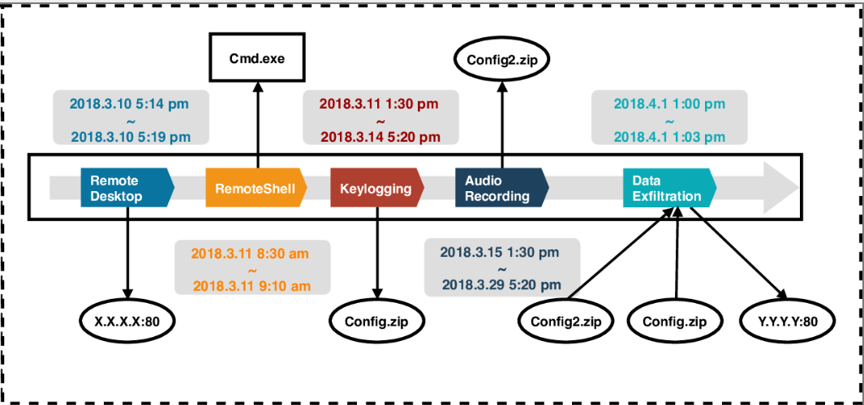
Case Study : Generalization
With our semantic-aware detection system, administrators can easily identify fine-grained semantic behaviors and understand consequences of the attack.

Slide 14
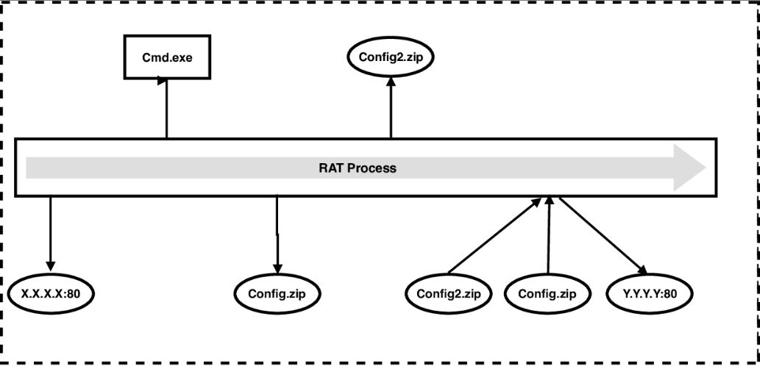
Case Study: Without Our System
Even if all artifacts left by the attack are captured, administrators still cannot understand consequences of the attack.

Slide 15
Challenges and Solutions for the Collector
How to parse callstack data efficiently?
Use trees to keep module and API intervals
Use LRU caches inside trees to increase speed when parsing sequential addresses
Memory challenge: A lot of information to keep about the processes
Delete the data we don’t need anymore (finished processes, closed network connections,…)
We clear up object UUID mapping every 30 seconds, which may lead to a new UUID assignment to the same object.
CPU overhead: Process huge amount of events
Filter events to those useful for detection and forensic
Missing parameters in some ETW events
Correlate events to fulfill the missing ones
Network overhead
Combine multiple APIs related to the same thread as one CDM record.
Notes:
For the last one: combine fileio events go get the operations done on the same file

Slide 16
Performance Evaluation
CPU-bound workload. The command line option of 7-zip supports a simple benchmark, which mostly perform CPU-bound computation.
IO-bound workload. In this situation, we use 7-zip to archive 3 folders including 73 files without compression. The total size of all files are 14.7 gigabyte. This is purely IO-bound workload.
Mixed workload. In this situation, the same 14.7 gigabyte files are compressed using 7-zip. Compression and writing to disk reflect a more mixed case in which an application is performing CPU-bound computation and IO-bound tasks.
 | Baseline | With our collector
CPU-bound workload | 59s | 59s(0%)
IO-bound workload | 250s | 255s(2%)
Mixed workload | 165s | 168(1.8%)

Slide 17
Outline
MARPLE TA1 System Design and Implementation
MARPLE TA1 Data Provided
MARPLE TA2 APTShield Results for Engagement 5
APTShield System Design
Future Work and Conclusions

Slide 18
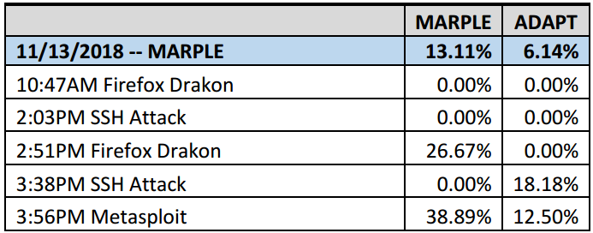
Our Findings Summary
Attacks were conducted by TA5.1 during 2 days: 13th (on MARPLE data), 19th (MARPLE - TRACE data)
On Nov. 13th: successfully detect four attacks in real-time.
Corrected:
4%
Corrected:
15.3%
Corrected Results haven’t been approved by Kudu

Slide 19
Our Findings Summary
Attacks were conducted by TA5.1 during 2 days: 13th (on MARPLE data), 19th (MARPLE - TRACE data)
On Nov. 13th:
We missed exploitation because our system focuses on post-breach analysis instead of exploits.
However, our system can detect any malicious behaviors after compromising the Firefox, such as stealing high confidential documents, downloading malware, etc.

Slide 20
Our Findings Summary
Attacks were conducted by TA5.1 during 2 days: 13th (on MARPLE data), 19th (MARPLE - TRACE data)
On Nov. 13th:
Two malicious executables which capture screen and record key stroke.
Powershell-based in-memory attack in which a malicious shellcode is loaded by using the DLL Injection technique.

Slide 21
Our Findings Summary
Attacks were conducted by TA5.1 during 2 days: 13th (on MARPLE data), 19th (MARPLE - TRACE data)
On Nov. 19th:
Combined Results: TRACE(2/32) + MARPLE(17/25) = 33.33%
68%

Slide 22
Our Findings Summary
Attacks were conducted by TA5.1 during 2 days: 13th (on MARPLE data), 19th (MARPLE - TRACE data)
On Nov. 19th:
Part of TA1 collectors was killed by an attacker through SSH.
Reconnaissance and Data Leakage. Host information is collected and exfiltrated through SSH.

Slide 23
Policy Enforcement Results Summary
Policy name | Data set | Result
Originating User | TRACE-MARPLE | Passed the test except missing one userid.
Remote Communication | MARPLE-THEIA | Not pass this test.
User Interface Action | MARPLE only | Passed this test except missing two process name.
Files Read And Origination | MARPLE-TRACE | Not tested and not run in the demo. MARPLE TA1 has fixed the issue about EVENT_NAME, but BBN used the wrong version.
There is no policy enforcement results in the final report of Kudu.

Slide 24
Attack Campaign 1 (on Nov 13th )
Two suspicious executable files is downloaded and executed.
doit2.exe is executed.
Keylogging and screengrab detected
Sending and receiving messages from 128.55.12.185 on port 31337.
cloud.exe was downloaded and executed by firefox.
Screengrab detected.

Slide 25
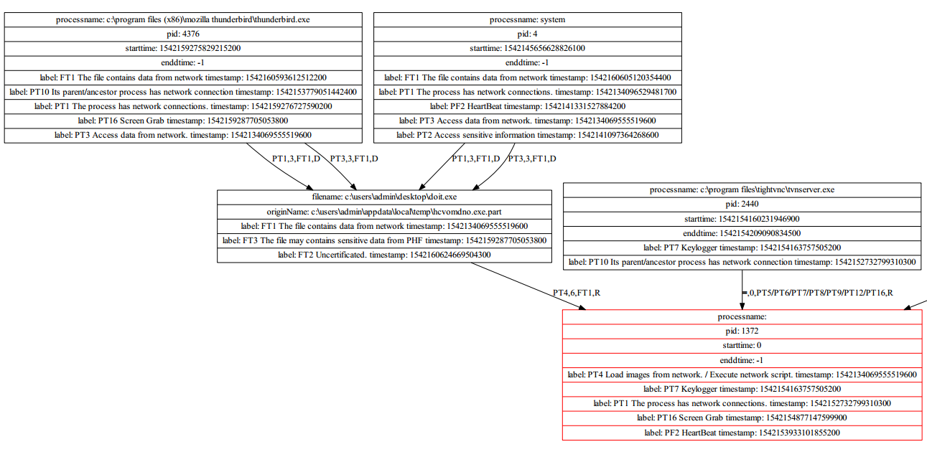
Attack Graph for Campaign 1
IP：128.55.12.185 Port: 31337
Notes:
Basically, our system will consider a process as malicious if 1) a untrusted file (e.g. downloaded from Internet) was executed 2) has network connection 3) did something suspicious (e.g. PHFs)
From the above picture, we can see that 1) doit2.exe was downloaded and executed 2) has network connection 3) perform Screengrab. Thus we consider doit2.exe (red box) as malicious.

Slide 26
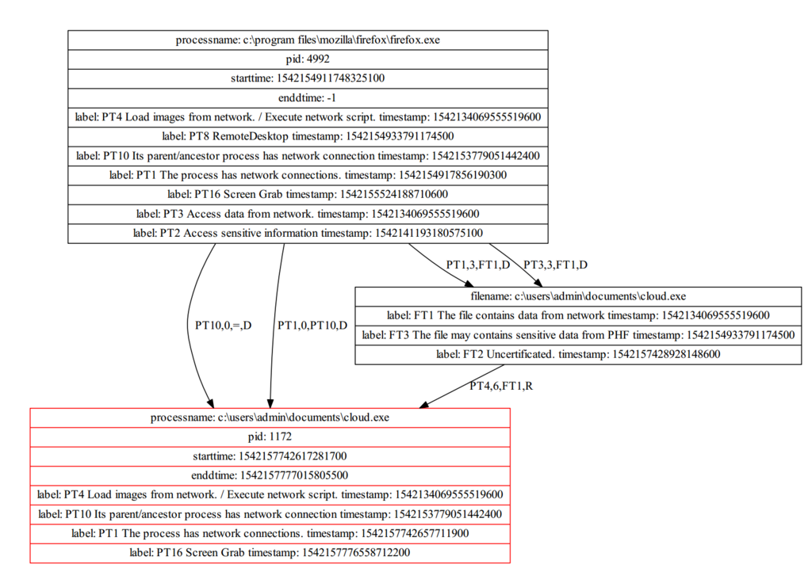
Attack Graph for Campaign 2
Notes:
Same as doit2.exe. Downloaded and executed by firefox and perform screengrab.

Slide 27
Attack Campaign 3 (on Nov 13th )
Attackers leverage Powershell to perform malicious actions.
A multi-layer obfuscated powershell script was downloaded and executed.
A malicious shellcode was loaded using the DLL Injection technique.
The shellcode connected to C&C server (128.55.12.185: 31337).
Same IP and port used in the earlier attack
Notes:
suspicious command session：
Survey the target on April 9th
Triple

Slide 28
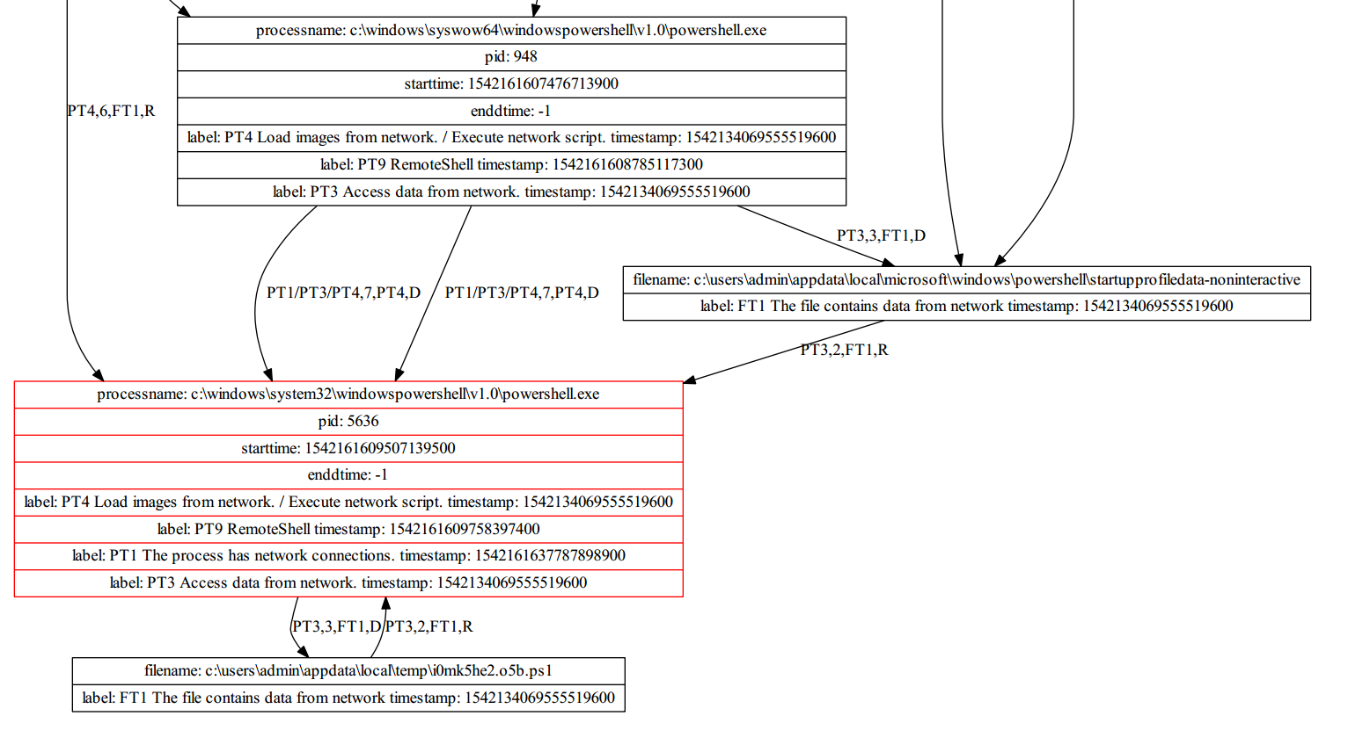
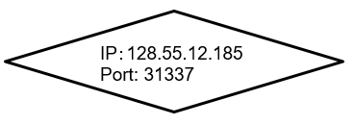
Attack Graph for Campaign 2
DLL Injection
Reverse TCP ShellCode
Notes:
A powershell was downloaded and executed
download shellcode from Internet, inject shellcode into another process
Perform remoteshell-like functionality

Slide 29
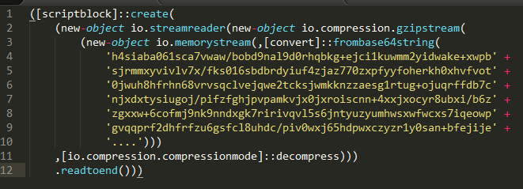
Details of obfuscated Powershell script
First layer: raw obfuscated script
The yellow string embedded in the script was first decoded by base64 and then decompressed using Gzip.

Slide 30
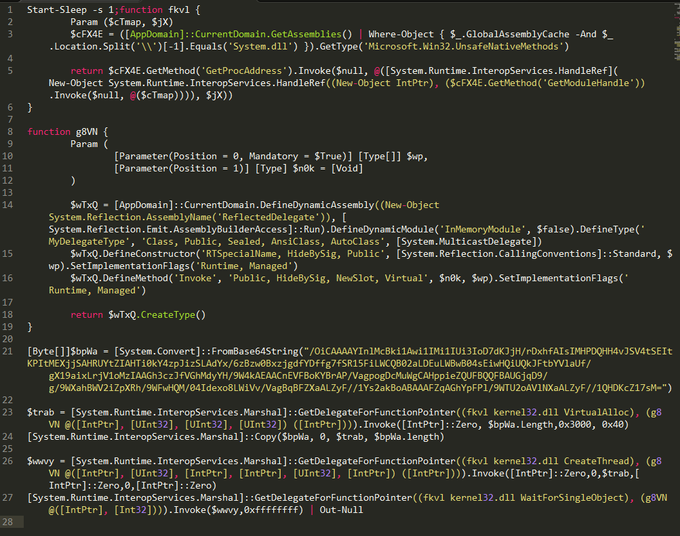
Details of obfuscated Powershell script
Second layer: deobfuscated script
The script leverage DLL Injection technique to load a base64 encoded shellcode from memory.
DLL Injection was implemented through 2 key APIs: VirtuallAlloc and CreateThread.
Found to be similar to open-source powershell tool
Notes:
Load shellcode from memory

Slide 31
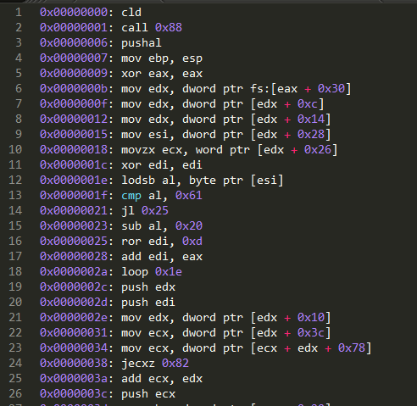
Details of obfuscated Powershell script
Third layer: shellcode
The shellcode connected to C&C server (128.55.12.185: 31337).
Notes:
Manual analysis of the shellcode

Slide 32
Attack Campaign 4 (on Nov 19th )
Through SSH connection, an attacker executed cmd.exe which run several commands to locate processes of TA1 collector:
schtasks /query # query schduled task in Windows
wmic qfe # query Windows Hotfix information
sc query # query services in Windows
tasklist # running process and process info(e.g. pid)
Then the attacker try to kill the TA1 collectors!
1) taskkill /PID 3764 /F # process (pid:3764) is a part of collector
2) taskkill /PID 2192 /F # process (pid:2192) is a part of collector
Data Collection and Exfiltration:
A file C:\Windows\System32\drivers\etc\hosts was exfiltrated through SSH.

Slide 33
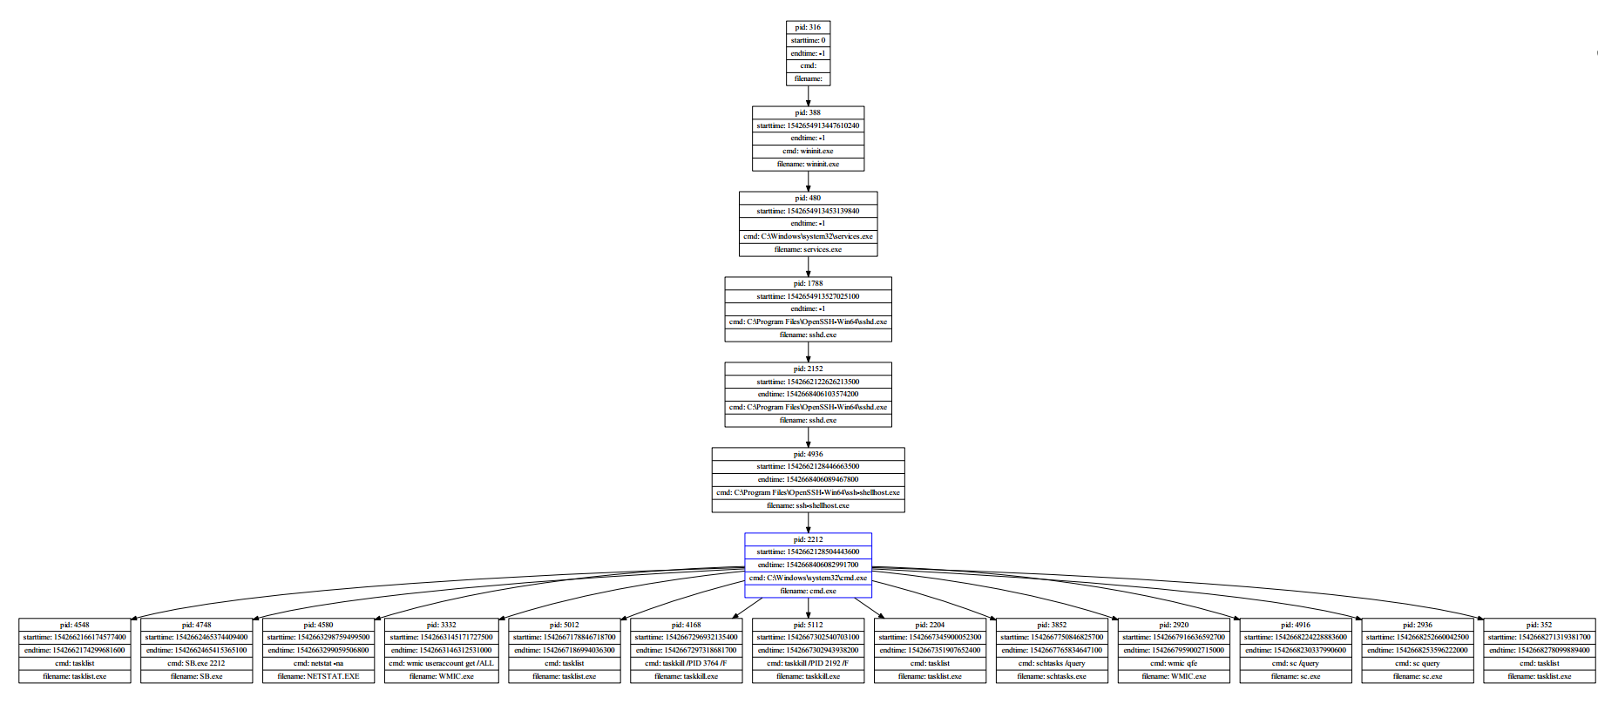
Attack Graph for Campaign 4
SSH server
cmd.exe
commands
Notes:
Commands execuated by attackers.

Slide 34
Outline
MARPLE TA1 System Design and Implementation
MARPLE TA1 Data Provided
MARPLE TA2 APTShield Results for Engagement 4
APTShield System Design
Future Work and Conclusions

Slide 35
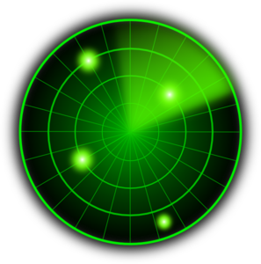
Motivation
Initial Compromise
Gaining Foothold
Lateral Movement
High Value Asset Acquisition
Malware (e.g. RAT)
Phishing
Exploit
vulnerability
Network scan
Code Repo
Malware
propagation
Attacker
Victim
CONFIDENTIAL
Malicious
Web
Exploit
browser
Database
Low-level Behavior based Malware detection
Design a detection mechanism that targets at the post-compromise steps in the APT life-cycle.
Notes:
No idea where to locate this slide

Slide 36
Motivation
Traditional detection approaches focus on exploit part of the attack chain by using IOC(Indicator of Compromise).
High confidence IOCs, such as IPs and Malware signatures, help detect known attacks without obfuscations.
For stealthy APT, low confidence IOCs are needed, for example, suspicious behaviors, which may lead a large number of alerts.

Slide 37
Challenges:
Filter false positive alerts;
Aggregate a large number of alerts;
Recover the context information (e.g., data flow and control flow) in real-time
Detect in real-time with low overhead;
Notes:
To detect APT attacks, we propose an alert aggregation system to analyze processes with semantic behaviors and context information.

Slide 38
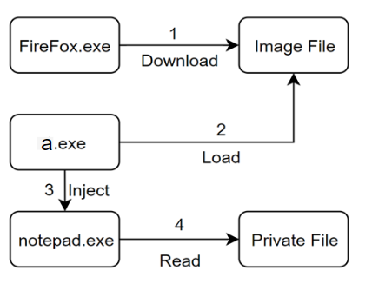
Motivation
Context-based detection shows the real attack
Standalone alerts:
One process is injected.
One process accesses sensitive files.
One process loads an uncertificated image.
An image file is downloaded.
After aggregation:
Notes:
We cannot tell if a standalone alert is malicious, but it would be much easier when aggregate them together.

Slide 39
System Details and Implementation
Problem 2 : Customized ASIs/rules/polices.
The framework is designed to be customizable to cover more attacks and adjust to different situation
ASIs(Identifier, Confidence Score, Type, Description):
PT2,1,PHF,Access sensitive information
FT5,1,Data,The file contains sensitive information
Rules(Subject, Event, Object/Subject, Direction):
PT2,2,FT5,R
Policies: (Combination of Type)
PHF & CodeSource & NoVisibleWinodw & Network

Slide 40
Main Idea
A Context-Based Semantic-Aware Attack Detection and Reconstruction System
Atomic suspicious indicators (ASI)
Aggregation Framework (Rules)
Detection Policies

Slide 41
System Overview
Detect attacks by aggregating multiple ASIs

Slide 42
Basic Idea
From MITRE Attack Matrix
for Enterprise
Tactics
Initial Access
Execution
Persistence
Privilege Escalation
Defense Evasion
Credential Access
Discovery
Lateral Movement
Collection
Exfiltration
Command & Control
ASIs (Atomic Suspicious Indicators) are
the semantic-aware indicators of an
attack.
Because there is no essential difference
between the implementation of malware
and of benign applications, these
indicators often occur in benign
application.
Notes:
Each tactic contains dozens of techniques.

Slide 43
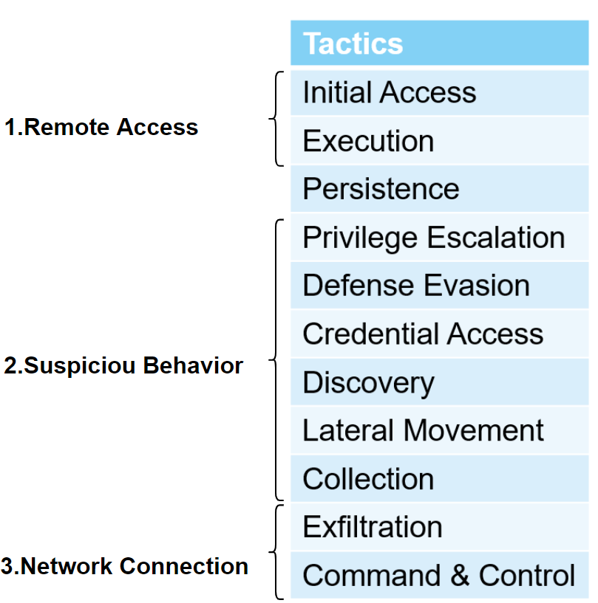
System Design -- ASI
How to design ASIs:
There are many tactics and techniques used in an attack life cycle, but they are not all necessary.
The essential parts of APT attacks:
1.Remote access to victims (including Malware download and VNC, etc.);
2.Execution of suspicious behavior to achieve attack goals;
3. Network Connection (to exfiltrate or connect to C&C server)
Meanwhile, other features, for example staying stealthy.

Slide 44
System Design – ASI detection with kernel monitoring
Principle | Category | ASI
Process | Behavior | Audio Recording
 |  | Keylogger
 |  | Remote Desktop
 |  | Remote Shell
 |  | Screen Grab
 |  | Execute sensitive programs/commands
 |  | Access sensitive information
 | Code Source | Load downloaded and uncertified images
 |  | Reflective Loading
 |  | Executing network script

Slide 45
System Design – ASI detection with kernel monitoring
Principle | Category | ASI
Process | Features | Without Human Interaction
 |  | Without Visible Windows
 |  | Heartbeat
 |  | Executed automatically
 |  | Network connections
File | Code Source | Contains data from network
 |  | Contains Macro
 | Feature | Uncertified
 |  | Contains user data in default

Slide 46
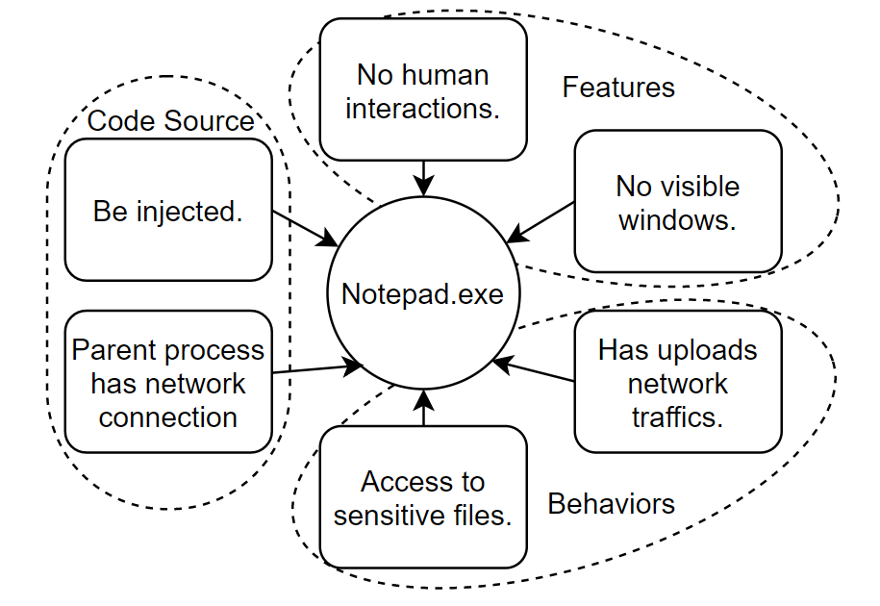
System Design – Aggregation Framework
It is more efficient to aggregate the indicators than detecting with graph pattern matching.
Notes:
After aggregation, we can detect an attack life cycle in only one process/point.

Slide 47
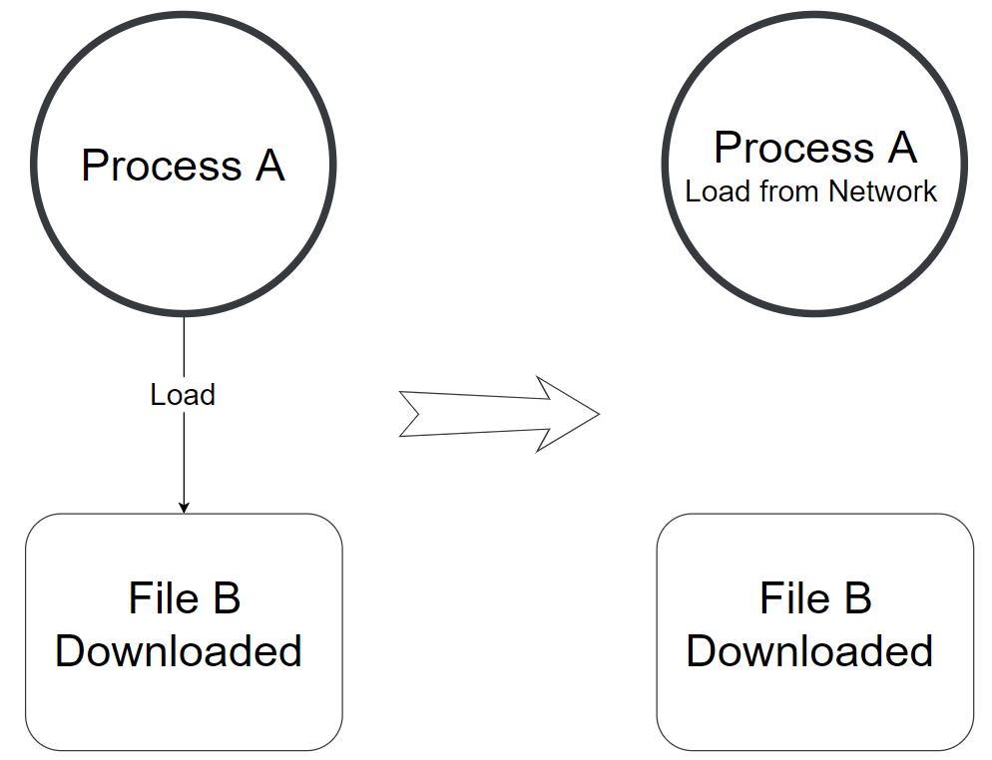
System Design – Aggregation Framework
Rules are used to aggregate ASIs from one subject/object to another, thus collecting the context information.
A simple example of
aggregation.

Slide 48
System Design – Aggregation Framework
Preliminary aggregation rule design
Data Flow: forward, which represents where the data from network, sensitive file and malicious behavior(for example, screengrab) gone;
Control Flow: backward, which represents the execution intention, for example, injection;
Notes:
Though we have a customizable rule definition language, we define rules as follows in E4 to cover attacks.

Slide 49
System Design
Detection Policy
Four Main Components of an attack life cycle:
1. Execute codes/scripts from external attacker (or insider attack)
2. Suspicious Behaviors: The target of the attack;
3. Network Connections: To communicate with attacker and exfiltration data
4.Other features: For example, stay stealthy.
The first three determines an attack while the 4th adds more confidence score.
Fast Policy Matching, only one process node involved.

Slide 50
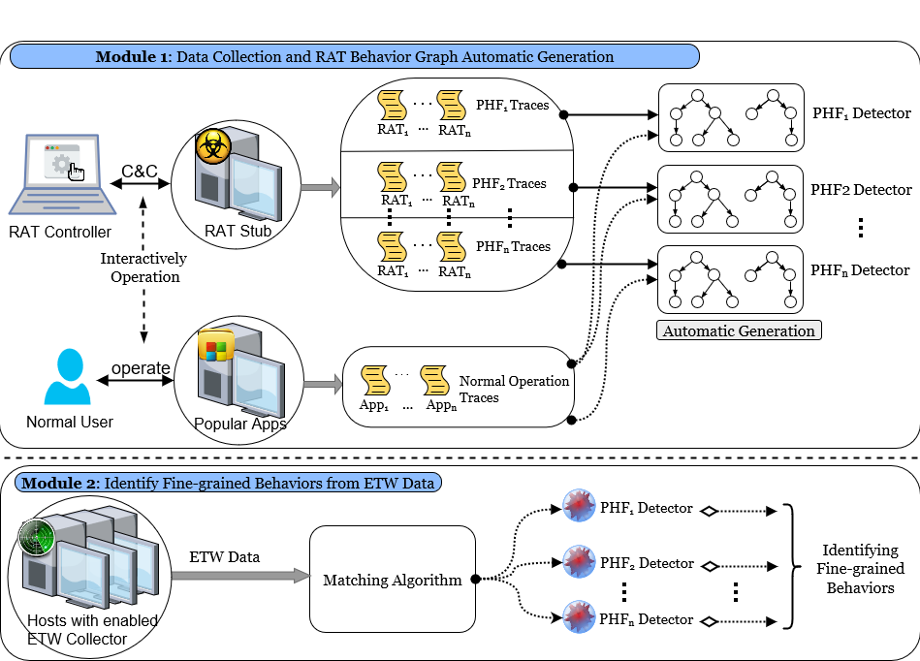
System Details and Implementation
Problem 1: ASI Signatures Training and Detection

Slide 51
System Details and Implementation
Problem 2: Attack Reconstruction
We’ve designed a ASI-based attack graph reconstruction approach.
If process A is found to be suspicious, our approach would explain the source of the ASIs in A.
Advantages: 1.Don’t use additional memory;
2.Fast;
3.Accurate in most scenarios.

Slide 52
System Details and Implementation
Problem 3: Data Storage in Memory
Instead of a graph, we prefer a process tree with a file list.
Process Tree
Each node is a process with its creation information and ASIs
Nodes are connected by creation relationships.
File List
Each element is a file with its attributes and labels
We don’t store events in memory, but status.

Slide 53
System Details and Implementation
Problem 3: Data Storage in Memory (cont’d)
Memory Usage in E4 for one day:
1122 processes, 132KB
10442 files, 625KB
Status (ASIs, Relationships and additional data), 12.45MB
Strings (Process Name, Command Line and File Path), 35MB

Slide 54
Conclusions
Design and implement a context-based semantic-aware APT detection system
Atomic suspicious indicators (ASI)
Aggregation Framework (Rules)
Detection Policies
Promising results on Engagement 4 as the First Attempt

Slide 55
Ongoing and Future Work
TA1: Reduce the amount of event data
Summarize the APIs and only report its semantics
TA2: Cross host analysis
TA2: Get more complete picture of the attack process

Slide 56
DARPA BAA 15-15 Transparent Computing: Project MARPLE
Mr. Jacob Torrey / I2O
TA1 Artifacts:
Provenance Info
MARPLE Analytics:
Real-time and forensic cyber threat discovery and analysis
Reports:
Real-Time Alerts
Attack Description and Visualization
Response for policy enforcement
Capability Objectives:
Detect attacks that they current enterprise security tools are missing today
Detect existing attacks faster and earlier in the kill-chain life cycle
Formulate and implement a scalable enterprise-wide defense so that intelligence from one part of the network can be used enterprise-wide
Enable sharing of actionable threat and vulnerability intelligence with peer enterprises.
Transition:
Potentially: DARPA/I2O and USG Agencies
Program changes: None
Real-time IOC detection
Sketch-based Point Analytics
Tag-based Detection
APT Behavior Reconstruction
Anomaly Detection using LSTM
Fine-grained RAT Behavior Analysis
Streaming Graph Anomaly Detection
Platform:
MARPLE platform based on Feature Store and τ-calculus
Space-Efficient Main Memory Representation of Provenance Graphs
Automatic and Human-Guided Analytics:
Sketch-based Point Analytics, SLEUTH, HOLMES, StreamSpot, LSTM Anomaly Detection, PHF Modeling and Detection, and τ-calculus analytics
Policy Reasoning and Response System
τ-calculus Policy Reasoning Module
Tag-based Policy Reasoning Module
General Graph Traversal Module
7 top-tier publications, multiple technical reports and disclosures
Fast analytics
τ-calculus: a DSL for security analytics
Heterogeneous Information Network
Mitigating APT Damage by Reasoning with Provenance in Large Enterprise Networks

Slide 57
The End

Slide 58
System Details and Implementation
Problem 2 : Customized ASIs/rules/polices.
The framework is designed to be customizable to cover more attacks and adjust to different situation
ASIs(Identifier, Confidence Score, Type, Description):
PT2,1,PHF,Access sensitive information
FT5,1,Data,The file contains sensitive information
Rules(Subject, Event, Object/Subject, Direction):
PT2,2,FT5,R
Policies: (Combination of Type)
PHF & CodeSource & NoVisibleWinodw & Network

Slide 59
System Details and Implementation
Problem 5: Cross-machine Detection
To do in the future.
All the memory increases linearly with number of machines.
So we can handle all data in only one process.

Slide 60
Related Work
APT Provenance tracking and Forensics
Connect collected low-level events to build the causal graph among them.
Similar with us, consider the complete APT attack process
Assume a confirmed attack point to start with and usually have efficiency problem.
Malware Detection with system-wide information flow
Build behavior model using information flow surrounding malwares.
Basically achieve real-time efficiency and use a relatively comprehensive behavior model(not only focus on behavior of one program)
Suffer from high FP and various evasion attacks.

Slide 61
Related Work(con’t)
Alert Correlation
Correlate different alerts caused by a single attack to recover attack lifecycles and get more accurate detection result.
Very similar high-level idea with us.(Aggregate alerts and perform better detection)
Techniques used by most previous works are out of date and inefficient.
Plenty of techniques were proposed to solve whether two event is related which can be solved by causality monitoring today.
Not semantics-aware at all. It usually leads to bad detection result quality.

