Slide 1
An Empirical Reexamination of Global DNS Behavior
Hongyu Gao
Northwestern
Vinod Yegneswaran
SRI
Yan Chen
Northwestern
Phil Porras
SRI
Shalini Ghosh
SRI
Jian Jiang
Tsinghua
Haixin Duan
Tsinghua

Slide 2
An Empirical Reexamination of Global DNS Behavior
Hongyu Gao
Northwestern
Vinod Yegneswaran
SRI
Yan Chen
Northwestern
Phil Porras
SRI
Shalini Ghosh
SRI
Jian Jiang
Tsinghua
Haixin Duan
Tsinghua

Slide 3
Motivation
Evolution of DNS

Slide 4
Motivation
DNS has been the subject of numerous measurement studies
1992: Danzig et al. An analysis of wide-area name server traffic: a study of the Internet Domain System
2001: Brownlee et al. DNS measurements at a root server
2002: Jung et al. DNS performance and effectiveness of caching
2008: Castro et al. A day at the root of the Internet
Secure Information Exchange
publicly available data source from hundreds of operational resolvers
primary driving force: security analysis

Slide 5
Background – DNS Protocol
Popular DNS query types:
A: domain names -> IPv4 addresses
AAAA: domain names -> IPv6 addresses
PTR: IP addresses -> domain names
…
Notes:
Introduce the recursive resolving process of DNS protocol
Then introduce the popular DNS query types that we will measure later

Slide 6
Background – SIE Dataset
Resolver population:
Commercial ISPs
Universities
Public DNS services
Geographic location:
North America
Europe
Notes:
Introduce how SIE dataset is collected.
Everything “below” recursive resolver is not collected.
Everything “above” recursive resolver is collected

Slide 7
Background – SIE Dataset
Data collection period:
12/09/2012 – 12/22/2012
Data size:
26 Billion DNS queries and responses
2 TB raw data / day
# of contributing resolvers:
628
Notes:
Introduce how SIE dataset is collected.
Everything “below” recursive resolver is not collected.
Everything “above” recursive resolver is collected

Slide 8
Background – SIE Dataset
Notes:
Added Figure 2 and Table 1

Slide 9
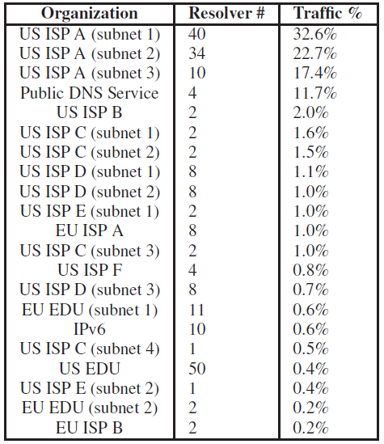
Background – SIE Dataset
Notes:
Added Figure 2 and Table 1

Slide 10
Goals
Empirically reexamine findings from prior DNS measurement papers from the vantage point of the SIE datastream
Differences due to perspective
Differences due to the evolution of DNS use patterns
Evaluate feasibility of extracting malicious domain groups from the global DNS data stream

Slide 11
Roadmap
Empirical Reexamination
Query type distribution
Traffic validity
TTL distribution
Malicious Domain Group Detection
Detection using temporal correlation
Domain group analysis
Conclusions
11
Notes:
11

Slide 12
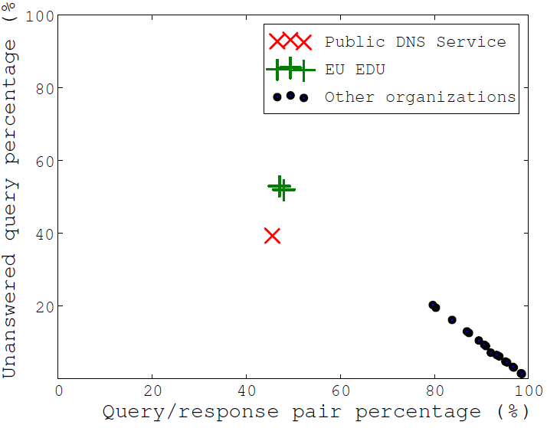
Unanswered queries and unsolicited responses
12
Notes:
12
Added Figure 4

Slide 13
Query Type Distribution
(%)
Distribution of DNS query types from the local perspective
* Dec 2000 (/ 2001) numbers are quoted from [Jung TON02]
Notes:
This figures shows the change of DNS query type distribution from the local perspective. We use the entire collected dataset from the recursive resolvers to compute the numbers.

Slide 14
Query Type Distribution (resolver to root perspective)
(%)
Distribution of DNS query types from the root perspective
* Oct 2002 numbers are quoted from [Wessels PAM03]
** Mar 2008 numbers are quoted from [Castro SIGCOMM CCR08]
Notes:
This figures shows the change of DNS query type distribution from the root perspective. We use the queries issued to root servers to compute the numbers.

Slide 15
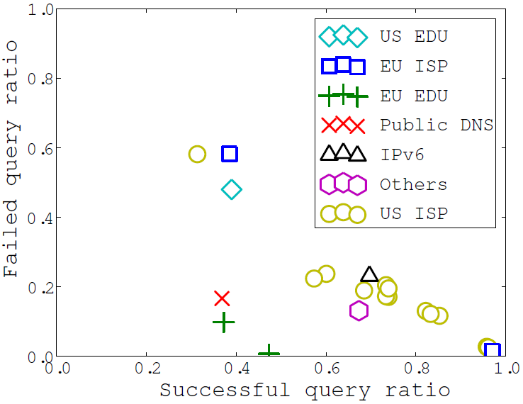
Successful / Failed / Unanswered
 | Jung et al. [2000] | SIE [2012]
Successful | 64.3% | 66.9%
Negative Answer | 11.1% | 18%
Unanswered | 23.5% | 15.1%
15
Notes:
15
Added Figure 5

Slide 16
Traffic Validity
Four established types of invalid traffic:
The query name has an invalid TLD
A-for-A Queries: The query “name” is already an IP address
A PTR query for an IP address from private space
Non-printable characters in the query name
*2001: 20.0% *2002: 19.53% *2008: 22.0% 2012: 53.5%
*2001: 12.0% *2002: 7.03% *2008: 2.7% 2012: 0.4%
*2001: 7.0% *2002: 1.61% 2012: 0.1%
*2002: 1.94% *2008: 0.1% 2012: 3.2%
* These numbers are quoted from multiple prior papers.
Please check our paper for more details.
Notes:
Multiple existing works have examined the traffic validity from root servers. We revisit this issue in 2012.
We examined 4 types of invalid traffic at root servers.
…
Please check out our paper for more details and the reference works where we quote the numbers

Slide 17
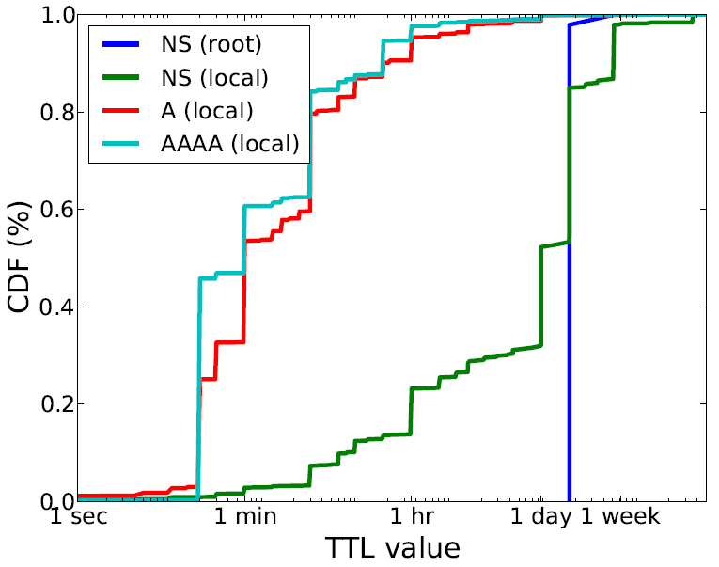
TTL Distribution
‘A’ and ‘AAAA’ records have similar TTL
‘NS’ records have longer TTLs
‘A’ records TTL becomes shorter
‘NS’ records from root is highly regular
Notes:
TTL distribution is not affected by invalid traffic, because invalid traffic does not result in any response.
Four observations:
A and AAAA records have similar TTL
Compare to year 2000 results [Jung TON 2002], the TTL of A records become much shorter. 2000 results: 20% of A records have TTL < 1 hour, 20% of A records have TTL > 1 day. 2012 results: 90% of A records have TTL < 1 hour. Possible cause: CDN and cloud
NS records have longer TTLs than A and AAAA records – consistent with findings in [Jung TON 2002]
Almost all records returned by root servers have TTL of 2 days.

Slide 18
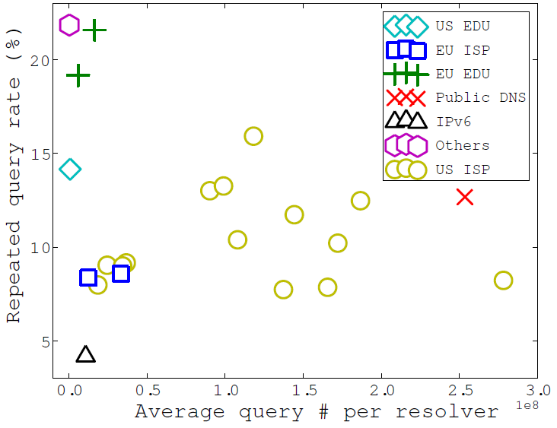
Repeated Queries
18
Notes:
18
Added Figure 7 and 8

Slide 19
Repeated Queries (2)
CNAME chain sanitization (~40% of repeated queries)
Concurrent overlapping queries
Premature retransmissions
e.g., Unbound has a short retransmission timer
Resolver quirks
In certain cases BIND resolves expired NS names twice before replying to client queries
Cache evictions

Slide 20
Key findings
Demise of A-for-A queries
Significant rise in AAAA queries
> 50% of queries sent to root servers do not produce a successful answer
Invalid TLD queries responsible for 99% of invalid queries sent to root servers
TTLs of A records have become much smaller
2001: 20% of A records have TTLs > 1 day
2012: 90% of A records have TTLs < 1 hour and 0% have TTLs > 1 day

Slide 21
Roadmap
Empirical Reexamination
Query type distribution
Traffic validity
TTL distribution
Malicious Domain Group Detection
Detection using temporal correlation
Domain group analysis
Conclusions
21
Notes:
21

Slide 22
Malware Domain Group Detection
Key intuition:
DNS queries are not isolated instances.
Detection method:
Advantages:
Detect malicious domain groups in general (scam, DGA, etc.)
Do not need comprehensive labeled training set
Anchor Malicious Domain
Temporal Correlation
Detected Malicious Domain
Notes:
Intuition:
For any DNS query, the underlying process that generates it is likely to generate other related queries. For example, drive-by exploits typically involve a long redirection chain before the occurrence of an exploit. Malware frequently uses domain generation algorithms (DGAs) as a rendezvous technique to search for command and control updates.
Detection method:
We propose to detect malicious domain groups by using the temporal correlation among DNS queries, given some well-known seed malicious domains (also known as anchor points).

Slide 23
Challenge
Detected!
Ideally:
In reality:
Malicious Domain 1
Anchor Malicious Domain
Malicious Domain 2
DNS caching effect!
Malicious Domain 1
Benign Domain 1
Anchor Malicious Domain
Benign Domain 2
Malicious Domain 2
Benign Domain 3
Notes:
Detecting correlated malicious domain groups using the DNS traffic collected from recursive resolvers is a challenging task.
(with animation)
In the ideal case, if we have prior knowledge that one domain is known to be malicious, and we know other domains that are queried by the same underlying process, we can easily detect the additional malicious domains.
However, we face two major challenges when we try to use this intuition in practice.
(with animation)
First, the collected DNS traffic is always a mixture of queries belonging to many different groups. In the example, although the two malicious domains exhibit temporal correlation with the anchor malicious domain, it is hard to differentiate them from the other benign domains that are mixed together.
Second, due to DNS caching effect, we may fail to observe some domain queries that should have been in the same group.

Slide 24
Practical Solution
A 3-step approach to identify the correlated domain group, given an anchor malicious domain
Identify the coarse related domain group using a TF-IDF heuristic
Cluster the coarse domain group
Refine the domain group according to the clustering result
Notes:
Due to time constraint, I will only cover the first step of the approach. Please refer to our paper for the detail of the subsequent steps.

Slide 25
Related Domain Identification
The concept of domain segments:
All domain queries in close temporal proximity with an anchor domain query.
An anchor domain queried for n times corresponds to n domain segments.
Determining whether the candidate domain c is related with the anchor domain s:
metric_{tf}: how many times c appears in the domain segments?
metric_{idf}: metric_{tf} / |c|
Need both metrics to surpass predefined thresholds.
Notes:
The term frequency metric reflects how frequently the candidate domain c is queried together with the anchor domain.
If the candidate domain is popularly queried in the DNS traffic, its term frequency value is expected to be large no matter whether it is related with the anchor domain or not—this will be counteracted by inverse document frequency metric, which down-weights popular domains. |c| denotes the total time that candidate domain c is queried.
If the candidate domain c have both metrics passing the corresponding thresholds, it is included in the coarse related domain group of the anchor domain, for further process.

Slide 26
Experimental Evaluation
DNS Data | Size | Anchor Domain #
Dec 16, 2012 | 1.82B queries | 129
Obtaining anchor domains:
Record all domains blacklisted on Dec. 16th from three external blacklists.
MalwareDomainBlockList, MalwareDomainList, Phishtank
Validating detected domains:
Blacklist matching with 5 external blacklists
McAfee SiteAdvisor and MyWot
IP address comparison
26
Notes:
26
To obtain anchor domains, we visit three blacklists: Malware Domain Block List, Malware Domain Block List and Phishtank. We choose three blacklists instead of other popular ones because they provide their blacklisted domain database including timestamp for download. We select all domains that are blacklisted on the same days of the data used for the experiment as anchor domains, obtaining 129 anchor domains.
We conduct a two-step process to validate detected domains.
We match the detected domains against 5 popular external blacklists. In addition to the 3 blacklists used to obtain anchor domains, we also query McAfee SiteAdvisor and myWoT.
IP address comparison. If a domain resolved to the same IP address with any confirmed malicious domains, we also confirm it as malicious.

Slide 27
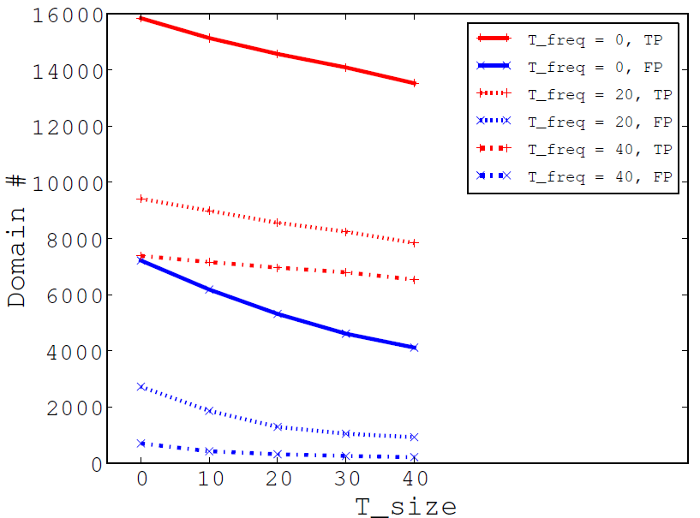
Detection Accuracy
A good threshold combination: T_freq = 40, T_size = 20
TP = 6890, FP = 258
precision = 96.4%, expansion rate = 53.4
27
Notes:
27
Our detection approach involves multiple tunable threshold values. In order to understand how the values of different thresholds affect the detection accuracy, we systematically tune the thresholds, measure the system performance with different values, and plot the result in the figure.
We find Tfreq = 40 and Tsize = 20 to be a good threshold choice by experiment. Please refer to our paper to get more details on the parameters that we have tuned.
With this setting, this module detects 6890 previously unknown malicious domains (true positives), with 258 false positive
domains. The detection precision achieves 96.4%. On average, each anchor domain is expanded to 53 previously unknown malicious domains. During real-world deployment, the operator who runs the malware domain group generation system will determine whether he prefers a tighter or a looser threshold. A tight threshold produces fewer false positives, but also discovers fewer malicious domains. A loose threshold does the opposite.

Slide 28
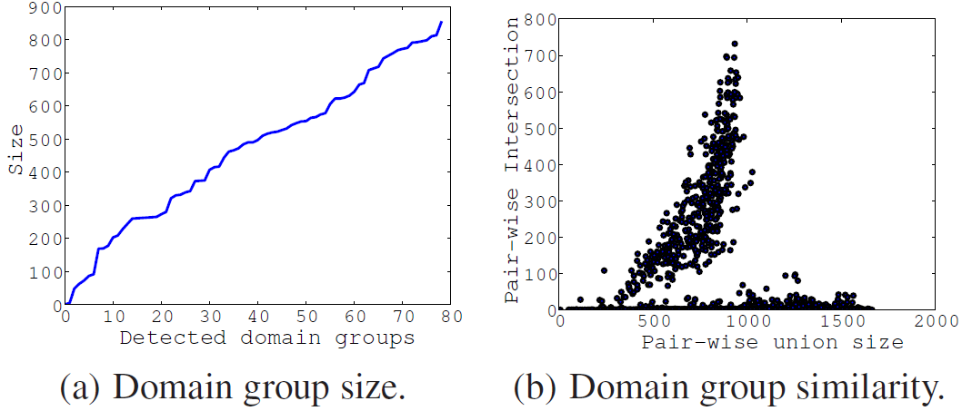
Domain Group Analysis
Sample anchor domain pairs deriving highly overlapping groups
surprise-mnvq.tk | surprise-mnvr.tk
vural-electronic.com | vfventura.sites.uol.com
voyeurpornweb.com | vkont.bos.ru
28
Notes:
28
Although we have 129 anchor domains, only 79 of them result in correlated domain groups. The left figure plots the distribution of the
detected domain group size. The largest group contains as many as 852 domains.
Next, we study the overlapping among the detected domain groups.
(animation)
The right figure shows the size of intersection and union of all the domain group pairs. If a group pair is completely identical, these two sizes will be equal. If a group pair is completely different, the intersection size will be 0.
We observe two obvious clusters. The one where the domain groups heavily overlap, and the one where the domain groups have very little overlap. We hypothesize that the highly overlapping domain groups are associated with anchor domains that are related.

Slide 29
Domain Group Analysis
pill-erectionmeds.ru | pillcheap-med.ru | onlinerxpillhere.ru
medspill-erection.ru | rxpill-medstore.ru | medpillbuy-online.ru
A pharmaceutical domain group, size = 295
uggsbootss.com | niceuggsforsale.com | louisvuittonwhite.net
uggsclassic.org | officialuggsretails.com | nicelouisvuittonbag.com
A counterfeit product domain group, size = 17
lq8p.ru | ol4k.ru | s3po.ru
n5di.ru | p9ha.ru | n4gf.ru
A suspected DGA domain group, size = 71
29
Notes:
29
Using our approach, we detected different types of domain groups. We now show some concrete examples.

Slide 30
Roadmap
Empirical Reexamination
Query type distribution
Traffic validity
TTL distribution
Malicious Domain Group Detection
Detection using temporal correlation
Domain group analysis
Conclusions
30
Notes:
30

Slide 31
Conclusions
We conducted a comprehensive measurement study with more than 26 billion DNS query-response pairs collected from 600+ global DNS resolvers.
While DNS characteristics vary significantly across networks, networks within an org exhibit similar behavior
Web servers should take IPv6 support into account
Client-side implementations could be more aggressive in suppressing invalid queries
We proposed a novel approach that isolates malicious domain groups using temporal correlation in DNS queries, given a few known malicious domains as anchors.
96.4% detection precision, 56 X expansion rate
Notes:
Our measurement findings can help implementation, deployment, and configuration of DNS software, websites, and other applications.

Slide 32
Acknowledgements
Paul Vixie, SIE Contributors, David Dagon, Sonia Fahmy, Yunsheng Cao
Thanks!

