Slide 1
AppShield: Enabling Multi-entity Access Control Cross Platforms for Mobile App Management
Zhengyang Qu¹, Guanyu Guo², Zhengyue Shao², Vaibhav Rastogi³, Yan Chen¹, Hao Chen⁴, Wangjun Hong¹
¹Northwestern University
²Zhejiang University
³University of Wisconsin, Madison
⁴University of California, Davis

Slide 2
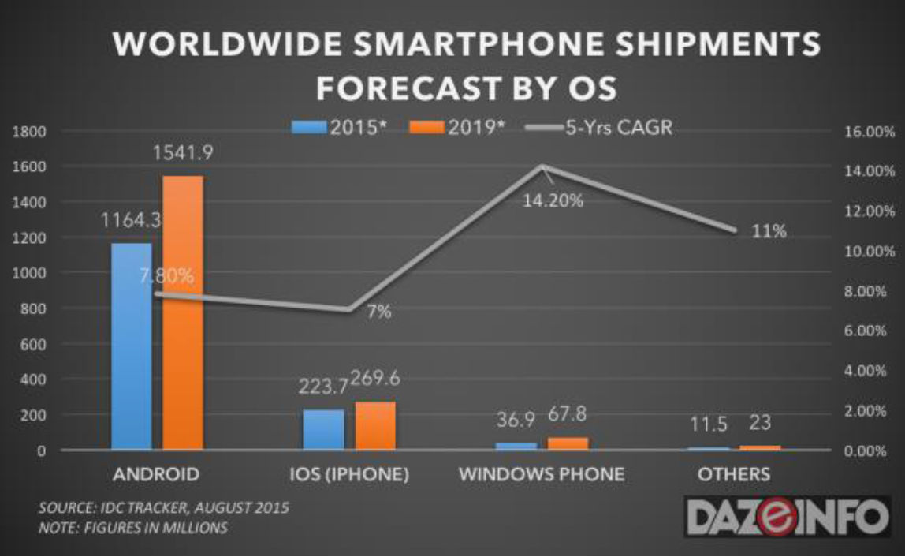
Android OS dominance
Mobile OS Market Share, by dazeinfo.com
Notes:
Android is the most dominant smartphone OS, which should be attributed to the wide availability of mobile applications from application marketplaces such as Google Play1 .

Slide 3
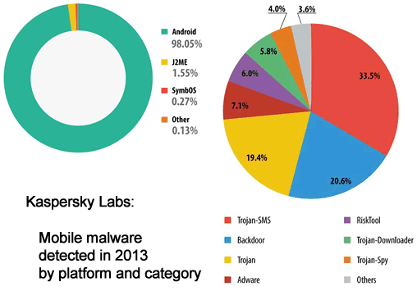
Android malware/spyware

Slide 4


Birth of bring-your-own-device
Enterprise Mobility Management (EMM)
Overall ecosystem: content analysis, social media integration
Mobile Application Management (MAM)
Application Delivery
Security and Policy
Mobile Device Management (MDM)
OS Management and Control

Slide 5
Policies required in BYOD

Slide 6
Outline
Introduction
Motivation
System Overview
Evaluation
Conclusion

Slide 7
Common deployment of MAM
  Application rewriting
    Mocana, AirWatch
    Work on all devices, NOT on all applications
  SDK
    Good, Citrix, AirWatch
    Work on all applications, extra developer support
  OS Modification
    Android for work on Android 5.0 and above
    Dependencies on OS versions or customization
    Limitation of portability

Slide 8
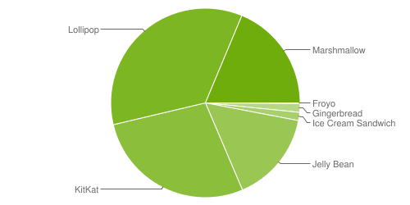
Android segmentation
Android OS distribution snapshot in March 2015 and September 2016

Slide 9
Desired system
Generality
  Convert any personal app to a business version
Ability of enforcing arbitrary access control policies
  Multi-entity management, Role-based access control (RBAC), granularity…
Portability
  No modifications (dependencies) on OS
Completeness
  Stealthy channels: reflection, native code, dynamic load
Cross-platform
  Extend to other platforms, e.g. iOS

Slide 10
Challenges
Lack of OS support
  Android storage mechanism supports either data sharing or data isolation alone
Diversity of data access behavior
  Native code, Java reflection, Dynamic loading
Performance penalty
  Popular resource virtualization-based solutions have the scalability issue
Notes:
Android KitKat 4.4 enables the private external sd card. Cannot assume the OS version. Sharing is difficult.

Slide 11
Contributions
A proxy-based data access mechanism to enforce arbitrary access policies without OS dependency
An application rewriting mechanism inject MAM features by hooking system calls to achieve complete mediation
A prototype system with low latency and resource consumption

Slide 12
Outline
Introduction
Motivation
System Overview
Evaluation
Conclusion

Slide 13
Security model

Slide 14
Application rewriting
Application decompilation
Native
  Customized system calls, e.g., ioctl(), open()
  Override Global Offset Table (GOT)
Bytecode
  Service: wrap the app, overwrite the GOT before app starts
  Activity: message popup, e.g., policy violation
Manifest file
  Declaring the Service and Activity injected
  Request the permission to access mirror content provider
Repack and sign

Slide 15
Proxy-based data access mechanism

Slide 16
Shield the privileged data
File-system
  open(), creat(), rename(), mkdir(), remove(): rewrite the file path to the internal storage of AppShield
  stat(), lstat(): pass the file descriptor to business file to fstat()
Content provider
  Mirror content provider
  System call ioctl(): redirect data request

Slide 17
Security policies
File isolation
Multi-entity management & RBAC
Fine-grained file access control
Content provider isolation

Slide 18
Outline
Introduction
Motivation
System Overview
Evaluation
Conclusion

Slide 19
Effectiveness
Select 50 popular apps from Google Play
  35 file related apps, 15 contact provider related apps
  1 app crashes; 2 apps file path “/./sdcard”
  1 app cannot be rewritten; use “Intent” to directly start system contact manager app
 | File isolation | Multi-entity management & RBAC | File-level granularity | Content provider isolation
Succeed | 33/35 | 31/35 | 31/35 | 14/15

Slide 20
Reliability
Select 1000 apps by popularity from Google Play in categories: Business, Finance, Medical, Productivity
Execute by ADB Monkey
  Original version also crash: 29 in 35
  Crash without code modification: 6 in 35
Total | Succeed | Rewriting failure | Crash
1000 | 953 (95.3%) | 12 (1.2%) | 35 (3.5%)

Slide 21
Impact of application rewriting
Micro: overall latency in 1000 data access:
Macro: overall time for human to open/close a window rendering the privileged data
 | File system |  | Content provider
 | Original | AppShield | Original | AppShield
Micro (s) | 0.180 | 0.382 | 7.303 | 9.014
Macro (s) | 1.472 | 1.524 | 1.068 | 1.194
Average memory usage increment: 28840.3KB
Average code size increment: 33.7KB

Slide 22
Comparision
 | AirWatch | MOCANA | GOOD | Citrix | Android L | AppShield *
Method | SDK & App rewriting | App rewriting | SDK | SDK | OS modification | App rewriting
Isolation | Sandbox | Sandbox | Sandbox | Encryption | DAC | Sandbox
Multi-entity management | No | No | No | No | No | Yes
RBAC | Yes | No | No | Yes | No | Yes
Granularity | Static | Static | Coarse dynamic | Static | Coarse dynamic | File-level dynamic
Sharing | Online | Online | Online | Local | Local | Local
Portability | High | High | High | High | Low | High

Slide 23
Conclusion
AppShield enforces arbitrary access control policies in the scenario of MAM
Application rewriting
  No dependency on OS, high portability
  System call hooking, complete mediation
Low overhead and impact on the original app

Slide 24
Thank you!
Questions?
http://list.cs.northwestern.edu/mobile/

Slide 25
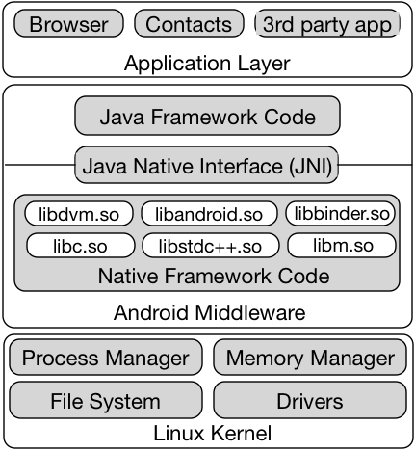
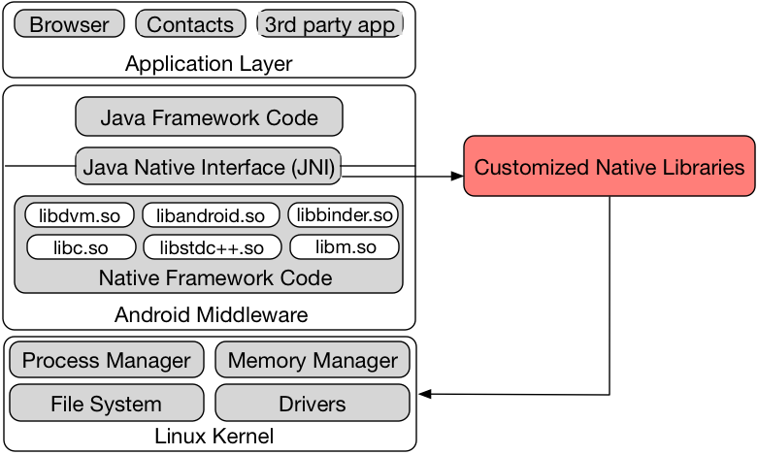
System call hooking

