Slide 1
APTShield: A Real-Time Situation-Aware Detection System for Remote Access Trojan in the APT Attacks
Yan Chen

Slide 2



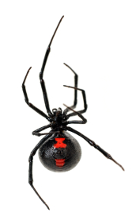



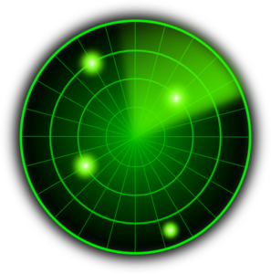




Our Focus
Initial Compromise
Gaining Foothold
Lateral Movement
High Value Asset Acquisition
Malware (e.g. RAT)
Phishing
Exploit
vulnerability
Network scan
Code Repo
Malware
propagation
Attacker
Victim
CONFIDENTIAL
Malicious
Web
Exploit
browser
Database
Behavior based Malware detection
Design a detection mechanism that targets at the post-compromise steps in the APT life-cycle.

Slide 3
和市场上主流APT产品的对比
产品 | 检测方法 | 主机监控范围 | APT攻击生命周期
 |  |  | 初始阶段 | 植入后门 | 后续扩散 | 敏感数据泄露
启明星辰 | 基于网络 | Web系统 | 实时检测已知恶意软件 | 无 | 无 | 无
360 | 基于网络和无沙箱主机 | 终端行为检测 系统日志 Web系统 文件系统 邮件系统 | 实时检测已知恶意软件 | 无 | 离线分析 | 离线分析
绿盟 | 基于网络和无沙箱主机 | 内存指令分析 系统日志 Web系统 文件系统 | 实时检测已知恶意软件 | 离线分析 | 离线分析 | 离线分析
阿里云 | 基于网络和无沙箱主机 | 主机行为 系统日志 Web系统 | 实时检测已知恶意软件 | 离线分析 | 无 | 无
天融信 | 基于沙箱的主机 | 文件系统 | 离线分析 | 离线分析 | 离线分析 | 离线分析
科来 | 基于网络和沙箱的主机 | 邮件系统 Web系统 | 实时检测已知恶意软件 | 离线分析 | 离线分析 | 离线分析
安恒 | 基于网络 | Web系统 文件系统 邮箱系统 | 实时检测已知恶意软件 | 无 | 无 | 无
APTShield | 基于沙箱的主机 | 全系统底层监控 | 利用已有检测系统 | 实时检测 | 实时检测 | 实时检测

Slide 4
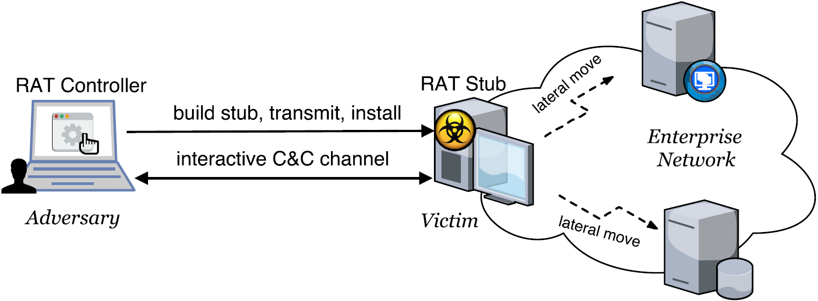
Background about APT Malware
Remote Access Trojan (RAT)
Based on the study of 300+ APT whitepapers, RAT is a core component in an APT attack, and >90% are Windows based.
Allows an adversary to remotely control a system.
A complex set of potentially harmful functions (PHFs)
  E.g., keylogger, screengrab, remote shell, audiograb
  A Windows RAT typically embodies10~40 PHFs.

Slide 5
Requirements of an APT Detection System
Fast and early detection
Enables organizations to act more quickly and effectively to block attacks and ensure critical assets are protected
Fine-grained and situation-aware
Understand what malicious activity is being performed
Provide visibility into APT for efficient forensic analysis.
Long-term monitoring with negligible overhead
Achieve continuous monitoring without consuming much valuable resources

Slide 6
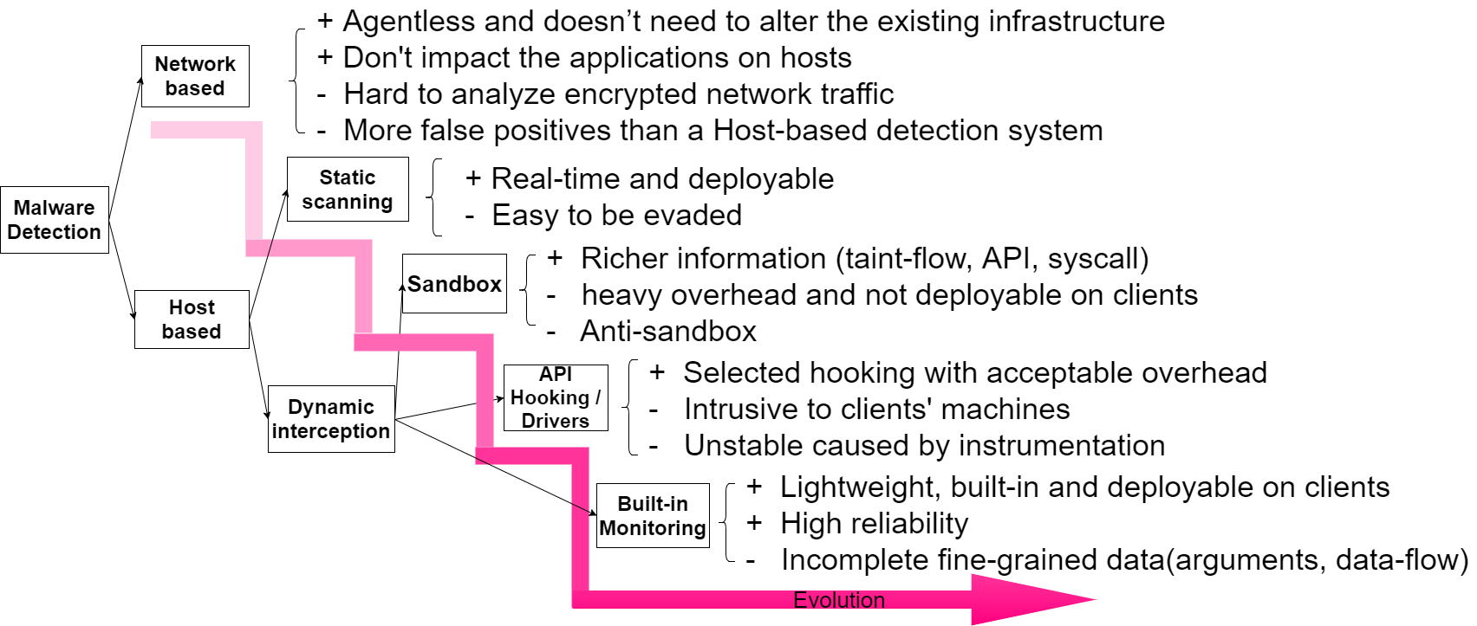

Slide 7
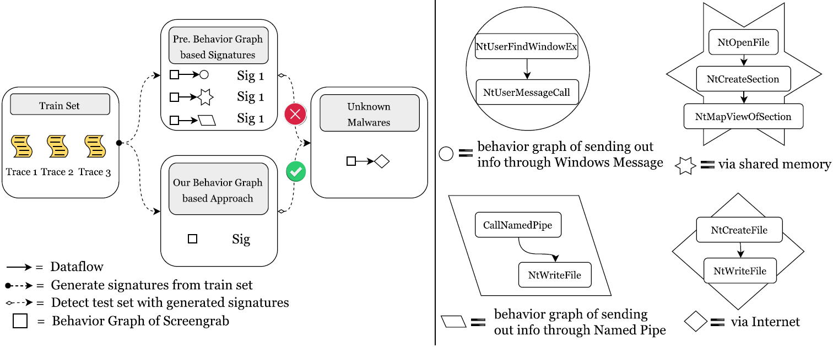
Previous Malware Detection Methods
Would Fail RAT Detection

Slide 8
Basic Idea
Observations
Ways of implementing a PHF are limited too, in terms of
  Core system calls & parameters , and such sequences
→ Possible to define each PHF using system call sequences
Propose PHF-based RAT detection when a program exhibits
  A sufficient number of PHFs
  RAT-specific resource access characteristics
Advantages: evasion-resilient and semantic-aware
  Hard to evade unless attackers find new ways of implementing PHFs
  Per PHF detector; semantic-aware; know exactly what activity is going on
Notes:
function-level, ground truth, supervised training,
is a must for adversaries to implement a PHF
A PHF could be exactly defined by a limited set of core system calls.
Separation of signatures for PHFs increases the detection specificity by combining different types of signatures
In each signature sequence, the core system calls are irreplaceable, and the order must be preserved to implement a p

Slide 9
Our System: Three Components
PHF-based situation-aware RAT detection
Develop behavior graphs for each of the most popular PHFs
Know exactly what activity a suspicious process is doing.
Discriminating features as supplement
Detection simply based on PHF behaviors may have FP
Features based on the characteristics of RATs are extracted for FP reduction.
  Keep stealthy, stay hidden and persistent, no human interaction
Real-time e2e system implementation
Sys call logging based on Event Tracing for Windows (ETW)
Notes:
function-level, ground truth, supervised training,
is a must for adversaries to implement a PHF
A PHF could be exactly defined by a limited set of core system calls.
Separation of signatures for PHFs increases the detection specificity by combining different types of signatures
In each signature sequence, the core system calls are irreplaceable, and the order must be preserved to implement a p

Slide 10
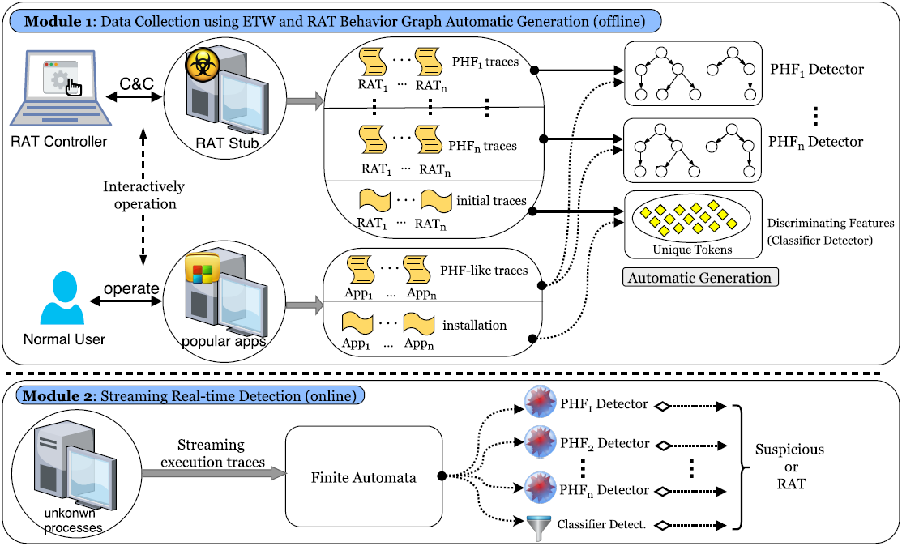
System Architecture
Notes:
function-level, ground truth, supervised training
Generated signatures for both determining the functionality and discerning between malicious and benign

Slide 11
PHF Detector Generation

Slide 12
PHF Detector Generation – Observations
Observations
  There are limited ways to implement a PHF at the system call level, and RATs tend to implement them quite similarly.
  Only quite a small proportion of lengthy malware execution traces are the essential “malicious section”, representing the core function of a PHF.
Challenge
  How to automatically extract only such essential part from lengthy system call?
Notes:
Thus, with tens of RAT samples available, it is feasible to identify all the core system call sequences possibly used for this PHF.
signatures regions of system calls

Slide 13
PHF Detector Generation – Solution
  Leverage sequence alignment algorithms borrowed from bioinformatics to identify regions of similarity in system call sequences.
    Such similarity regions typically correspond to the execution of similar code.
  Build finite automata to model the similarity regions as our PHF detectors.
Notes:
Thus, with tens of RAT samples available, it is feasible to identify all the core system call sequences possibly used for this PHF.
signatures regions of system calls

Slide 14
PHF Detector Generation – ScreenGrab Example
⁞
NtProtectVirtualMemory
NtProtectVirtualMemory
NtGdiCreateCompatibleDC
NtGdiCreateCompatibleBitmap
NtGdiBitBlt
NtGdiDeleteObjectApp
NtGdiExtGetObjectW
NtProtectVirtualMemory
NtProtectVirtualMemory
⁞
⁞
NtDelayExecution NtDelayExecution
NtGdiCreateCompatibleDC
NtGdiCreateDIBSection
NtGdiStretchBlt
NtGdiDeleteObjectApp
NtGdiExtGetObjectW NtDelayExecution NtDelayExecution
⁞
Notes:
Thus, with tens of RAT samples available, it is feasible to identify all the core system call sequences possibly used for this PHF.
signatures regions of system calls

Slide 15
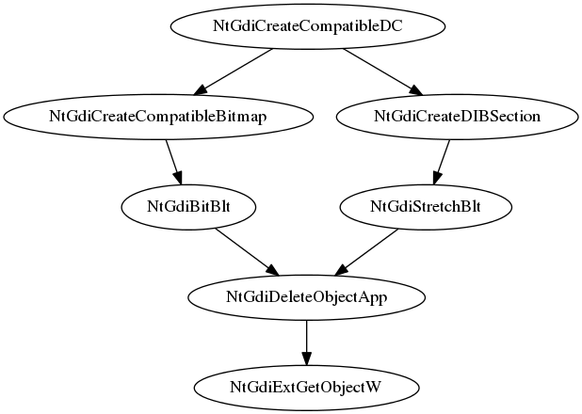
PHF Detector Generation – ScreenGrab Example
Notes:
Thus, with tens of RAT samples available, it is feasible to identify all the core system call sequences possibly used for this PHF.
signatures regions of system calls

Slide 16
Sequence Alignment Algorithm
Step 1: Local alignment
  Preferable when two traces are widely divergent overall but have regions of similarity within long sequences.
  Tune the classic Smith-Waterman algorithm to take into consideration the data dependencies between system call events and the weight of each event.
Step 2: Global alignment
  Preferable when the two sequences are similar and of roughly equal size.
  Adjust the Needleman-Wunsch algorithm to fit our problem.
Notes:
Thus, with tens of RAT samples available, it is feasible to identify all the core system call sequences possibly used for this PHF.
signatures regions of system calls

Slide 17
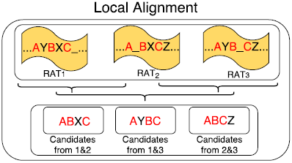
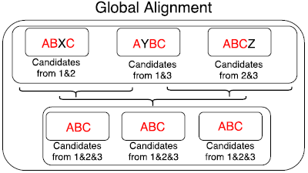
Sequence Alignment - Illustration
Notes:
Thus, with tens of RAT samples available, it is feasible to identify all the core system call sequences possibly used for this PHF.
signatures regions of system calls

Slide 18
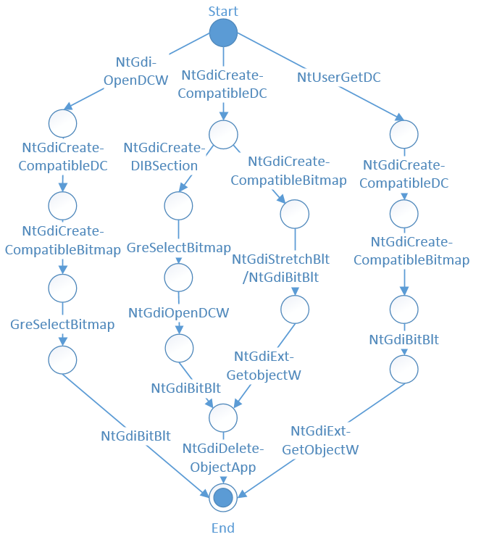
Example of PHF Detector Generated for Screengrab
A path (start, s₁, s₂, …, s_{n}, end) represents one implementation.
There can be any other system calls between two consecutive system calls in a path.
The two system calls must have direct or indirect data flow dependency.
Notes:
function-level, ground truth, supervised training,
is a must for adversaries to implement a PHF
A PHF could be exactly defined by a limited set of core system calls.
Separation of signatures for PHFs increases the detection specificity by combining different types of signatures
In each signature sequence, the core system calls are irreplaceable, and the order must be preserved to implement a
In the rightmost path, NtGdiCreateCompatibleDC
is invoked to create a memory device context (DC); then NtG
diCreateCompatibleBitmap creates a bitmap and place
it in the memory DC; afterwards NtGdiBitBlt copies the
on-screen image into the memory DC; finally, NtGdiExtGet
ObjectW and NtGdiDeleteObjectApp are invoked to do
the rounding-off work, and the task of screen grabbing is completed.

Slide 19
Major PHFs -1
Key Logging: log all the keys stroke by the victim & send to the attacker
Screen Grab: capture the victim’s desktop screen
Remote Shell: remotely open cmd.exe on a victim host & execute arbitrary commands
Audio Record: capture audios with victim’s microphone
Registry Manager: remotely view/modify a victim’s Windows Registry
Notes:
function-level, ground truth, supervised training,
is a must for adversaries to implement a PHF
A PHF could be exactly defined by a limited set of core system calls.
Separation of signatures for PHFs increases the detection specificity by combining different types of signatures
In each signature sequence, the core system calls are irreplaceable, and the order must be preserved to implement a p

Slide 20
Major PHFs -2
Send & Execute: upload a local executable file to the victim’s host and automatically execute
URL Download: command the victim to visit a specified website, download an executable file, and then automatically execute it
In-memory Attack by Reflective DLL Injection: a library injection technique, using reflective programming to load of a library from memory into a host process.
Notes:
function-level, ground truth, supervised training,
is a must for adversaries to implement a PHF
A PHF could be exactly defined by a limited set of core system calls.
Separation of signatures for PHFs increases the detection specificity by combining different types of signatures
In each signature sequence, the core system calls are irreplaceable, and the order must be preserved to implement a p

Slide 21
Classifier Signature Generation

Slide 22
Classifier Signature Generation –
Greedy Algorithm- Insight
RAT malware often tampers with security-sensitive system settings and registry entries
  During the initial foothold establishment period
  Benign programs seldom touch them.
A RAT always tries to stay hidden and has no interactivity as benign apps do
  No displaying windows, interaction with users, or accept human user input.

Slide 23
Classifier Signature Generation –
Greedy Algorithm-2
Solution
  Develop a greedy algorithm to automatically extract the discriminating tokens which achieve
    High coverage: Appear in traces of most RAT malware samples.
    Near-zero false positive: Seldom appear in traces of benign programs.

Slide 24
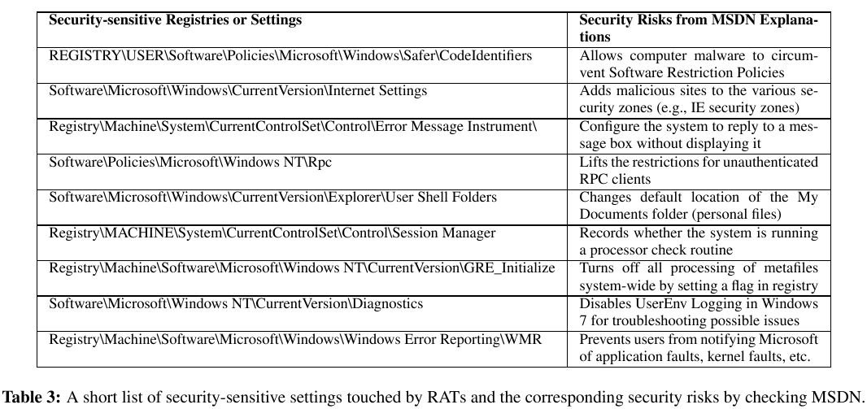
Example of Discriminating Features Extracted
Notes:
Find the key called “MachineGuid” this key is generated uniquely during the installation of Windows and it won’t change regardless of any hardware swap. It won’t change unless you do a fresh reinstall of Windows. (uniquely Identify A Windows Machine)

Slide 25
Evaluation by Kudu Dynamics

Slide 26
Dataset and Detection Results
Data Summary
  35,650,758 system call events; 529 processes involved (30 benign programs)
  20 mins processing time; throughput: 1,782,538 records/min
Three processes were reported by our RAT detector
  Profile.exe (2) matched with the remoteshell signature
  Prodat.exe matched with the screengrab signature
Perform backtracking with the 3 identified processes
  Successfully identified all 22 processes (4% out of 529 total processes) involved in malicious activities.
Notes:
23KB/s = 1.38MB/min

Slide 27
Attack Graph for the Real-World Scenario

Slide 28
A More Comprehensive Evaluation

Slide 29
RAT Collection
80 RAT controllers collected from underground hacker forums
  Controllers were cracked and shared in hacker forums
  Each RAT controller could be considered from a unique RAT family, given
    Each one is unique in terms of its GUI, the combination of functionalities, and the malware author.
  Those RATs have been involved in several famous security incidents: Iran nuclear facility attack, Sony hack, RSA data theft, …
Notes:
RAT-initialization and RAT-per-functionality: 1,271,049 and 5,080,212 system calls

Slide 30
Evaluation of Detection Capability
Experiment 1: Per-PHF traces collected on our own
  80 RATs in total = 40 RATs used for training + 40 for test
  Capture 80 initialization traces and 560 (i.e., 80*7) per-PHF traces for each RAT → 1,271,049 and 5,080,212 system calls, respectively
  Results: 97.9% detection accuracy
Experiment 2: Third-party (from Univ. of New Mexico) benign traces
  More than 21 million system calls invoked by 422 processes, corresponding to 27 unique benign applications
  Results: 2 false alarms that the two applications Word and Excel performed keylogging operations. No false alarms after initialization signatures are applied.
Notes:
RAT-initialization and RAT-per-functionality: 1,271,049 and 5,080,212 system calls

Slide 31
Evaluation of Detection Capability – cont’d
Experiment 3: Benign traces collected on our own
  Select 31 popular Windows applications and perform RAT-like behaviors;
    E.g., operate the browser Firefox to download a software from online, install and run it on the machine, which is a behavior quite similar to the PHF “URL Download”
  6,861,915 system calls collected
  Test each of the 31 Windows application traces against the all 7 PHF sig, and also apply initialization signature
  Results: 3.2% (7 out of 217 test results) false positive rate. ZERO false positive rate after initialization signatures are applied.

Slide 32
Evaluation of Robustness against Evasion Attacks
Piggyback Attack
  An RAT injects itself into a benign program and then runs in the background whenever the host program is launched
  We create 40 mixed traces of benign and RAT processes
  Results: 100% detected
    A parasite RAT malware still needs to generate execution traces to accomplish an attack, although its traces may be mixed together with those of the host program.
Notes:
System Call Reordering Attack
Obfuscation Attack

Slide 33
Evaluation of Robustness against Evasion Attacks – cont’d
System Call Injection Attack
  An attacker inserts arbitrarily functionality-irrelevant system calls into its execution traces.
  Results: our system is robust to such attack by nature.
    Our per-functionality behavior graphs do not require the system calls contained to be contiguously located in a trace.
Notes:
System Call Reordering Attack
Obfuscation Attack

Slide 34
Evaluation of Robustness against
Evasion Attacks – cont’d
System Call Reordering Attack
  However, reordering system calls without affecting the semantics of an original program has quite limited applicability.
    Strict semantic logic, and data and control dependencies exist among the system calls events which compose a behavior graph to represent a PHF.
Notes:
specifically including randomly inserting branches within a basic block, reordering instructions, encrypting string variables, and dummy code insertion

Slide 35
Evaluation of Robustness against
Evasion Attacks – cont’d
Obfuscation Attack
  We used a powerful obfuscation tool to perform a series of control flow and data flow obfuscation techniques on RAT samples.
  Results: Our system is able to detect all of them, while 35 out of 55 VirusTotal scanners fail to detect them.
Notes:
specifically including randomly inserting branches within a basic block, reordering instructions, encrypting string variables, and dummy code insertion

Slide 36
Performance Evaluation
  APTShield consists of an ETW based audit logging system and a detection engine
  The audit system running in a PC of a 3.3 GHz Intel(R) Core(TM) i5-4590 processor, 8 GB of RAM, and 64bit Windows OS, while the detection engine running in a server running Ubuntu 12.04 LTS.
  The streaming data generated by the audit system was sent to the server as a message queue.
  Overhead of the audit system: launching several popular software including Word, Chrome, Excel and so on, and the audit system use less than 100MB memory with 22% CPU usage (full working load), which is acceptable to enterprise
  Real-time detection: install a DarkComet Rat in the PC and trigger its PHF (e.g., screen grabbing); the detection engine would report an alert within one second.
Notes:
specifically including randomly inserting branches within a basic block, reordering instructions, encrypting string variables, and dummy code insertion

Slide 37
In-Memory Attack Detection: Design and Evaluation

Slide 38
In-Memory Attack
1. Allocates memory and writes module to it
APT
process
Host
process
netrecon
2. Executes module in memory
Notes:
specifically including randomly inserting branches within a basic block, reordering instructions, encrypting string variables, and dummy code insertion

Slide 39
Focus on In-Memory Attack by
Reflective DLL Injection
Reflective DLL Injection
A library injection technique, using the concept of reflective programming to load of a library from memory into a host process;
Two stages: code injection and reflective loading.
Notes:
specifically including randomly inserting branches within a basic block, reordering instructions, encrypting string variables, and dummy code insertion

Slide 40
Reflective DLL Injection – Stage 1
Stage 1: Code Injection
  Performing in the APT process;
  Goal: the attacker injects the malicious DLL into the target process, and gets the code execution in the target process;
  Step 1: select target process;
  Step 2: allocate memory in the target process;
  Step 3: write the malicious library into the allocated memory ;
  Step 4: create a thread in the target process, e.g., using CreateRemoteThread;
Notes:
specifically including randomly inserting branches within a basic block, reordering instructions, encrypting string variables, and dummy code insertion

Slide 41
Reflective DLL Injection – Stage 2
Stage 2: Reflective Loading
  Performing in the target process;
  Now, the execution is passed to the library's ReflectiveLoader function;
  Goal: relocate the malicious library to a suitable location in memory, and resolve its imports so that the library's run time expectations are met.
Notes:
specifically including randomly inserting branches within a basic block, reordering instructions, encrypting string variables, and dummy code insertion

Slide 42
Detecting Reflective DLL Injection
Basic ideas
  Each stage could be defined as a sequence of key steps;
  Identifying those key steps means detecting each of the two stages;
  Consider each stage as a PHF.
Notes:
specifically including randomly inserting branches within a basic block, reordering instructions, encrypting string variables, and dummy code insertion

Slide 43
Experiment Methodology
Perform reflective loading-based attacks with two existing tools
  Stephenfewer’s implementation*, the first one ever
  Metasploit’s built-in function
Extract behavior graphs using sequence alignment algorithm
  Perform comparative analysis between
    traces invoked by the original target process vs. traces invoked by both the after-injection target process and the APT process.
  To extract unique behavior graphs that appear in after-injection traces while not in original target process traces.
* https://github.com/stephenfewer/ReflectiveDLLInjection
Notes:
specifically including randomly inserting branches within a basic block, reorde
Experiment details:
Select a target process and get its PID
Perform attacks with either one implementation mentioned above
E.g., executing< inject.exe targetPID>
Monitor the execution of the original target process, as well as both the after-injection target process and the APT process, and collect traces
ring instructions, encrypting string variables, and dummy code insertion

Slide 44
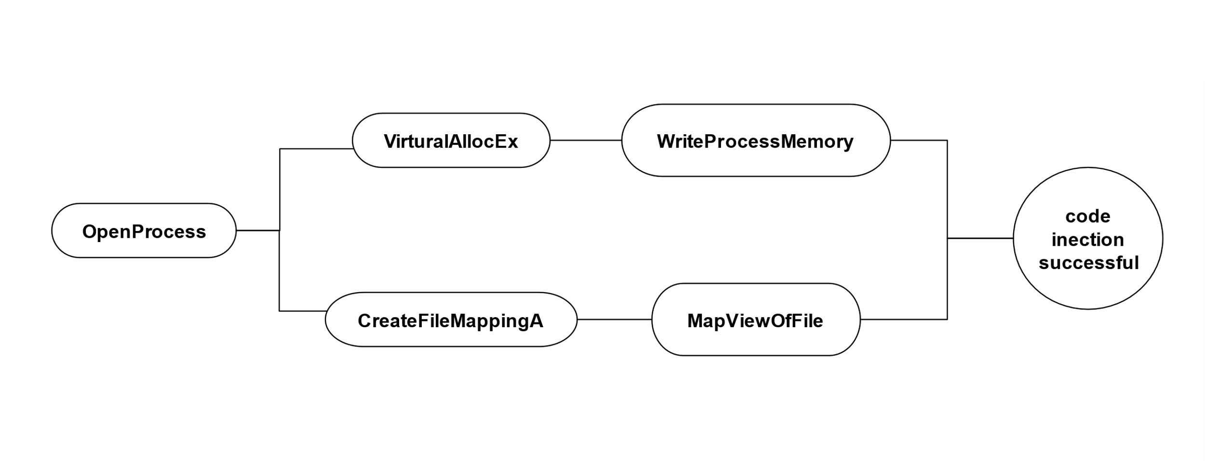
A Simplified Behavior Graph Extracted for Injection Stage
Notes:
specifically including randomly inserting branches within a basic block, reordering instructions, encrypting string variables, and dummy code insertion

Slide 45
Evaluation of In-Memory Attack Detection
Leverage existing tools of in-memory attacks. Specifically, select target processes, perform attacks, monitor before- and after- injection traces.
Overall dataset: 14 injection stage traces, 10 loader stage traces, 2222 other traces
Training set: 7 injection stage traces, 6 loader stage traces
Test set: 7 injection stage traces, 4 loader stage traces
TP:
  Injection stage: 6/7
  Loader stage: 4/4
FP: 0/2222
Notes:
specifically including randomly inserting branches within a basic block, reordering instructions, encrypting string variables, and dummy code insertion

Slide 46
Conclusions
We proposed a real-time, fine-grained, and situation-aware RAT detection approach.
With both third-party traces and various attacks evaluated, our approach has demonstrated very high accuracy in real-time.
Notes:
Fine-Grained, Evasion-Resilient and Real-time RAT Detection

