Slide 1
Virtual Browser: a Virtualized Browser to Sandbox Third-party JavaScripts with Enhanced Security
Yinzhi Cao, Zhichun Li*, Vaibhav Rastogi, Yan Chen, and Xitao Wen
Labs of Internet Security and Technology
Northwestern University
*NEC Labs America

Slide 2
Outline
Introduction
Related Work
Design
Security Analysis
Evaluation
Conclusions

Slide 3
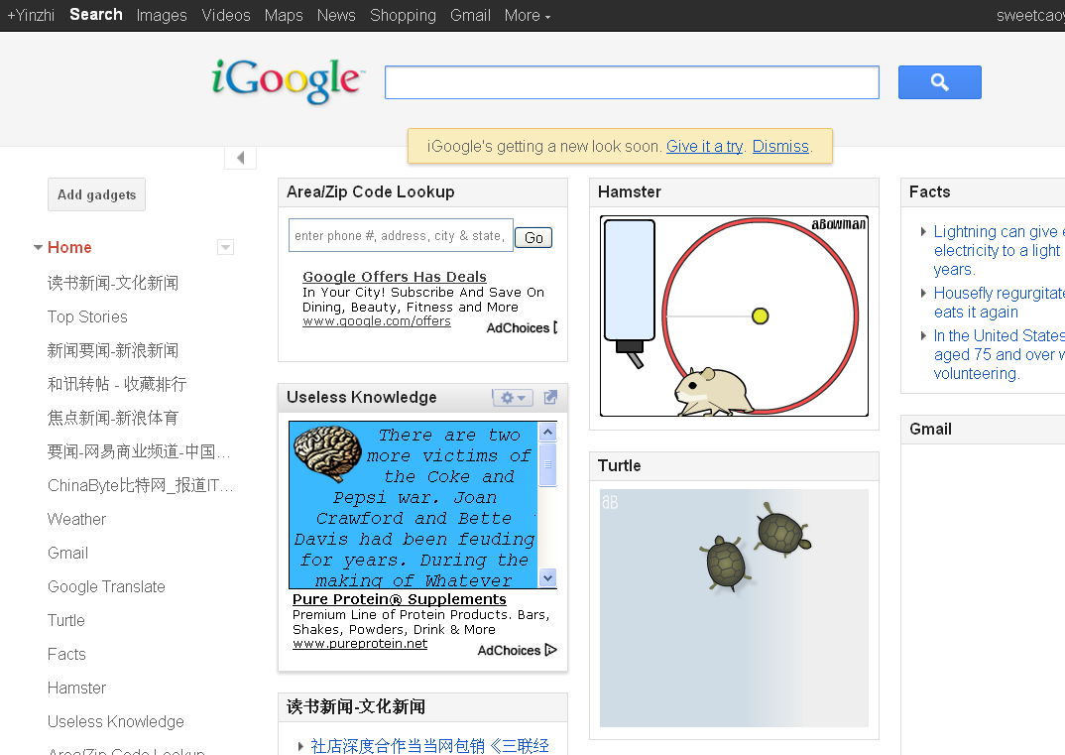
Introduction
Third-party JavaScripts are popular.
Web Mashups
Third-party Games
Widgets
Visitor Counters
However, they share the same privilege as host web site, and thus
They can sabotage host web site.
They can exploit client browsers.
So we propose: Virtual Browser, a virtualized browser built upon native browsers.

Slide 4
Outline
Introduction
Related Work
Design
Security Analysis
Evaluation
Conclusions

Slide 5
Related Work
JavaScript level approaches
Static methods (ADSafe, FBJS, CoreScript, and Maffeis et al.)
Runtime Approaches (Microsoft Web Sandbox, and Google Caja)
Mixed Approaches (GateKeeper, Huang et al.)
Native approaches
Browser modification (ConScript, MashupOS and WebJail)
Approaches using NaCl (AdSentry)
Approaches using iframes (AdJail and SMash)

Slide 6
JavaScript level approaches
No dynamic JavaScript feature support (eval and with)
Vulnerable to drive-by-download (especially unknown attacks)
Vulnerable to browser quirks
Undocumented HTML/JavaScript parsing behavior such as <scri\npt> is parsed as <script>

Slide 7
Native approaches
Modification to browsers.
Many are vulnerable to drive-by-download attacks.

Slide 8
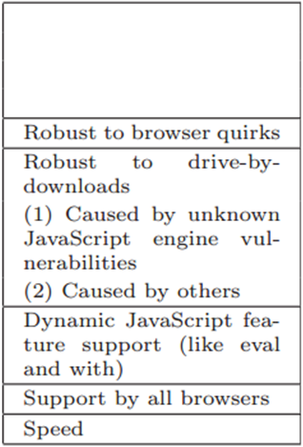

Slide 10
Therefore we propose:
An approach that is (your take-away)
Robust to drive-by-download
Support dynamic JavaScript features
Supported by all the browsers
Robust to browser quirks
Virtual Browser

Slide 11
Outline
Introduction
Related Work
Design
Security Analysis
Evaluation
Conclusions

Slide 12
System Architecture

Slide 13
System Architecture

Slide 14
System Architecture
Only one parser: mitigating quirks

Slide 15
System Architecture

Slide 16
System Architecture

Slide 17
System Architecture

Slide 18
System Architecture

Slide 19
System Architecture

Slide 20
System Architecture

Slide 21
System Architecture

Slide 22
System Architecture

Slide 23
System Architecture
All written in JavaScript: supported by all browsers

Slide 24
System Architecture
Virtualization: Robust to drive-by-download

Slide 25
An Example
How to support dynamic features?

Slide 26
An Example

Slide 27
An Example

Slide 28
An Example

Slide 29
An Example

Slide 30
An Example

Slide 31
An Example

Slide 32
Outline
Introduction
Related Work
Design
Security Analysis
Evaluation
Conclusions

Slide 33
Security Analysis
Isolating third-party JavaScript through Avoidance
Cutting off Outflows of Virtual Browser
Cutting off Inflows of Virtual Browser
Communication between third-party JavaScript and trusted JavaScript
Data Security
Script Security
Securing Data Flows in Virtual Browser

Slide 34
Isolation through Avoidance
Cutting off Outflows of Virtual Browser
We ensure third-party codes are trapped inside Virtual Browser.
An assumption: Any JavaScript code has to be parsed in the native JavaScript parsers before it can be executed in native browser.
(1) Look up Manuals
(2) Call Graph Analysis

Slide 35
Cutting off Outflows
Cutting off Outflows of Virtual JavaScript Engine
Only eval and new Function will cause native parsing.
Call graph analysis also shows that.
Cutting off Outflows of Virtual HTML and CSS parser :Similar
So we avoid using eval and new Function in Virtual Browser source codes.

Slide 36
Cutting of Inflows
Anonymous Object Encapsulation
(function(){
this.evaluate= function () {
codes
}
other codes
})
();

Slide 37
Communication through Redirection
Data Security
General Data Security
Mirrored Object
Access Control
Such as Object Views
function String(s) {
s = arguments.length ? "" + s : "";
if (this instanceof String){
this.value = s;
return this;
}
return s;
}

Slide 38
Communication through Redirection
Data Security
Script Security
Determined Scripts
Scripts that need immediate execution. (evaluate it)
Scripts that need delayed execution. (such as setTimeout)
Pseudo-function Pointer
setTimeout(function(){
execute(parsed node, exe context)
}
,100)

Slide 39
Communication through Redirection
Data Security
Script Security
Undetermined Script
Privilege escalation may happen.
We are on par with existing solutions.
As shown by Finifter et al., we need to adopt narrow interface.

Slide 40
Securing Data Flows

Slide 41
Securing Data Flows
Redirect them back to virtual engine
document.write
eval

Slide 42
Securing Data Flows
Prevented by encapsulation

Slide 43
Securing Data Flows
Privilege escalation: we are on par with existing solutions.

Slide 44
Securing Data Flows

Slide 45
Similar analysis can be applied to virtual CSS parser and HTML parser.

Slide 46
Outline
Introduction
Related Work
Design
Security Analysis
Evaluation
Conclusions

Slide 47
Evaluation
Performance Evaluation
Speed
Memory Usage
Parsing Latency
Browser Quirk Compatibility
Robustness to Unknown JavaScript Vulnerability
Completeness of Implementation

Slide 48
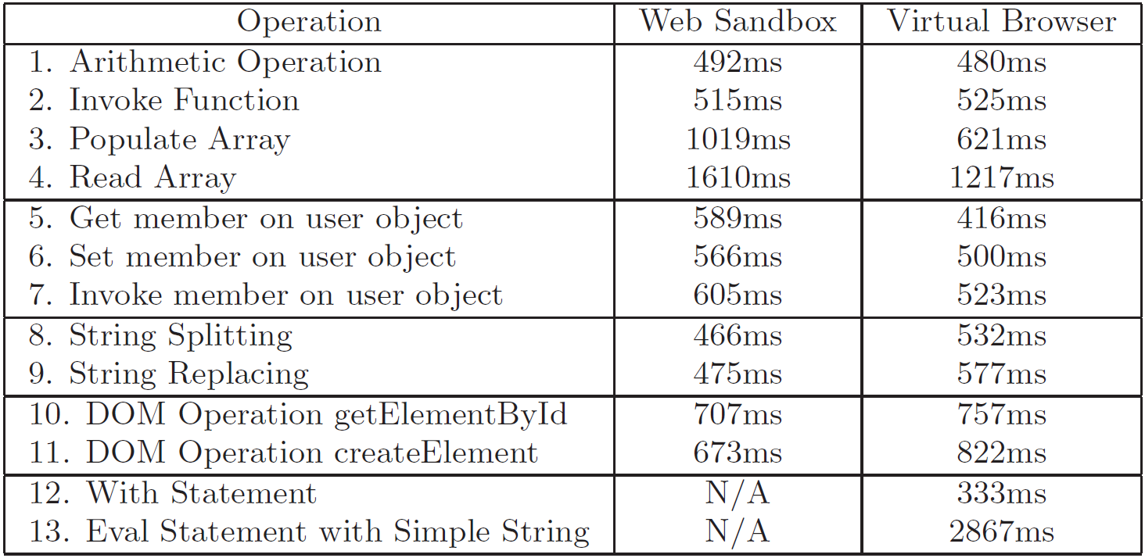
Performance
On par with Web Sandbox.
Micro-benchmark

Slide 49
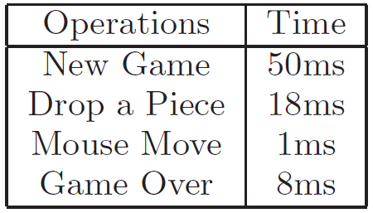
Performance
Macro-benchmark (Game: Connect Four)

Slide 50
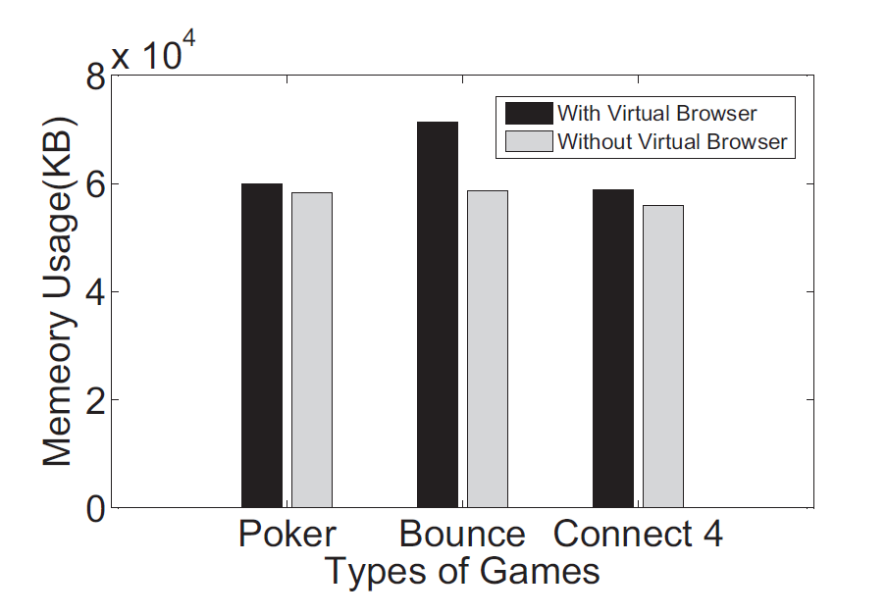
Memory Usage

Slide 51
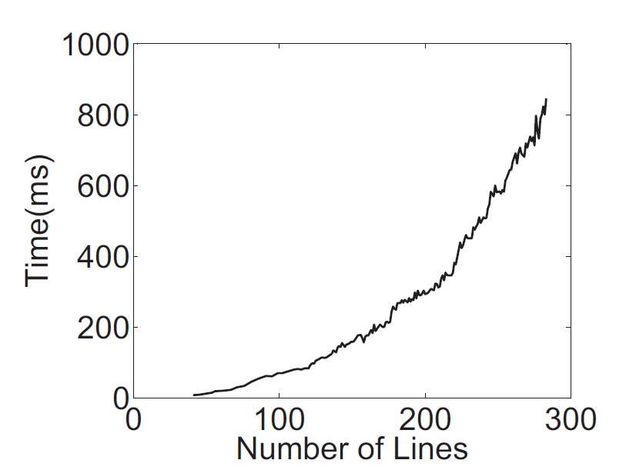
Parsing Latency (JavaScript)

Slide 52
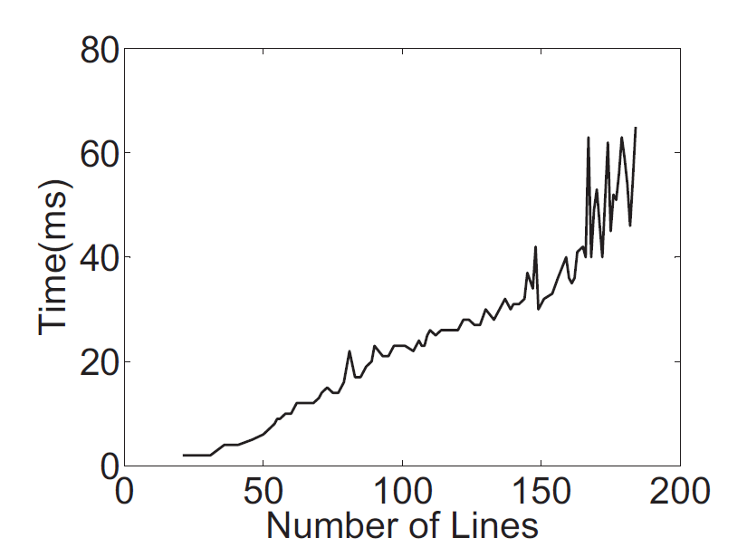
Parsing Latency (HTML)

Slide 53
Evaluation
Robust to Browser Quirk
Robust to 113 browser quirks in XSS cheat sheet
Robust to Unknown JavaScript Vulnerabilities
Robust to 14 JavaScript engine vulnerabilities in CVE
Completeness of Implementation
Pass 96% test cases of ECMA-262 Edition 1 from Mozilla

Slide 54
Discussion
Speed – Slow
Yes. However, latency is acceptable.
JavaScript engine is becoming faster and faster
How do we deal with vulnerability of virtual engine?
Type safe language
Virtual engine adds another layer that make sure security. (Similar to Virtual Machine)

Slide 55
Outline
Introduction
Related Work
Design
Security Analysis
Evaluation
Conclusions

Slide 56
Conclusion
We build Virtual Browser, a virtualized browser upon native browsers.
We are
Robust to browser quirks.
Robust to drive-by-download.
Supported by all current browsers.
Support dynamic JavaScript features
And Slow – Yes, we are ☺

Slide 57
Thanks ☺
Any Questions?

