Slide 1
AutoCog: Measuring the Description-to-permission Fidelity in Android Applications
Zhengyang Qu¹, Vaibhav Rastogi¹, Xinyi Zhang^{1,2}, Yan Chen¹, Tiantian Zhu³, and Zhong Chen⁴
¹Northwestern University, IL, US,
²Fudan University, Shanghai, China,
³Zhejiang University, Hangzhou, China,
⁴Wind Mobile, Toronto, Canada
Notes:
She worked on this project mainly during her summer internship at northwestern university.

Slide 2
Outline
Problem Statement
Approach & Design
Evaluation
Conclusions

Slide 3
Outline
Problem Statement
Approach & Design
Evaluation
Conclusions

Slide 4
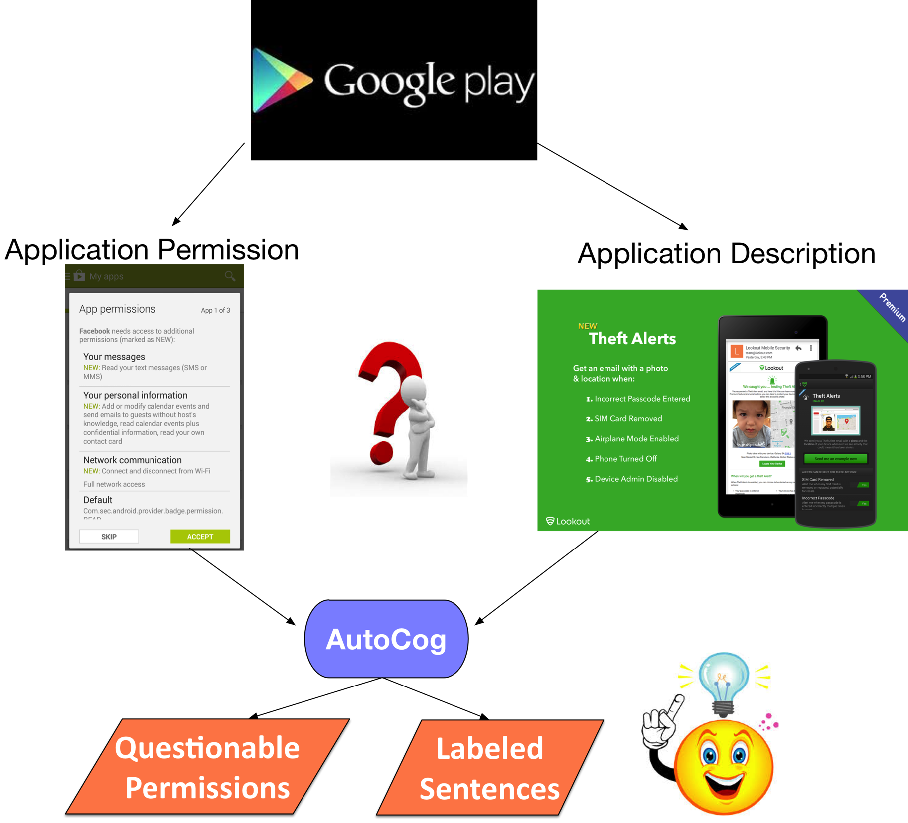
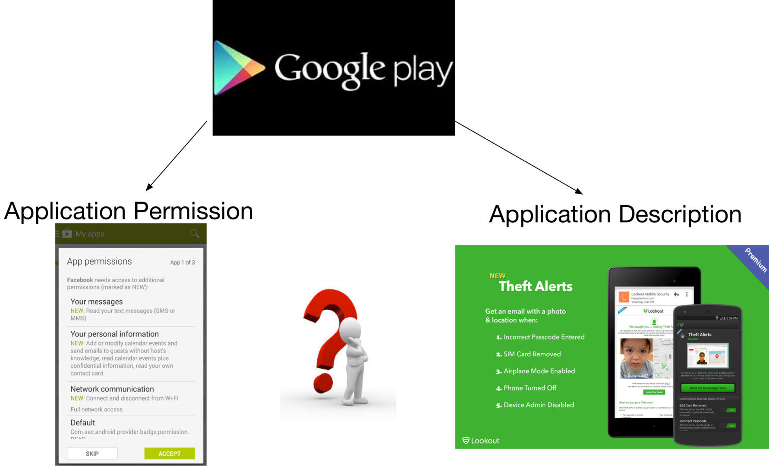
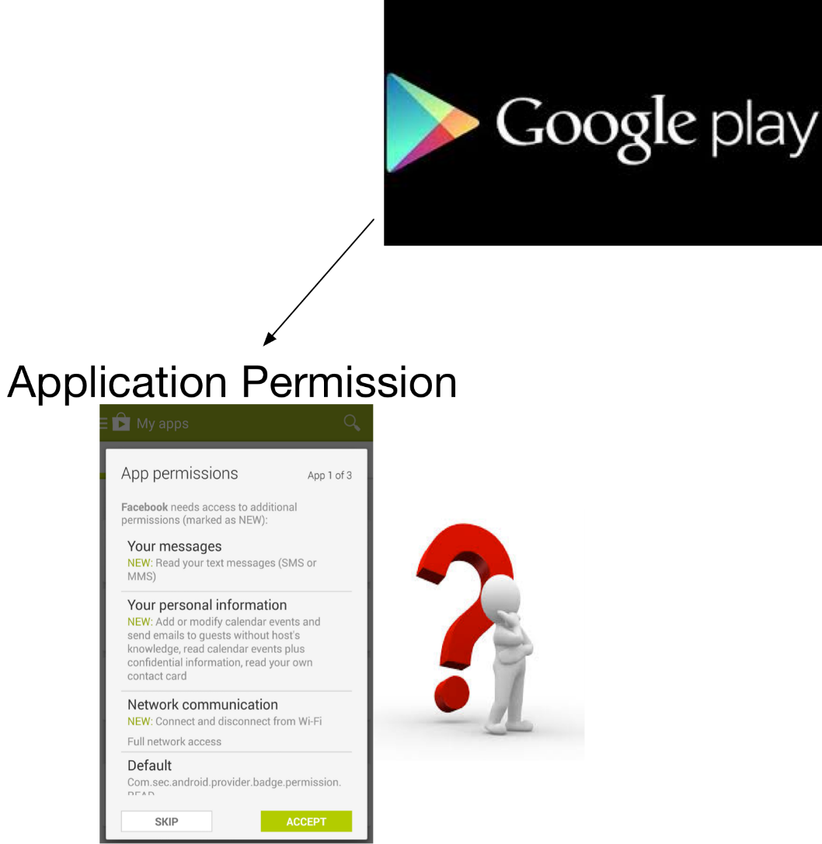
Motivations
Android Permission System
  Access control by permission system
  Few users can understand security implications from requested permissions
User expectation v.s. Application Behavior
  User expectation based on application description
  Permission defines application behavior
  Assess how well permission align with description
Notes:
Android is the most popular mobile operating system. The open nature bolster its market share. However, the open nature also employs some security issues.
User privacy access control by permission system
Few users are discreet enough or have the professional knowledge to understand security implications from requested permissions
Even from description, user do not know what to expect. Usability problem. AutoCog output questionable permissions and the sentences annotated the usage of other permissions to assist user to matching description to permission.

Slide 5
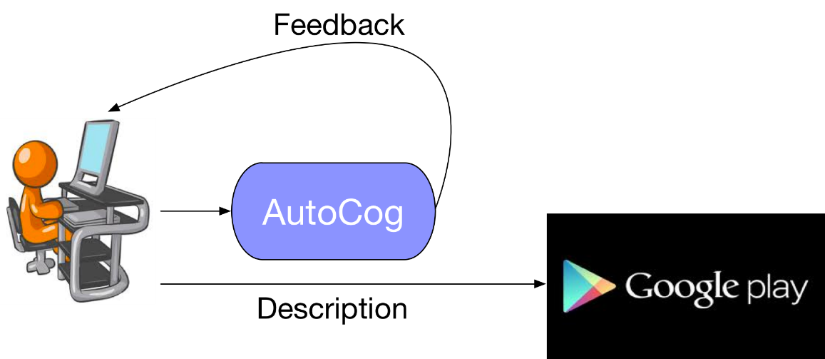
Desired Systems
Application developers
End users
Requirements:
  Rich semantic information
  Independent of
  external resource
  Automation
Notes:
Application developers use this tool to receive an early, automatic feedback on the quality of descriptions of stating the usage of permissions.
End users use this system to understand if an application is over-privileged and risky to use.
Great diversity of natural language, should have a good coverage on them.
Independent of external resource: availability of resource ,whether it is complete? Example, API document. Ours only requires the information from Google Play
Automation, is error-pron and inefficient if manual efforts is needed.

Slide 6
Challenge & Contributions
Inferring description semantics
  Similar meaning may be conveyed in a vast diversity of natural language text
  “friends”, “contact list”, “address book”
Correlating description semantics with permission semantics
  A number of functionalities described may map to the same permission
  “enable navigation”, “display map”, “find restaurant nearby”
  1. Leverage stat-of-the-art NLP techniques
  2. Design a learning-based algorithm
Notes:
In the domain of smartphone contact book.

Slide 7
System Prototype
Available on Google Play
  https://play.google.com/store/apps/details?id=com.version1.autocog

Slide 8
Outline
Problem Statement
Approach & Design
  Description Semantics (DS) Model
  Description-to-Permission Relatedness (DPR) Model
Evaluation
Conclusion

Slide 9
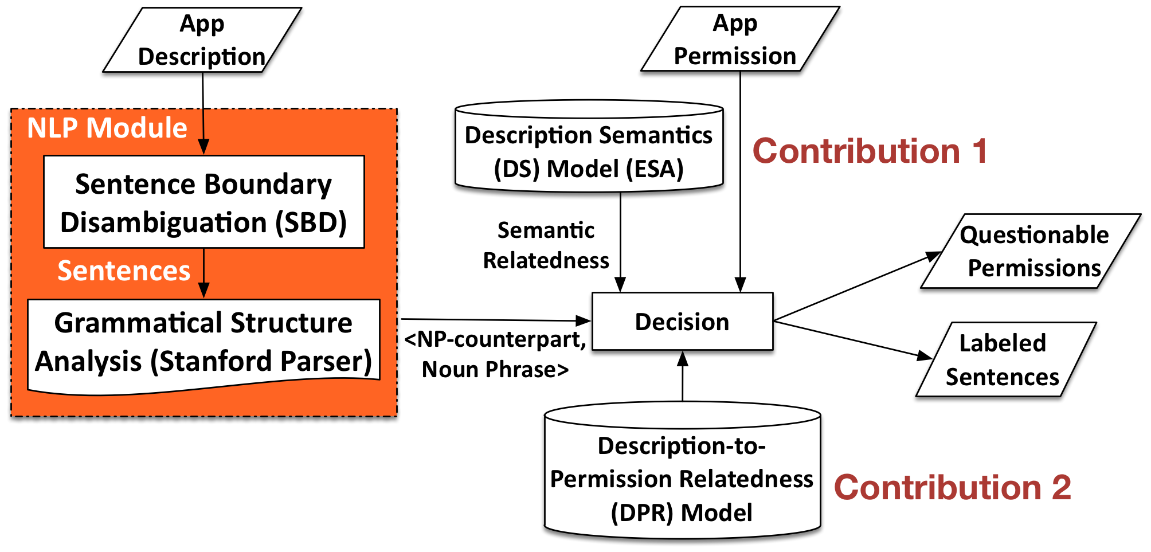
System Overview

Slide 10
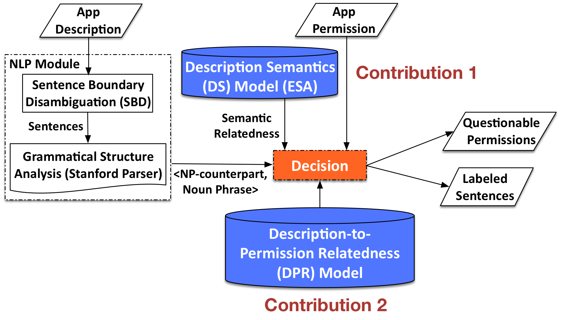
System Overview

Slide 11
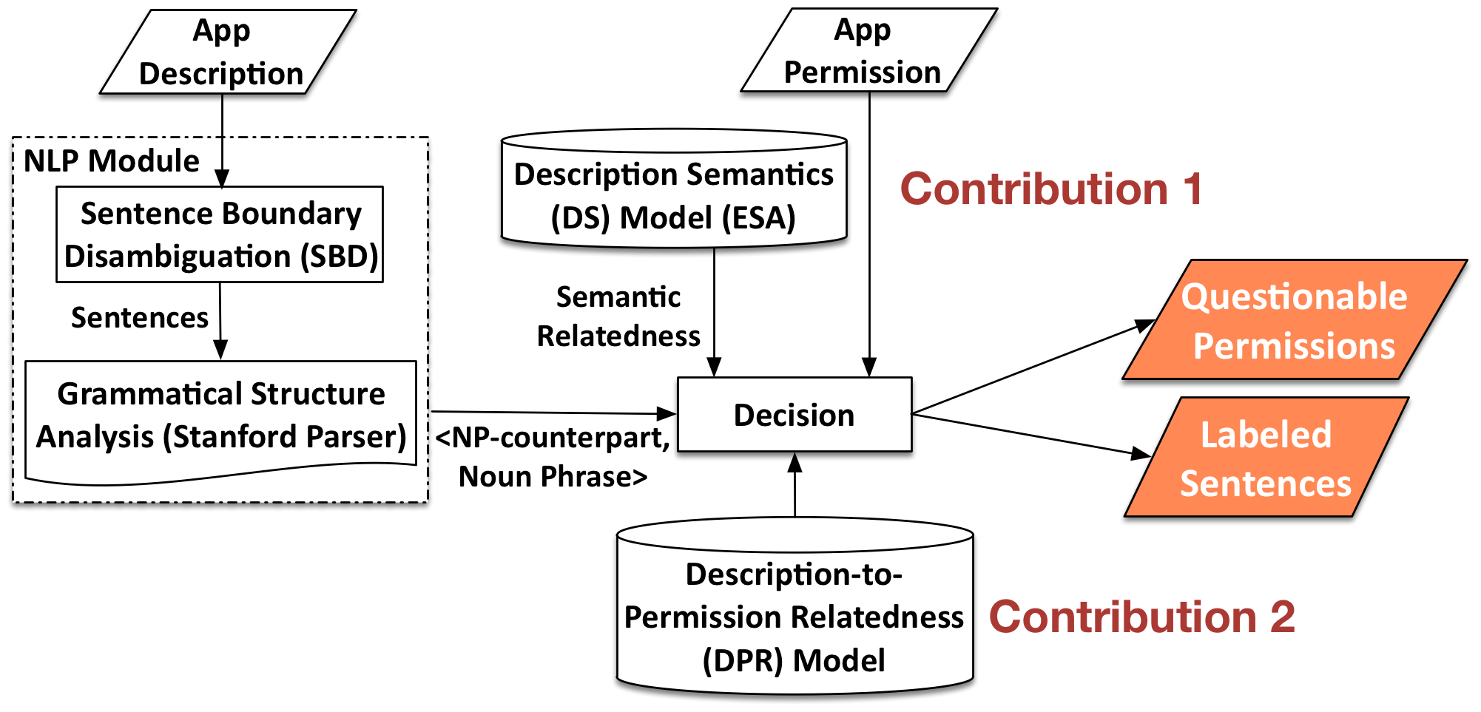
System Overview

Slide 12
Ontology modeling
Logical dependency between verb phrase and noun phrase
  <“scan”, “barcode”> for CAMERA, <“record”, “voice”> for RECORD_AUDIO
Logical dependency between noun phrases
  <“scanner”, “barcode”>, <“note”, “voice”>
Noun phrase with possessive
  <“your”, “camera”>, <“own”, “voice”>

Slide 13
Description Semantics Model (Contribution 1)
Extract Abstract Semantics
Explicit Semantic Analysis (ESA)
  Computing the semantic relatedness of texts
    Leverage a big document corpus (Wikipedia) as the knowledge base and constructs a vector representation
  Advantages:
    Rich semantic information, Quantitative representation of semantics
Notes:
Understand how different words and phrases in a vocabulary related to each other
Wikipedia, as the knowledge base on ESA is much richer than other created dictionary or database. Example, Google Map, social networking.
ESA offers a much more detailed and quantitative representation of semantics. It maps the meaning of words/phrases to a weighted combination of concepts, while mapping a word in WordNet amounts to simple lookup, without any weight

Slide 14
Description-to-Permission
Relatedness (DPR) Model (Contribution 2)
Learning-based method
  Input: application permission, application description
  Output: <np-counterpart, noun phrase> correlated with each sensitive permission
Notes:
To construct the DPR model : measure how closely a pair of noun phrase and np-counterpart related to permission, our learning-based algorithm is composed of three steps.
Input, output
3 stages

Slide 15
Samples in DPR Model
Permission | Semantic Patterns
WRITE_EXTERNAL_STORAGE | <delete, audio file>, <convert, file format>
ACCESS_FINE_LOCATION | <display, map>, <find, branch atm>, <your location>
ACCESS_COARSE_LOCATION | <set, gps navigation>, <remember, location>
GET_ACCOUNTS | <manage, account>, <integrate, facebook>
RECEIVE_BOOT_COMPLETED | <change, hd paper>, <display, notification>
CAMERA | <deposit, check>, <scanner, barcode>, <snap, photo>
READ_CONTACTS | <block, text message>, <beat, facebook friend>
RECORD_AUDIO | <send, voice message>, <note, voice>
WRITE_SETTINGS | <set, ringtone>, <enable, flight mode>
WRITE_CONTACTS | <wipe, contact list>, <secure, text message>
READ_CALENDAR | <optimize, time>, <synchronize, calendar>

Slide 16
Learning Algorithm for DPR
S1: Grouping noun phrases
  Create semantic relatedness score matrix
  <“map”, [(“map”, 1.00), (“map view”, 0.96), (“interactive map”, 0.89), …]>
S2: Selecting Noun Phrases Correlated with Permissions
  Not biased to frequently occurring noun phrases
  Jointly consider conditional probabilities:
  P(perm | np) and P(np | perm)
Notes:
Create semantic relatedness score matrix for high-frequency noun phrase
High frequency noun phrase: present in the number of application description above the threshold
As the small number of samples cannot provide enough condence in our frequency-based measurement. If a low-frequency phrase is similar to a high-frequency phrase, our decision process will not be affected as the decision module employs DS model.

Slide 17
Learning Algorithm for DPR(cont’d)
S3: Pairing np-counterpart with Noun Phrase
  “Retrieve Running Apps permission is required because, if the user is not looking at the widget actively (for e.g. he might using another app like Google Maps)”
Notes:
To explore the context and semantic dependencies
Read the whole sentence here

Slide 18
Outline
Problem Statement
Approach & Design
Evaluation
Conclusions

Slide 19
Evaluation
Training set: 36,060 applications
Validation set: 1,785 applications (150-200 for each permissions), 11 sensitive permissions
Notes:
We ask human readers to annotate these sentences. When AutoCog aligns with human readers decide a permission if true positive. Similarly, is fp, fn, tn.

Slide 20
Closely Related Work
Whyper, Pandita et al., USENIX Security 2013
  Leverages API documentation to generate a semantics model
  APIs are mapped to permissions using PScout
Limitations
  Limited semantic information
    “Blow into the mic to extinguish the flame…” for RECORD_AUDIO permission not in API document
  Lack of associated APIs
    RECEIVE_BOOT_COMPLETED has no associated APIs
  Lack of automation
Notes:
Use API document to pickup resource names and actions to construct the semantic engine
For the mobile banking requesting CAMERA permission, it supports deposits checking by taking a photograph of the check、、
Whyper's extraction of patterns from API documents involved manual selection to preserve the quality of patterns; what policies could be used to automate this process in a systematic manner is an open question.
.

Slide 21
Accuracy Comparison
System | Precision (%) | Recall (%) | F-score (%) | Accuracy (%)
AutoCog | 92.6 | 92.0 | 92.3 | 93.2
Whyper | 85.5 | 66.5 | 74.8 | 79.9
Notes:
We run AutoCog and Whyper in parallel and evaluate how well they are aligning with human reader’s groundtruth.
Precision higher than whyper by 7 percentage.
Recall higher than whyper over 20 percentage.

Slide 22
Results
Case Studies:
  AutoCog TP/ Whyper FN:
    “Filter by contact, in/out SMS”, “5 calendar views”
  AutoCog TN/Whyper FP
    “Saving event attendance status now works on Android 4.0”
  AutoCog FN/Whyper TP
    “Ability to navigate to a Contact if that Contact has address”
  AutoCog FP/Whyper TN
    “Set recording as ringtone”
Latency: 4.5 s check an application
Notes:
To analyze in depth about the difference on the performance:
The difference in the fundamental method to find semantic patterns related to permissions, (2) we include the logical dependency between noun phrases as extra ontology. Whyper is limited by the use of a fixed and limited set of vocabularies derived from the Android API documents and their synonyms. Our correlation of permission with pairs of noun phrase and np-counterpart is based on clustering results from a large application dataset, which is much richer than that extracted from API documents.
One major reason for this difference in detection is that Whyper is not able to accurately explore the meaning of noun phrase with multiple words
In the training process, some patterns may not be included in the training set and not be able to be related in semantics by ESA
Some patterns dominant in statistics but not make sense to human could not be fully excluded by AutoCog, but whyper would not pick them up in the API document

Slide 23
Conclusions
AutoCog is a system to measure the description-to-permission fidelity
  Learning-based algorithm to generate DPR model, better accuracy performance, ability to extend over other permissions
Ongoing work
  Optimize the training algorithm to improve the scalability
  Simplify our semantics models

Slide 24
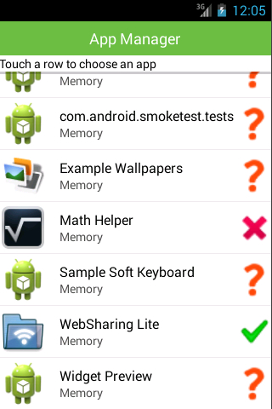
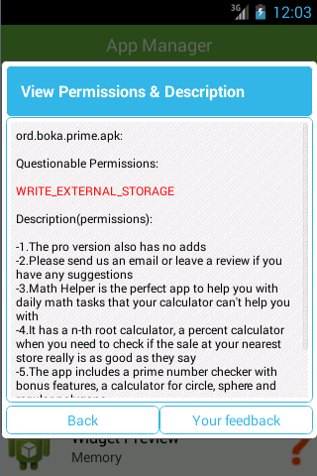
AutoCog App

Slide 25
Thank you!
Questions?
http://list.cs.northwestern.edu/mobile/

Slide 26
NLP Module
Sentence boundary disambiguation (SBD)
  Description is split into sentences for subsequent sentence structure analysis (Stanford Parser)
Grammatical structure analysis
  Stanford Parser outputs typed dependencies and PoS tagging of each word
  Extract pairs of noun phrase and np-counterpart
  Remove stopwords and named entities; Normalized by lowercasing and lemmatization
Notes:
Characters such as period, comma, and some others like star that may start bullet points are treated as sentence separators. Regular expressions are used to annotate email addresses, URLs, IP addresses, Phone numbers, decimal numbers, abbreviations, and ellipses, which interfere with SBD as they contain the sentence separator characters.
PoS part of speech tagging

Slide 27
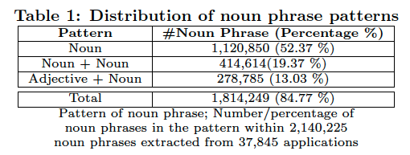
Description-to-Permission
Relatedness (DPR) Model (Contribution 2)
Notes:
To construct the DPR model : measure how closely a pair of noun phrase and np-counterpart related to permission, our learning-based algorithm is composed of three steps.
3 stages

Slide 28
Decision
Extract all pairs of noun phrase and np-counterpart
Condition:
Notes:
Here, gamma and theta are the thresholds of the semantic relatedness score for np-counterparts and noun phrases. The sentences indicating permissions will be annotated. Besides, AutoCog finds all the questionable permissions, which are not warranted in description.

Slide 29
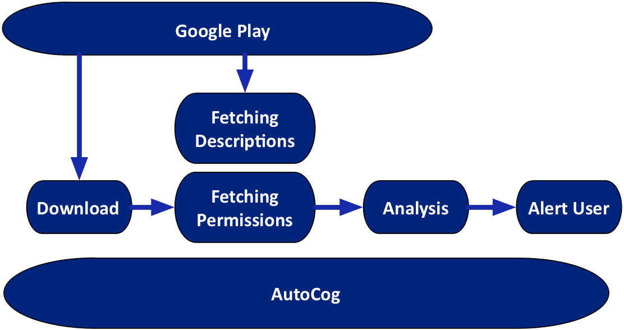
Deployment
Notes:
Blue color

Slide 30
DPR Model (cont’d)
Pairing np-counterpart with Noun Phrase
  To explore the context and semantic dependencies
  SP: total number of descriptions where the pair <nc, np’> is detected, the number of application requesting the permission is

Slide 31
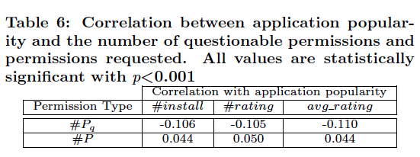
Measurement Results
Another 45,811 applications, DPR model trained in accuracy evaluation
Negative correlation between the number of questionable permissions of one application by a specific developer with the total number of applications published by that developer:
r = -0.405, p < 0.001
Notes:
Only 9.1% of applications are clear of question- able permissions.

Slide 32
Backup

Slide 33
Back up

