Slide 1
Constraint propagation is your friend Ian Horswill and Leif Foged Northwestern University

Slide 2
Constraint programming
Declarative programming technique
For configuration problems
Choices (variables)
Requirements (constraints)
Find choices that satisfy requirements

Slide 3
Take-home messages
Constraint programming can be fast
It can solve useful problems
It’s not mysterious rocket science
You can implement it in a weekend
Relatively designer friendly

Slide 4
Simple example: level population
Placing items and enemies (e.g. for roguelikes)
One variable for each room
Possible values
Enemies (zombie, ghost, etc.)
Resources (ammo, health)
Keys and locks
Boss

Slide 5
Common constraints
There should be one boss
One variable should have the value “boss”, but I don’t care which one
There should be 5-10 enemies
Again, don’t care where

Slide 6
Common constraints
There should be enough bullets
#enemies < k×#ammo
Adjust k to taste
There shouldn’t be too many bullets
Change < to >

Slide 7
Shigi lite™

Slide 8
Quick example
6 rooms
One variable per room
Values: health pack, enemy, ammo, nothing
Constraints
1 health pack
At least 1 enemy
As many ammo packs as enemies

Slide 9
Solving it
Enemy
Health
Ammo
Nothing
Enemy
Health
Ammo
Nothing
Enemy
Health
Ammo
Nothing
Assume any room
can have any value
Enemy
Health
Ammo
Nothing
Enemy
Health
Ammo
Nothing
Enemy
Health
Ammo
Nothing
Constraints
1 health pack
At least 1 enemy
#ammo = #enemies

Slide 10
Solving it
Enemy
Health
Ammo
Nothing
Enemy
Health
Ammo
Nothing
Enemy
Health
Ammo
Nothing
Pick a room
Enemy
Health
Ammo
Nothing
Enemy
Health
Ammo
Nothing
Enemy
Health
Ammo
Nothing
Constraints
1 health pack
At least 1 enemy
#ammo = #enemies

Slide 11
Solving it
Enemy
Health
Ammo
Nothing
Enemy
Health
Ammo
Nothing
Enemy
Health
Ammo
Nothing
Pick a value (cross off other values)
Enemy
Health
Ammo
Nothing
Enemy
Health
Ammo
Nothing
Enemy
Health
Ammo
Nothing
Constraints
1 health pack
At least 1 enemy
#ammo = #enemies

Slide 12
Solving it
Enemy
Health
Ammo
Nothing
Enemy
Health
Ammo
Nothing
Enemy
Health
Ammo
Nothing
No other room can
have a health pack (cross off health)
Enemy
Health
Ammo
Nothing
Enemy
Health
Ammo
Nothing
Enemy
Health
Ammo
Nothing
Constraints
1 health pack
At least 1 enemy
#ammo = #enemies

Slide 13
Solving it
Enemy
Health
Ammo
Nothing
Enemy
Health
Ammo
Nothing
Enemy
Health
Ammo
Nothing
Pick another room
Enemy
Health
Ammo
Nothing
Enemy
Health
Ammo
Nothing
Enemy
Health
Ammo
Nothing
Constraints
1 health pack
At least 1 enemy
#ammo = #enemies

Slide 14
Solving it
Enemy
Health
Ammo
Nothing
Enemy
Health
Ammo
Nothing
Enemy
Health
Ammo
Nothing
Pick a value
Enemy
Health
Ammo
Nothing
Enemy
Health
Ammo
Nothing
Enemy
Health
Ammo
Nothing
Constraints
1 health pack
At least 1 enemy
#ammo = #enemies

Slide 15
Solving it
Enemy
Health
Ammo
Nothing
Enemy
Health
Ammo
Nothing
Enemy
Health
Ammo
Nothing
Pick another room
Enemy
Health
Ammo
Nothing
Enemy
Health
Ammo
Nothing
Enemy
Health
Ammo
Nothing
Constraints
1 health pack
At least 1 enemy
#ammo = #enemies

Slide 16
Solving it
Enemy
Health
Ammo
Nothing
Enemy
Health
Ammo
Nothing
Enemy
Health
Ammo
Nothing
Pick a value
Enemy
Health
Ammo
Nothing
Enemy
Health
Ammo
Nothing
Enemy
Health
Ammo
Nothing
Constraints
1 health pack
At least 1 enemy
#ammo = #enemies

Slide 17
Solving it
Enemy
Health
Ammo
Nothing
Enemy
Health
Ammo
Nothing
Enemy
Health
Ammo
Nothing
Pick another room
Enemy
Health
Ammo
Nothing
Enemy
Health
Ammo
Nothing
Enemy
Health
Ammo
Nothing
Constraints
1 health pack
At least 1 enemy
#ammo = #enemies

Slide 18
Solving it
Enemy
Health
Ammo
Nothing
Enemy
Health
Ammo
Nothing
Enemy
Health
Ammo
Nothing
Pick a value
Enemy
Health
Ammo
Nothing
Enemy
Health
Ammo
Nothing
Enemy
Health
Ammo
Nothing
Constraints
1 health pack
At least 1 enemy
#ammo = #enemies

Slide 19
Solving it
Enemy
Health
Ammo
Nothing
Enemy
Health
Ammo
Nothing
Enemy
Health
Ammo
Nothing
Not enough rooms
left for more enemies (cross off enemy)
Enemy
Health
Ammo
Nothing
Enemy
Health
Ammo
Nothing
Enemy
Health
Ammo
Nothing
Constraints
1 health pack
At least 1 enemy
#ammo = #enemies

Slide 20
Solving it
Enemy
Health
Ammo
Nothing
Enemy
Health
Ammo
Nothing
Enemy
Health
Ammo
Nothing
Pick a room
Enemy
Health
Ammo
Nothing
Enemy
Health
Ammo
Nothing
Enemy
Health
Ammo
Nothing
Constraints
1 health pack
At least 1 enemy
#ammo = #enemies

Slide 21
Solving it
Enemy
Health
Ammo
Nothing
Enemy
Health
Ammo
Nothing
Enemy
Health
Ammo
Nothing
Pick a value
Enemy
Health
Ammo
Nothing
Enemy
Health
Ammo
Nothing
Enemy
Health
Ammo
Nothing
Constraints
1 health pack
At least 1 enemy
#ammo = #enemies

Slide 22
Solving it
Enemy
Health
Ammo
Nothing
Enemy
Health
Ammo
Nothing
Enemy
Health
Ammo
Nothing
Last room has to
be ammo
Enemy
Health
Ammo
Nothing
Enemy
Health
Ammo
Nothing
Enemy
Health
Ammo
Nothing
Constraints
1 health pack
At least 1 enemy
#ammo = #enemies

Slide 23
Solving it
Enemy
Health
Ammo
Nothing
Enemy
Health
Ammo
Nothing
Enemy
Health
Ammo
Nothing
Done
Enemy
Health
Ammo
Nothing
Enemy
Health
Ammo
Nothing
Enemy
Health
Ammo
Nothing
Constraints
1 health pack
At least 1 enemy
#ammo = #enemies

Slide 24
Constraint propagation (AC-3)
Track remaining values for variables
Repeat until all variables have 1 value
Pick a variable w/more than 1 value
Pick a value from its remaining values
Narrow values for other variables
No possible values remaining?
Then you picked wrong, backtrack

Slide 25
Wait! Room order matters!
Bad:
boss
weapon you need to kill boss
Good:
weapon you need to kill boss
boss

Slide 26
Constraints on resource availability
Add extra variable for each room
Resource acquired on path to room
Minus amount used on path to room
Handle forks/joins by taking min or max
This example: +1 for weapon, -1 for boss
Constraint: ≥0
This example: (weapon-boss)≥0

Slide 27
Boss with weapon availability
Weapon: -1
Weapon: 0
Bad:
boss
weapon you need to kill boss
Weapon: 1
Weapon: 0
Good:
weapon you need to kill boss
boss

Slide 28
This trick works for
Lock and key puzzles
Ensure key before lock
Health/ammo survivability
Ensure health/ammo is sufficient
Ensure health/ammo is in useful locations
Health/ammo difficulty
Ensure there isn’t too much health/ammo

Slide 29
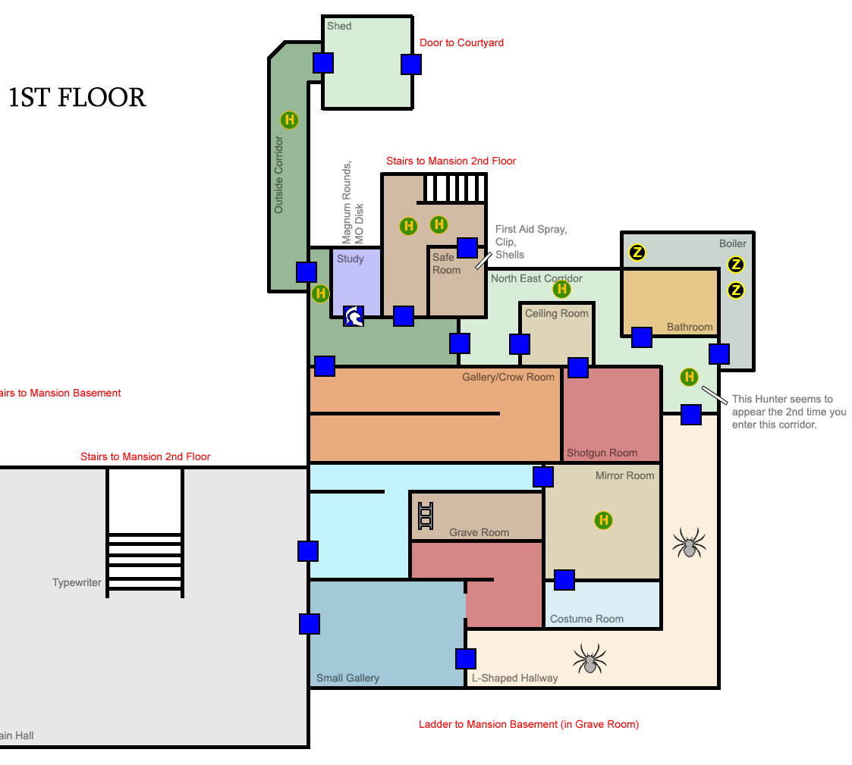
A more interesting level
Resident Evil 1F mansion west wing
17 rooms, 16 doors
Item/enemy placement
Health/ammo survivability

Slide 30
Speed (C# implementation)
Easy: minimal constraints (94μsec)
1-7 health packs, 1-5 zombies, 1-3 double zombies
Medium: cram stuff into limited rooms (900μsec)
1-40 HP, ammo, zombie & double zombie; 1-2 dogs, 1 trap
Hard: force exact numbers of items (8ms)
1-40 HP; exactly 3 ammo, 2 zombie, 2 double zombie, 1 trap; 1-2 dogs
1-5kW RAM for data structures and stack

Slide 31
Demo 1: This is fast

Slide 32
Model
15 rooms
15 variables
0 constraints
Avg. solve time: 15µs

Slide 33
Model
53 variables
36 constraints
Avg. solve time: 235µs

Slide 34
Model
170 variables
175 constraints
Avg. solve time: 1ms

Slide 35
Demo 2: You can give designers control

Slide 37
Dynamic difficulty
Pin the content the player has seen
Regenerate everything else to satisfy objectives

Slide 38
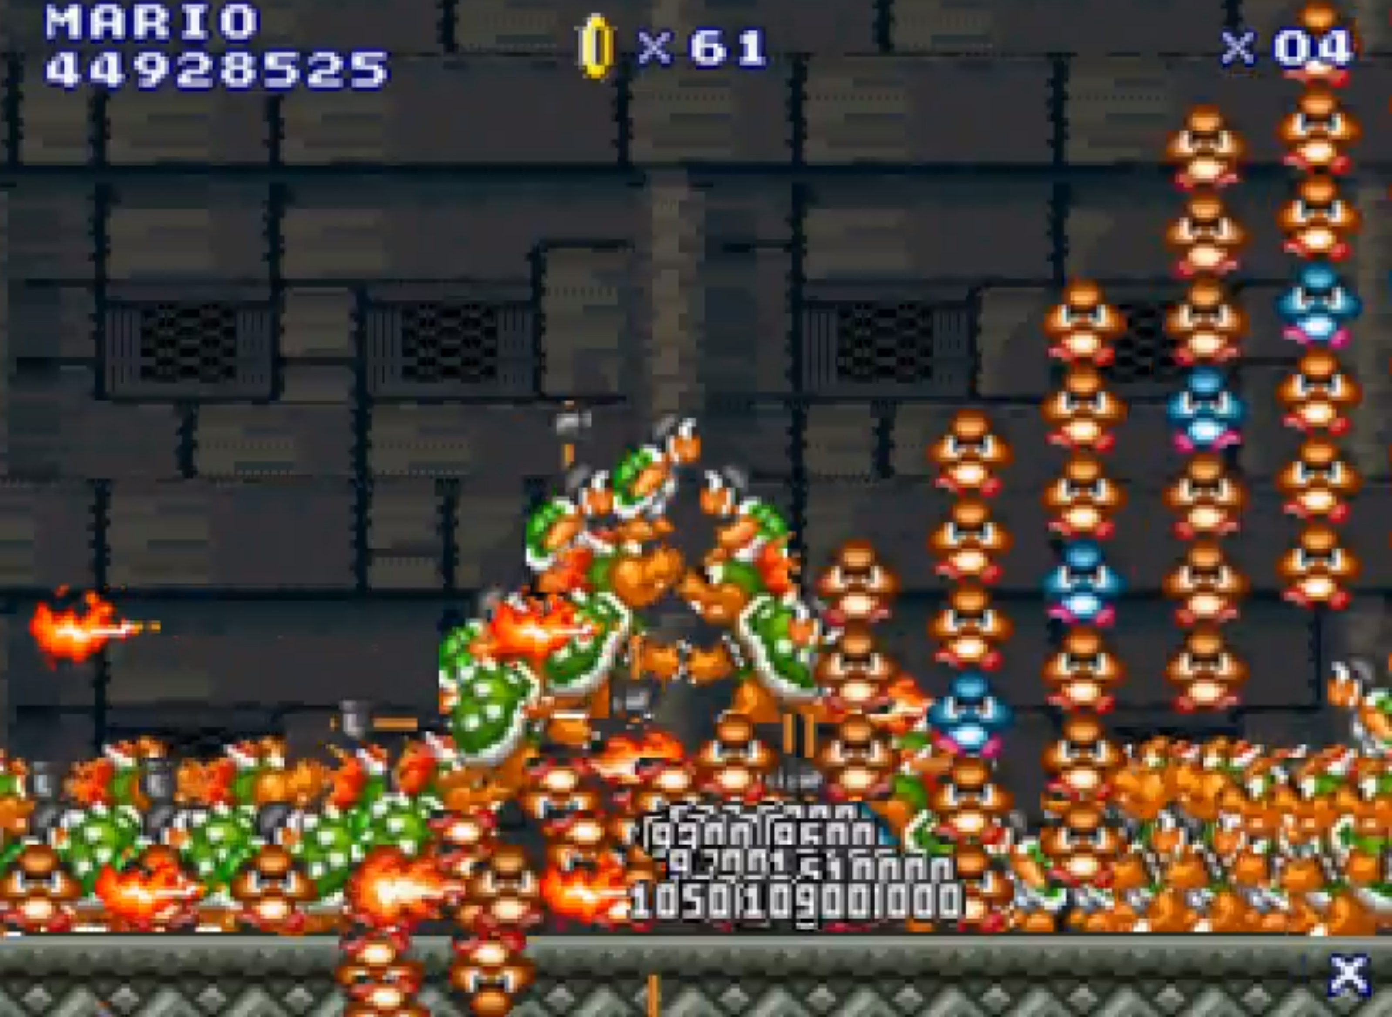
Design checkers/automators
See the work of Gillian Smith and Adam Smith for great examples!

Slide 39
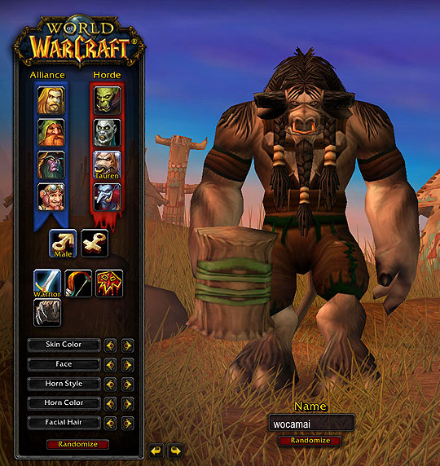
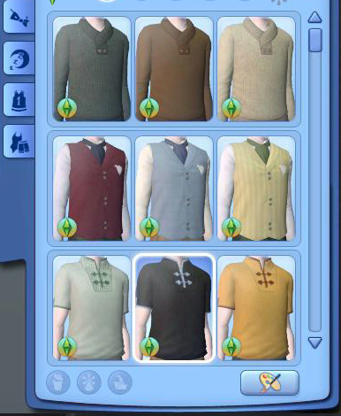
Build-a-bears

Slide 40
The catch
Easy CP problems run in linear time
E.g. lots of rooms, few objects and constraints
Lots and lots of solutions
System usually hits one on the first try
Hard ones run in exponential time
E.g. barely enough rooms, highly constrained
Very few solutions
System has to try all/most possible assignments

Slide 41
When should you use it?
When there are lots of solutions
You don’t care which you use
Want random choice for variety

Slide 42
Links
“How to build a constraint propagator in a weekend”:
bit.ly/constraints-how-to
Reference solver (C#): bit.ly/constraint-thingy
AIIDE paper: bit.ly/aiide-paper
Unity starter kit: bit.ly/angry-bots-constraint

