Slide 1


CSPAutoGen: Black-box Enforcement of Content Security Policy upon Real-world Websites
Xiang Pan¹, Yinzhi Cao², Shuangping Liu¹,
Yu Zhou¹, Yan Chen^{1,3}, Tingzhe Zhou²
1 Northwestern University, Illinois, USA
2 Lehigh University, Pennsylvania, USA
3 Zhejiang University, Zhejiang, China

Slide 2
RoadMap
CSP Background
Architecture
Design
  Template Mechanism
  Processing Scripts based on Templates
Evaluation
Conclusion

Slide 3
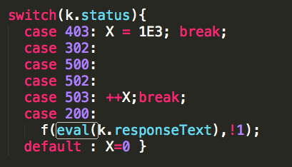
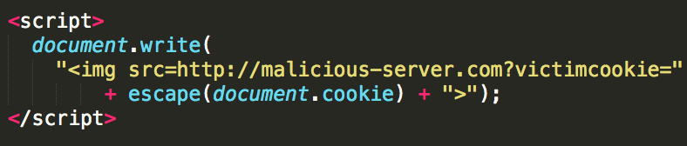
Content Security Policy (CSP)
Whitelist-based mechanism against XSS attacks.
Supported by all popular browsers.
CSP allows website developer to create a whitelist of sources of trusted content, and instructs the browser to only execute or render resources from those sources.
CSP disables eval and inline scripts by default.
  unsafe-inline
  unsafe-eval
Eval Script Example.
“UNSAFE”
Inline Script Example.

Slide 4
CSP Server Deployment Rate is Low
Website | Unsafe-inline | Unsafe-eval
facebook.com | Enabled | Enabled
twitter.com | Disabled | Enabled
yandex.ru | Enabled | Enabled
mail.ru | Enabled | Enabled
pinterest.com | Enabled | Enabled
alibaba.com | Enabled | Enabled
CSP deployment burden is high.
  Only 0.002% of Alexa Top 1M (20) websites enable CSP. [1]
  Only 0.00086% of 900,000 (8) least popular websites enable CSP. [1]
Few websites use CSP securely.
  Many specify “unsafe-inline” and “unsafe-eval”.
Alexa Top 50 Websites with CSP Deployed.
[1]. M. Weissbacher, T. Lauinger, and W. Robertson. Why is CSP Failing? Trends
and Challenges in CSP Adoption. In RAID. 2014.

Slide 5
Limitation of Existing Works
White-box approach: AutoCSP and deDacota.
  Require Server Modification.
Black-box approach: autoCSP.
  Serious compatibility issue.
All these works don’t support eval scripts and inline scripts generated during client-side execution.
  Sacrificing security or compatibility.

Slide 6
RoadMap
CSP Background
Architecture
Design
  Template Mechanism
  Processing Scripts based on Templates
Evaluation
Conclusion
Notes:
Keep within 5-6 min

Slide 7
Contributions
Black-box approach.
  No server modification.
  Support any server-side language.
Allow unseen, benign scripts.
Use CSP securely.
  Not specifying “unsafe-inline” or “unsafe-eval”.
Securely transform all types of JS to be CSP compatible.
  None of existing works can achieve that.
Notes:
Finer-grained

Slide 8
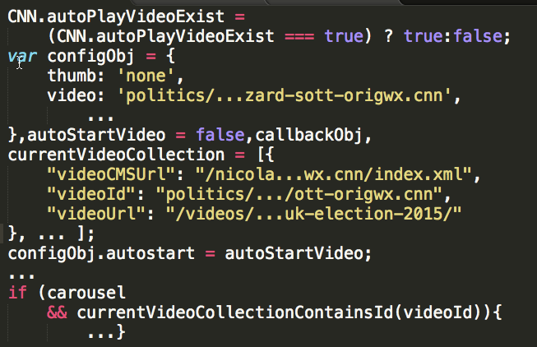
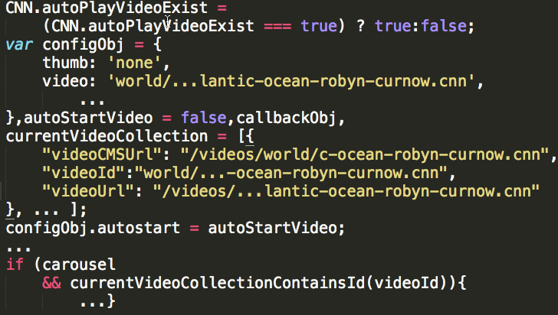
CSPAutoGen Core Idea
Code structures and logic are same.
Core Idea: build a template that infers scripts’ exact structures and types of contained data.
Data in the codes are different.
Notes:
for each website, it build templates that infer scripts structures and contained data's type, and then uses the templates to make CSP more infer-grained.

Slide 9



CSPAutoGen Architecture
Training
Phase:
Training templates.
Offline.
Rewriting Phase:
Rewrite webpage.
Inject CSP & library.
Web application firewall (WAF).
Runtime
Phase
Handle dynamic scripts.
Handle runtime-included scripts.
Browser.
Notes:
Should use less than 7 mins.
Needs to finish in 5 mins (arch part)

Slide 10
CSPAutoGen Architecture
(Training Phase)
URLs with various configures.
Inline &
dynamic
scripts
Template
Generator
Template DB
Headless
Browser
Cluster
Templates
cnn.com
External scripts
src attributes
Host
Whitelist
Generator
JS Host
Whitelist
Notes:
1

Slide 11



CSPAutoGen Architecture
(Rewriting & Runtime Phase)
1. DOM tree observer
2. Symbolic Template
Trusted Server
Template DB
New Page:
1. No inline scripts.
2. CSP.
3. Library.
Benign Inline to External Script
1. Templates
2. JS Host Whitelist
CSPAutoGen Policy
Applier Engine
Original
Webpage.
User
Web server
Client Side
Server Side
Notes:
Each site
1:40 without talking how to convert inline to external.
2:30

Slide 12
RoadMap
CSP Background
Architecture
Design
  Template Mechanism
  Processing Scripts based on Templates
Evaluation
Conclusion
Notes:
Make sure stop at 12min. Now 11:30
Design would take 8 mins
Evaluation+conclution: 5min

Slide 13
Design: Template Mechanism
/* Simplified Script */
AMPTManager.pageSlotsObj['ad_rect_btf_01'] =
fun.setTargeting('pos', ['rect_btf_01']);
AMPTManager.pageSlotsObj
['ad_rect_btf_01'] =
fun.setTargeting('pos', ['rect_btf_01']);
AMPTManager.pageSlotsObj
['ad_rect_btf_03'] =
fun.setTargeting('pos', ['rect_btf_03']);
Generalized AST
Notes:
Total 3:00

Slide 14
Design: Type System
AMPTManager.pageSlotsObj
['ad_rect_btf_01'] =
fun.setTargeting('pos', ['rect_btf_01']);
…
AMPTManager.pageSlotsObj
['ad_rect_btf_03'] =
fun.setTargeting('pos', ['rect_btf_03']);
The template mechanism (gAST) satisfies high matching rate, but might be abused by attackers.
CSPAutoGen Template Mechanism
=
gAST + Type System
Type:
  CONST
  NUMBER
  ENUM
  URL
  REGEXP
  GAST
[ad_rect_btf_01,
ad_rect_btf_03,
ad_rect_btf_03,
ad_rect_btf_03,
…
ad_rect_btf_01]
[pos, pos,
pos, pos,
…, pos]

Slide 15
Design: Script Processing
JavaScript Category Modifiers:
  Inline vs External.
  Runtime-included vs Pre-included.
  Dynamic.
Any JavaScript can be described using one or more modifiers.
Pre-included, runtime-included external script.
Pre-included, Runtime-included inline script.
Dynamic script.
Notes:
5

Slide 16
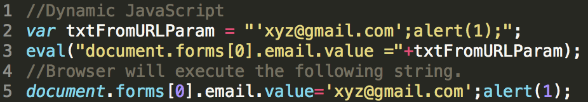
Design: Dynamics Scripts
Eval and Eval-like functions:
eval, setTimeout, setInteval and Function
Core Idea: we know benign dynamic scripts’ structures, so we can define all allowed script structures as functions and data node as functions’ parameters (symbolic template).

Slide 17
eval( "AMPTManager.pageSlotsObj[’ad_ns_btf_01’] =
googletag.defineSlot(’/8663477/CNN/world/leaf’,
[[1 ,2] ,[150 ,90] ,[300 ,50] ,[300 ,100]] , ’ad_ns_btf_01 ’).
addService(googletag.pubads()).
setTargeting(’pos’, [’ns_btf_01 ’]);");
//convert gAST to JavaScript.
AMPTManager.pageSlotsObj[CSP_String] =
googletag.defineSlot(CSP_String , CSP_Array , CSP_String).
addService(googletag.pubads()).
setTargeting(CSP_String , CSP_Array);
//Symbolic template function for the gAST.
var symTemplate = function ( CSP_S1 ,CSP_S2 ,CSP_A3 ,CSP_S4 ,CSP_S5 ,CSP_A6) {
AMPTManager.pageSlotsObj[ calcNodeVal(CSP_S1) ] =
googletag.defineSlot(
calcNodeVal(CSP_S2), calcNodeVal(CSP_A3), calcNodeVal(CSP_S4) ).
addService(googletag.pubads()).
setTargeting(calcNodeVal(CSP_S5), calcNodeVal(CSP_A6)); };

Slide 18
Design: Dynamics Scripts (Cont.)
1. Rewrite eval and eval-like functions.
  E.g., window.eval = function(arg) {}.
  The rewritten eval function is allowed by CSP.
2. In rewritten eval function, we match the argument against the templates.
  If not matched, do nothing.
  If matched, we instantiate the symbolic template function to execute the argument as JavaScript.

Slide 19
RoadMap
CSP Background
Architecture
Design
  Template Mechanism
  Processing Scripts based on Templates
Evaluation
Conclusion

Slide 20
Evaluation:
Robustness on Unseen Webpages
Training Page : 2,000
Testing Page : 500
Template # : 262
Matching Rate:
91.6% - 100%
Median: :99.2%
Median: 99.2%

Slide 21
Evaluation:
Robustness Over Time.
Domain | # of Templates (01/01/16) | MR (02/01/16) | MR (03/01/16) | MR (04/01/16)
Amazon | 596 | 99.62% | 99.13% | 98.39%
CNN | 259 | 98.72% | 98.50% | 98.30%
Facebook | 53 | 99.47% | 97.90% | 95.98%
Google | 857 | 97.89% | 94.13% | 87.14%
Reddit | 49 | 97.47% | 97.01% | 89.78%
Yahoo | 295 | 99.30% | 99.05% | 94.01%
Real-word Websites
# of Training Page: 2000, # of Testing page: 2000

Slide 22
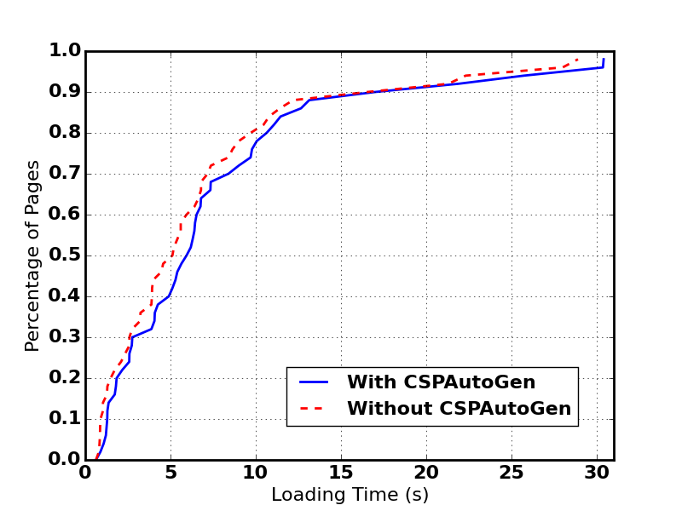
Evaluation:
Performance Overhead
Can be optimized.
Source | Min (ms) | Median (ms) | Max (ms)
DOM Tree Parsing | 1.97 | 112.62 | 1349.0
Script Transmission | 23 | 51 | 332
gAST Building | ~0 | 0.2 | 33
Template Matching | ~0 | 0.1 | 0.5
Runtime-included Script | 9 | 107 | 1419
Dynamic script | ~0 | 9 | 64
Alexa Top 50 websites.
  Median: 470ms, 9.1%.
Running asynchronously.
The Breakdown of CSPAutoGen Latency.

Slide 23





Evaluation: Compatibility
Correctly render Alexa Top 50 Websites.
Case study on five popular websites (without CSP support) in different areas.
Email
Search Engine
Online Shopping
Online Social Network
Web Portal

Slide 24
Conclusion
Black-box approach to deploy CSP for existing websites.
  Server modification is not required.
  Support any server language.
Securely convert ALL types of JS to be compatible with CSP.
  Including dynamic scripts and runtime-included inline scripts.
Acceptable performance overhead (9.1%) and compatible with existing websites.

Slide 25
Thank You！
Demo: https://goo.gl/wWtNfE
NU LIST Group: http://list.cs.northwestern.edu/
Lehigh SecLab：http://www.yinzhicao.org/

Slide 26
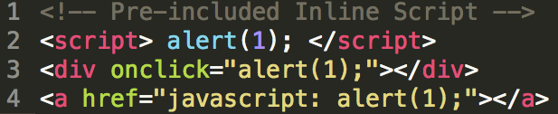


Design: Pre-included Inline Scripts
Core Idea: transform benign inline scripts to external scripts during rewriting phase.
<script src=http://domainA.csp.com/hash.js> </script>
1. Match the script against templates.
2. Put benign script to server.
3. Rewrite script tag.
Notes:
The rest two should be refer to paper
There are three types of pre-included inline script:
the inline scripts embedded in the script tag, shown in line 2,
The inline event handler embedded in a tag attribute, shown in line 3.
The inline script embeded through JavaScript URL scheme.
Pre-included incline scripts are visible during rewritting phase.
So during the rewriting phase, we match each inline script against templates, if matched, we put them into a trusted server where the script an associated url is allocated to that script. Last, we set the src attribute of the script tag as the url, transforming the inline script to external scripts. For inline event handlers and JavaScript URL scheme, they can be handled in a similar ways with two extra steps. Firtst, they need to be wrapped by a function and then this function needs to be registered as corresponding event handler.

Slide 27
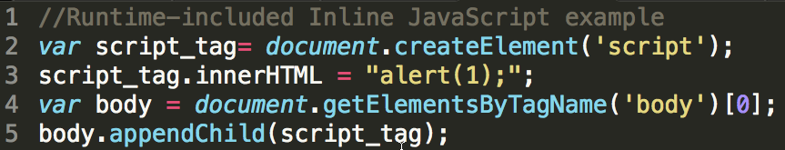
Design: Runtime-included Inline JavaScript
Core Idea: observe DOM-tree change and process new-added script tag the same way as pre-included inline script.
Notes:
CSPAutogen can handle it by observing DOM-tree change because no matter how the scripts are generated, they have to modify DOM tree before being exected by browser.
Runtime-included JavaScript are included and executed during runtime by other JavaScripts.
It’s Widely-used, but none existing works can handle.
This is because the scripts are not visible until the codes are executed at client-side. Here is an example, the script first create a script tag and then set inline script to the tag, after that, the tag is appended back to the page’s DOM true, when it is done, the script will be executed.
For such case, no matter how it is included, a script tag has to be added to the DOM tree. Therefore, we can process runtime-inclded inline JS by observing DOM-tree change. And whenever a new script tag is crated, we can process them in a simlar way as pre-included inline script.

Slide 28


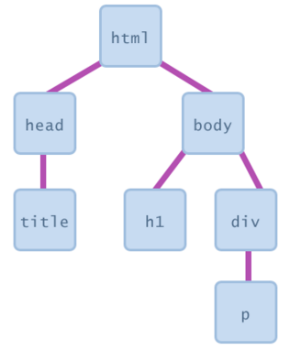
<script>
alert(1);
</script>
2. Find a new script tag with inline scripts.
1. Observe DOM tree change.
4. If matched, send the inline script to CSPAutoGen server.
3. Match the script against templates.
<script
src=“http://da.csp.com/path1”>
</script>
5. CSPAutoGen server matches and stores the JavaScript into a file accessible to outside.
7. Client-side library add a new script tag with src attribute set as the returned URL.
6. CSPAutoGen returns the script file’s URL back to client-side.
Notes:
Here is the details. During runtime-phase, our library wil register an observer to observe the DOM tree change when the page is ready. Whenever a new script tag with inline script is detected, we will extract the inline script and use it to match against the templates. If matched, the script will be sent to the website’s trusted server. Where a url is created for this script. Then the server will returns the url back to client-side library, which will use the url to add a new exteal script tag to the DOM tree. Since the script trusted server is specified in the CSP’s whitelist, the external script will be executed.
This process is asynchronized. However, all the runime-inlucded scripts are synchronized, so it won’t break the website’s functionality.

Slide 29
Design: Non-nested Object
Array Data
[ ’str1’, 3, 2, 3
[4,’str2’],
{k1 : ’str3’},
fun()+3 ];
[ ’str5’, ’str6’, 4, 9,
[’str7’],
{k5 : ’str8’},
fun()+1 ];
Non-nested Object
Array and Object data nodes can be so complex that’s hard to infer a type for each element.
  Convert Array and Object nodes into non-nested object.
  Infer a type for each of the key-value pair.
{ csp_number : [3,2,3,4],
csp_str_lev1 : [‘str1’],
csp_str_lev2 : [‘str2’],
csp_exp : [gAST1],
k1 : [‘str3’]}
{ csp_number : [4,9],
csp_str_lev1 : [‘str5’],
csp_str_lev2 : [‘str7’],
csp_exp : [gAST2],
k5 : [‘str8’]}
Combined non-nested Object
Type
{ csp_number : [3,2,3,4, 9],
csp_str_lev1 : [‘str1’, ‘str5’],
csp_str_lev2 : [‘str2’, ‘str7’],
csp_exp : [gAST1, gAST2],
k1 : [‘str3’],
k5 : [‘str8’] }
{ csp_number : NUMBER,
csp_str_lev1 : REGEXP,
csp_str_lev2 : REGEXP,
csp_exp : [gAST1, gAST2],
k1 : CONST,
k5 : CONST }
Notes:
Non-nested objects as backup.

Slide 30
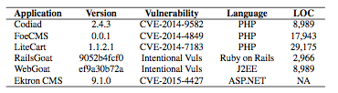
Evaluation: Security
Evaluate if CSPAutoGen can successfully protect real-world vulnerable applications against existing XSS attacks.
  XCampo generates XSS payload.
Manual reviewing flexible types:
  Four gASTs have one data node or field assigned with flexible type.
  Randomly pick out five websites (aliexpress.com, reddit.com, taobao.com, weibo.com, youtube.com).
  The numbers of their flexible types are 43, 2, 15, 11 and 10 respectively.
  We review these flexible types in 7 hours.
  No data node needs to be adjusted to more restrictive type.
Notes:
backup

Slide 31
Design: Template Design Principles
High benign script matching rate.
  Not possible to see all scripts during training phase.
  Exact matching won’t work.
Prevention of injected scripts.
  Tradeoff between first and this principal.
High performance.
  Many string similarity algorithms (e.g., Levenshtein algorithm) won’t work.
Notes:
backup

Slide 32
No Effective Black-box Enforcement
These strings include the title of current news.
White-box approach: AutoCSP and deDacota.
  Only support ASP or PHP.
Black-box approach: autoCSP.
  Infer policies based on violation reports.
  All these works don’t support dynamic scripts and runtime-included scripts.
Scripts extracted from two news pages of cnn.com

Slide 33
Deployment
Server Deployment.
  (+) Guarantee clean training set.
  (+) High code coverage.
  (-) Require server support.
Middlebox Deployment
  (+) Do not require server support.
  (-) Hard to guarantee clean training set.
    Manual review is preferred.
  (-) Undecidable code coverage.
Notes:
There are three ways to deploy CSPAutoGen. The idea way is server deployment: deploying at the gateway of a website, such as implemnted as an Apache module. It requires server support, but such deployment can guarantee a clean training set and achieve a high code coverage, if source code or test cases are given.
Also, it can be deployed as a middlebox, such as on the gateway of a school or organization. It doesn’t require server support, but it requires manual review to guarantee the training set is clean; and how to achieve a high code coverage is a challenging task.

Slide 34
Evaluation:
Robustness Over Time.
Application | V1-V3 Duration | V2-V3 Duration | MR (V1) | MR (V2)
Concrete5 | 333 | 116 | 67.7% | 85.6%
Drupal | 1057 | 497 | 100% | 100%
Joomla | 128 | 2 | 100% | 100%
MyBB | 268 | 101 | 99.6% | 100%
SilverStripe | 603 | 79 | NA | 100%
WordPress | 104 | 12 | 0% | 100%
Domain | # of Templates (01/01) | MR (02/01) | MR (03/01) | MR (04/01)
Amazon | 596 | 99.62% | 99.13% | 98.39%
CNN | 259 | 98.72% | 98.50% | 98.30%
Facebook | 53 | 99.47% | 97.90% | 95.98%
Google | 857 | 97.89% | 94.13% | 87.14%
Reddit | 49 | 97.47% | 97.01% | 89.78%
Yahoo | 295 | 99.30% | 99.05% | 94.01%
heap.offer(new Cell(0,i,heightMap[0][i]));
Real-word Websites
# of Training Page: 2000, # of Testing page: 2000
Web Frameworks
Notes:
Then we want to measure how long a template can achieve a high matching rate without updating.
In the first experiment, we select six popular websites. For each website, we crawled their webpages on four different days, 1/1, 2/1, 3/1 and 4/1. We used the data created in J1 to build templates and then use the templates to match scripts captrued in the remaining three days. In this expriment, the size of training and testing set are both 2000.
Amazon,CNN and Facebook can maintain a high rate for three month;
Yahoo and Reddit’s template works well for two month.
Google needs to update every month.
The second experiment, we want to measure the template robustness on web frameworks. We chose six popular open source frameworks. For each of them, we chosse three popular versions, V1, v2 and V3, v1 being the oldest version and v3 being the latest version. Then we build two templates, one with the v1’s data and the other with version 2’s data. Next, we used the two templates to match version 3’s scripts, shown in the last two colums. The results show that using V2 template to match V3 scripts can achieve an acceptable matching rate. The median value of the duration between V2 and V3 is 90 days, meaning that on average, the template can work 90 days without updating.

Slide 35
Goals and Contributions
No server modification.
Allow unseen, benign scripts.
Use CSP securely.
Compatible to existing websites.
  Black-box Approach
  Template matching
  Disable “unsafe-eval”,
  “unsafe-inline”
  Compatible to Alexa Top 50 Websites.
None of existing works can achieve these goals.
Notes:
Finer-grained
Shouldn’t sacrifice security for compatibility.
1:15

