Slide 1
Spam ain’t as Diverse as It Seems: Throttling OSN Spam with Templates Underneath
Hongyu Gao, Yi Yang, Kai Bu, Yan Chen, Doug Downey, Kathy Lee, Alok Choudhary
Northwestern University, USA
Zhejiang University, China

Slide 2
Background
Among world’s most visited websites by Alexa
http://afrodigit.com/visited-websites-world/
2
1.35 billion monthly active users by Jul 2014
10
284 million users by Oct 2014
14
332 million users by Nov 2014
2
Notes:
Online social network has become extremely popular among Internet users.
According to Alexa,
Facebook is the 2nd most visited website,
2. Twitter is the 10th most visited website,
3. LinkedIn is the 14th most visited website,
http://expandedramblings.com/index.php/resource-how-many-people-use-the-top-social-media/21/
With tremendous popularity, online social networks have also attracted attackers. In this study, we target the spam problem.
2

Slide 3
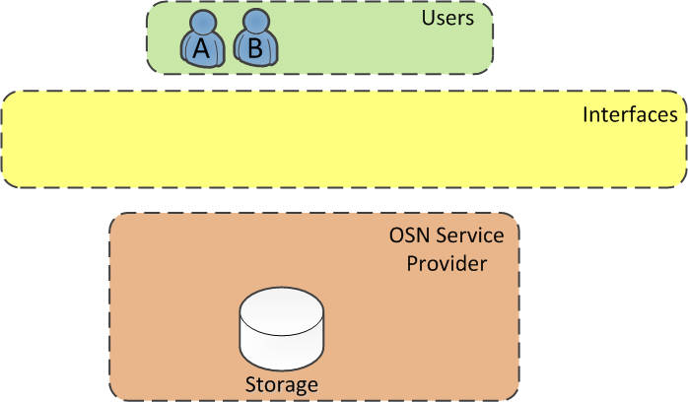
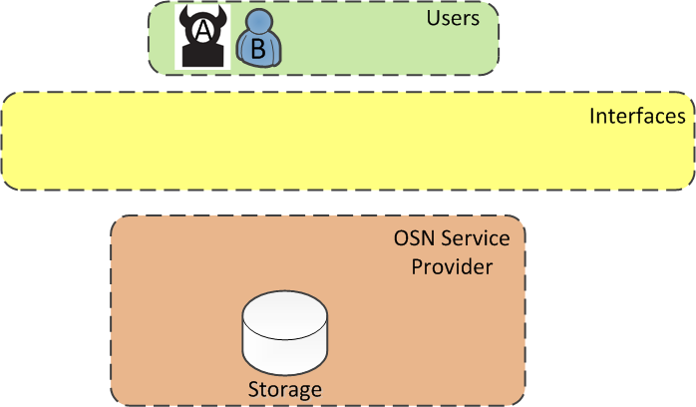
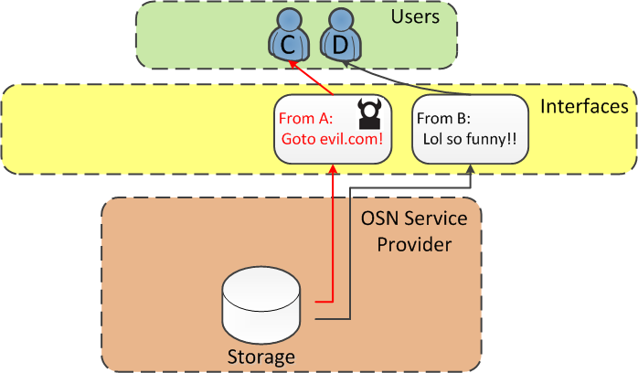
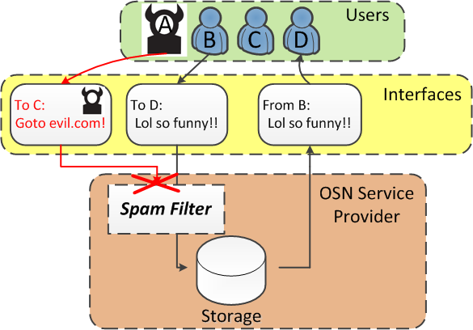
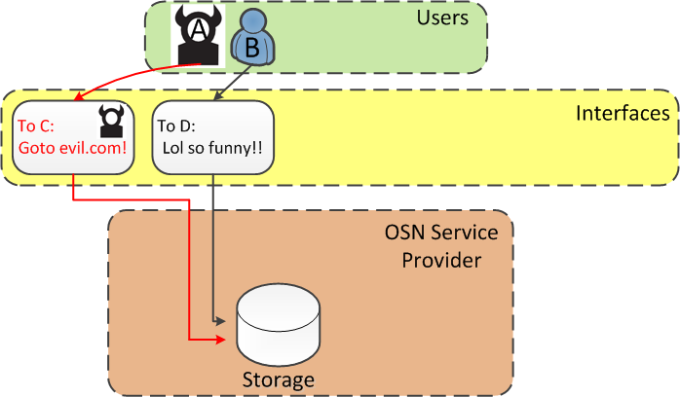
Background
3
Notes:
1. All commercial Osns adopt client-server architecture. The users interact with each other through well-defined interfaces, and the service provider mediates all interactions.
2. However, not all users are necessarily benign. Suppose we now have a bad user, A, and a legitimate user, B.
3. A sends a spam message to user C, while B sends a legitimate message to user D. In this example a message always has one sender and one receiver. Nowadays a popular way of using a social network is to broadcast a message. For example, messages in Twitter are broadcast to all followers. For simplicity, we treat a broadcast message equivalently as a message sent to each of the recipients.
4. Next, the service provider receives the message and waits for the recipients to sign in.
5. Once the recipients sign in, the service provider renders the messages to them. D receives a legitimate message. It’s fine. C receives the spam and is exposed to various kinds of fraud.
6. Our goal is to design an online spam filter to deploy as part of the OSN platform. It inspects every message before the message is rendered to the recipient.
3

Slide 4
Background
Scary Twitter spam stats
2011. 3.5 billion tweets posted to Twitter every day are spam
http://tinyurl.com/p8mqqvs
2014. 14 percent of Twitter’s user base is bots and spam bots
http://tinyurl.com/l755bvm
4
4
Notes:
4

Slide 5
Our Prior OSN Security Work
First study to offline detecting and characterizing Social Spam Campaigns (SIGCOMM IMC 2010)
Largest scale experiment on Facebook then
3.5M user profiles, 187M wall posts
Confirm spam campaigns in the wild.
200K spam wall posts in 19 significant campaigns.
Featured in Wall Street Journal, MIT Technology Review and ACM Tech News
Online spam campaign discovery (NDSS 2012)
Mostly use non-semantics information, syntactic clustering

Slide 6
How Are the Spam Tweets Generated?
Measuring Trend of Twitter Spam
Download tweets containing popular hashtags
Visit Twitter retrospectively to identify suspended accounts
2011 Twitter data:
17 Million tweets
558,706 spam tweets (>3%)
6
Notes:
6

Slide 7
Template Model
A macro sequence (m₁, m₂, …, m_{k})
Each macro instantiates differently during spam generation
Macro₁ | Macro₂ | Macro₃
Beppe Signori | making out with another man - | URL
Jason Isaacs | making out with another man - | URL
Beppe Signori | is really gay, look at this video | URL
Jason Isaacs | is really gay, look at this video | URL
RIP Jonas Bevacqua | is really gay, look at this video | URL
Template = celebrity names + actions + URL
7
Notes:
7

Slide 8
Semi-automated Spam Measurement
Spam data | With Template | Paraphrase | No-content | Others
2011 | 63.0% | 14.7% | 8.4% | 13.9%
2012 | 68.3% | 12.9% | 0.3% | 18.5%
The majority of spam is generated with underlying templates
We collect a smaller 2012 Twitter data containing 46,891 spam tweets
The prevalence of template-based spam is persistent
Syntactic only detection is not sufficient!
8
Notes:
8
To motivate the a template-based solution, we need to know how popular template-based spam is.
Existing email study…
We conduct a semi-automated measurement study on our collected Twitter spam.
We first cluster the spam messages, then manually check each big clusters to determine whether they are generated by templates.
The result is that

Slide 9
Semantics Based Spam Detection
Extract spam template in real time
Fight spam with its own template
Detect multiple spam templates simultaneously
9
9
Notes:
9

Slide 10
Challenges
Absence of invariant substring in template
Prior study assumes the existence of invariant substrings. [Pitsillidis NDSS’10][Zhang NDSS’14]
Prevalence of noise
Spammers extensively add semantically unrelated noise words into spam messages.
Spam heterogeneity
It is hard to obtain a training set containing spam instantiating a single template in practice.
10
Notes:
10
It is challenging to generate OSN spam template.
There are three major challenges.
..
We address these challenges with the following design.

Slide 11
Solutions
Absence of invariant substring in template
Spam template generation without the need for invariant substring.
Prevalence of noise
Automated noise labeling to identify and exclude noise words from template generation.
Spam heterogeneity
Cluster and refine.
11
Notes:
11
It is challenging to generate OSN spam template.
There are three major challenges.
..
We address these challenges with the following design.

Slide 12
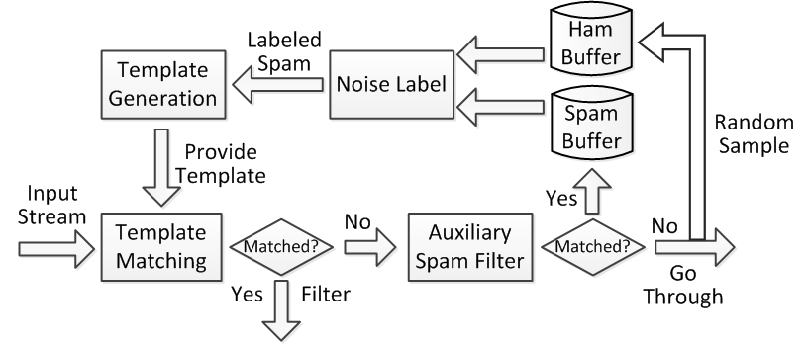
Template Generation/Matching Module
Real-time detection
The auxiliary spam filter supplies training spam samples
Could use black list or any other spam detection systems
Heterogeneous filters to avoid evasion
12
Notes:
12
To address the challenges, we design the following system.
As stated before, it detects spam in real-time.
There are two parts in the module that can detect spam. The template matching part, and the auxiliary spam filter.
At the beginning, the template matching part does not have any available template to use, so all messages will pass through. …

Slide 13
Single Campaign Template Generation
Step 1: Compute a “good” common super-sequence (Majority-Merge algorithm)
Beppe Signori making out – URL
Jason Isaacs making out – URL
Beppe Signori is really gay URL
Jason Isaacs is really gay URL
RIP Jonas Bevacqua is really gay URL
Super-sequence
Beppe | Signori | Jason | Isaacs | making | out | is | really | gay | - | url | RIP | Jonas | Bevacqua | is | really | gay | url
Beppe | Signori | ε | ε | making | out | ε | ε | ε | - | url | ε | ε | ε | ε | ε | ε | ε
ε | ε | Jason | Isaacs | making | out | ε | ε | ε | - | url | ε | ε | ε | ε | ε | ε | ε
Beppe | Signori | ε | ε | ε | ε | is | really | gay | ε | ε | ε | ε | ε | ε | ε | ε | url
ε | ε | Jason | Issacs | ε | ε | is | really | gay | ε | ε | ε | ε | ε | ε | ε | ε | url
ε | ε | ε | ε | ε | ε | ε | ε | ε | ε | ε | RIP | Jonas | Bevacqua | is | really | gay | url
13
Notes:
13
For the ease of presentation, I first introduce the template generation approach given spam instances that instantiate the same underlying template.
It is the basis of the system.
I use the same sample spam campaign as a running example. The first macro is a celebrity name. The second macro is an action. The third macro is a URL.
Given the super-sequence, we can represent the campaign as a matrix. Each column is … Each row is … Each cell is …

Slide 14
Single Campaign Template Generation
Step 2: Matrix columns reduction
Beppe | Signori | Jason | Isaacs | making | out | is | really | gay | - | url | RIP | Jonas | Bevacqua | is | really | gay | url
Beppe | Signori | ε | ε | making | out | ε | ε | ε | - | url | ε | ε | ε | ε | ε | ε | ε
ε | ε | Jason | Isaacs | making | out | ε | ε | ε | - | url | ε | ε | ε | ε | ε | ε | ε
Beppe | Signori | ε | ε | ε | ε | is | really | gay | ε | ε | ε | ε | ε | ε | ε | ε | url
ε | ε | Jason | Issacs | ε | ε | is | really | gay | ε | ε | ε | ε | ε | ε | ε | ε | url
ε | ε | ε | ε | ε | ε | ε | ε | ε | ε | ε | RIP | Jonas | Bevacqua | is | really | gay | url
Super-sequence
(Beppe|ε) (Signori|ε) (Jason|ε) (Isaacs|ε) …
Beppe | Signori | Jason | Isaacs | making | out | - | RIP | Jonas | Bevacqua | is | really | gay | url
Beppe | Signori | ε | ε | making | out | - | ε | ε | ε | ε | ε | ε | url
ε | ε | Jason | Isaacs | making | out | - | ε | ε | ε | ε | ε | ε | url
Beppe | Signori | ε | ε | ε | ε | ε | ε | ε | ε | is | really | gay | url
ε | ε | Jason | Issacs | ε | ε | ε | ε | ε | ε | is | really | gay | url
ε | ε | ε | ε | ε | ε | ε | RIP | Jonas | Bevacqua | is | really | gay | url
14
Notes:
14
In theory, the matrix representation can already convert into a template. Each column can convert into a macro. Like this…
However, such a template has low quality.
To generate a template with high quality, we need to further reduce the matrix columns. Matrix column reduction is performed on columns with the same word label, like the one shown. The columns also need to complement each other.
We can merge the blue columns, and the green columns.
After merging, the matrix becomes like this. There were 2 URL columns. After merging, there is only 1.
Note that after merging, the matrix columns are still the super-sequence of the input campaign.

Slide 15
Single Campaign Template Generation
Step 3: Matrix columns concatenation
Beppe | Signori | Jason | Isaacs | making | out | - | RIP | Jonas | Bevacqua | is | really | gay | url
Beppe | Signori | ε | ε | making | out | - | ε | ε | ε | ε | ε | ε | url
ε | ε | Jason | Isaacs | making | out | - | ε | ε | ε | ε | ε | ε | url
Beppe | Signori | ε | ε | ε | ε | ε | ε | ε | ε | is | really | gay | url
ε | ε | Jason | Issacs | ε | ε | ε | ε | ε | ε | is | really | gay | url
ε | ε | ε | ε | ε | ε | ε | RIP | Jonas | Bevacqua | is | really | gay | url
Regular Expression Template
Beppe Signori|Jason Isaacs|RIP Jonas Bevacqua | Is really gay|making out - | url
Beppe Signori | making out - | url
Jason Isaacs | making out - | url
Beppe Signori | is really gay | url
Jason Issacs | is really gay | url
RIP Jonas Bevacqua | is really gay | url
15
Notes:
15
We’ve made good progress so far, but all the columns are still single word. The next step, matrix column concatenation, helps to reveal semantically meaningful phrases.
The criteria for column concatenation is that the corresponding cells need to have 1-1 mapping.
For example…
After concatenation, the matrix becomes like this. Now each columns can convert to 1 macro, and we can get a good template.

Slide 16
Solutions
Spam template generation without the need for invariant substring.
Automated noise labeling to identify and exclude noise words from template generation.
Cluster and refine for mixture of spam campaigns.
16
Notes:
16

Slide 17
Noise Labeling
Key problem: spammers extensively insert noise words into spam messages
To draw a larger audience
To diversify the message
@mentions, #hashtags, popular terms, etc.
17
Notes:
17
Noise are unrelated to the semantics of the rest of the tweet

Slide 18
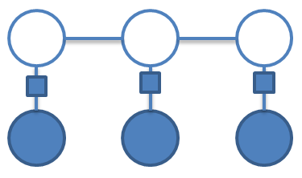
Noise Labeling
Goal: exclude the noise words from the template generation process.
Method: treat noise detection as a sequence labeling task, using Conditional Random Fields (CRFs) approach.
Output: a “noise” or “non-noise” label for each word in the message.
18
Notes:
18
Noise are unrelated to the semantics of the rest of the tweet

Slide 19
Feature Selection
Intuition: noise words are popular, but the combination of them are not popular.
Features:
freq(t_{i})
freq(t_{i}t_{i+1})²/(freq(t_{i})freq(t_{i+1}))
freq(t_{i-1}t_{i})²/(freq(t_{i-1})freq(t_{i}))
Orthographic features:
Is capitalized?
Is numeric?
Is hashtag?
Is user mention?
19
Notes:
19
The first feature captures the popularity of the token ti.
The second and the 3rd feature represents the popularity the that word appearing together with two words surrounding it.
For noise, the first feature has high value, while the other two do not.

Slide 20
Solutions
Spam template generation without the need for invariant substring.
Automated noise labeling to identify and exclude noise words from template generation.
Cluster and refine for mixture of spam campaigns.
20
Notes:
20

Slide 21
Multi-campaign Template Generation
Problem: in realistic scenario the system observes the mixture of spam instantiating multiple templates, rather than a single one.
Solution:
Part 1, coarse pre-clustering, using standard clustering technique.
Part 2, refine the single campaign template generation process, by limiting the ratio of “ε” in the matrix to prune out “outlier” messages.
21
Notes:
21
Next, we need to consider multi-campaign template generation

Slide 22
Recap: Template Generation/Matching Module
Real-time detection
The auxiliary spam filter supplies training spam samples
22
Notes:
22
The majority of spam is generated by template. However, syntactical clustering based detection cannot achieve very high accuracy, because spam message instantiating the same underlying template can be syntactically quite different. Hence, we need the other module of our detection framework, the spam template generation module to further enhance the spam detection performance.
In addition, 4.7% spam are semantically dissimilar. For example, retweeted news content. This type of spam is inherently not suitable for detection based on content mining.

Slide 23
Evaluation Results
Dataset:
17M tweets generated between June 1, 2011 and July 21, 2011
558,706 spam tweets
Auxiliary spam filter:
The online campaign discovery module (introduced later)
63.3% TP rate, 0.27% FP rate
23
Notes:
23

Slide 24
Detection Accuracy
Module | Template Generation | Auxiliary Filter | Combined
Spam Category
Template-based | 95.7% | 70.1% | 98.4%
Paraphrase | 51.0% | 51.4% | 70.1%
No-content | 73.8% | 67.0% | 83.1%
Others | 18.4% | 43.2% | 44.7%
Overall TP | 76.2% | 63.3% | 85.4%
FP | 0.12% | 0.27% | 0.33%
24
Notes:
24
Describe the template generation module.
On the other hand, we have an auxiliary spam filter, which is the other module in our system framework. There is a significant difference in the spam messages that these two modules detect.
As a result, combining these two has the potential to achieve even better detection performance.

Slide 25
Generated Template Example
Top 5 generated templates with the most matching spam:
Spam # | Template
11.1% | ^ (I wager|My my ,) you (cannot|ε) (ε|defeat) this \. URL .* $
7.2% | ^ The (ε|folks|people) at my (ε|place|location) are groveling for this ! URL .* $
6.4% | ^ You (will not|won’t|ε) (ε|think|believe) this \. The (ε|best|greatest) (thing|factor|ε) (because|since) slice bread \. URL .* $
5.0% | ^ (Cool|Wow|Amazing) , I (by no means|in no way) (found|noticed) (people|anyone) (do that|ε) (just before|prior to) \. URL .* $
4.1% | ^ You (will not|won’t|ε) (think|believe|ε) the (issues|points|things) they do on this (site|web page|web-site) \. URL .* $
25
Notes:
25
Next, let us look at some templates that are used by nowadays spammers.
The table lists top 5 …
Noise words are common. But they only appear at the end, and sometimes at the front.

Slide 26
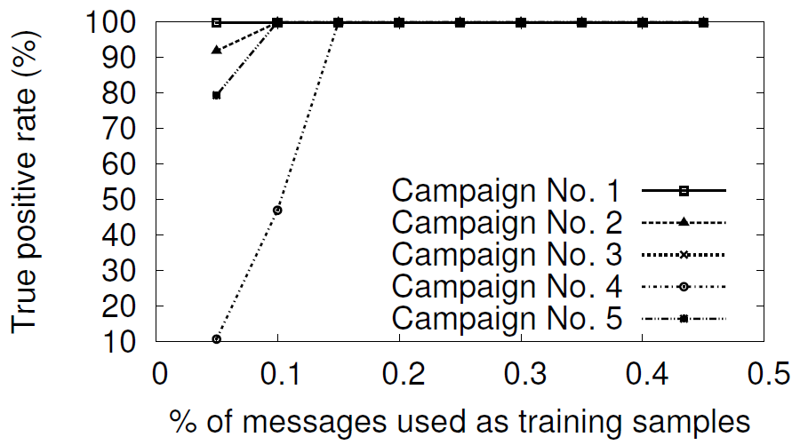
Sensitivity for New Campaigns
Pick the top 5 campaigns
All campaigns achieve almost 100% detection rate with 0.15% of messages as training samples.
The system can react to newly emerged campaigns quickly.
26
Notes:
26
Next, we test the sensitivity for new campaigns.

Slide 27
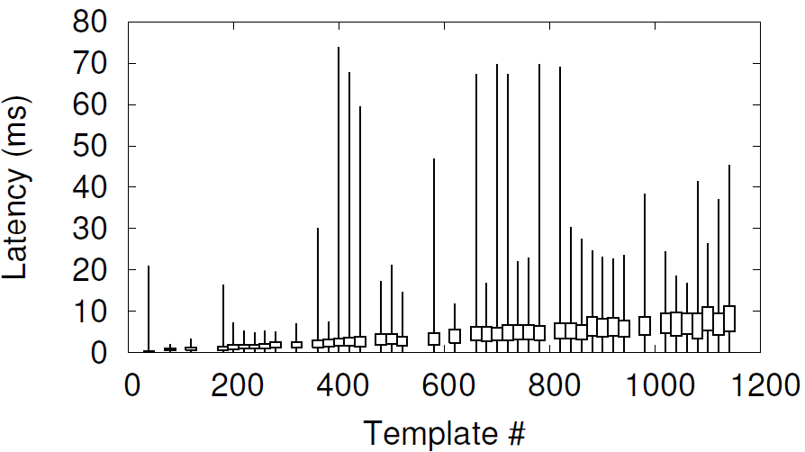
Template Matching Speed
The median matching latency grows slowly with template number, less than 8ms.
The largest latency is less than 80ms, unnoticeable to users.
27
Notes:
27
This figure shows the latency incurred by template matching.
The boxes are the 25 and 75 percentile.

Slide 28
Conclusions
Tangram: first system to real time extract multiple spam templates without unique invariants.
63% of Twitter spam is generated by templates.
Detect 95.7% of template-based spam.
Overall TP rate of 85.4% and FP rate of 0.33%.
Applying text analytics in other security applications
Measuring the Description-to-permission Fidelity in Android Applications, CCS 2014
28
Notes:
28

Slide 29
Existing Work, cont’d
Spam template generation [Pitsillidis NDSS’10][Zhang NDSS’14]
How to detect spam without invariant substrings?
Spammer account detection [Stringhihi ACSAC’10][Yang RAID’11]
How to detect spam in real-time?
How to detect spam originating from compromised accounts, e.g., in a worm propagation scenario?

Slide 30
Thank you!
http://list.cs.northwestern.edu/
Questions?

Slide 31
Background
Filtering Twitter spam is uniquely challenging
Twitter exposes developer APIs to make it easy to interact with Twitter platform
Real-time content is fundamental to Twitter user’s experience
http://tinyurl.com/oxtmmnz
31
31
Notes:
31

