Slide 1
An Investigation into Android In-App Ad Practice:
Implications for App Developers
Boyuan He^{[1]}, Haitao Xu^{[2]},Ling Jin^{[1]}, Guanyu Guo^{[1]}, Yan Chen^{[1][2]}, Guangyao Weng^{[1]}
Lab of Internet and Security Technology (LIST)
[1] Institute of Cyber Security Research, Zhejiang University, China.
[2] EECS, Northwestern University, USA.
Notes:
Good afternoon everyone, I am Boyuan He , a PhD student from Institute of Cyber Security Research, Zhejiang University, China.
Today, it is my great honor here to present our work: An Investigation into Android In-App Ad Practice: implications for App Developers.
Supervised by my advisor Prof. Yan Chen, this work is conducted with a joint Lab of Internet and Security Technology (LIST) at Zhejiang University and Northwestern University.
Before we talk about the motivation, we first take a look at Android ecosystem and app monetization.

Slide 2
App Monetization
87.7%
37.9%
Mobile OS market share (Q2’17)
Global OS market share (Mar.17)
2.9Million
92.5%
1.3Million
Apps in Google Play (Feb.17)
Ratio of free apps in Google Play
Android developers (Oct. 2016)
How to monetize a free app?
In-app advertising!
Notes:
Android has become the dominant operating system for mobile devices today, and its market share has reach 87.7% in the second quarter of 2017. Moreover, recently Android has overtaken Windows as the world’s most popular OS for all kinds of devices and its global os market share has reach 37.9% in March 2017. In addition, Google Play has also become the world’s largest mobile application market, the total number of apps has reached 2.9 million, among which 92.5% are free apps. Besides, there are more than 1.3 million Android developers around the world. Given the existence of so many developers and the fact that users always prefer free apps, it is very important for developers to find the best practice of app monetization. So the question is what is the most convenient way to monetize a free app? And the answer is quite obvious today: in-app advertising!

Slide 3
In-app Advertising
Popular
In-app advertising is getting popular today.
Ad Platform
Big app vendors have their own advertising platforms, and are always easy to find advertisers to pay. (E.g. YouTube and Facebook)
Third-party Ad Network
SALE
Developers need a third-party Ad networks!
Notes:
In-app advertising or mobile advertising is getting popular today. When you look into many of most popular apps in the market, you can always find some in-app ads showing up. Apps from big companies, like YouTube or Facebook usually have their own ad platform. Because of large user base, these apps are always easy to find advertisers to pay. However, for other developers, how can they use in-app advertising? That why they need a third-party ad network!

Slide 4
In-app Advertising
In-app advertising ecosystem: advertisers, ad networks, developers and users.
Advertiser
Users
Launch an advertising campaign.
Show ads to users in their apps.
Ad Network
Aggregate ad inventory
Developers (Publishers)
Notes:
In general ,the ecosystem of in-app advertising includes multiple parties. There are advertisers, ad networks, developers and users. Advertisers are those companies launching advertising campaign for their customers. Developers are those who show ads to their users in return for advertising revenue. And an ad network is a third party intermediate platform which connects advertiser and developers. It exchanges ad inventory and revenue across the entire ecosystem.

Slide 5
AD Network
Ad Network
Server
Ad Library
Ad Request
Ad Response
Notes:
This page of slides shows how a typical ad network actually works. Usually, an ad network provides a third party library, called ad library, for developers to integrate into their own apps. After a successful integration, the ad library sends request to an ad network server on behalf of the app, and gets ad contents from the server to show in the app.

Slide 6
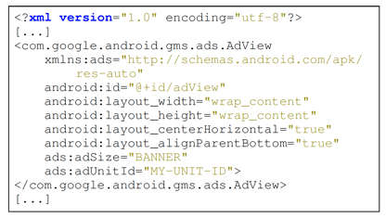
Ad Network
Ad integration via Java APIs
A banner ad from Google Admob is added by calling Java APIs of ad network.
Ad integration via XML files
A banner ad from Google Admob is added by changing XML layout file.
Notes:
Let’s a closer look at how this integration process is implemented inside an Android app. Usually there are two approaches for developers to place an ad in their app: one approach is to change the layout XML file and place the ad to a specific location to show up, the other is to directly call Java APIs of a certain ad library whenever an ad need to be displayed.
This page of slides gives us examples of the two approaches to show a banner ad. The left one use XML files and the right one use Java APIs.

Slide 7
In-app Advertising
Top 10 ad networks with different features in 2017
Ad Network | Supported Ad Types
Admob | Native, Video, Interstitial
AdColony | Rich Media, Video
Airpush | App Icon, Messaging, Notifications, Offerwall
Chartboost | Content Lock, Interstitial, OfferWall, Video
Fyber | Interstitial, Native, Video
Inmobi | Banner, Native, Video, Interstitial, Rich Media
Leadbolt | Native, Video, Interstitial
RevMob | Interstitial, Video, Pop-up, Rich Media
Startapp | App Icon, Full Page Ads, InApp Ads, Interstitial, Video
Tapjoy | Content Lock, Interstitial, Offerwall, Rewards
Notes:
Because of the popularity of in-app advertising, there are quite a lot ad networks in the market today. Here are the top 10 ad networks in the year of 2017 and as we can see, they are all different in supported ad types and many other features.

Slide 8
Motivation
What is the best ad practice in a free app?
What is the trend in ad networks used in recent years?
Can in-app advertising jeopardize user experience？
Are there any patterns in different co-existed ad types within the same app?
How many ad networks within an app can be considered as acceptable to users?
What are the popular ad types? What are the ad types that user are more likely to tolerate?
Notes:
Sine there is no guidelines for developers to use ad networks, Our goal is to find the best ad practice in free apps and provide practical guidelines for developers.
As a developer, it is very important to find answers for all these questions before ad integration, such as What is the trend in ad networks used in recent years?
……….
In our research, we try to answer all these questions by conducting a fine-grain and large-scale measurement study.

Slide 9
Contributions
Our research makes the following contributions:
To the best of our knowledge, we are the first to provide practical guidelines for mobile developers to monetize their apps through third-party in-app advertising.
We are the first to measure third-party in-app advertising in Android apps at API granularity.
We are the first to provide a unified classification system for mobile in-app ads, and measure the impact of different ad types on various properties of apps.
Notes:
To summarize our research makes the following contributions:
1、To the best of our knowledge, we are the first to provide practical guidelines for mobile developers to monetize their apps through third-party in-app advertising.
2、We are the first to measure third-party in-app advertising in Android apps at API granularity.
3、We are the first to provide a unified classification system for mobile in-app ads, and measure the impact of different ad types on various properties of apps.

Slide 10
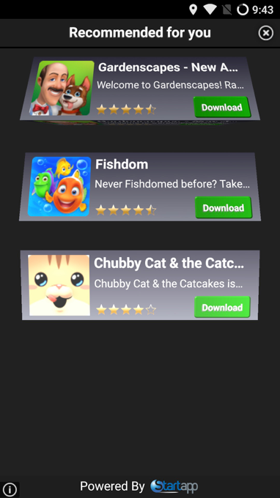
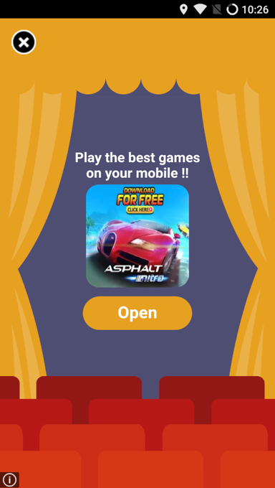
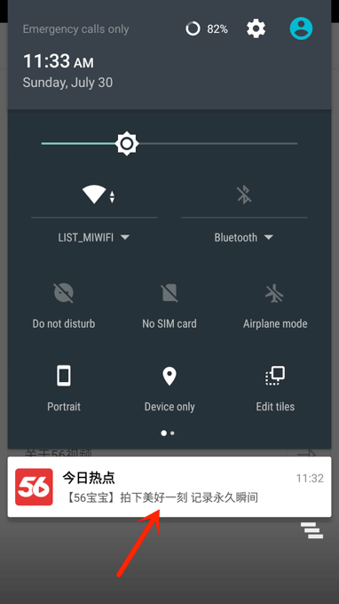
Ad Classification
Based on UI behavior, we divide mobile ad into the following 5 types:
Offerwall ad.
Popup ad.
Notification ad.
Floating ad.
Embedded ad.
Offerwall ad
Popup ad
Notification ad
Notes:
Before we could start the measurement work, we first propose a methodology of ad classification based on different UI behavior. In general, we classify mobile in-app ads into 5 different types: offerwall, popup, notification, floating and embedded. This and the next page of sides show images of these 5 types of ads

Slide 11
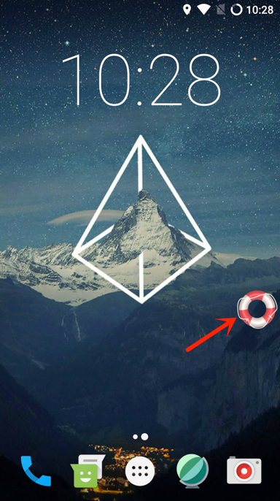
Ad Classification
Furthermore, we assign different aggressiveness level to each ad type.
Ad type | Aggressiveness level
Offerwall | High
Popup | Low
Notification | High
Floating | Low
Embedded | Low
Floating ad
Embeded ad
Notes:
Furthermore, we assign different aggressiveness level to each type of ad based on its user experience. For example, for those types of ad that can be easily ignored, skipped or
closed by user, we consider them as user tolerable and their aggressiveness as “Low”. Otherwise, the aggressiveness is high.

Slide 12
System Design of MadLens
App data collection.
Ad network identification.
Ad network API mapping.
Ad detection.
Ad Network
SDK Docs
Ad Network
API Mapping
Ad Network
API Dataset
Android App
Dataset
Module
Analysis
Ad Network
Dataset
Static
Analysis
Report
Notes:
For the measurement study, we develop a system called MAdLens, a static analysis framework for Android in-app ads.
MadLens are able to extracts ad libraries of different ad networks from a large set of apps, map each of ad relevant APIs to a specific ad type and generates summary information.
This page of slides shows the system design of MadLens.
Generally, there are 4 major steps for MadLens to perform the analysis, we will go through each of them in the following pages of slides.

Slide 13
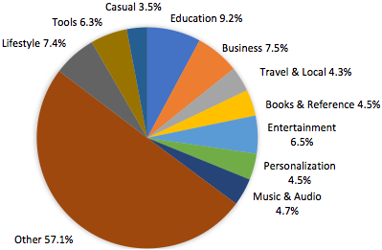
App Data Collection
Our app dataset includes 277,616 free Android apps from Google Play (Mar. 2017).
Our app dataset covers all 48 categories of apps.
For each app, we collect the apk file as well as meta information (e.g. descriptions, # of downloads, ratings and reviews).
Notes:
The first step App data collection
Our Android application dataset includes more than 270 thousand apps from Google Play market, and covers all 48 categories of apps. Besides the app’s APK file, we also collect meta information for each app we crawled. For example, app descriptions, # of downloads, user ratings and so on)

Slide 14
Ad Network Identification
Two important observations
Popular ad libraries (ad network modules) are shared by many apps. So code clones can be detected in these apps.
The code logic in ad libraries are relatively independent, and ad libraries usually interact with apps via ad network APIs.
Module analysis
Static analysis and clustering techniques are employed to measure the coupling of different modules inside an app.
Map code clusters to ad libraries.
Notes:
Then the second step:ad network Identification
MadLens first identifies different ad networks from a large set of Android apps by performing module analysis. This analysis is based on two important observations: first, popular ad libraries are shared by many apps. So code clones can be detected in these apps. second, the code logic inside an ad library is relatively independent. As a result, we use static analysis and clustering techniques to measure the coupling between different modules, and therefore identify all the ad networks from Android apps

Slide 15
Ad Network API Mapping
API mapping
Documentation from ad networks are used to map specific ad APIs to a certain ad type.
Dynamic analysis are used to verify the behavior of the ad API call.
Ad network API dataset
In all, we collect 697 unique ad APIs in our ad network API dataset.
 | Embeded | Popup | Floating | Notification | Offerwall | Total
# of APIs | 407 | 200 | 10 | 29 | 51 | 697
Notes:
After identified different ad networks, we need to map all their ad APIs to specific ad types. For those well-documented ad networks, we leverage on their documents for this mapping process, for others, we take a dynamic approach to verify the behavior of the ad API call.
In all, we collected 697 unique ad APIs as our ad network API dataset.

Slide 16
Ad Detection
We take a static approach for ad detection, and use Androguard as static analyzer.
Unpack apk file to extract all the resources files and configuration files.
Covert code in dex file to Smali code for further analysis.
Match ad network API patterns in both XML and Java files.
Our static analysis is resistance to many apk obfuscation and hardening techniques.
Notes:
With the 3 dataset we collect from previous steps, now it’s the time for MadLens to perform ad detection. MadLens takes a static approach and leverage on Androguard to unpack apk files and convert code in dex file to Smali code for further analysis. MadLens is able to detect various ad behaviors of different ad networks by matching ad network API patterns in both XML and Java files. In addition, Our static analysis is resistance to many apk obfuscation and hardening techniques.

Slide 17
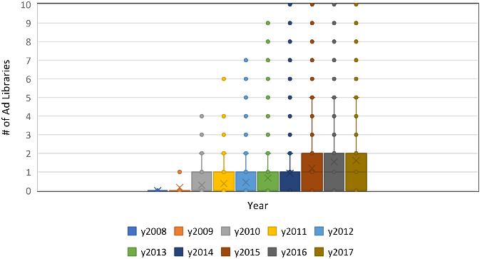
Result
The Trend in # of ad libraries in an app.
2008-2009: barely have ad library.
2010-2014: 25% have at least 1 ad library.
2015-2017: 50% have at least 1 ad library, and 25% have at least 2 ad libraries.
Notes:
For the rest of this presentation, I’d like to show some interesting results of our measurement study. First, we study the trend of # of ad networks used in an app. As we can see from this box plot, the results show an increase of average ad network numbers inside an app. For example, apps

Slide 18
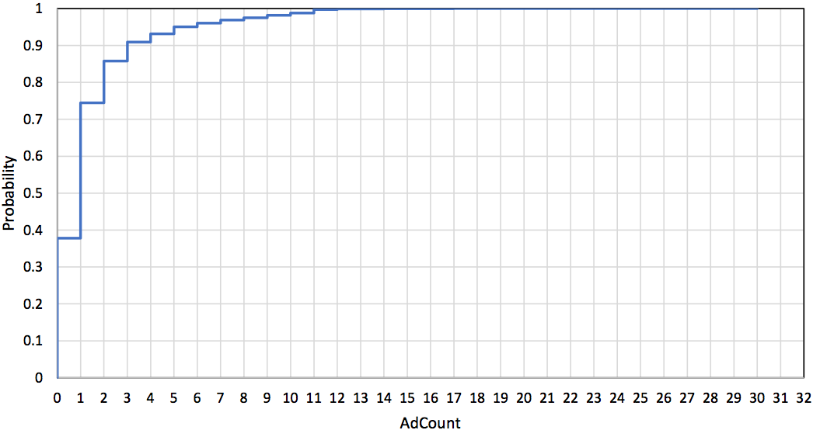
Result
The Trend in # of ad libraries in an app.
37.8% have no ad library.
33% have 1 ad library.
10% have 2 ad libraries.
5% have 3 ad libraries.
Implication1: Developers have more choices about ad networks than several years before. Most developers are conservative about ad placement in their apps given the observation that about 71% apps contain at most one ad library.
Notes:
Meanwhile, we use this CDF (cumulative distribution function) figure to show distributions of ad network number inside an app. As a result, developers have more choices about ad networks than several years before. Most developers are conservative about ad placement in their apps given the observation that about 71% apps contain at most one ad library.

Slide 19
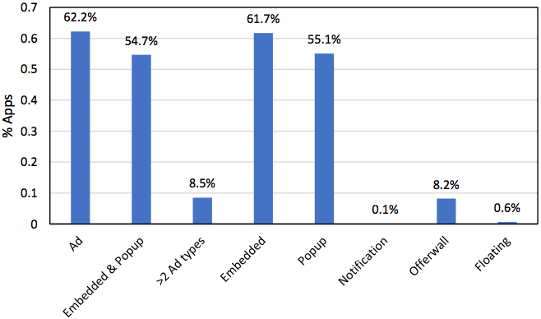
Result
Prevalence of ad types in an app
Offerwall: 8.2%.
Popup: 55.1%.
Notification: 0.1%.
Floating: 0.6%.
Embedded: 61.7%.
Both of Embedded & Popup: 54.7%.
62.2% have at least 1 ad type.
8.5% have more than 2 ad type.
Implication2: Statistically, developers include two lowly aggressive ad types, Embedded and Popup, simultaneously in more than a half of their apps. The two highly aggressive ad types including Offerwall and Notification are not popular.
Notes:
Second, we study the prevalence of ad types in an app. Our results indicate that developers include two lowly aggressive ad types, Embedded and Popup, simultaneously in 54.7% of their apps. The two highly aggressive ad types including Offerwall and Notification are not popular.

Slide 20
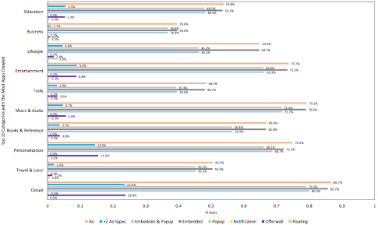
Result
Prevalence of ad types in the apps of the top 10 categories
Business: 39.6%
Education: 48.0%
Tools: 48.5%
Entertainment: 73.7%
Music&Audio: 79.2%
Personalization: 74.9%
Casual: 86.7%
Notes:
Third, we also studied the prevalence of ad types in the apps of the top 10 categories. We found some category of apps are more likely to have ads, for example, 86.7% of app from Casual category have at least 1 types of ad, while the number in Business app is only 39.6%.

Slide 21
Result
Prevalence of ad types in the apps of the top 10 categories
Implication3: To some extent, the likeliness of an app containing ads depends on the app category to which it belongs Thus, developers may decide the ad placement issue based on the category of their own apps.
Implication4: the two lowly aggressive ad types, Embedded and Popup, are popular with apps in nearly all categories.The highly aggressive ad type, Offerwall, is somewhat popular. Developers could consider placing these three types of ads in their apps.
Notes:
So we believe to some extent, the likeliness of an app containing ads depends on the app category to which it belongs. So developers may decide the ad placement issue based on the category of their own apps.
Another finding is that the two lowly aggressive ad types, Embedded and Popup, are popular in nearly all categories. The highly aggressive ad type, Offerwall, is also somewhat popular.
So developers could consider to use these three types of ads in their apps.

Slide 22
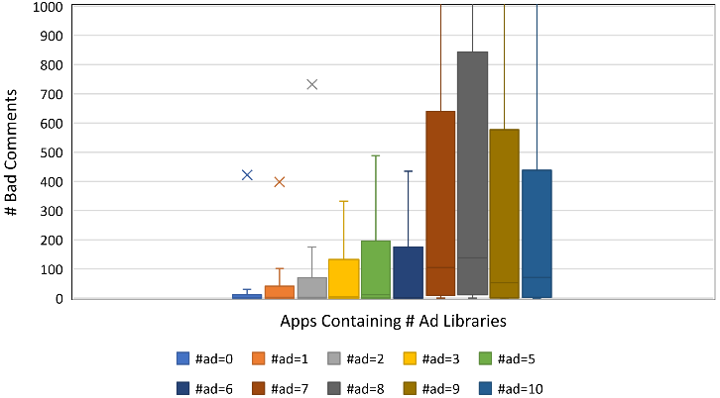
Result
Correlation between in-app ads and app rating from user.
Implication5:
Developers should avoid embedding too many ad libraries into an app, empirically no more than 6, which otherwise would anger the app users and result in bad ratings.
Notes:
Empirically, a user could be annoyed by an app embedded with too many ads. So we also studied
relationships between in-app ads and user ratings.
This page of sides clearly shows that the number of bad user ratings increase significantly along with the number of ad libraries. So developers should avoid embedding too many ad libraries into an app, empirically no more than 6, which otherwise would anger the app users and result in bad ratings.

Slide 23
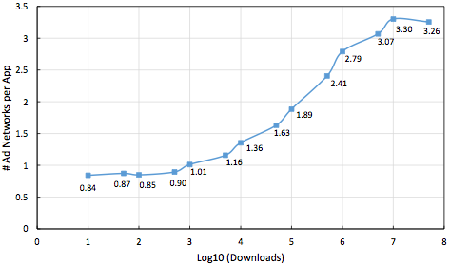
Result
Ad network choice for apps in the different stage of their lifecycle
Implication6:
A developer should use at most one ad network when her app is still at the initial stage and could start using more (2 or 3) ad networks when the app becomes popular, reflected by its downloads.
Notes:
Finally, we examined the correlation between downloads of an app and the number of ad networks in an app. The x axis denotes the logarithm of the downloads of apps, and the y axis denotes the number of ad networks used per app on average. The result show a strong positive correlation between the number of downloads and the average number of ad networks in an app. Statistically, the number of downloads indicates the different lifecycle stage of apps, so a developer should use at most one ad network if her .app is still at the initial stage and could start using more when the app becomes popular.

Slide 24
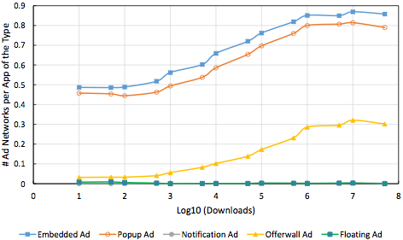
Result
Ad type choice for apps in the different stage of their lifecycle
Implication7:
A developer should mainly place Embedded and Popup ads on her app in whatever lifecycle stage, and could start to place Offerwall ads when her app has many enough downloads.
Notes:
Similarly, we also examined the correlation between downloads of an app and the number of ad networks of each ad type in the app. Our results indicates that a developer should mainly place Embedded and Popup ads on her app in whatever lifecycle stage, and could start to place Offerwall ads when her app has become popular.

Slide 25
Summary
Propose a unified methodology of ad classification based on UI behavior.
Design and implement MadLens, a framework for fine-grained and large-scale Android in-app ads analysis.
Provide insights for developers about how to optimize their app monetization with optimal ad placement choices.
Notes:
In summary, our research first propose a unified methodology of mobile ad classification based on UI behavior.
Then, we design and Implement MadLens, a framework for fine-grain and large-scale Android in-app ads analysis.
Finally, based on the results of our measurement study, we provide insights for developers about how to optimize their app monetization with optimal ad placement choices.

Slide 26
Question?
Notes:
That’s the end of my presentation today. Thanks you!

Slide 27
Thank you !

