Slide 1
RISKCOG
Implicit and Continuous
User Identification on
Smartphones in the Wild
Sandeep Raju Prabhakar
srp@u.northwestern.edu
Karan K Shah
karan.shah@u.northwestern.edu
EECS 450 : Internet Security
Fall 2016, Northwestern University

Slide 2
CONTENTS
Background and motivation
The problem at hand
What has been done so far
Using Gait for verification
RISKCOG
Differences in the approach
Flaws and unanswered questions
Conclusions and takeaways

Slide 3
BACKGROUND & MOTIVATION
Notes:
Ask a stupid question: How many of you have smart phones?
How many of you have used your phones for making payments or storing sensitive information?
How many of you hate typing username and password on phones?

Slide 4
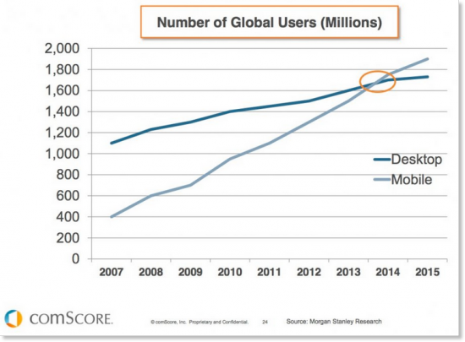

Slide 5
92% | US Adults have cellphones
68% | US Adults have smartphones
Source: http://www.pewinternet.org/2015/08/26/americans-views-on-mobile-etiquette/
Notes:
Based on a recent nationwide survey in 2015 …
92% is a big number = millions of people

Slide 6
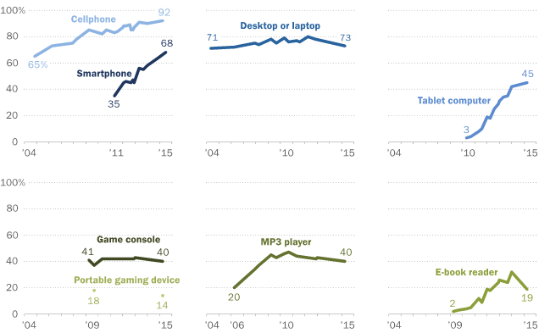
...and if you see the growth
Source: http://www.pewinternet.org/2015/10/29/technology-device-ownership-2015/
Notes:
The smartphone usage has skyrocketed.
Compare it with the cellphone usage.
See how the tablet market is stagnating in 2015.
This clearly shows how important mobile phones have become.
Mobile phones are ubiquitous

Slide 7
How many of you use your smartphones to make payments?

Slide 8
How many of you use your smartphones to make payments?
What about to storing sensitive data
or personal photos?

Slide 9
52% | Use smartphone to make payments
41% | Use it regularly to make payments
99% | Store sensitive personal and professional information
40% | Don’t protect their devices with a password
Source: http://www.creditcards.com/credit-card-news/mobile-payment-statistics-1276.php
Notes:
This means millions on bank accounts, personal details and photos are out in the open
People think info is invaluable
Cumbersome to use

Slide 10
RISKS
Data-driven
(network, malware, phishing)
Human driven
(physical unauthorized access)

Slide 11
Question
On a scale of 1 to 10 (with 10 being the highest),
how uncomfortable will you be
if your phone having sensitive data was got stolen?
What if it did not have a lockscreen
with a strong password?

Slide 12
THE PROBLEM AT HAND

Slide 13
Phones are extremely personal devices
We all store extremely sensitive information in them
Increasingly use them to make payments
Having complicated passwords is safe(er) but cumbersome
Losing them or having unauthorized
access can be very problematic

Slide 14
what if…
There was a way to ‘continuously’ and ‘unobtrusively’ identify the phone’s owner
in an ‘implicit’ way
(without compromising user privacy!)

Slide 15
WHAT HAS BEEN DONE SO FAR

Slide 16
PASSWORDS
Hard to remember
Hard to type on handheld devices
Prone to dictionary attacks

Slide 17
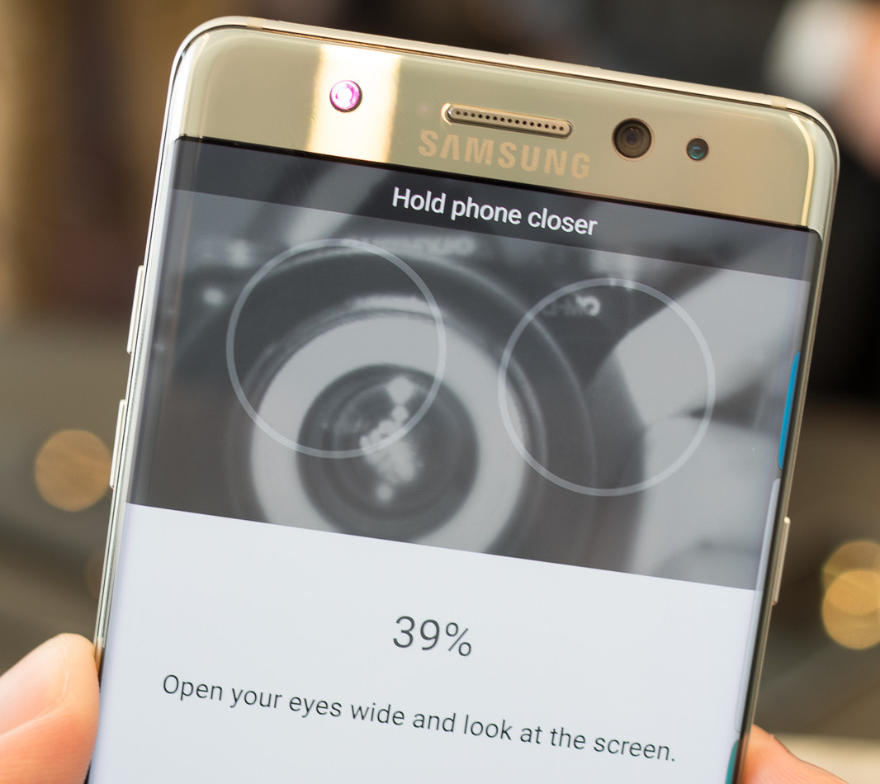
PASSWORDS
IRIS SCAN
Hard to remember
Hard to type on handheld devices
Prone to dictionary attacks
Cumbersome to use
Not practical in all situations
Still under active research

Slide 18
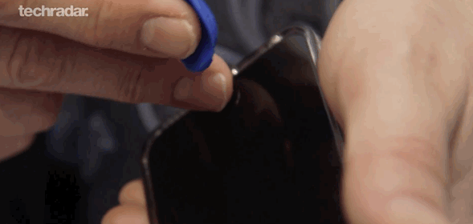
FINGERPRINTS
Needs a fingerprint sensor
Privacy concern
Vulnerable to Play-Doh attacks!

Slide 19
FINGERPRINTS
PATTERN
Needs a fingerprint sensor
Privacy concern
Vulnerable to Play-Doh attacks!
Strong patterns are hard to use
Prone to shoulder surfing
Not practical in all situations
vs

Slide 20
FACE RECOGNITION
Needs a camera
Privacy concern
Easily hackable (... using your photo!)

Slide 21
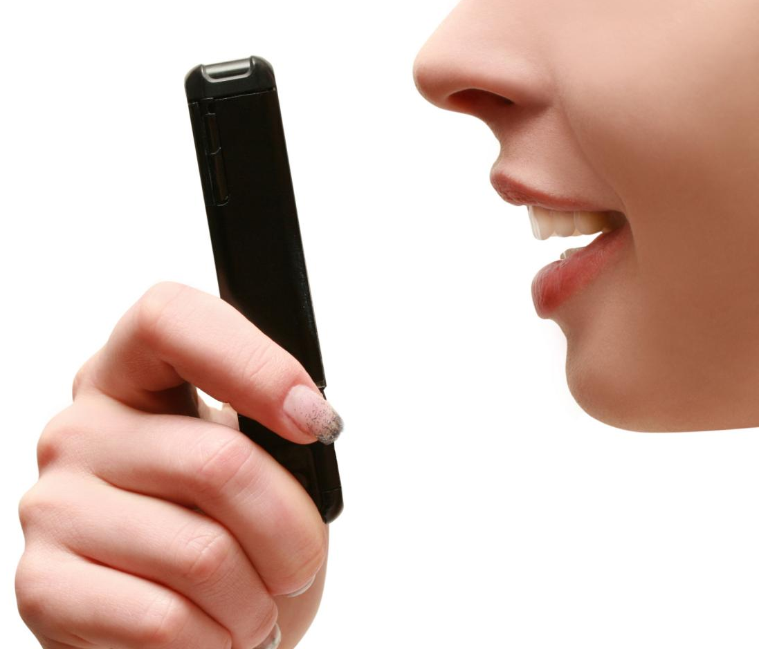
FACE RECOGNITION
SPEECH RECOGNITION
Needs a camera
Privacy concern
Easily hackable (... using your photo!)
Ambient noise affects the recognition
Privacy concern still exists
Still hackable (recording your voice)

Slide 22
USING GAIT FOR VERIFICATION

Slide 24
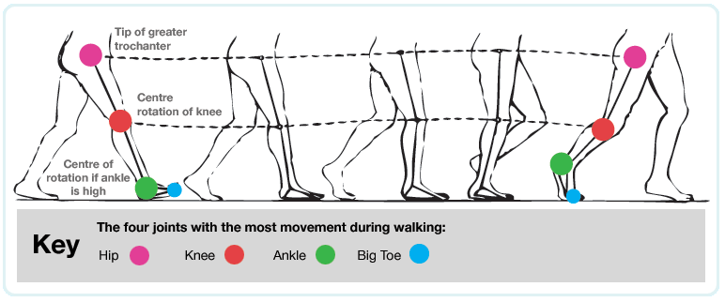
It works by sensing accelerometer data and analysing it to detect a unique pattern

Slide 25
ADVANTAGES
CHALLENGES
Non-invasive
Does not require subject’s explicit cooperation
Provides continuous (almost) authentication
Least likely to be forgotten or stolen (or copied)
Body placement (location of the device)
Device orientation
Gait can change over time

Slide 26
An overview of Lu et al’s technique

Slide 27
PRE PROCESSING
Raw accelerometer data is segmented into frames
Sensor sampling rate is 100 samples / sec
512 samples are grouped into one frame
Two consecutive frames have a 50% overlap
Frame 02
Frame 01

Slide 28
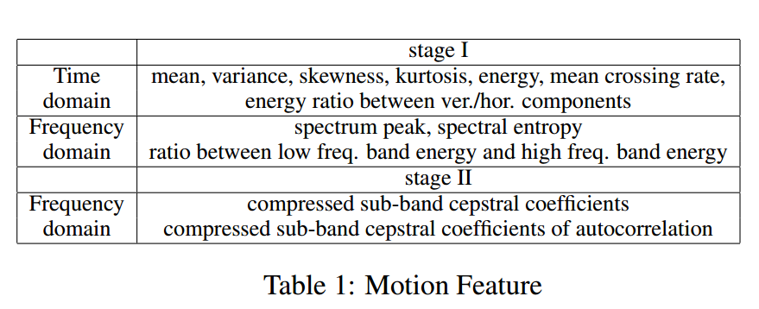
FEATURE EXTRACTION - PHASE 1
From the frames, a base set of features are extracted
It is to detect if the person is walking or not
These features are both in time and frequency domain E.g. mean, variance, skewness, kurtosis, energy, mean-crossing, spectrum peak, etc.

Slide 29
WALKING DETECTION
To determine if the frame represents a person walking or not
The features are extracted from the frames
Frames are checked against a decision tree
Markov model smoother is used to ignore outliers
Unwanted frames are discarded at the end

Slide 30
FEATURE EXTRACTION - PHASE 2
More relevant features are extracted for gait modelling
Various techniques are used to extract features from different kinds of movements E.g. Auto-correlation is useful for cyclic, periodic data
Finally, 87 features are extracted for gait verification

Slide 31
CLASSIFICATION FRAMEWORK
Uses Gaussian Mixture Model -Universal Background Model (GMM-UBM) for gait verification
The algorithm has 3 main parts
Offline training
Model generation
Runtime inference and adaptation

Slide 32
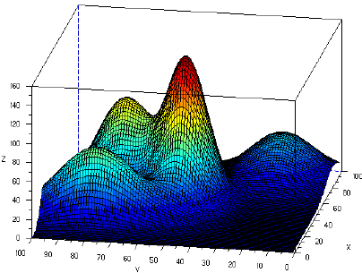
INTUITION BEHIND UBM
UBM is a generic GMM trained from data pooled from lots of subjects.
Represents subject independent gait patterns (i.e., represents how humans walk in general - not to any specific person)

Slide 33
INTUITION BEHIND UBM (CONT’D.)
Uses Maximum-a-Posteriori (MAP) for adaptation
MAP personalizes the UBM by adjusting the shape of its gaussian components and mixture weights

Slide 34
GAIT MODEL TRAINING

Slide 35
GAIT MODEL VERIFICATION
Compare the ‘log likelihood’ of the user gait model and the original UBM to make a decision.
If the walker is the user, the log likelihood of the user model will be higher than UBM model.

Slide 36
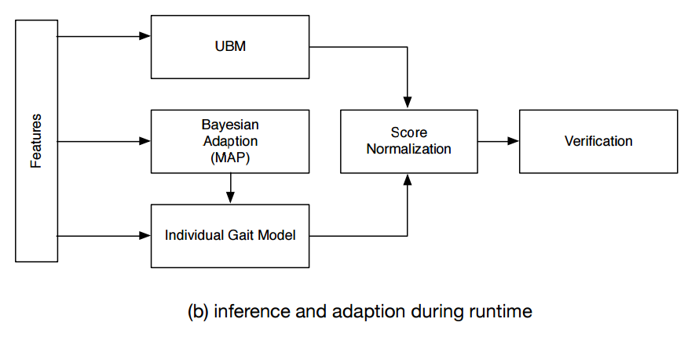
GAIT MODEL VERIFICATION (CONTD.)

Slide 37
EXPERIMENTS & RESULTS
Three datasets
47 subjects, 18 hours, multiple activities, many placements
12 subjects, 1 hour, only walking, 2 placements
8 subjects, 5 hours, no restriction on activity or placement
98% Precision, 95% Recall on dataset 1 with 10 fold CV
More results and conclusions later

Slide 38
A QUICK PRIMER ON EVAL. METRICS

Slide 39
FOUR PILLARS OF CLASSIFIER EVALUATION
True Positives (TP): number of positive examples, labeled as such.
False Positives (FP): number of negative examples, labeled as positive.
True Negatives (TN): number of negative examples, labeled as such.
False Negatives (FN): number of positive examples, labeled as negative.

Slide 40
ACCURACY, PRECISION & RECALL
accuracy = (TP + TN)/(TP + TN + FP + FN)
A.k.a the number predictions that the classifier got right
precision = TP/(TP + FP)
out of all the examples the classifier labeled as positive, what fraction were correct?
recall = TP/(TP + FN)
out of all the positive examples there were, what fraction did the classifier pick up?
Ref: https://tryolabs.com/blog/2013/03/25/why-accuracy-alone-bad-measure-classification-tasks-and-what-we-can-do-about-it/

Slide 41
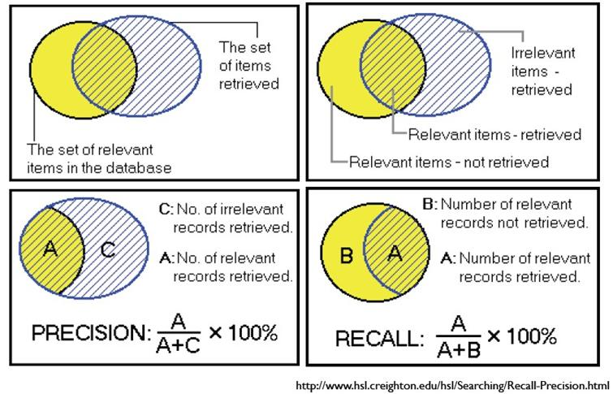

Slide 42
EXPERIMENTS & RESULTS (AGAIN)
Three datasets
47 subjects, 18 hours, multiple activities, many placements
12 subjects, 1 hour, only walking, 2 placements
8 subjects, 5 hours, no restriction on activity or placement
98% Precision, 95% Recall on dataset 1 with 10 fold CV
More results and conclusions later

Slide 43
WHAT WE NEED IN AN IDEAL SYSTEM

Slide 44
A more generic approach at user identification
using sensor data
Uses accelerometer, gyroscope, gravity sensor, etc.
Does not require the user to be in motion state
No need to keep the phone in a constant position / orientation
Takes into effect changes due to things like people playing games, etc. on the phone

Slide 45
RISKCOG

Slide 46
GOALS
Learning-based mechanism for user fraud detection
Least user privacy required, high detection accuracy
Device-level approach
Robust, hard to evade

Slide 47
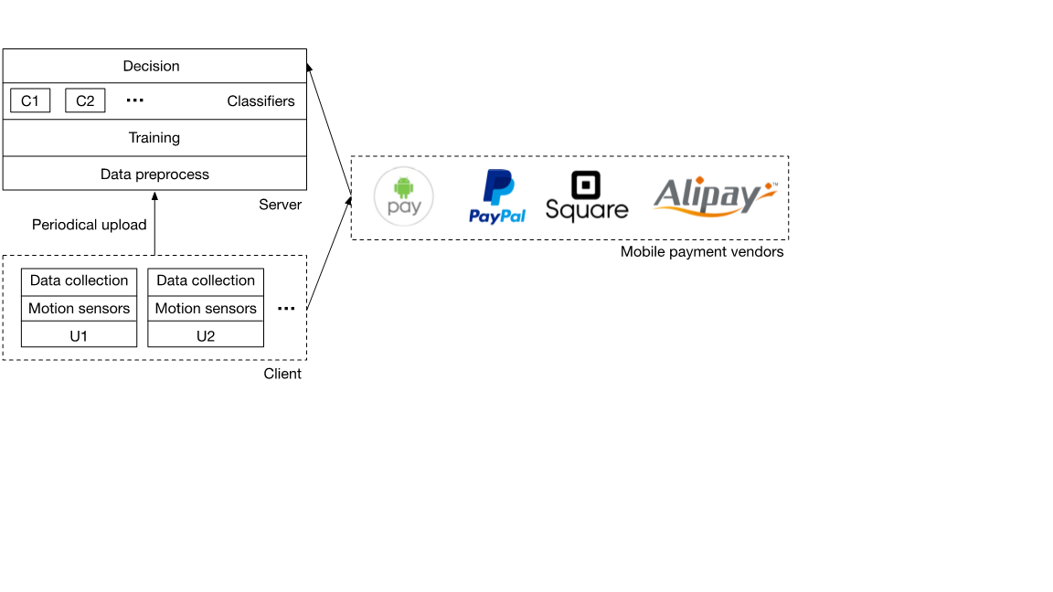

Slide 48
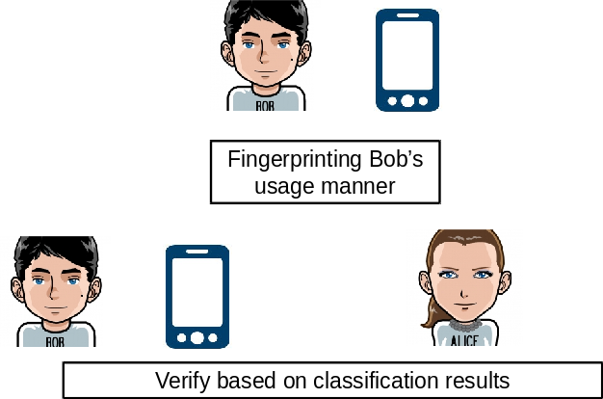

Slide 49
CHALLENGES WITH EXISTING TECHNIQUES
Compromises user privacy
Detection / identification is app level
Each app has its own data collection channel individually
Requires the user to move or place the mobile in specific location of the body.

Slide 50
BUT, USER IDENTIFICATION WITH
JUST MOTION SENSORS HAS ITS
OWN SET OF CHALLENGES

Slide 51
CHALLENGES
Lack of features
Data availability & Dynamic Device placement
Noise surrounding
Imbalanced dataset
Unlabeled data

Slide 52
LACK OF FEATURES
Only basic sensors (acceleration and gyroscope sensor)
Extracting features with just 6 sensor readings is hard

Slide 53
DATA AVAILABILITY & DYN. PLACEMENT
Different users, different ways of handling (activity detection should be done)
Some people have limited motion while others walk, run, cycle. Period data collection needed.
Some people keep the phone in a stationary place all day
The position in which the phone is generally kept (trouser pockets, jacket, hand)

Slide 54
IMBALANCED DATA
NOISE SURROUNDING
Calibrating sensor data based on gravity direction
Identifying user motion state: steady or motion?
Lot of negative data points compared to positives (random selection & stratified sampling)
As more and more users are added, imbalance keeps increasing

Slide 55
UNLABELED DATA
There is no definitive ground truth that only single person is using the data (family members, kids, etc)
Due to large data size, unsupervised learning techniques like clustering are very hard to use.
Need for a new learning technique which is semi-supervised.

Slide 56
OVERVIEW OF HOW RISKCOG WORKS
Accelerometer, Gyroscope and Gravity sensor data is collected
Preprocess and remove all stationary data points
Classify the remaining data points as either steady or in-motion
Train the appropriate (steady or in-motion) classifier
The classifier adaptively learns on commit-rollback model

Slide 57
HOW DOES RISKCOG TACKLE THE CHALLENGES
Despite the lack of features, using only 3 sensors, 56 features are extracted
New technique to discard stationary data
To solve imbalanced dataset, stratified sampling is used
Semi-supervised technique learns incrementally and the commit-rollback makes sure unlabelled data is not a problem

Slide 58
RISKCOG SYSTEM DESIGN
In brief, the system design can be split into four components
Sensor data collection and preprocessing
Feature generation and selection
Semi-supervised online learning algorithm
Decision

Slide 59
LET US SEE EACH COMPONENT IN DETAIL

Slide 60
SENSOR DATA COLLECTION AND PREPROCESS
Accelerometer, gyroscope, gravity sensor data is collected
BroadcastReceiver handler is used to check if device is active
To remove the stationary data, boundary conditions are used
The data is projected into a ‘global coordinate system’ (independent of the orientation of the system)

Slide 61
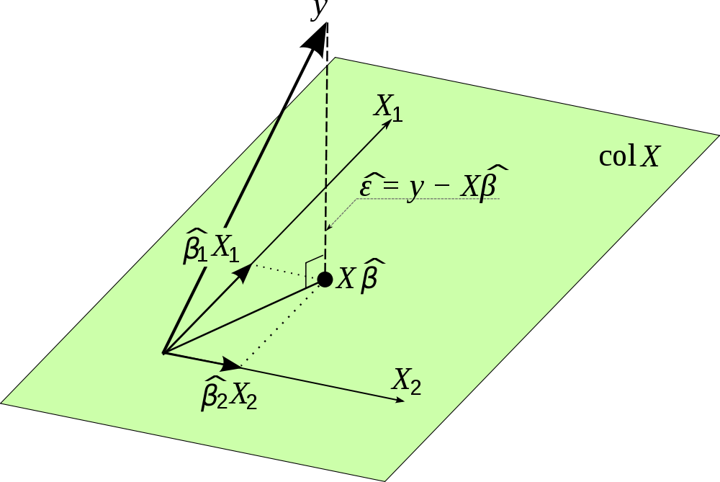
FIGURING OUT GLOBAL COORD. SYSTEM
Determine direction of gravity using gravity sensor
Other sensor data is projected on this new axis
Constant frame of reference

Slide 62
DIFFERENTIATE STEADY vs MOTION
Higher amplitude difference between accelerometer and gravity sensors
Set a threshold amplitude to differentiate

Slide 63
FEATURE GENERATION & SELECTION
For classification, use only accelerometer and gyroscope
0.2 sec segments, each feature vector from 10 readings in it
Sliding window with 50% overlap to maintain continuity
The length of sliding window based on trade off between accuracy and practicality

Slide 64
FEATURE GENERATION & SELECTION
Initially 80 features were generated
Which 80 features are important? (80 models are built and contribution in prediction checked)
Pick features based on independent classification capabilities
Finally 56 out of 80 features are picked

Slide 65
SEMI-SUPERVISED ONLINE LEARNING ALGO.
The 'user' to 'other' ratio is too low (and increases as more users are added)
More negative points than positive data points
Stratified sampling is used to solve this problem

Slide 66
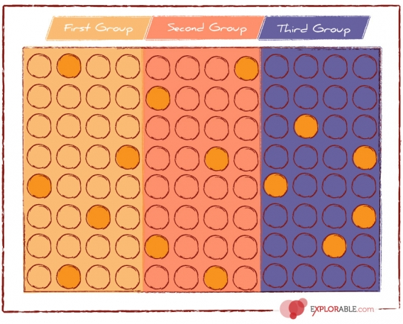
STRATIFIED SAMPLING
Is a probability sampling technique
Divide entire data into subgroups
Randomly select the final data point proportionally from the different subgroups

Slide 67
SEMI-SUPERVISED ONLINE LEARNING ALGO.
‘User’ to ‘other’ is chosen at 1:5 based on experiments
Determine data points limit: plot size of dataset vs accuracy

Slide 68
ROLE OF SUPPORT VECTOR MACHINES (SVMs)
For classification, SVMs are chosen. SVMs are suitable to this problem due to the following reasons
Nonlinear Classification Boundary
Comparatively High Dimensional Space
Due to random sampling, decision forests can’t be used

Slide 69
SEMI-SUPERVISED ONLINE LEARNING ALGO.
Notes:
When the new data is used to train the classifier, it checks if the new classifier will be better than the old one by running predictions on the validation dataset and check for performance drops. If the performance drops, then the classification model is bad -- else it is good..
Commit - Rollback model is used to detect and filter noisy data

Slide 70
IMPLEMENTATION
Uses Android’s UsageStatsManager to check for app activity
Data pre-process module is implemented in C++
For feature generation, LibXtract is used
Weka and LibSVM is used to train the model for each person
For online learning, Vowpal Wabbit (C++) is used
Overall 5000 lines of C++ and 2000 lines of Java code

Slide 71
EVALUATION
Experimental data
Dataset with 10 users, 9240 samples (both steady & motion)
Test to train ratio is 1:4, User to other ratio is 1:5
Data in the wild
50 samples / sec - collection frequency
1513 users for 10 days
60 seconds of data per hour is collected

Slide 72
EVALUATION METRICS
True positive (TP) -The authorized owner is correctly identified.
False positive (FP) - Other users are incorrectly identified as the authorized owner.
False negative (FN) - The authorized owner is incorrectly identified as other users.
True negative (TN) - Other users are correctly identified.
Performance & Overhead. (battery consumption, etc.)
Robustness

Slide 73
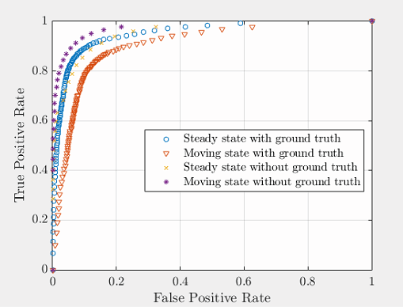
ROC BASED ON EXPERIMENTS
True Positive Rate (Sensitivity or Recall)
TPR = TP/(TP+FN)
False positive Rate
(Fall out)
FPR = FP/(FP+TN)

Slide 74
OTHER CONSIDERATIONS
Overhead on the phone
Resistance against bruteforce attacks
Automatic - Generate data to simulate human behavior
Manual - Confuse the system with gestures

Slide 75
DIFFERENCES IN THE APPROACH

Slide 76
SIGNIFICANT DIFFERENCES
Gait based user identification | RISKCOG for user identification
The user has to be in motion since the technique is based on Gait Identification is not continuous Based on past technologies like GMM popular in pattern recognition and biometrics Smaller dataset generated from experiments Accuracy is 98% | The user need not be in motion - the algorithm takes into consideration the steady state as well Continuous identification Uses SVM used for more generic purposes Larger dataset collected from users in the wild Accuracy is around 95%

Slide 77
FLAWS AND UNANSWERED QUESTIONS

Slide 78
The authors do not comment on how UBM changes with more people added over time
Both papers do not provide a way to evaluate the performance of adaptivity of the algorithm for concept drift (change in Gait or in motion patterns)
RISKCOG specifies the lack of literature in algorithms to handle imbalanced data. This is a common problem and a lot of literature is already present - these algorithms are called ‘outlier detection’ algorithms

Slide 79
The details about threshold setting for Steady vs Motion and the role of DFT is not explained in the paper in detail
How real-time is the training of chunks done to adapt? What is the size of each chunk?
The SVM parameters (Gamma and C) are not discussed
Online algorithms come with an overhead of accuracy which isn’t discussed
The reason for not using decision trees is not based on strong theoretical explanation or citation or reference

Slide 80
The ROC curves show the results with 80 which is lower than results for experimental data, but the final result for all 1513 users is very high. There is no explanation given to this.
The evaluation is performed on static, offline classifiers though the online classification is proposed in the paper. No results on online classification is shown.
No emphasis is given on why and how this technique works when the user is steady and the evaluation doesn’t concentrate on proving that this is indeed true

Slide 81
CONCLUSIONS & TAKEAWAYS

Slide 82
Both the papers propose a way to achieve user identification using mobile phone sensors
The use of accelerometer, gyroscope and gravity sensor data is less privacy intruding than other forms and hence more users would be willing to adopt this solution
RISKCOG provides a way to identify the user without a need for walking or running (which all other gait based mechanisms require)
The semi supervised learning can smartly adapt to the concept drift which gets introduced over time

Slide 83
Q&A

Slide 84
RISKCOG SYSTEM DESIGN - OVERVIEW
Device is uniquely identified using the IMEI
Periodically collect data and incrementally send to server
Preprocess and training set construction
Using statistical consistency checks, eliminate the outliers
Train the model using rest of the data
When the model gives consistent accuracy across multiple data chunks, the training is complete

