Slide 1
Android App Static Analysis
Gan Fang
Diane Liu
James Whang

Slide 2
Overall Intro: Android Security
Android has seen a constantly growing market share in the mobile phone market, which is now at 81%
Android has a permission-based security model
Growing threats of privacy violations which leak sensitive information
e.g.: Ad libraries that collect unique identifying information such as MAC address
Applications that collect location, contact information, pictures, financial info, etc.
A large variety of sensors like GPS allow a context-sensitive user experience, they also create additional privacy concerns if used for tracking or monitoring
Notes:
developers specify permissions they want. user has to accept all or can’t install
Felt et al discovered out of 940 apps from Android market, 1/3rd overpriveleged

Slide 3
Motivation
Increasing chance of potential data leakage in Android apps
High rate of false alarms within current approaches
Notes:
info leakage can be intentionally introduced by malicious developers or unintentionally introduced by careless developers
either purposefully sending info elsewhere
or making info available and able to be read by 3rd party sources like ad libraries
application processes sensitive data and makes it available on insecure part of device
e.g. copy paste buffer caching - copy sensitive info to clipboard
browser cookies, url caching, analytics data,

Slide 4
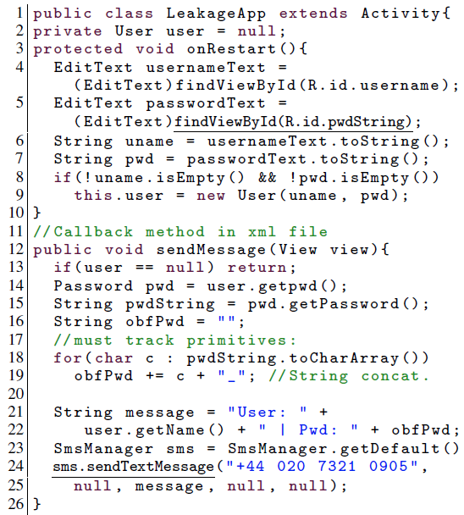
Background: Android Information Leakage
Example of Information Leakage in Android Code:
Line 5: Read Password
Line 24: Send the password via SMS
Notes:
example of data leakage in code
on restart, read password string (ln 5), and send password string via SMS (ln 24)
sendMessage() callback associated with button onClick()
source = password field, sink = SMS API
only occurs if onRestart() called; taint analysis needs to be able to recognize this possible lifecycle

Slide 5
Background: Android Information Leakage
Example malicious app which reads from copy/paste buffer - if user copies sensitive information, 3rd party app can access
Notes:
example of unintended data leakage
application processes sensitive data and makes it available on insecure part of device
e.g. copy paste buffer caching - copy sensitive info to clipboard
others: browser cookies, url caching, analytics data,
http://resources.infosecinstitute.com/android-hacking-security-part-4-exploiting-unintended-data-leakage-side-channel-data-leakage/

Slide 6
Background: Static Analysis
Static analysis inspects the program code to derive information about the program’s behavior at runtime.
Abstracts from concrete program runs
Makes conservative assumptions about all possibilities
Static analysis can check for programming errors and security flaws, and is also included in modern compilers for optimization purposes.
In general, two different approaches to static analysis: type systems and data-flow based approaches.
Notes:
abstract from concrete program runs: nearly every program has variable ingredients (inputs from a user, files, the internet etc.), dont generate all combos
sound static analysis might detect behvaior that doens’t happen during runtime, but will never miss behavior that can happen during runtime
type systems: analyze program based on concrete value types using rules of inference
type systems aren’t flow or context sensitive
data flow approach: generate control flow graph to determine parts of a program to which a particular value assigned to a variable might propagate.

Slide 7
Background: Taint Analysis
A taint analysis is a special type of data flow analysis. It follows a sensitive “tainted” object from source to sink, tracking tainted relevant data along the way.
This allows us to track the influence of a tainted object along a program execution.
Can be used to find information leakage and program vulnerabilities
Notes:
information leakage & program vulnerabilities
program vulnerabilities (code injection): unknown input not sanitized before its sent to sensitive sinks (e.g. databases)
information leakage: what we are focusing on
sensitive information leaked to unknown sinks
1. taint data that contains user secrets
2. taint variables whose data depends on these tainted values
3. observe if tainted data might flow to fxns that send data other places

Slide 8
FlowDroid: Precise Context, Flow, Field, Object-sensitive and Lifecycle-aware Taint Analysis for Android Apps, S. Arzt et.al
FlowDroid: the first fully context, field, object and flow sensitive taint analysis for Android which considers the Android application lifecycle and UI widgets, and which features a novel, particularly precise variant of an on-demand alias analysis
DroidBench: a novel, open and comprehensive micro benchmark suite for Android flow analyses
Experiments confirming precision and recall of FlowDroid
Experiments applying FlowDroid to 500 Google Play apps, 1000 VirusShare project malware apps.

Slide 9
Main Idea: FlowDroid
What is FlowDroid?
A precise static taint analysis tool for Android applications
What does it do?
Analyzes the apps’ bytecode and configuration files to find potential privacy leaks
Why FlowDroid?
It maximizes precision in flow/leakage analysis

Slide 10
Challenges that FlowDroid Addresses
Need precise models of Android lifecycles and their associated callbacks
Can’t determine sources of sensitive information from program code alone, need auxiliary information from Manifest and XML files
Java code - deep, complicated Aliasing and Virtual Dispatching contructs, so need high object sensitivity to resolve aliasing effectively
High false-positive and false-negative rate of analysis

Slide 11
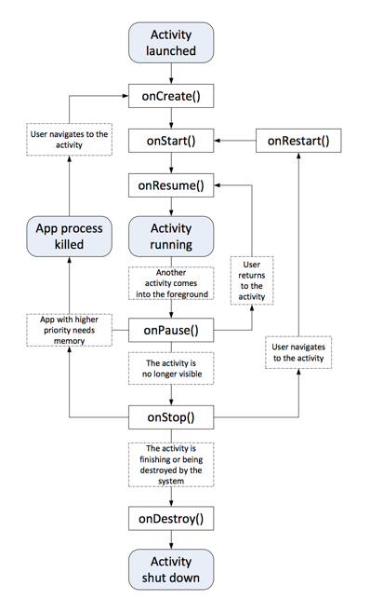
Challenge 1: Precise Modelling of Lifecycle
This is addressed through:
Multiple Entry Points
Asynchronously Executing Components
Callbacks
Also incorporates Challenge 2, which takes into account auxiliary sources of information

Slide 12
Multiple Entry Points
Unlike standalone Java programs, Android applications do not have a main method. Apps instead comprise many entry points that aren’t statically accessible.
There are 4 possible components in Android apps::
Activities are single focused user actions
Services perform background tasks, content
Providers define a database-like storage
Broadcast receivers listen for global events
Notes:
types of different entry points: start, restart, come from another app, etc
dummy main contains all calls

Slide 13
Multiple Entry Points
The Android framework calls these methods to start or stop the component, or to pause or resume it, depending on environment needs.
When constructing a call graph, Android analyses cannot simply start by inspecting a predefined “main” method.
To cope with this problem, FlowDroid constructs a custom dummy main method emulating the lifecycle.
Notes:
dummy main just calls all given entry points

Slide 14
Asynchronously Executing Components
FlowDroid assumes that all components (activities, services, etc.) inside an application can run in an arbitrary sequential order (including repetition).
FlowDroid bases its analysis on IFDS, an analysis framework which is not path sensitive.
FlowDroid can thus generate and efficiently analyze a dummy main method in which every order of individual component lifecycles and callbacks is possible; it does not need to traverse all possible paths.
Notes:
services and broadcast receivers run in parallel, activities run sequentially
order of activities can be subject to user input and isn’t predefined/constant
conservatively assume all components can run in arbitrary sequential order
within each component, lifecycle allows only certain execution orders of the framework method
UI callbacks can also occur in arbitrary order, assuming corresponding activity is running -> flowdroid assumes they are in any order
Flowdroid based on IFDS analysis (not path sensitive)
IFDS interprocedural finite distributive subset problems. set of dtatflow facts is finit and dataflow functions distribute over meet operator. graph reachability problem - along iterprocedurally realizable paths
join all analysis results immeditaly at any control flow merge point, allows generation f main method in which every order of components and callbacks is possible. dont have to take into account different paths separately

Slide 15
Callbacks
The Android operating system allows applications to register callbacks for various types of information, e.g., location updates or UI interactions.
FlowDroid models these callbacks in its dummy main method.
For precision, FLOWDROID thus associates components (activities, services, etc.) with the callbacks they register.

Slide 16
Callbacks
There are two different ways to register callback handlers on the Android platform.
Callbacks can be defined declaratively in the XML files of an activity.
They can also be registered imperatively using well-known calls to specific system methods.
FlowDroid supports both ways.
Notes:
scans layout XML files in the apk file for text inputs and links them to source ode statements where they are accessed. this is nontrivial bc android OS accesses these resources at runtime - need to simulate this w static analysis

Slide 17
Callbacks
For finding callbacks registered in the application code, FlowDroid first computes one call graph per component, starting at the lifecycle methods (onCreate(), onStop(), etc.)
The call graph is incrementally extended to include these newly discovered callbacks, and the scan is run again since callback handlers are free to register new callbacks on their own
Notes:
flowdroid comes with list of callback interfaces extracted from android documentation
compute call graph, ignoring callbacks
incrementally extended until no new callbacks found
custom dummy main generated after this, which takes all callbacks into account

Slide 18
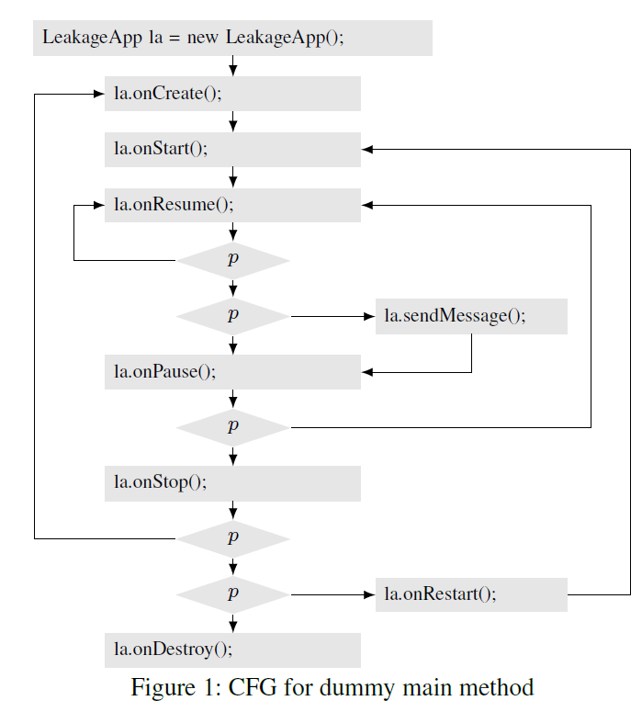
Life Cycle Modeling Example
Figure 1 shows the control-flow graph of the dummy main method example. The graph models a generic activity lifecycle augmented with the sendMessage callback. In this figure, p represents an opaque predicate of which we know that FlowDroid won’t be able to evaluate it statically. In result, the analysis will automatically consider on equal terms both branches for conditions involving p
Notes:
p represents “opaque nodes” that FlowDroid can’t analyze statically

Slide 19
Challenge 3: Aliasing
Given the code on the right, a, b, c, and d.f all refer to the same data
The data from source is therefore aliased by 4 different names: a, b, c, and d.f
int a = source();
int b = a;
int c = b;
Data d.f = c;

Slide 20
Alias Analysis
Analyzing all of the aliases in a given Android app is expensive and imprecise.
It also analyzes variables that are not necessarily aliases of source, so we end up keeping track of a lot more aliases than we need to
On-demand alias analysis for tainted information only is needed to avoid this problem
int a = source();
int b = 3;
int c = b;
Data d.f = c;
int e = a;
Data f.src = e;

Slide 21
On-Demand Alias Analysis
When a tainted variable is assigned to a heap-allocated variable (e.g. a field in a class, or an array), we need to go and find aliases of the heap-allocated variable on top of such variables.
int a = source();
int b = 3;
int c = b;
Data d.f = c;
int e = a;
Data f.src = e;

Slide 22
Context Sensitivity
More precise, higher-cost static analysis technique
Context insensitive analysis would know that a and b are associated with addFive() but doesn’t know that b is still 1 at (1)
Context sensitive analysis knows that at (1) b is unchanged, and only a is changed to 5.
int main() {
int a = 0;
int b = 1;
addFive(&a); (1)
addfive(&b); (2)
}
void addFive(int * p) {
*p += 5;
}

Slide 23
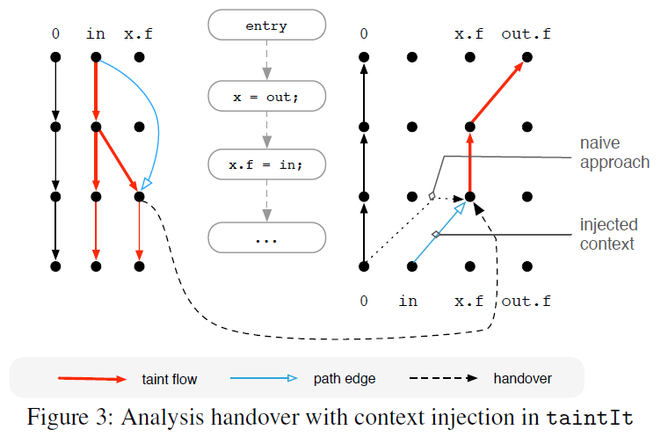
Maintaining context sensitivity
Here the black nodes represent dataflow facts before/after the respective statement and the black and red edges represent data flows. The fact 0 is the tautological fact that is always true.

Slide 24
Maintaining context sensitivity
The left-hand side of the figure shows how the forward taint analysis determines x.f to be tainted.
When processing the assignment to x.f, the forward analysis spawns an instance of the backward alias analysis, shown on the right-hand side.

Slide 25
Maintaining context sensitivity
A second problem is to avoid false positives due to unrealizable paths:
FlowDroid needs to prevent the backwards analysis to return into contexts not analyzed by the forward analysis (and vice versa).
To implement this constraint, the backward analysis in FLOWDROID actually never returns into the caller at all.

Slide 26
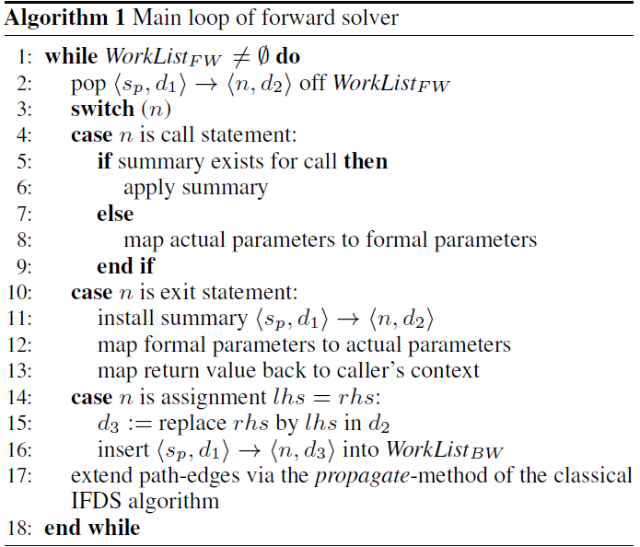
Algorithm: Main Loop of Forward Solver
Once FlowDroid finds an assignation of a tainted variable, it consults the “path edge” to that variable, which the IFDS algorithm stores as a side-effect of its summary computation. It then injects that entire edge into the backward solver. (line 16)

Slide 27
Algorithm: Main Loop of Forward Solver
Context injection happens both ways. At line 9 in the example, when the backward analysis spawns a forward analysis for out.f, it injects into the forward analysis the original context in.(see Algorithm 2, line 17)

Slide 28
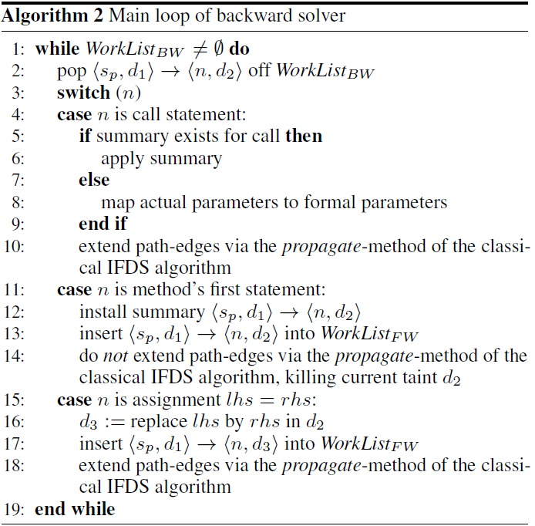
Algorithm: Main Loop of Backward Solver
When the backwards analysis descends into a call, it will eventually spawn a forward analysis when reaching the method header. (Line 13)
The forward analysis can then make sure to only return into the right caller because its context is injected by the backward analysis.

Slide 29
Maintaining flow sensitivity
Without flow sensitivity, the analysis would report two leaks at lines 2 and 4, even though the first call to sink definitely happens before p2.f becomes tainted.
Keep track of activation statements: Whenever spawning an instance of the backwards alias analysis, the respective access path is augmented with the current statement, the alias’ activation statement.
In general, activation statements are representatives of call trees.

Slide 30
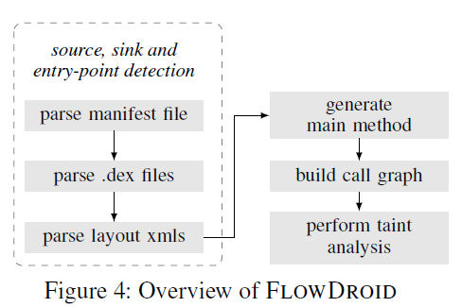
Implementation: Architecture
FLOWDROID searches the application for lifecycle and callback methods as well as calls to sources and sinks.
FLOWDROID generates the dummy main method from the list of lifecycle and callback methods. This main method is then used to generate a call graph and an inter-procedural control-flow graph (ICFG).

Slide 31
Implementation: Architecture
3. Starting at the detected sources, the taint analysis then tracks taints by traversing the ICFG.
4. At the end, FLOWDROID reports all discovered flows from sources to sinks. The reports include full path information.

Slide 32
Implementation
“Shortcuts” for Native Library Calls
Doing static analysis on the entire Android framework takes way too long
Define “shortcuts” that adds taint to given set of library calls
Native Calls (Calls made to native C libraries from Android, etc.)
Treated as a black box
By default, call arguments and the return value are become tainted if at least one parameter was tainted before
Possible limitation

Slide 33
Other Limitations: FlowDroid
Inter-Components Communication and Intent-based Communication
Can handle Reflective Calls only if their arguments are constant string
Unsoundness
Can’t handle probabilistic taints that occurs through multithreading
Notes:
we should expand on these points

Slide 34
Other Limitations: FlowDroid
Can handle Reflective Calls only if their arguments are constant string
This is largely due to the fact that reflective calls set their method through some kind of external configuration file
Android doesn’t support load-time instrumentation to statically access this kind of information
Notes:
we should expand on these points

Slide 35
Other Limitations: FlowDroid
Can’t handle leakage through multithreading
Multithreading introduces nondeterministic and probabilistic call-flow which makes it difficult to analyze
Notes:
we should expand on these points

Slide 36
Evaluating FlowDroid with DroidBench
What is DroidBench?
--A set of well-known Android test applications, contains 39 hand-crafted Android apps.
On DroidBench, FlowDroid finds a very high fraction of data leaks while keeping the rate of false positives low.
On DroidBench, FlowDroid achieves 93% recall and 86% precision, greatly outperforming the commercial tools IBM AppScan Source and Fortify SCA.

Slide 37
Evaluation: FlowDroid
AppScan shows a relatively decent precision of 74%.
Fortify’s precision measures as 81%.
FlowDroid successfully finds leaks in a subset of 500 apps from Google Play and about 1,000 malware apps from the VirusShare project.
FlowDroid also find all 7 data leaks verified by hand in InsecureBank.
But, due to different kinds of reasons, the authors were unable to successfully evaluate even a single scientific taint-analysis tool for Android on our own.
Notes:
we can probably split this up into a couple of slides

Slide 38
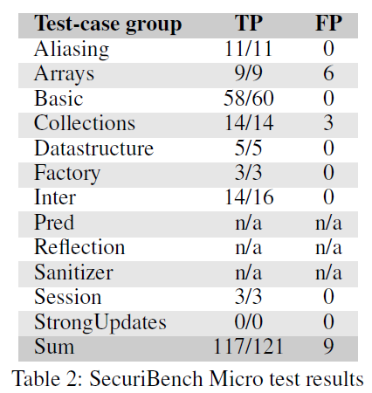
Evaluation: FlowDroid
How well does FLOWDROID perform when being applied to taint-analysis problems related to Java, not Android, both in terms of precision and recall?
TP column shows the true positives, i.e., the number of actual leaks that FlowDroid found. For the example of Basic, for instance, FlowDroid found 58 out of 60.
FP column shows the number of false positives.

Slide 39
What’s Next?
Lists of sources and sinks known from the scientific literature only contain some few well-known methods for obtaining and sending out potentially sensitive information.
However, developers of malicious applications can thus choose less well known sources and sinks to circumvent analysis tools.
It’s important to generate a comprehensive list of sources and sinks for detecting malicious behavior in deceptive applications.

Slide 40
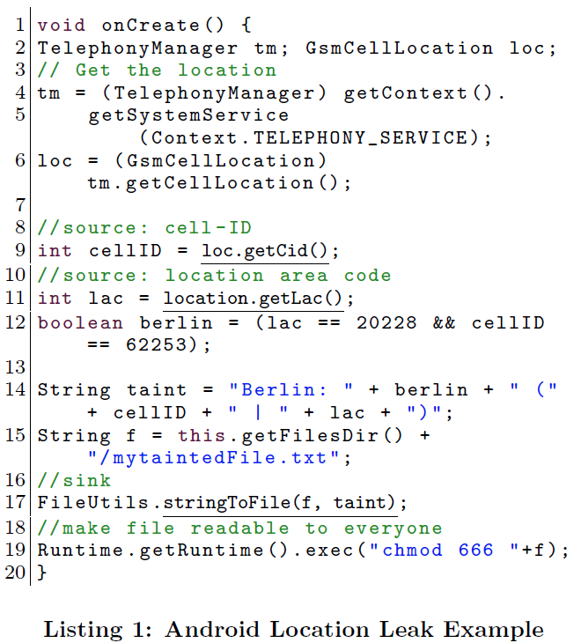
Example: Avoiding Detection
In our scenario, we have two source methods.
Line 9 calls getCid(), returning the cell ID.
Line 11 then calls getLac(), returning the location area code.
Both pieces of data in combination can be used to uniquely identify the broadcast tower servicing the current GSM cell.
line 12 the code checks for a well-known cell-tower ID in Berlin. An actual malicious app would perform a lookup in a more comprehensive list.

Slide 41
SuSi: A Tool for the Fully Automated Classification and Categorization of Android Sources and Sinks, S. Arzt et.al
Existing static and dynamic analysis tools aid to assess the behavior of mobile applications, but are only as good as the privacy policies they are configured with.
Policies typically refer to a list of sources of sensitive data as well as sinks which might leak data to untrusted observers.
However, Sources and sinks are moving targets: new versions of the mobile operating system regularly introduce new methods, and security tools need to be reconfigured to take them into account.

Slide 42
Main Idea: Susi
What is Susi?
A fully automated Android source code Analyzer with machine-learning approach for identifying sources and sinks.
What does Susi do?
Deduct manual works and mine + identify the Sources and Sinks in Android code automatically
Why is Susi good?
It’s fully automated with increasing precision and learning ability

Slide 43
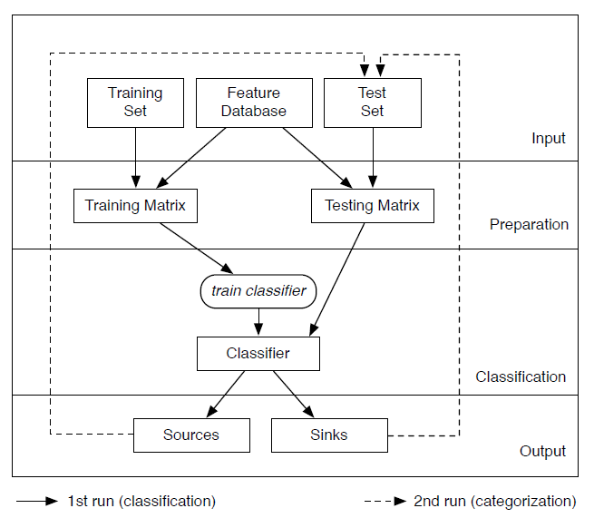
Structure: Susi
Susi’s structure has 4 different layers:
input, preparation, classification, and output.
The execution of Susi run two rounds:
One for classifying methods as sources, sinks, or neither, and one for categorizing them.

Slide 44
Features & Details
For identifying sources and sinks, SuSi uses the following classes of features:
Method Name | Method Has Parameter? | Return Value Type | Parameter Type | Parameter Is An Interface? | Method Modifiers
Class Modifiers | Class Name | Dataflow to Return | Dataflow to Sink | Data Flow to Abstract Sink | Required Permission

Slide 45
Learning Models and Methods
As a concrete classifier, we use support vector machines (SVM), a margin classifier, more precisely the SMO implementation in Weka with a linear kernel.
SMO is only capable of separating two classes. We solve the problem with a one-against-all classification.
In general, problems can be transformed into higher-dimensional spaces if the data is not linearly separable.

Slide 46
Enhancements
Implicit Annotations for Virtual Dispatch: propagate method annotations up
Although based on Weka, however, they found that when annotating methods to obtain training data it would be beneficial to propagate method annotations up and down the class hierarchy in cases in which methods are inherited.
Prefiltering: Reduce the # of methods
We also prune all private methods and all methods in private classes. This design choice is justified by the fact that apps can access such methods only through reflection.

Slide 47
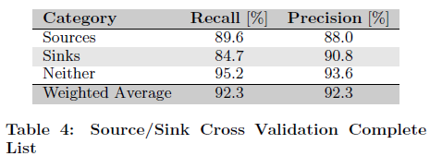
Evaluation-1: Susi
Can SuSi effectively find sources and sinks with high accuracy?
--Table 4 shows the ten-fold cross-validation results of applying our approach to the complete Android SDK of about 110,000 public methods.

Slide 48
Evaluation-1: Susi
The results of applying different learning models are listed in Table 5:
In Table 5, the weighted average precision for SMO, J48, and Naive Bayes, the most well-known representatives of their respective families of classifiers are compared.

Slide 49
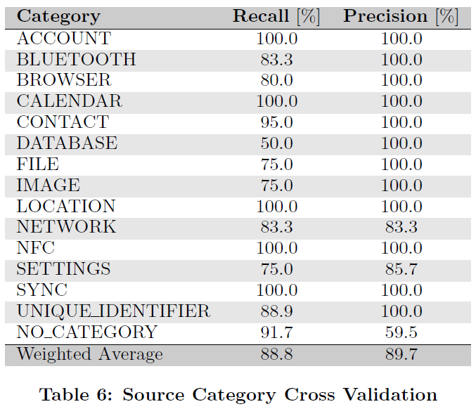
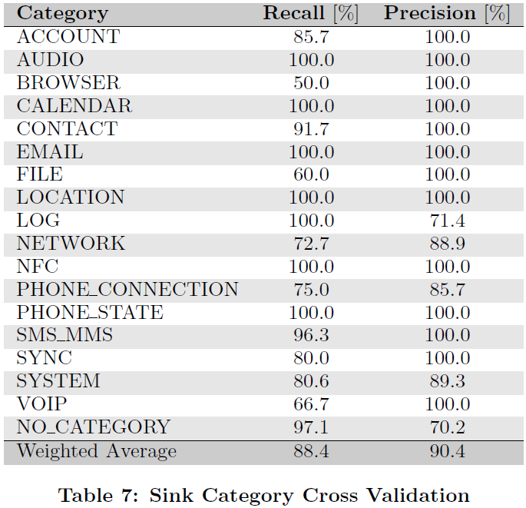
Evaluation-2: Susi
Can SuSi categorize the found sources and sinks with high accuracy?

Slide 50
Evaluation-3: Susi
How complete are the lists of sources of sinks distributed with existing Android analysis tools and how do they relate to SuSi’s outputs?
--SCanDroid is available as an open-source tool. We extracted the source and sink specifications from the source code. The resulting list appears hand-picked and only contains a small fraction of SuSi’s.
Fortify can be configured with rules for defining sources and sinks. The list contains about 100 Android sources and 35 Android sinks, all of which are also included in our results.

Slide 51
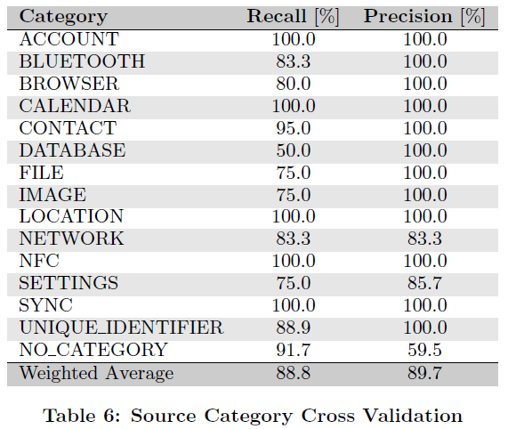
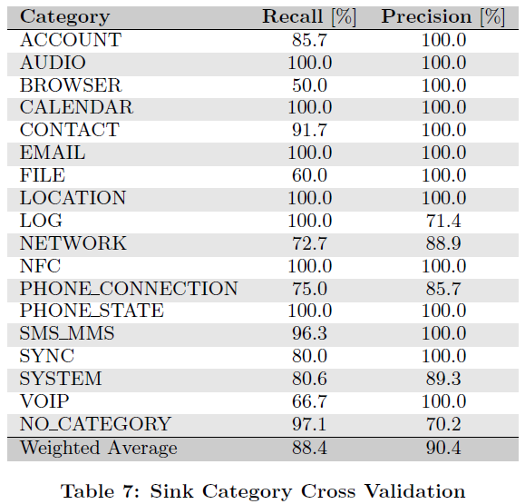
Evaluation: Susi

Slide 52
Limitations: Susi
Applications can implement callback methods and receive data from the operating system through the parameters of these methods. SuSi cannot currently find such callbacks as, by our definition of sources, such callbacks are out of scope.
Example:
In an attempt to avoid detection, the app could however register the callback with onNmeaReceived instead of the well-known onLocation-Changed method and then parse the raw GPS data (the NMEA records). However, Both kinds of callbacks receive sensitive data as parameters.

Slide 53
Conclusion: Wrap up
There are bunch of Static Taint Analysis Tools available, but with certain limitations.
FlowDroid provides a solution for leakage detection specifically for Android.
FlowDroid’s highlights are located at “Higher Precision”, with the improvements in sensitivity and better modelling for App Life Cycle.
Susi is an analyzing tool that merges Taint Analysis and Machine Learning Categorization approaches.
FlowDroid detects potential leakages, Susi further analyzes the results.

Slide 54
Related Works
[1] Arzt, S., Rasthofer, S., Fritz, C., Bodden, E., Bartel, A., Klein, J., ... & McDaniel, P. (2014). Flowdroid: Precise context, flow, field, object-sensitive and lifecycle-aware taint analysis for android apps. ACM SIGPLAN Notices, 49(6), 259-269.
[2] Arzt, S., Rasthofer, S., & Bodden, E. (2013). Susi: A tool for the fully automated classification and categorization of android sources and sinks. University of Darmstadt, Tech. Rep. TUDCS-2013-0114.
[3] IBM Rational AppScan, Apr. 2013. http://www-01.ibm.com/software/de/rational/appscan/.
[4] Fortify 360 Source Code Analyzer (SCA), Apr. 2013. http://www8.hp.com/us/en/software-solutions/software.html?compURI=1214365#.UW6CVKuAtfQ.
[5] INFOSEC Institute, Exploiting Unintended Data Leakage (Side Channel Data Leakage), http://resources.infosecinstitute.com/android-hacking-security-part-4-exploiting-unintended-data-leakage-side-channel-data-leakage/
[6] Fritz, C. (2013). Flowdroid: A precise and scalable data flow analysis for android (Doctoral dissertation).

Slide 55
Questions?

