Slide 1
Thesis Proposal:
Achieving Security and Efficiency in Software-Defined Networks
Xitao Wen
Committee Members:
Prof. Yan Chen
Prof. Alekxandar Kuzmanovic
Dr. Li Erran Li
Prof. V.N. Venkatakrishnan
Notes:
It’s my pleasure to have you guys attending my thesis proposal defense…

Slide 2
Background
SDN: Push everything to software
  Software control-plane
  Software forwarding
  Network function virtualization (NFV)
Two objectives in SDN platform design
  Performance
  Security
Notes:
Original idea, separate CP and DP, so new ideas deployed
Nowadays, people realize software dataplane is a good idea on the edge of the network
Performance latency, throughput, scalability
Large body of system papers on performance
Limited works on security

Slide 3
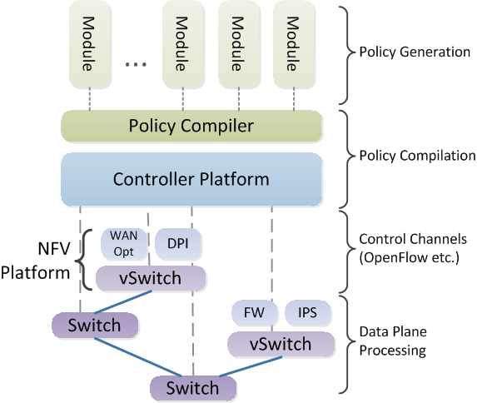
SDN Architecture
Notes:
Today’s view of SDN architecture
From bottom up
Dataplane consist of forwarding fabric and network functions (or middleboxes). VNF are hosted a common platform on commodity servers, which we call NFV platform
Controller configures DP through control protocols such as OpenFlow
Policy actually comes from customized controller modules, which are located on the top of the ecosystem
In some systems, policy generated by the modules are in a high level policy language, which needs to be translated by a policy compiler
In my thesis, I’m gonna follow the this architecture, and provide a secure controller platform and a secure NFV platform

Slide 4
Design Consideration
Traditional Security Threats
  Traffic security and integrity
New Security Threats to SDN
  Misbehaved control-plane modules
  Compromised data-plane functions
Performance Demands
  Control-plane: policy update
  Data-plane: low-latency VNF
Notes:
To design new SDN platforms, these are the main design considerations
In the security aspect,
In the efficiency aspect, we observe urgent demands from two specific places (details later)

Slide 5
Related Work
Use SDN to enhance traditional security
  Enable arbitrary middlebox placement [SIMPLE…]
  Middlebox consolidation [CoMb, xOMB…]
Provide better solution to traditional network threats
Do not address new security issues of SDN itself

Slide 6
Related Work
Security on SDN control plane
  Detect rule conflicts [FortNOX, FRESCO]
Security on SDN data plane
  Add intelligence to DP to increase resilience to anomalous traffic [Avant-Guard]
Do not cover the huge threat space that does not produce rule conflicts
Represents only one spot in the threat space
Notes:
Also, there are a few working talking about security for SDN
Control plane: Not enough
Data plane: prevent from flooding attacks of new flows

Slide 7
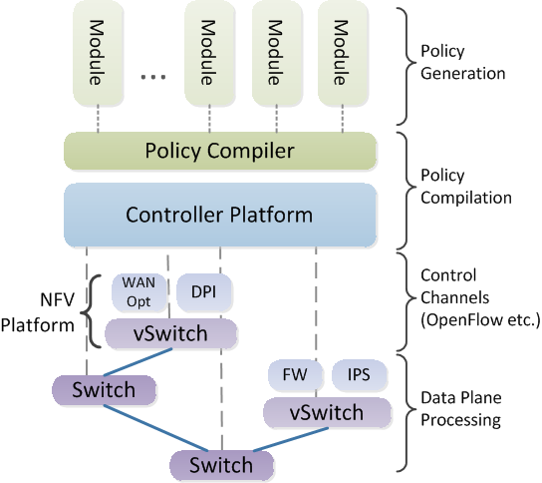
Research Questions
How to secure the policy generation on control plane?
How to provide a secure NFV platform with the least efficiency sacrifice?
How to efficiently push policy updates to data plane?

Slide 8
Thesis Statement
To provide a secure and efficient SDN platform that comprises of
  A secure control plane
  A secure NFV platform on data plane
    Efficient module reuse/sharing
  Capability of efficient policy update between control plane and data plane
Notes:
Generally, the goal of my thesis is to provide a ….

Slide 9
Contribution
Securing policy generation on control plane
  SDNShield [HotSDN’13, full paper in submission]
Securing network functions on data plane
  A Consolidated NFV Platform for Security Middleboxes [proposed work]
Speeding up policy update b/w CP and DP
  Compact Update [HotSDN’14, full paper in progress]
Notes:
These are the three pieces of work I propose to have in my thesis

Slide 10
SDNShield: Privilege Enforcement for SDN application
“Secure policy generation on control plane”
Notes:
Let’s dive into the first work

Slide 11
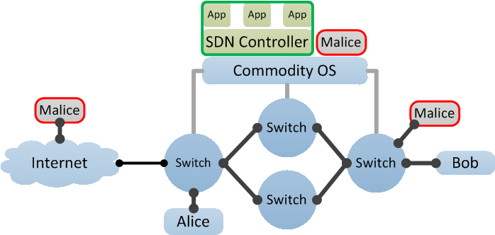
Motivation
New attack surface brought by SDN
Jeopardize the security of the entire network
New Attack Surface:
Host-Controller Channel
Traditional Attack Surface:
DP-CP Channel

Slide 12
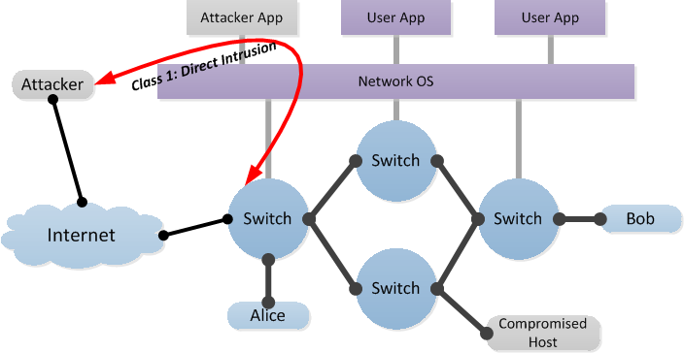
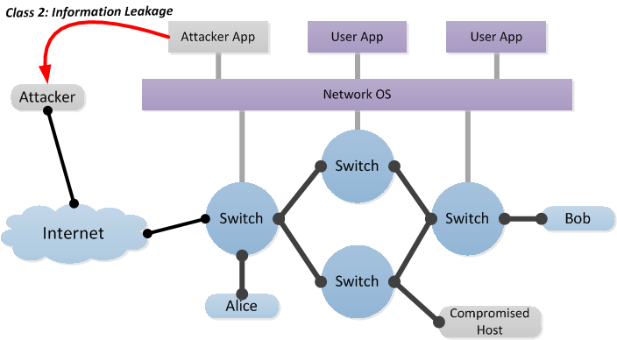
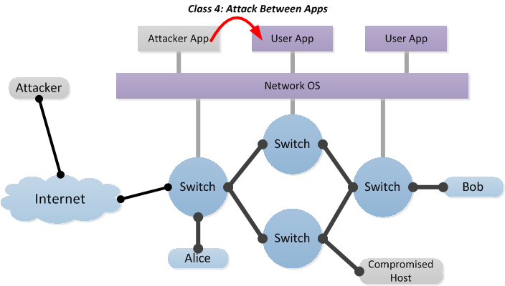
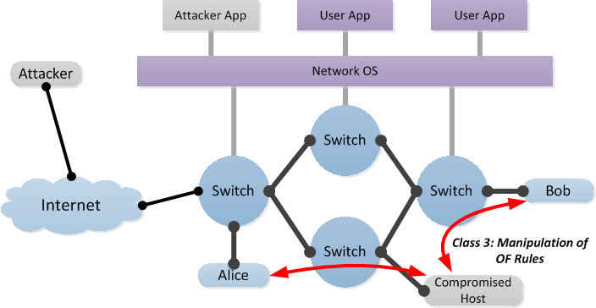
Threat Model
Two threat models
  Exploit of existing benign-but-buggy apps
  Distribution of malicious apps by attacker
Plenty of potential attacks
Notes:
We foresee the attack to come in two ways…

Slide 13
Approach
Policy-based Access Control on Apps
  Proactively eliminate apps’ over-privilege behaviors

Slide 14
App Behavior Space
Describes all behaviors an app can conduct
  Insert flows on edge switches matching ip dst range 10.1.1/24
  Read statistics of owned flows
  Send topology info to 168.124.8.8 via HTTP
  …
Complexity in describing the space
  High dimensional: app action, flow predicate, topology, ownership…
  Heterogeneous partition standard: trie for IP, set for phy topo, map for virt topo, yes/no for flow ownership, integer range for priority, wildcard
  Non-orthogonal dimensions/inter-dimension dependency: e.g. priority limit is valid for flow insert and modification, but not valid for flow delete
Key difference with firewall rules

Slide 15
Challenge
How to describe SDN app based permissions?
  Accurately describe the complex API behavior space
  Complicated logic is needed to depict inter-dimensional relations
How to refine app permissions based on network admin’s security policy?
  Need to mediate inputs from app developer and network admin
  Need a bridge to reshape app’s permission space with local security requirements
SDNShield Permission Language
SDNShield Constraint Language

Slide 16
Comparison
 | Control-plane or Data-plane | Allow App Cooperation? | Protection beyond Flow Conflict | Protection beyond CP/DP Channel?
FortNOX/FRESCO | CP | Yes | No | No
FlowVisor | CP | No | Yes | No
AvantGuard | DP | N/A | N/A | N/A
SDNShield | CP | Yes | Yes | Yes

Slide 17
System Overview
Permission Manifest
  Describes per-app permission requirement
  Written in permission language
  Drafted by app developer
  Reviewed by controller vendor
Security Constraints
  Describes security requirements of local environment
  Written in constraint language
  Provided by network admin

Slide 18
Static vs. Dynamic
Permission Language
  Evaluated dynamically
  Because the parameters of API calls are not concrete until runtime
Constraint Language
  Evaluated statically (no runtime overhead)
  We specifically design the constraint language to be verifiable statically through formal reasoning

Slide 19
Permission Language
Establishes behavior boundary for individual apps
Challenge: deals with a multi-dimensional space of app behaviors, where each dimension requires distinct partition principle
Space of App Behavior
App 2
App 1
App 3

Slide 20
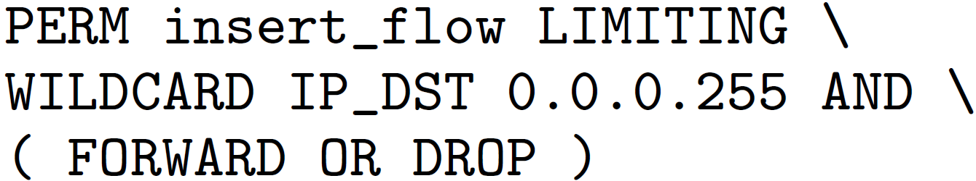
Permission Design
Coarse-grained permission headers
  Describe large pieces of logical resources
  Each corresponds to one or more APIs
Fine-grained permission options
  Partition resources to smaller pieces
Permission Header
Permission Options
Notes:
Manage multi-dimensional complexity with permission filters and the filter logic

Slide 21
Constraint Language
Describes permission boundary and inter-permission conflicts
  Permission boundary
  Mutual exclusion
  ……
Category X
Mutex Y
Mutex Z
App 2
App 3
App 1
Permission Violations

Slide 22
Enforcement
Theorems on permission comparability
Algorithms of permission arithmetic

Slide 23
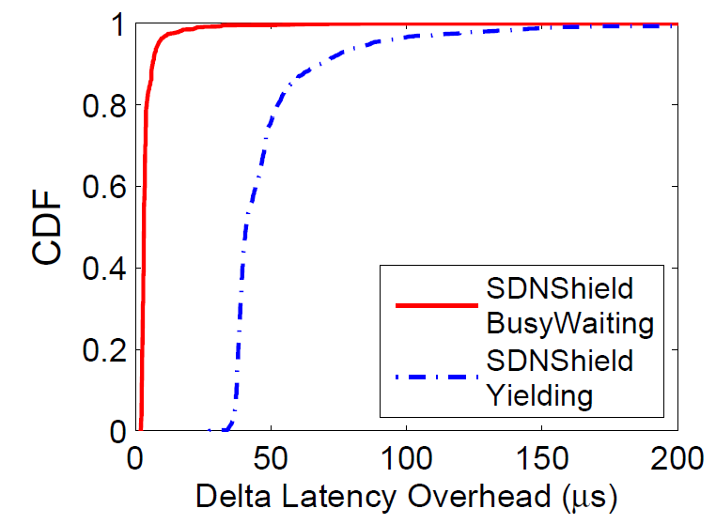
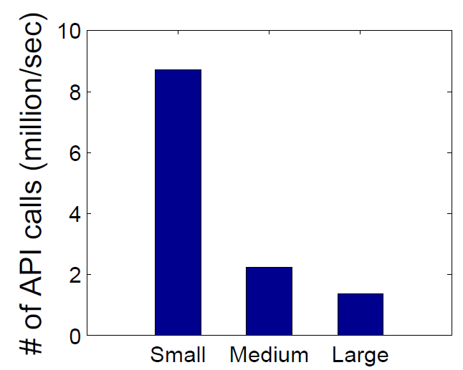
Evaluation
Delta Latency Overhead
  1s to 10s of microseconds
  100x smaller than the typical latency in DCN
Permission checking throughput
  Multiple million per sec per core

Slide 24
A consolidated NFV platform for security middleboxes
“Securing network functions on data plane”

Slide 25
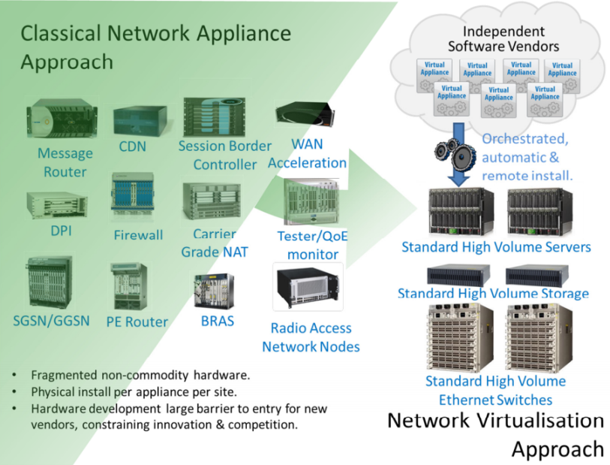
Network Function Virtualization
Consolidating software middleboxes on commodity servers
Two trend in designing NFV Platform
  “Parallel”: one packet is handled by a single core
  “Pipeline”: one packet is handled by multiple cores

Slide 26
Parallel vs. Pipeline
Parallel [CoMb, xOMB…]
Pipeline [NetVM, ClickOS…]
Better Performance
  No queuing, fewer cache misses
No security protection
  MBs share same memory space
Poor Performance
  Queuing delay, memory copy…
Perfect security isolation
  MBs are isolated by process and even VM container
Questions:
How about a deeper pipeline of security functions?
How about adding security features to parallel paradigm?
Notes:
Parallel and pipeline represent two end of the spectrum.

Slide 27
Idea 1:
Consolidating Security Middleboxes
Security Middleboxes
  Firewall, IDS/IPS, DPI, AppFilter, Proxy…
Common operations
  Protocol parsing, packet classification, pattern matching…
Idea:
To consolidate common functions and accelerate!
Notes:
Avoid duplication in developing software MB

Slide 28
Consolidated MB Pipeline
DPI Web SF IDS Proxy
Firewall
Parsers
Classifier
Pattern Matching
Session Management
Common functions are implemented just once.
Common operations are executed just once.

Slide 29
Idea 2:
Inter-middlebox attack prevention
Memory-based attacks between middleboxes
  Buffer overflows
  Data leakage (e.g. Heartbleed)
Resource exhaustion attacks between middleboxes
  CPU time
Memory space isolation
Predictable latency
Idea: extending “parallel” model with memory isolation and strict latency guarantee.
Notes:
As a reminder, the 2ed direction is to add security features to the parallel paradigm

Slide 30
Memory Isolation
Bottom-line approach: OS process
  Good: memory space isolation
  Bad: expensive CPU context switching
More lightweight approach?
  Static analysis for stack abuses
  Isolate heaps for different middleboxes

Slide 31
Strict Latency Guarantee
Key idea: allow middlebox to time out
  Process will be preempted when an unexpected long time is used.
  Customize kernel scheduler to implement
Profiling middleboxes to determine good timeout values
Possible action to packet after timeout
  Drop
  Move to a slow queue
  Skip current middlebox (if it won’t cause error)

Slide 32
Proposed Work
Consolidating security middleboxes
  Use case survey
  Framework design and implementation
Memory isolation design and implementation
  Mechanism design and security analysis
  System implementation
Latency-aware scheduling
  Mechanism design and security analysis
  System implementation
System integration and measurements

Slide 33
Compiling Minimum Incremental Update for Modular SDN Languages
“Speeding up policy update between CP and DP”

Slide 34
Flow Table Update
Huge latency overhead
  Switch update rate: 10s ~ 100s entries/sec
  Refreshing 5K entries takes minutes
Given a policy update, it is desirable to modify as few flow entries as possible.

Slide 35
SDN Policy Language
Higher-level abstractions in network programming
  Flow space abstraction
  Policy composition
Naïve algorithm generates inflated # of updates
  Most updates only modify the priority

Slide 36
Rule Dependency and Priority
Priority is used to disambiguate rule overlap
  The rule with higher priority matches
  Priority encodes rule dependency
Rule dependency induces a partial order
  Forms a directed acyclic graph (DAG)
  Priority encoding loses information

Slide 37
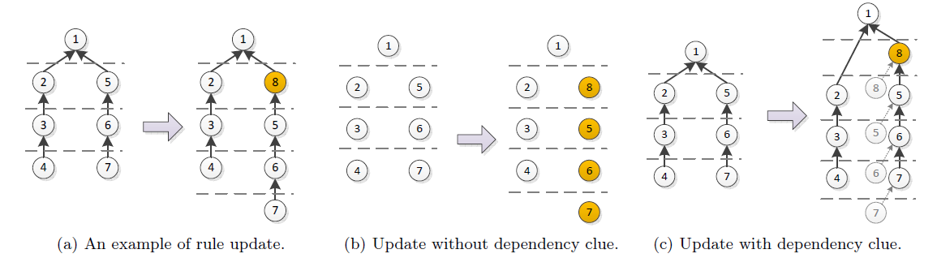
A Motivating Example
Add Rule 8 to a flow table
  Without dependency info, 4 rules are modified
  With dependency info, only 1 rule is modified, which is optimal
Rule dependency is the key to generate minimal update.

Slide 38
Solution
Policy Compiler
  Generates dependency DAG along with flow table
Comparer
  Generates optimal DAG-level flow table update
Prioritizer
  Scatter priority values to reduce future priority shifts

Slide 39
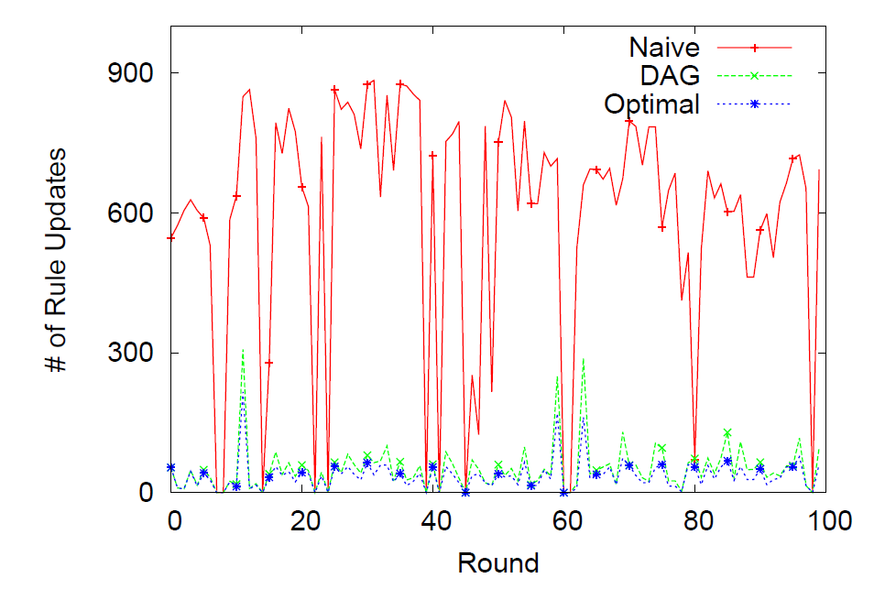
Preliminary Result
We obtain an average of 10x reduction on update size.

Slide 40
Thesis Timeline
May 2014 – Sep 2014: Compact update implementation
  Preserving dependency during compilation
  Online prioritizer
Oct 2014 – Dec 2015: NFV platform design iteration
  Consolidating security middleboxes
  Memory isolation
  Latency-aware scheduling
Jan 2015 – Mar 2015: NFV platform implementation and experiments
  Component implementation
  System integration and experiments
Apr 2015 – May 2015: Dissertation writing and defense

Slide 41
Publication
Conference Papers
X. Wen, C. Diao, X. Zhao, Y. Chen, L. Li, B. Yang, K. Bu, “Compiling Minimum Incremental Update for Modular SDN Languages”, full paper in HotSDN 2014
X. Wen, Y. Chen, C. Hu, C. Shi, Y. Wang, “Towards A Secure Controller Platform for OpenFlow Application”, poster paper in NSDI 2013 and short paper in HotSDN 2013
X. Wen, K. Chen, Y. Chen, Y. Liu, Y. Xia, C. Hu, “VirtualKnotter: Online Virtual Machine Shuffling for Congestion Resolving in Virtualized Datacenter”, in ICDCS 2012
K. Chen, A. Singla, A. Singh, K. Ramachandran, L. Xu, Y. Zhang, X. Wen, Y. Chen, “OSA: An Optical Switching Architecture for Data Center Networks with Unprecedented Flexibility”, in NSDI 2012
Y. Cao, Z. Li, V. Rastogi, Y. Chen, X. Wen. “Virtual Browser: a Virtualized Browser to Sandbox Third-party JavaScripts with Enhanced Security”, in ASIACCS 2012

Slide 42
Publication
Journal Papers
S. Zou, X. Wen, K. Chen, S. Huang, Y. Chen, Y. Liu, Y. Xia, C. Hu, “VirtualKnotter: Online virtual machine shuffling for congestion resolving in virtualized datacenter”, Computer Networks
K. Chen, A. Singla, A. Singh, K. Ramachandran, L. Xu, Y. Zhang, X. Wen, Y. Chen, “OSA: An Optical Switching Architecture for Data Center Networks with Unprecedented Flexibility”, IEEE/ACM Transection of Networking
Papers in Submission
X. Wen, B. Yang, Y. Chen, C. Hu, Y. Wang, B. Liu, “SDNShield: Application-oriented Privilege Enforcement for Modular OpenFlow Controllers”
K. Chen, X. Wen, X. Ma, Y. Chen, Y. Xia, C. Hu, Y. Liu, “WaveCube: A Scalable, Fault-tolerant, High Performance Optical Data Center Architecture”
K. Chen, C. Hu, X. Wen, Y. Chen, B. Liu, “Towards Internet Emergency Response via Reconfiguration in Internet eXchange Points”

Slide 43
Thanks!

Slide 44
Actually, I have something more…

Slide 45
Preserving Dependency in Compiler
Baseline algorithm
  Restores DAG after compilation
  O(n³-n⁴)
Optimized algorithm (ongoing)
  Builds DAG incrementally during compilation
  O(k*n²)

Slide 46
Online Prioritizer
K-factor strategy
  Maintains gap lengths within the range of [1/k, k]
  Amortized cost: O(1)
  Worst-case cost: O(n)
Is it possible to further reduce worst-case cost? (ongoing)

