Slide 1
SafePay: Protecting against Credit Card Forgery with Existing Magnetic Card Readers
Yinzhi Cao†, Xiang Pan§, Yan Chen§
† Lehigh University
§ Northwestern University
Notes:
Paper, not project

Slide 2
Road Map
Introduction & Background
Design & Implementation
Evaluation
Conclusion

Slide 3
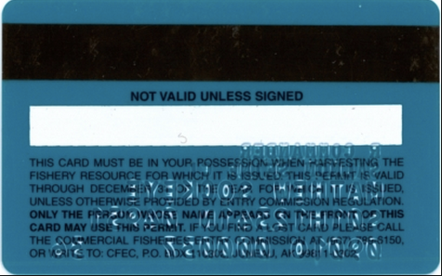
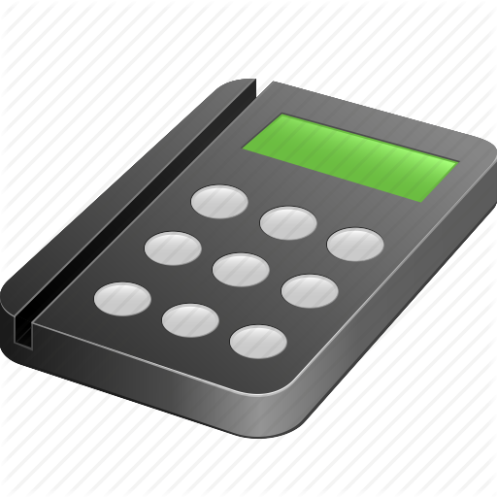
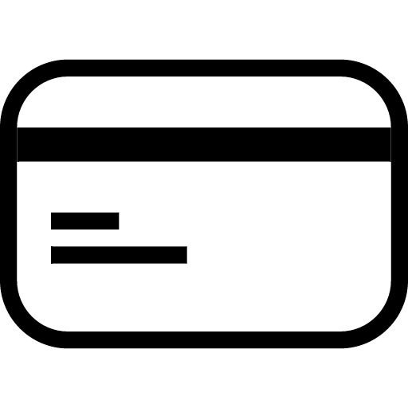
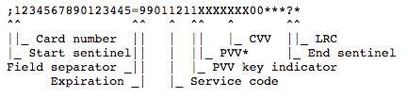


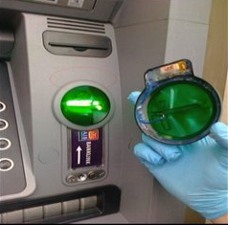
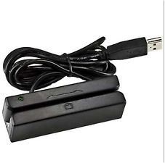
Magnetic stripe card suffers from credit card forgery attack
Magnetic stripe stores plain text of card information
Original card:
Attacker
Forged card:
Malicious merchant
Card reader hacker
Bad guy with skimming device
Notes:
Skimming device
Plain test vs unencroypt
Make clearer

Slide 4
Real world attack examples
[Barnes & Noble store]. Attackers have stolen customers’ credit card information at 63 Barnes & Noble stores by hacked credit card readers.
[Target Store]. Credit and debit card information of 70 million customers has been stolen during a large-scale data breach of Target stores.
...
The incurred loss of such attack in the U.S is over $8 billion dollars per year.
Notes:
bookstore chains
American retailing company
Credit card number for target.
40s

Slide 5
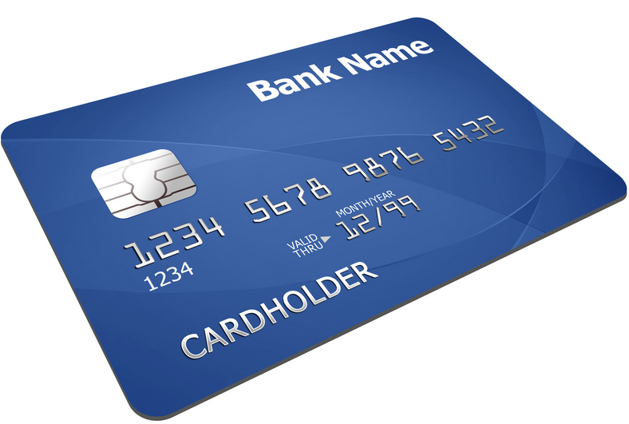
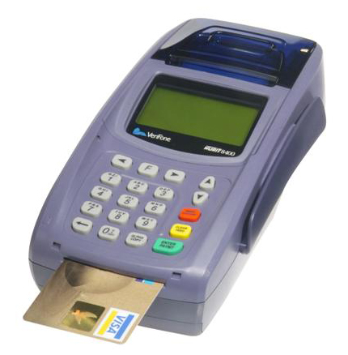
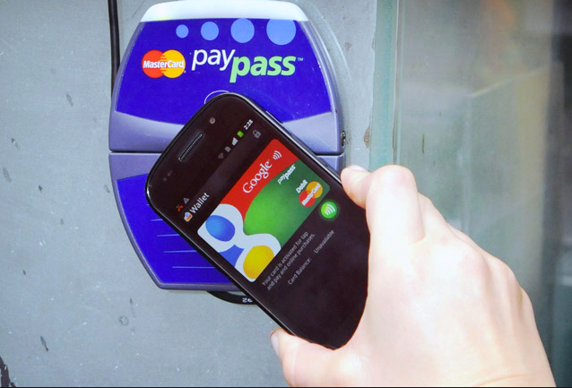
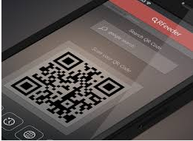
Existing approaches are not compatible
EMV card:
  Not compatible with dominant magnetic card readers.
  All existing EMV cards still have a magnetic stripe as a backup (still vulnerable).
Mobile wallet applications (e.g., Apple Pay, Google Wallet):
  Various techniques such as QR codes and using Near Field Communication (NFC).
  Does not work with card readers, and adopted even less than EMV cards.
Notes:
Discuss why it’s vulnerable.
EMV 2017 news
In short time, EMV will not be used by all merchants
http://www.merchantmaverick.com/really-need-emv-chip-card-terminal/

Slide 6


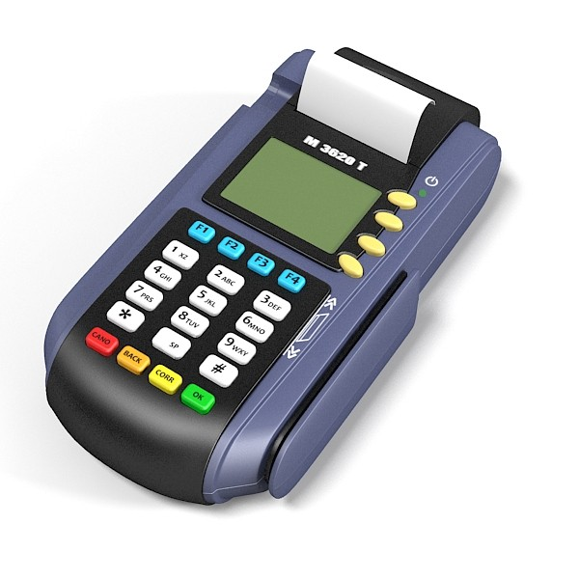


SafePay
Coffee
Shop
Gas
Station
Design Goals
Leakage Resilience: prevent credit card information leakage through malicious magnetic card reader. Backward Compatibility: be compatible with magnetic card reader. User Friendly and Low Cost: be easy to use and impose low cost.
Card No. A
Core Ideas
Disposable Credit Card Number: virtual card number that will expire after a number of usage. Dynamic Magnetic Credit Card Chip: a chip that accepts new data (card information) and can be swiped on existing card readers. Mobile Banking Application: A mobile app that combines the above two components.
Card No. A
(1111 … 11)
Card No. B
(2222 ... 22)
Notes:
Figure shows card no.A invalid.
Change user into mobile phone.

Slide 7
Road Map
Introduction & Background
Design & Implementation
Evaluation
Conclusion

Slide 8

SafePay design
Credit Card
Association
Side (i.e., bank and
payment network)
(4). Authorization
Merchant Side
(No Modification)
(1). Request disposable
credit card information.
(2). Connected through
Microphone jack or bluetooth
SafePay Magnetic Credit Card Chip
(3). Swipe the chip
SafePay
Mobile App
Client Side
Notes:
Animation
No listen to

Slide 9
SafePay deployment
Bank Deployment
Proxy Deployment
Notes:
animation

Slide 10
SafePay Magnetic Credit Card (MCC) chip requirement
SafePay Magnetic Credit Card Chip
  Work on magnetic
  card reader.
  Support dynamic card information.
  Easy to update associated card information with low cost.
SafePay
Mobile App
Notes:
http://www.instructables.com/id/Magnetic-stripe-card-spoofer/

Slide 11
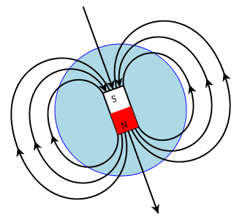


SafePay MCC chip design
  Replicate the changing magnetic field generated by swiping magnetic card.
    No storage of the card number
2. Generate changing magnetic field
4. Decode current and reconstruct data
1. Swipe card
3. Induce current
Notes:
When the card is swiped past the card reader, the changing magnetic field of the passing flux reversals induce a current in the reader element, which is then decoded into binary bits, and the original data stored on the magnetic stripe is reconstructed.
When an electric current is passed through the coil, a magnetic field is created. By turning the electromagnet on and off rapidly, we can replicate the changing magnetic field of a magnetic stripe swipe.
(coil of wires)

Slide 12
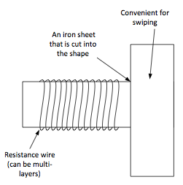
SafePay MCC chip design (cont’d)
How to generate magnetic field?
  Electromagnet, which is solenoid (coil of wires).
How to control the solenoid?
  Waveform of current.
  Encode disposable card information into sound (WAV) file and play it.
Notes:
Change a solenoid
When an electric current is passed through the coil, a magnetic field is created. By turning the electromagnet on and off rapidly, we can replicate the changing magnetic field of a magnetic stripe swipe.
(coil of wires)
Media play will convert waveform stored in the sound file into elecric current.
recreate a particular waveform of current through the solenoid in order to create a particular waveform of magnetism

Slide 13
SafePay User-side Component
Notes:
1,2,3,4,5,6
Array direction

Slide 14
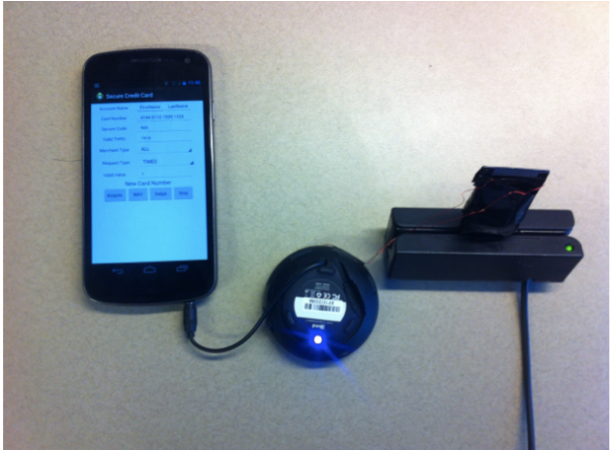
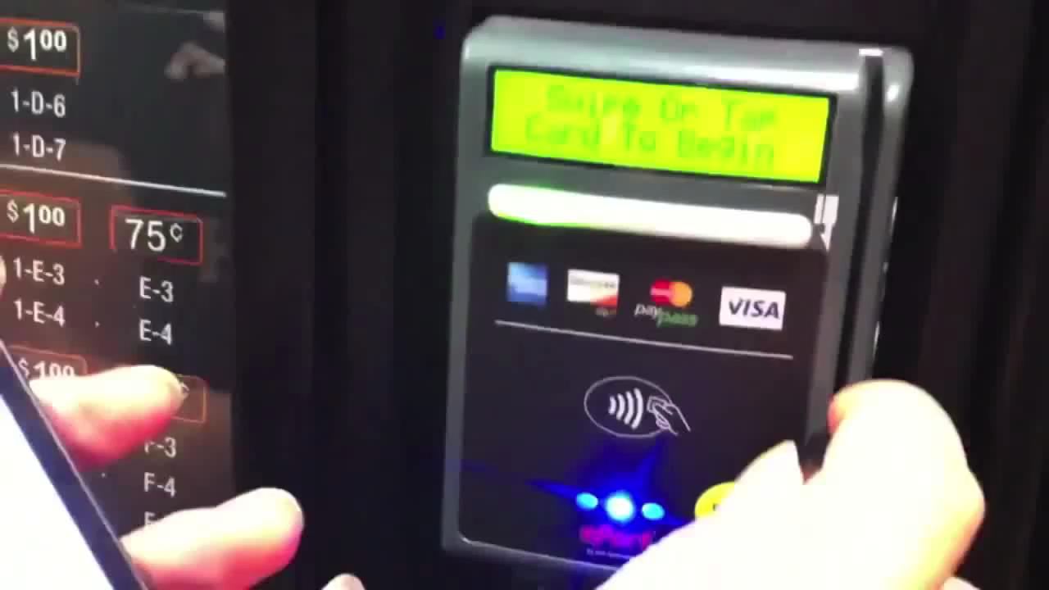
SafePay implementation & demo
Notes:
Solenoid inserted into a card reader

Slide 15
Road Map
Introduction & Background
Design & Implementation
Evaluation
Conclusion

Slide 16
Evaluation: Feasibility
Feasibility experiments in the wild:
  Get disposable card number through ShopSafe.
  Succeeded in all scenarios: vending machine, coffee shop, and gas station.
Notes:
the output wave monitored by oscilloscope exactly matches the generated wave file.

Slide 17
Evaluation: Robustness
  Randomly select 20 people.
  Ask them to install SafePay on their phones and use it for 10 times.
  19/20 of them get 10 times correct swipe.
  The failed case is caused by low volume setting of the phone.
Notes:
the output wave monitored by oscilloscope exactly matches the generated wave file.

Slide 18
Evaluation: Scalability
  For each set of valid card info, 13 digits can be used for disposable credit card numbers.
  Assuming 1 billion people using the service, each person can have 10 billion disposable credit card numbers.
Notes:
The disposable credit card information faces the problem of capacitor since every day every one may acquire several credit card numbers.

Slide 19
Evaluation: cost of users
  Mobile app: free.
  Magnetic card chip:
    Amplifier: ~$0.37
    Low pass filter: ~$0.02
    Solenoid: ~$0.1
    Total: < $0.5
    Will be even cheaper with massive production

Slide 20
Road Map
Introduction & Background
Design & Implementation
Evaluation
Conclusions

Slide 21
Conclusions
We propose SafePay, a system to protect customers from credit card forgery and is compatible with existing magnetic card readers.
We implemented a prototype of SafePay and successfully tested it on several real-world merchants.
  Its cost is less than $0.5.
Since published, SafePay has been reported by dozens of media, such as economictimes.com, yahoo.com and sciencenewsline.com.

Slide 22



















Recognition
Interest from vendors
22

Slide 23
Thanks & Questions?

