Slide 1
Towards the privacy leakage and user fraud detection of Android applications
Zhengyang Qu
Northwestern University, IL, US,
Notes:
She worked on this project mainly during her summer internship at northwestern university.

Slide 2
Outline
Introduction
Problem statement
Solutions
Conclusion

Slide 3
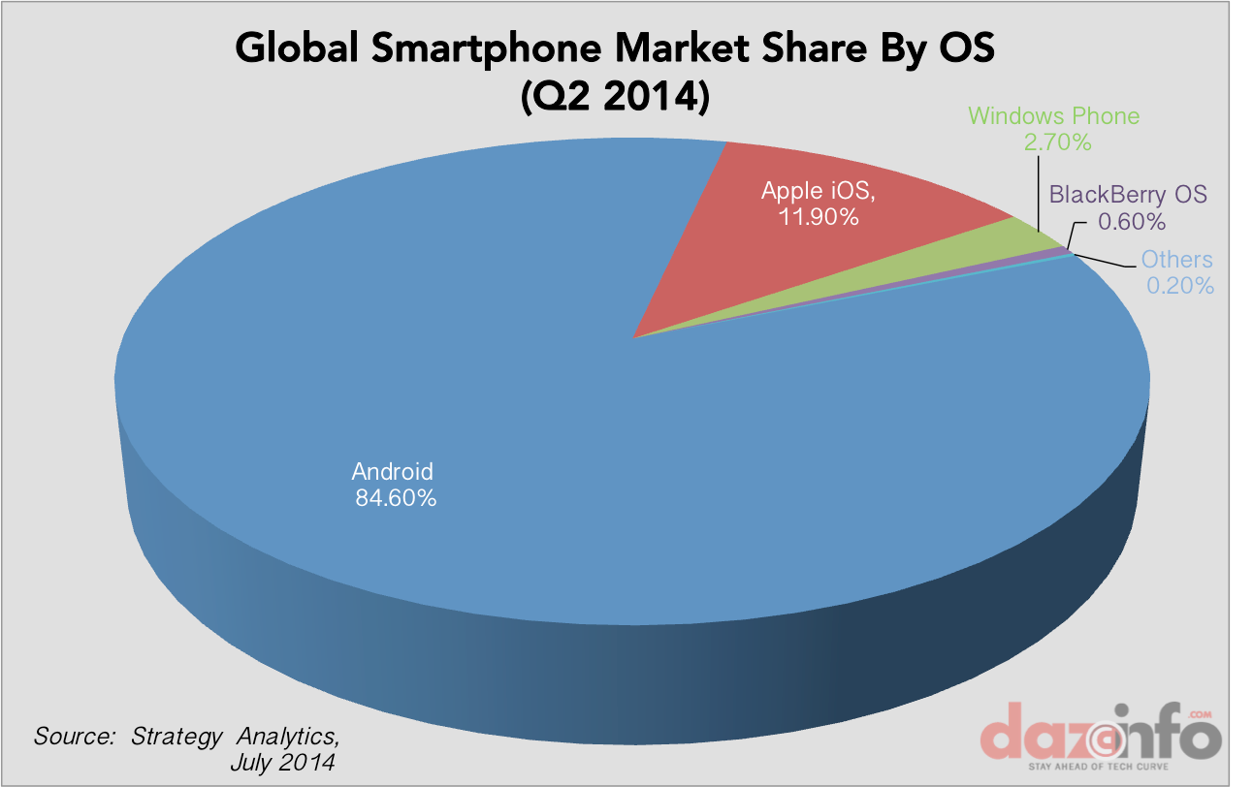
Android OS Dominance
Mobile OS Market Share, July 2014, by dazeinfo.com

Slide 4
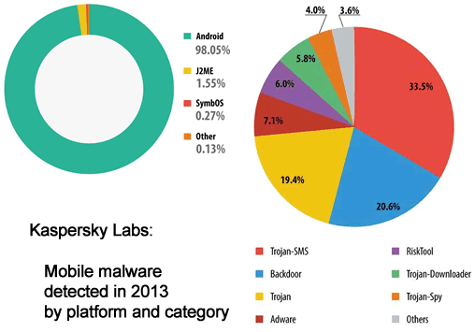
Android Malware/Spyware

Slide 5
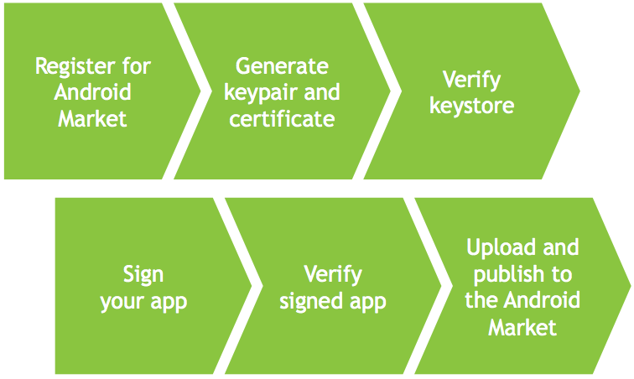





Source of Android
Security Risks
Diverse mobile application market places
Ease of deployment
Open nature of development
  Java is the primary language
  Alternatives: Java reflection, Dynamic code loading (DCL): bytecode and native code

Slide 6
Outline
Introduction
Problem statement
Solutions
Conclusion

Slide 7
Architecture

Slide 8
Outline
Introduction
Problem statement
Solutions
Conclusion

Slide 9
Risk management in mobile payment

Slide 10
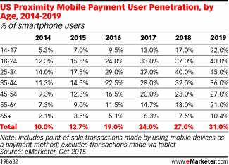




Motivations
The growing popularity of mobile payment
Attack surface of smartphone → User’s financial loss
Countermeasure:
  G1: authentication
  G2: risk management
    Heavy usage of user privacy (location etc.)
    Fragmentation

Slide 11
Goal
A learning-based mechanism for user fraud detection
  Least user privacy required, high detection accuracy
  High portability

Slide 12
Goal

Slide 13
Challenges
Lack of feature
Data availability
Imbalanced dataset
Noise surrounding
Unlabeled data
Notes:
Lack of feature: location track user privacy, deployment
force sensor, integrated into app context

Slide 14
Challenges
Lack of feature
  Only based on acceleration sensor and gyroscope sensor
  Feature selection (6 values → 64 features)
Data availability
Imbalanced dataset
Noise surrounding
Unlabeled data
Notes:
6 values → 64 features, average, variance

Slide 15
Challenges
Lack of feature
Data availability
  Periodical data collection
  User motion detection
Imbalanced dataset
Noise surrounding
Unlabeled data
Notes:
If the phone is put on desk, the data is useless in identifying user.
We design a data collection mechanism to resolve the data availability issue, which cognitively recognize phone usage events and completely captures all the data helpful in fingerprinting usage pattern. Moreover, the useless data is filtered out to reduce battery consumption and network traffic.

Slide 16
Challenges
Lack of feature
Data availability
Imbalanced dataset
  Control of distribution of training set
  Random selection & Stratified sampling
Noise surrounding
Unlabeled data
Notes:
Distribution 1:5, by experiment. Too small cannot be handled by SVM

Slide 17
Challenges
Lack of feature
Data availability
Imbalanced dataset
Noise surrounding
  Calibrate sensor data based on gravity direction
  Identify user motion state: sit or walk?
Unlabeled data
Notes:
Handle the phone with various orientation, calibrate sensor data with gravity direction
Sit walk? If not, data would be mixed

Slide 18
Challenges
Lack of feature
Data availability
Imbalanced dataset
Noise surrounding
Unlabeled data
  Semi-supervised online learning
Notes:
We design a semi-supervised online learning algorithm, which allows us to eliminates the high time latency when handling unlabeled data with unsupervised methods.
Data input in various chunks, rollback or accept?

Slide 19
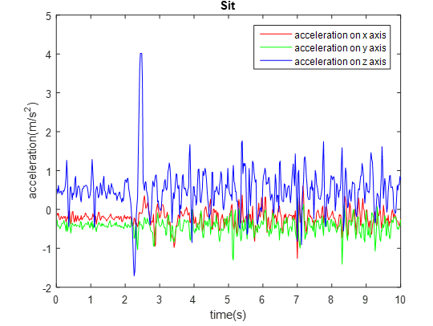
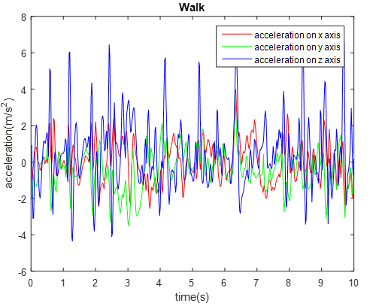
Data preprocess
Filter the useless data on client
  -1.5 < X < 1.5 AND -1.5 < Y < 1.5 AND (9 < Z < 10 AND -10 < Z < -9)
Identify motion state on server

Slide 20
Training set construction

Slide 21
ML algorithm selection
 | Decision Tree | kNN | Naïve Bayes | SVM
Accuracy in general | ++ | ++ | + | ++++
Speed of Classification | ++++ | + | ++++ | ++++
Tolerance to missing values | +++ | + | ++++ | ++
Tolerance to irrelevant attributes | +++ | ++ | ++ | ++++
Tolerance to redundant attributes | ++ | ++ | + | +++
Tolerance to noise | ++ | + | +++ | ++
Attempts for incremental learning | ++ | ++++ | ++++ | ++
MLA Kotsiantis, Sotiris B., I. Zaharakis, and P. Pintelas. "Supervised machine learning: A review of classification techniques." (2007): 3-24.

Slide 22
Semi-supervised online learning

Slide 23
Preliminary Evaluation
Metrics
  True positive: owner is correctly identified
  False positive: other is incorrectly identified as owner
  False negative: owner is incorrectly identified as other
  True negative: other is correctly identified
  Precision:
  Recall:

Slide 24
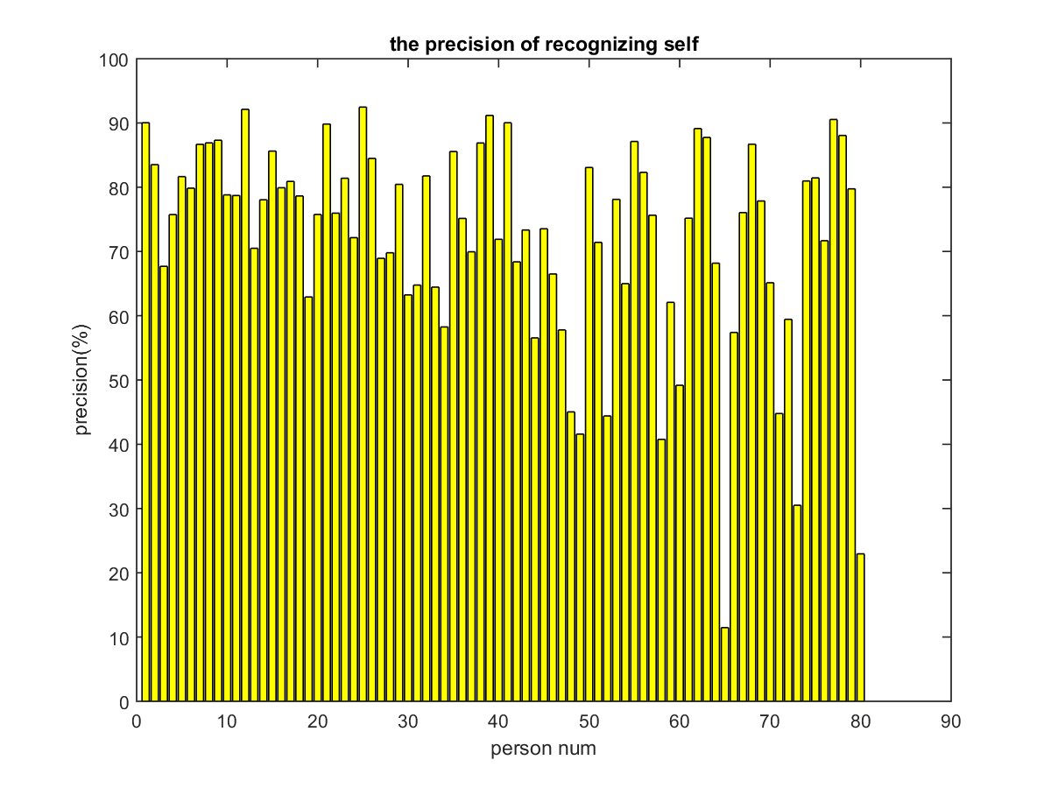
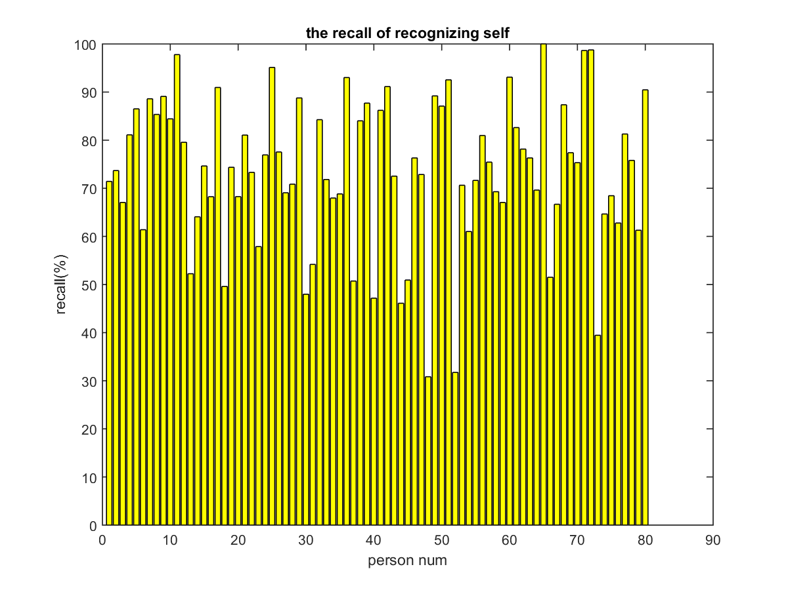
Accuracy
80 users; each user has 4K samples in training set and 1.2K samples in test set.
Average precision: 72.33%
Average recall: 73.49%

Slide 25
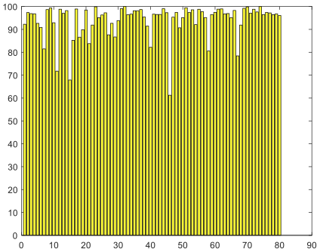
Robustness
Brute-force attack
  A set of 500K randomly generated samples
  Percentage of samples detected as not the owner

Slide 26
DyDroid: Measuring dynamic code loading
and its security in Android Applications

Slide 27
Motivation
Android allows developers to load external code dynamically
  ClassLoader: bytecode
  Java-Native-Interface (JNI): native code
Unpredictable, no security verification
Ineffective dynamic analysis system (Google bouncer)
Notes:
Unpredictable: from where, who loads

Slide 28
Motivation

Slide 29
Problems
Source
  Local/remote availability
  Responsible entity
Security benefits
  Obfuscation
Security risks/implications
  Vulnerabilities
  Privacy tracking
  Malware

Slide 30
Challenges
Dynamic code loading (DCL) recognition/interception
  Static analysis: false positive
  Dynamic analysis: high time latency
Obfuscation identification
  Bytecode encryption, loading interposed in app startup: general pattern?
Responsible entity analysis
Notes:
It is difficult to enforce complete mediation
when intercepting the loaded binaries. The developer can utilize diverse methods to access binaries dynamically, e.g., remote fetch, static files of other local applications.
Static analysis can localize DCL. However, the uncertainty regarding whether the code will actually be executed at runtime affects the accuracy of
our measurement. For example, it is difficult to identify and eliminate the complex dead code in static analysis [43, 55, 54], which would cause false positives if the dead code contains DCL.
Dynamic analysis is not suitable for our large scale measurement due to its heavy cost.
The modules of bytecode decryption, code loading, and application life-cycle construction are interposed in the original application’s launching procedure. We investigate an application’s pattern after obfuscation, popularity, and comparison with other common obfuscation techniques, including native code, lexical

Slide 31
DyDroid

Slide 32
DCL recognition/interception
Static analysis
  Check invocation of ClassLoader and JNI
Dynamic analysis
  Instrument system APIs: DexClassLoader, PathClassLoader, load, loadLibrary → Complete mediation
  Path to loaded file, directory of ODEX code, call site class
  Android emulator based on QEMU

Slide 33
Measurement summary
 | DEX | Native
Failure | 11762 (30.58%) | 5638 (20.84%)
Rewriting failure | 618 (1.61%) | 94 (0.35%)
Installation failure | 30 (0.08%) | 36 (0.13%)
No activity | 2586 (6.72%) | 2620 (9.68%)
Crash | 8528 (22.17%) | 2888 (10.68%)
Exercised | 26697 (69.42%) | 21415 (79.16%)
Captured | 19110 (49.69%) | 16192 (59.85%)
Intercepted | 462 (1.2%) | 16185 (59.83%)

Slide 34
Source identification
Check loaded file with unzipped APK archive
Check call site class with application package name
 | Remote | Local | Remote & Local | 3rd-party | Own | 3rd-party & Own
DEX | 18986 (99.35%) | 136 (0.71%) | 35 (0.18%) | 19089 (99.89%) | 433 (2.27%) | 412 (2.16%)
Native | 93 (0.57%) | 16151 (99.75%) | 52 (0.32%) | 14578 (90.03%) | 2372 (14.65%) | 758 (4.68%)
Notes:
Fetching code remotely dominates DEX code loading 99.35%, in contrast to the case of native code 0.57%. Except
the 23 applications that incorrectly invoke the function of loading class with an empty path, only 136 applications
load bytecode locally and 18,986 applications download the execution payload remotely, where the intersection
includes 35 applications. On the contrary, 99.75% applications retrieve the native code from local static files. The update mechanism of mobile marketplace
is a reasonable explanation of the measurement results. Application developer fully controls the update release. SDK vendors cannot predict whether the most
up-to-date version of library will be included. In other words, the mobile market channel is not dependable. Fetching the DEX code from a remote server allows the third-party SDK providers to modify the libraries without any constraint. Native code, however, provides low-level functionalities, and changes much less frequently compared with the application level. Another explanation is that native code is frequently integrated by applications for performance reasons and/or games, and both of these would just include the native code in the installation package locally.

Slide 35
Obfuscation
Technique | #Apps (%) | With DCL (%)
Lexical | 89934 (89.95%) | 35.47%
Reflection | 82629 (82.64%) | 38.27%
Native | 16192 (16.20%) | 100%
DEX encryption | 127 (0.13%) | 100%
Anti-decompilation | 125 (0.13%) | N/A
Notes:
89.95% applications use the lexical obfuscation. The high adoption rate is expected, as this functionality is included in ProGuard and served within Android IDE for free [22]. Even with the high popularity, lexical obfuscation just makes the source code not human readable.
Reflection allows a running program to retrieve information about itself and the runtime environment, which can be used to instantiate arbitrary classes, invoke methods, and alter data fields. As with native code, although developers might have various purposes of using these techniques, such as performance improvement, accessing private fields and methods, they do increase the bar of reverse engineering, because they make analyzing the program statically very difficult. But a dynamic analysis is still able to recover the execution of the applications obfuscated by these two methods.
As apktool keeps evolving, the percentage of applications with anti-decompilation capability remains low 0.13%.
The adoption rate of DEX encryption method is still low 0.13%, and it is mainly applied in shopping applications with sensitive payment functionalities. Developers may have the compatibility concern, given the Android fragmentation issue [7]. It is also possible that this technique is relatively new and does not have enough market penetration.

Slide 36
Unknown malware variant detection
87 Apps found to load malicious code from 91 files
 | Family | #Apps | Sample App (#Download)
DEX | Swiss code monkeys | 1 | com.sktelecom.hoppin.mobile (10,000,000)
 | Adware airpush minimob | 2 | com.oshare.app (10,000)
Native | Chathook ptrace | 84 | com.com2us.tinyfarm.normal.freefull.google.global.android.common (10,000,000)
Notes:
One application loads the malicious DEX code in the Swiss code monkeys family. It adds the malicious code as a service, and sends IMEI, phone number, and IMSI to a remote site. A remote user is able to send and execute a command, such as application installation, website navigation, adding browser bookmark, sending text message, and blocking test message response.
Two applications are found to execute the malicious bytecode in the family Adware airpush minimob , where mobile advertisement is pushed to the device via notification. Moreover, shortcuts are placed on users’ home screens and browser settings are changed to redirect homepage
There are total 84 applications loads malicious native code in the family Chathook ptrace , which mainly targets the two popular chatting applications QQ3 and WeChat4 with millions of downloads. The malicious application tries to get the root privilege first. Then, it attaches the system call ptrace to the two applications as the superuser, controls the two applications, and hooks the Java methods related to the chatting window. Finally, the malware leaks the chat history to a remote server.

Slide 37
Vulnerabilities ??
The file dynamically loaded is writable by other parties
 | Category | #Apps | Sample App (#Download)
DEX | Internal storage of other Apps | 12 | com.keerby.mp3gain (100,000)
 | External storage | 5 | com.fkccy.view (100,000)
Native | Internal storage of other Apps | 10 | fr.ikomobi.auchandrive (100,000)
 | External storage | 0
Notes:
The application com.keerby.mp3gain accesses the bytecode stored in the APK file engine.apk owned by the application com.coolapps.DeathBattle.en. The application fr.ikomobi.auchandrive loads the native code from file libaudio-interface.so in the internal storage of the application com.revesoft.mobiledialer.islamtelecom.islamtelecom.
The application com.fkccy.view stores its bytecode file clib.jar in the public directory /mnt/sdcard/Android/data/.cache/.
Malicious parties can exploit these vulnerabilities by replacing the original file with arbitrary binaries. For example, one application with only the permission of writing to the SD card can misbehave with all the permissions declared by the vulnerable application granted.

Slide 38
Privacy tracking
Mark sensitive APIs and content providers as source, total 19 types of privacy
Type | #Apps (%) | Exclusively 3rd-party (%)
Location | 276 (59.74%) | 99.64%
IMEI | 220 (47.62%) | 99.55%
Phone number | 29 (6.28%) | 100%
Installed apps | 98 (21.21%) | 98.98%
Contact | 68 (14.72%) | 98.53%
Calendar | 131 (28.35%) | 100%
Image | 124 (26.84%) | 99.19%
…
Notes:
Sensitive information is heavily tracked in DCL. Almost all of these operations are conducted exclusively in third-party libraries. The offline analysis system in mobile marketplace is ineffective when identifying these stealthy actions within DCL.

Slide 39
Publication List
Zhengyang Qu, V. Rastogi, X. Zhang, Y. Chen, T. Zhu, Z. Chen, “AutoCog: Measuring the Description-to-permission Fidelity in Android Applications” in ACM CCS 2014 (114/585, 19.5%)
V. Rastogi, Zhengyang Qu, J. McClurg, Y. Cao, Y. Chen, W. Zhu, P. Xu, W. Chen, “Uranine: Real-time Privacy Leakage Detection and Prevention without System Modification for Android”, in SecureComm 2015 (30/108 = 27.8%).
Zhengyang Qu, G. Guo, Z. Shao, V.Rastogi, Y. Chen, H. Chen, W. Hong, “AppShield: A Proxy-based Data Access Mechanism in Enterprise Mobility Management”, under submission.

Slide 40
Publication List
Zhengyang Qu, S. Alam, Y. Chen, X. Zhou, W. Hong, R. Riley, “DYDROID : Measuring Dynamic Code Loading and Its Security Implications in Android Applications”, under submission.
S.Alam, Zhengyang Qu, R. Riley, Y. Chen, V. Rastogi, “DroidNative: Semantic-Based Detection of Android Native Code Malware”, under submission.

Slide 41
Thank you!
Questions?
http://list.cs.northwestern.edu/mobile/

Slide 42

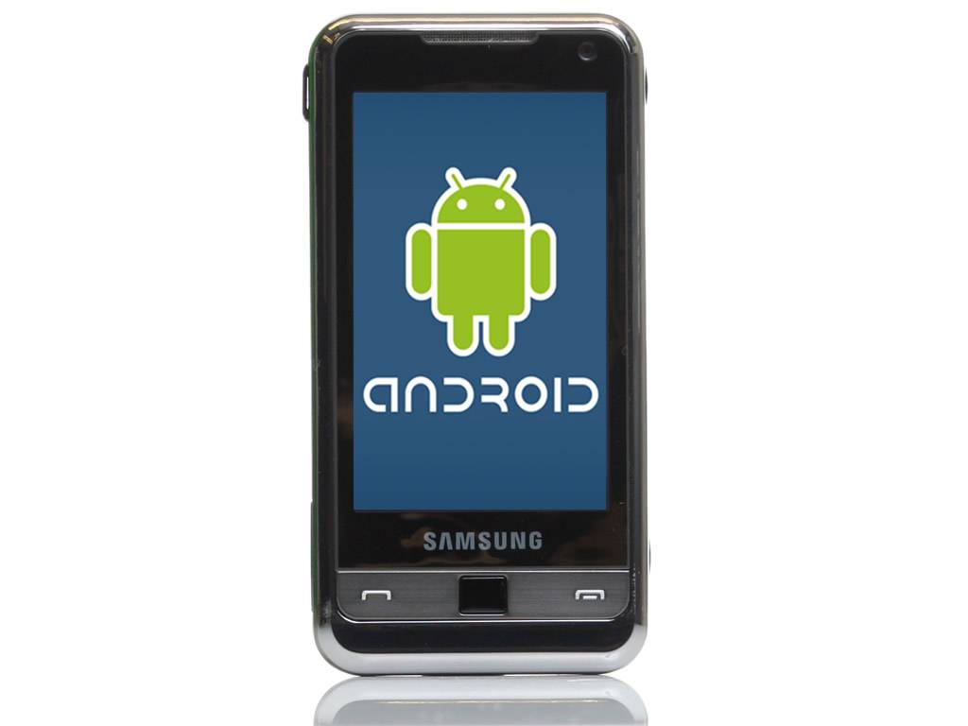
Android Security Risks
DCL: DyDroid
Malware: DroidNative
App marketplace
Meta data
Download
App usage
Bring-your-own-device: AppShield
Payment: Mobile Risk Management
Privacy: Uranine
User
Smartphone
User expectation vs. Permission: AutoCog

Slide 43
AutoCog: Measuring the description-to-permission
fidelity of Android applications

Slide 44
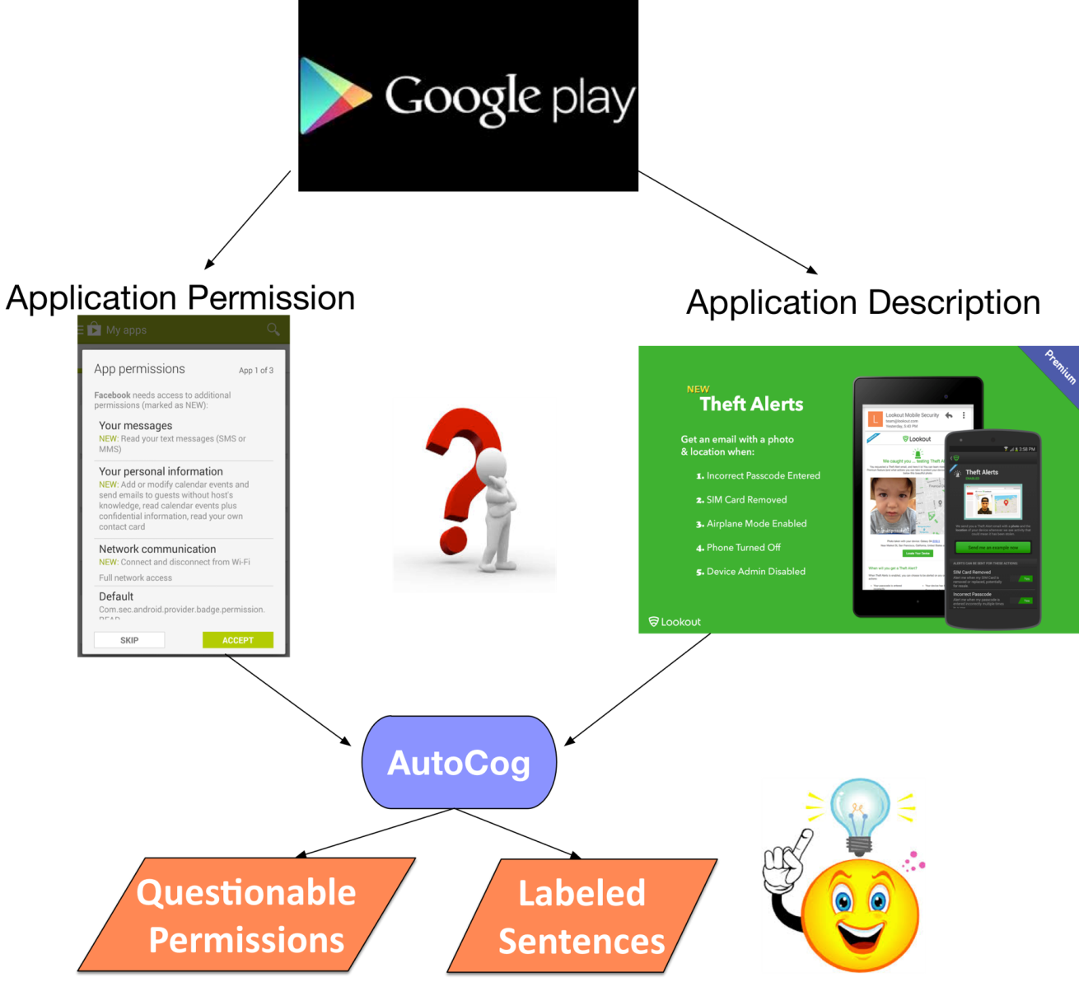
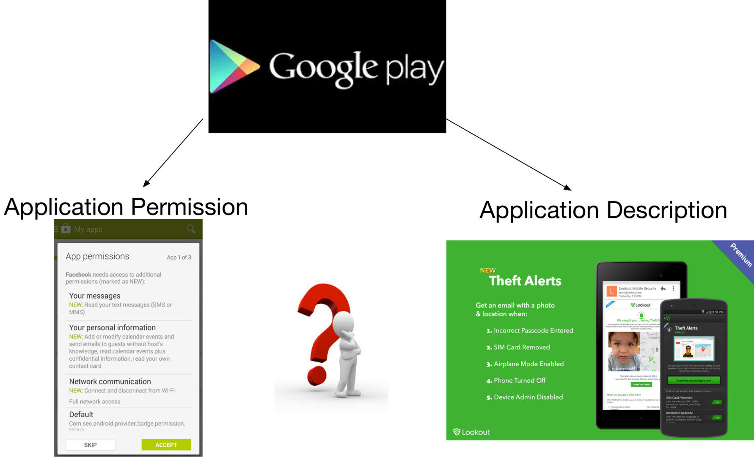
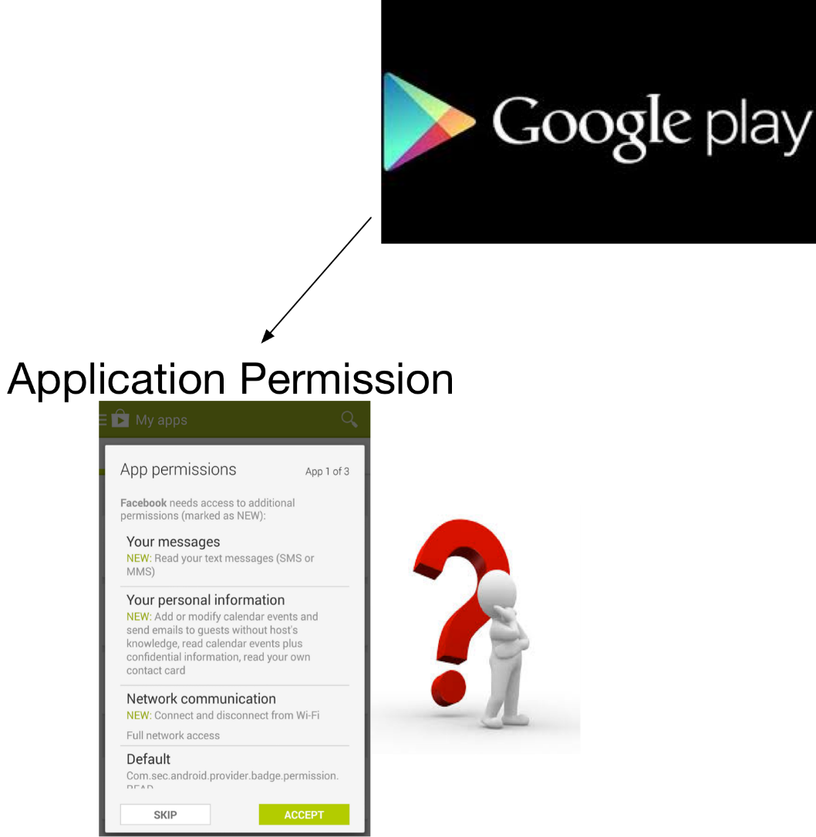
Motivations
Android Permission System
  Access control by permission system
  Few users can understand security implications from requested permissions
User expectation v.s. Application Behavior
  User expectation based on application description
  Permission defines application behavior
  Assess how well permission align with description
Notes:
Android is the most popular mobile operating system. The open nature bolster its market share. However, the open nature also employs some security issues.
User privacy access control by permission system
Few users are discreet enough or have the professional knowledge to understand security implications from requested permissions
Even from description, user do not know what to expect. Usability problem. AutoCog output questionable permissions and the sentences annotated the usage of other permissions to assist user to matching description to permission.

Slide 45
Challenges & Contributions
Inferring description semantics
  Similar meaning may be conveyed in a vast diversity of natural language text
  “friends”, “contact list”, “address book”
Correlating description semantics with permission semantics
  A number of functionalities described may map to the same permission
  “enable navigation”, “display map”, “find restaurant nearby”
  1. Leverage stat-of-the-art NLP techniques
  2. Design a learning-based algorithm
Notes:
In the domain of smartphone contact book.

Slide 46
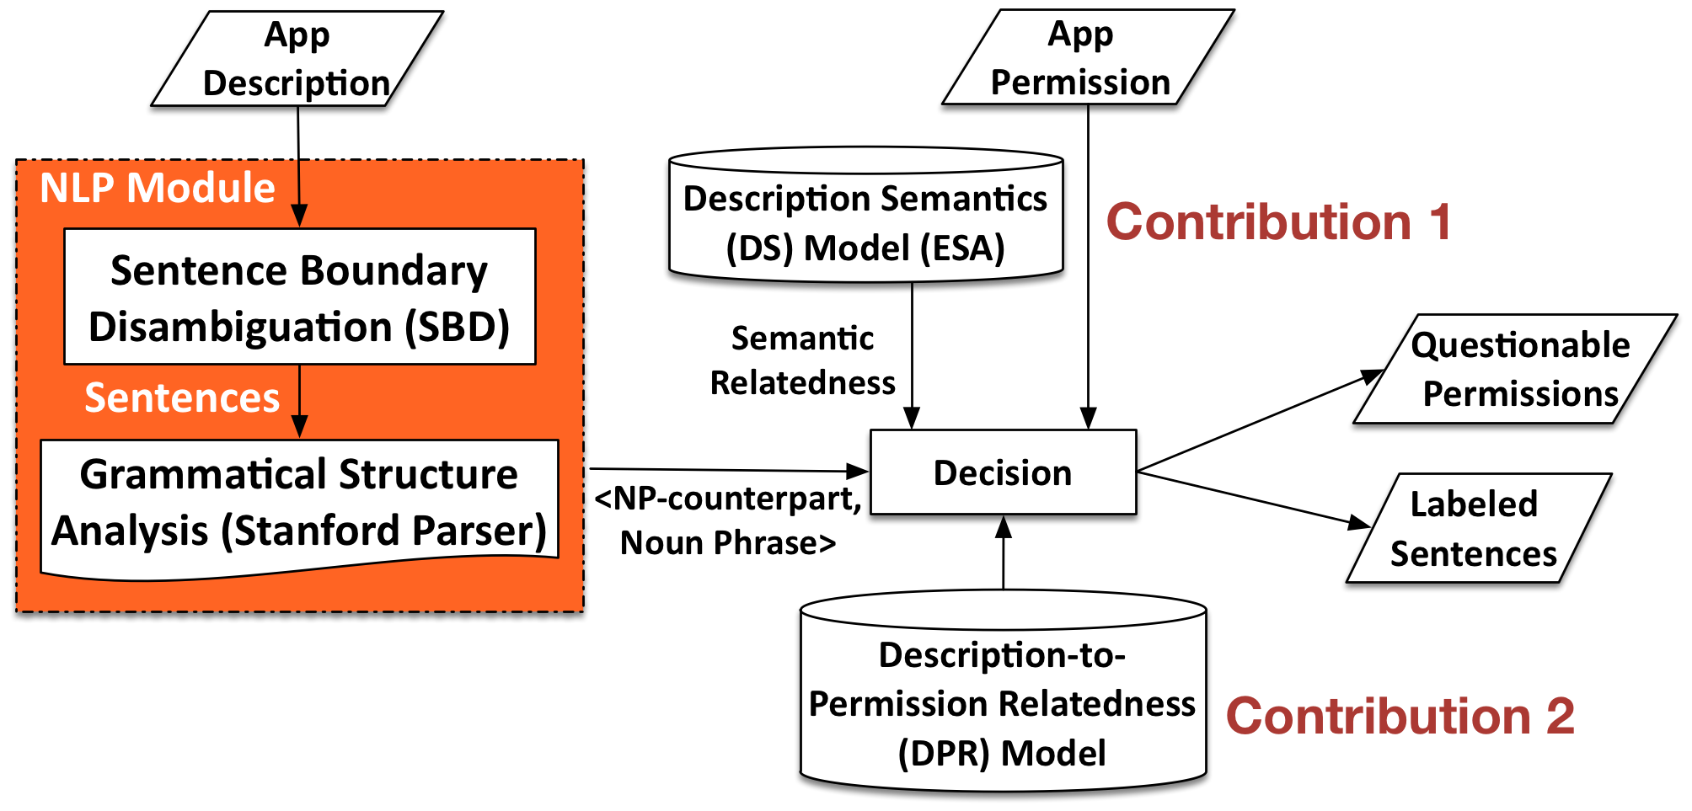
System Overview

Slide 47
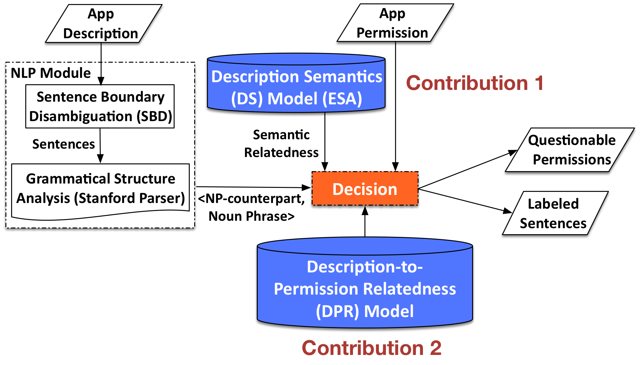
System Overview

Slide 48
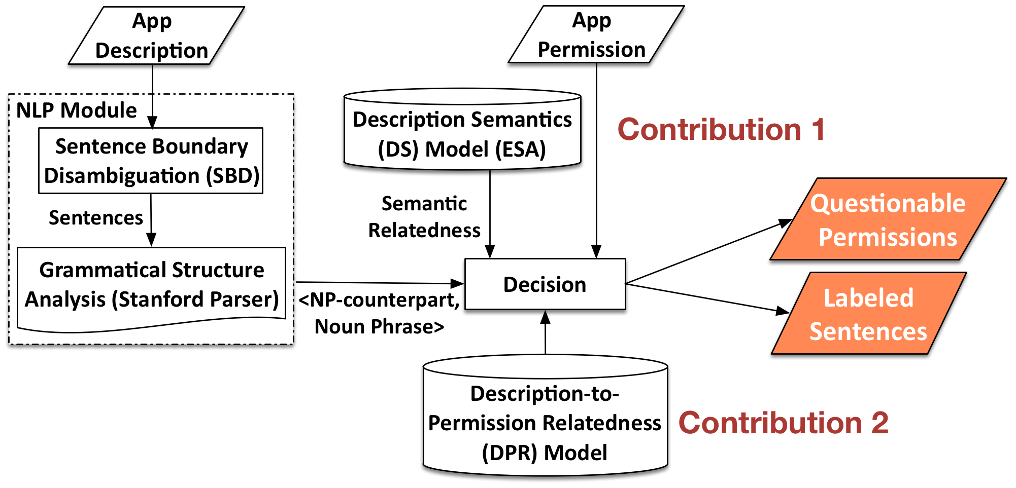
System Overview

Slide 49
Ontology modeling
Logical dependency between verb phrase and noun phrase
  <“scan”, “barcode”> for CAMERA, <“record”, “voice”> for RECORD_AUDIO
Logical dependency between noun phrases
  <“scanner”, “barcode”>, <“note”, “voice”>
Noun phrase with possessive
  <“your”, “camera”>, <“own”, “voice”>

Slide 50
Description Semantics Model (Contribution 1)
Extract Abstract Semantics
Explicit Semantic Analysis (ESA)
  Computing the semantic relatedness of texts
    Leverage a big document corpus (Wikipedia) as the knowledge base and constructs a vector representation
  Advantages:
    Rich semantic information, Quantitative representation of semantics
Notes:
Understand how different words and phrases in a vocabulary related to each other
Wikipedia, as the knowledge base on ESA is much richer than other created dictionary or database. Example, Google Map, social networking.
ESA offers a much more detailed and quantitative representation of semantics. It maps the meaning of words/phrases to a weighted combination of concepts, while mapping a word in WordNet amounts to simple lookup, without any weight

Slide 51
Description-to-Permission
Relatedness (DPR) Model (Contribution 2)
Learning-based method
  Input: application permission, application description
  Output: <np-counterpart, noun phrase> correlated with each sensitive permission
Notes:
To construct the DPR model : measure how closely a pair of noun phrase and np-counterpart related to permission, our learning-based algorithm is composed of three steps.
Input, output
3 stages

Slide 52
Samples in DPR Model
Permission | Semantic Patterns
WRITE_EXTERNAL_STORAGE | <delete, audio file>, <convert, file format>
ACCESS_FINE_LOCATION | <display, map>, <find, branch atm>, <your location>
ACCESS_COARSE_LOCATION | <set, gps navigation>, <remember, location>
GET_ACCOUNTS | <manage, account>, <integrate, facebook>
RECEIVE_BOOT_COMPLETED | <change, hd paper>, <display, notification>
CAMERA | <deposit, check>, <scanner, barcode>, <snap, photo>
READ_CONTACTS | <block, text message>, <beat, facebook friend>
RECORD_AUDIO | <send, voice message>, <note, voice>
WRITE_SETTINGS | <set, ringtone>, <enable, flight mode>
WRITE_CONTACTS | <wipe, contact list>, <secure, text message>
READ_CALENDAR | <optimize, time>, <synchronize, calendar>

Slide 53
Learning Algorithm for DPR
S1: Grouping noun phrases
  Create semantic relatedness score matrix
  <“map”, [(“map”, 1.00), (“map view”, 0.96), (“interactive map”, 0.89), …]>
S2: Selecting Noun Phrases Correlated with Permissions
  Not biased to frequently occurring noun phrases
  Jointly consider conditional probabilities:
  P(perm | np) and P(np | perm)
Notes:
Create semantic relatedness score matrix for high-frequency noun phrase
High frequency noun phrase: present in the number of application description above the threshold
As the small number of samples cannot provide enough condence in our frequency-based measurement. If a low-frequency phrase is similar to a high-frequency phrase, our decision process will not be affected as the decision module employs DS model.

Slide 54
Learning Algorithm for DPR(cont’d)
S3: Pairing np-counterpart with Noun Phrase
  “Retrieve Running Apps permission is required because, if the user is not looking at the widget actively (for e.g. he might using another app like Google Maps)”
Notes:
To explore the context and semantic dependencies
Read the whole sentence here

Slide 55
Accuracy Comparison
System | Precision (%) | Recall (%) | F-score (%) | Accuracy (%)
AutoCog | 92.6 | 92.0 | 92.3 | 93.2
Whyper [1] | 85.5 | 66.5 | 74.8 | 79.9
[1] Whyper, Pandita et al., USENIX Security 2013
Notes:
We run AutoCog and Whyper in parallel and evaluate how well they are aligning with human reader’s groundtruth.
Precision higher than whyper by 7 percentage.
Recall higher than whyper over 20 percentage.

