Slide 1
Motivation and Problem Statement

Slide 2
Key Idea
Initial Compromise
Gaining Foothold
Lateral Movement
High Value Asset Acquisition
Malware (e.g. RAT)
Phishing
Exploit
vulnerability
Network scan
Code Repo
Malware
propagation
Attacker
Victim
CONFIDENTIAL
Malicious
Web
Exploit
browser
Database
Low-level Behavior based Malware detection
Design a detection mechanism that targets at the post-compromise steps in the APT life-cycle.

Slide 3
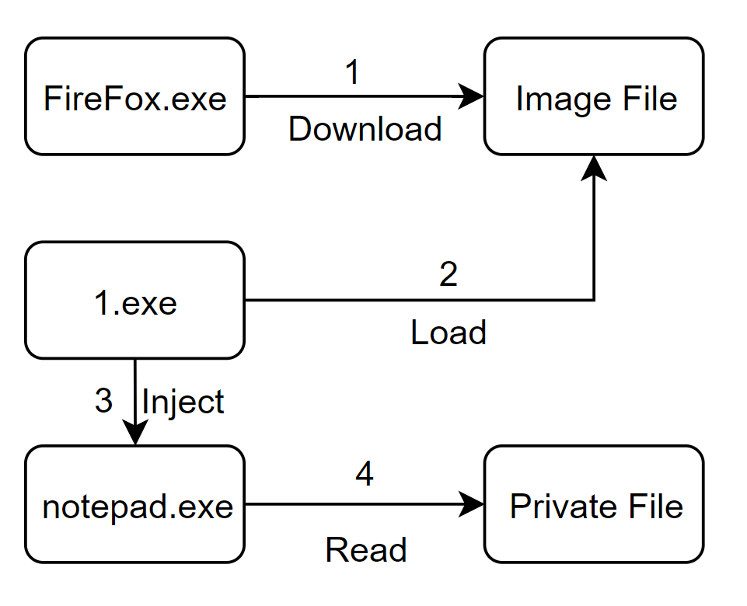
Basic Idea
Context-based detection has better effect:
One process is injected.
One process accesses sensitive files.
One process loads an uncertificated image.
An image file is downloaded.

Slide 4
System Overview
Detect attacks by process behaviors and context information AGGREGATION

Slide 5
Basic Idea
Detect attacks by suspicious indicators and process context information:
Suspicious behaviors with high-level semantics
Context Information:
Process Features
Code Source
Data Flow

Slide 6
Main Idea
A Context-Based Semantic-Aware Attack Detection and Reconstruction System
Atomic suspicious indicators (ASI)
Aggregation Framework
Detection Policies

Slide 7
System Design -- ASI
ASIs are used to represent the current status (its own and context information) of one process and one file, including:
Process ASIs:
Behaviors: Screengrab, Keylogger and Execute sensitive commands, etc. ;
Features: Have Visible Windows, Have Human Interactions, its ancestor process has network connections etc.
Code source: Injected and Load a downloaded image, etc.;
Data flow: Access Data from Network, etc.

Slide 8
ASI Design and Selection

Slide 9
System Design
File ASIs:
Data flow: Access Data from Network and Contains Sensitive Information, etc.
Features: Uncertificated and Contains Macros, etc.

Slide 10
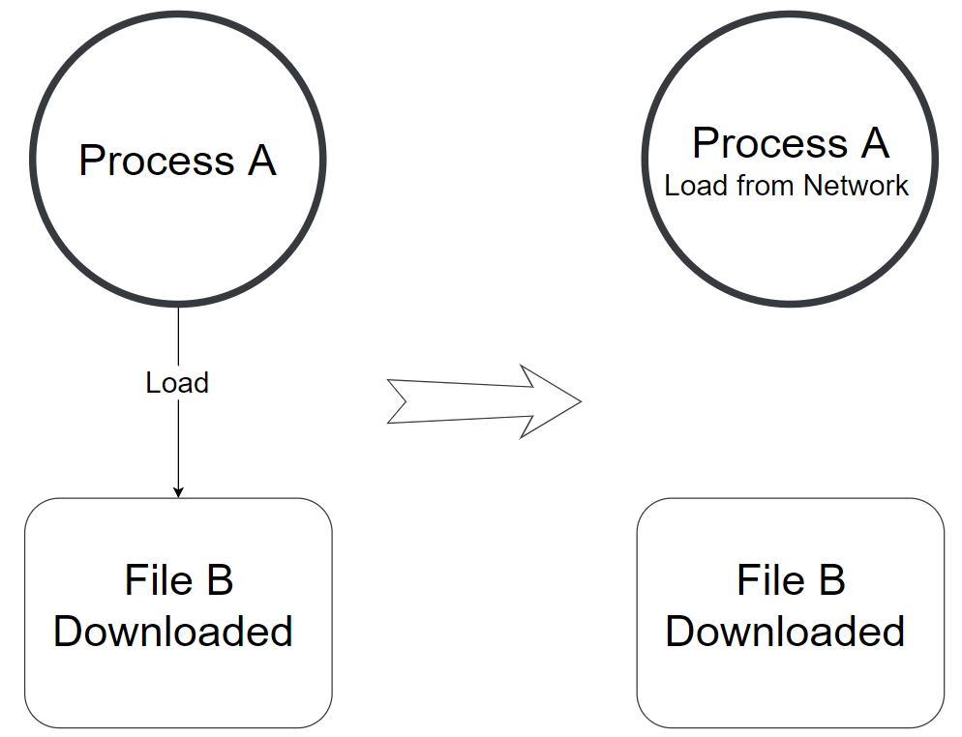
System Design – Aggregation Framework
Problem statement
Solution comparison (forward, backward, bi-directional)
Rules are used to propagate labels from one subject/object to another, in other words, the context information.
For example,

Slide 11
System Design
Policies (clearly define it)
Four Main Components:
1. Execute codes/scripts from attacker(or insider attack)
2. Suspicious Behaviors: The target of the attack;
3. Network Connections: To communicate with attacker and steal data
4.Other features: For example, unrealized by users.
Fast Policy Matching

Slide 12
System Details and Implementation
Problem 1: semantic behavior detection

Slide 13
System Details and Implementation
Problem 2 : Customized labels/rules/polices.
The framework is designed to be customizable to cover more attacks and adjust to different situation
Labels(Identifier, Confidence Score, Type, Description):
PT2,1,PHF,Access sensitive information
FT5,1,Data,The file contains sensitive information
Rules(Subject, Event, Object/Subject, Direction):
PT2,2,FT5,R
Policies:

Slide 14
System Details and Implementation
Problem 3 : Attack Reconstruction
We’ve designed a label-based attack graph reconstruction approach.
If process A is found to be suspicious, our approach would show the source path of the labels in A.
Advantages: 1.Don’t use additional memory;
2.Fast;
3.Accurate in most scenarios.

Slide 15
System Details and Implementation
Problem 4 : Data Storage in Memory
Instead of a graph, we prefer a process tree with a file list.
Process Tree
Each node is a process with its creation information and labels
Nodes are connected by creation relationships.
File List
Each element is a file with its attributes and labels
We don’t store events in memory, but status.

Slide 16
Challenges & Solutions
Challenge 5: Cross-machine Detection
TODO

