Slide 1


Scalable Name Lookup in NDN Using Effective Name Component Encoding
Yi Wang, Keqiang He, Huichen Dai, Wei Meng, Junchen Jiang, Bin Liu, Yan Chen

Slide 2
——Outline
1. Named Data Networking (NDN) Introduction
2. Name Lookup in NDN
3. Name Component Encoding (NCE)
4. Analysis
5. Experimental Results
6. Conclusion

Slide 3
——NDN Introduction
Named Data Networking (NDN)
  Named Data Networking is proposed recently as the clean-slate network architecture for future Internet, which no longer concentrates on “where” the information is located, but “what” the information (content) is needed.
  NDN uses names to identify every piece of contents instead of IP addresses for hardware devices attached to IP network.
Notes:
Unlike traditional IPv4/6 networks,

Slide 4
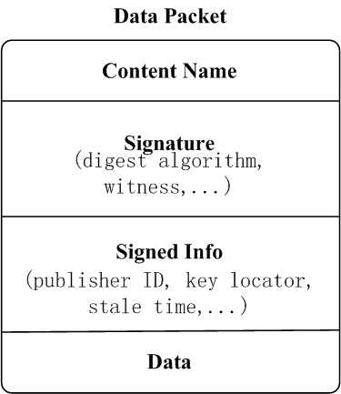
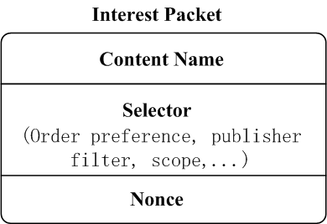
——NDN Introduction
Naming in NDN
  An NDN name is hierarchically structured and composed of explicitly delimited components
Interest and Data Packets in NDN
/com/google/maps
com
google
maps
Notes:
while the delimiters, usually slashes or dots, are not part of the name.

Slide 5

——NDN Introduction
IP Packet
Packet Forwarding Process
Interest Packet
Data Packet
Client
Dst
Src
FIB
Content Store
Content Provider

Slide 6
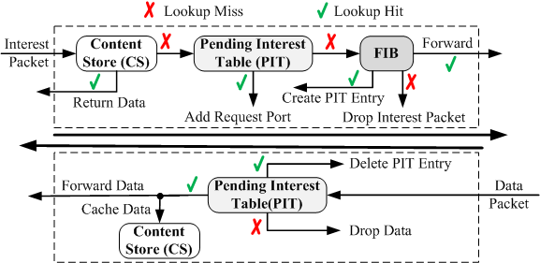
——NDN Introduction
Packet Forwarding Process

Slide 7
——Outline
1. Named Data Networking (NDN) Introduction
2. Name Lookup in NDN
3. Name Component Encoding (NCE)
4. Analysis
5. Experimental Results
6. Conclusion

Slide 8
——Name Lookup in NDN
The challenges of name lookup as below:
  Variable length name: unlimited components number and unfixed component’s length
  Longest name prefix matching: aggregate prefixes to reduce the total number of prefixes in FIB
  Interest Packet and Data Packet has different lookup processes
  The large-scale name prefix set
  Frequently update
Notes:
NDN forwards packets by names, which implies a substantial re-engineering of forwarding and its lookup mechanism.
Name lookup is a generic problem for content centric networking, URL filters and DNS. And the techniques can be broadly used.

Slide 9
——Name Lookup in NDN
Name lookup at component granularity
level-1
level-2
level-3
level-4
level-5
/com/yahoo/news
/com/yahoo/music/new
/com/google/news
/com/google
/cn/com/sina/news
/cn/com/sina/mail
/cn/yahoo/news
news
8
yahoo
4
new
music
9
D
2
com
google
news
5
A
1
news
E
sina
cn
6
B
com
mail
F
3
yahoo
news
7
C
Name Prefix Trie (NPT)

Slide 10
——Outline
1. Named Data Networking (NDN) Introduction
2. Name Lookup in NDN
3. Name Component Encoding (NCE)
4. Analysis
5. Experimental Results
6. Conclusion

Slide 11
——NCE Algorithm
level-1
level-2
level-3
level-4
level-5
news
4
Name | Pointer
/com/yahoo | …
/com/yahoo/news | …
/com/yahoo/maps/uk | …
/com/google | …
/com/google/maps | …
/cn/google/maps | …
/cn/sina | …
/cn/baidu | …
/cn/baidu/map | …
yahoo
3
uk
maps
5
6
2
com
google
maps
7
8
1
maps
google
A
B
cn
sina
9
C
baidu
map
D
E
< yahoo,1> <google, 2>
<baidu,1> <sina, 2> <google, 3>
<baidu,1> <google, 2> <google, 3> <sina, 3> <yahoo, 1>
<baidu,1> <google, 4> <sina, 3> <yahoo, 1>

Slide 12
level-1
level-2
level-3
level-4
level-5
news,1
9
Name | Coding | Ports
/com/yahoo | /1/1 | 1
/com/yahoo/news | /1/1/1 | 1
/com/yahoo/maps/uk | /1/1/3/1 | 2
/com/google | /1/4 | 2
/com/google/maps | /1/4/3 | 1, 2
/cn/google/maps | /2/4/3 | 3
/cn/sina | /2/3 | 2, 3
/cn/baidu | /2/1 | 4
/cn/baidu/map | /2/1/1 | 4
yahoo,1
4
uk,1
maps,3
A
E
2
com,1
maps,3
google, 4
5
B
1
google,4
maps,3
6
C
cn,2
sina,3
3
7
baidu,1
map,1
1
8
D
Base: (hex)
0001 | 4001 | 8001 | 0004 | 0007 | 8005 | 0009 | 4004 | 000A | 000B | 000D | 000E | 000F | 0010
2
4
3
6
Transition_1:
2 | 1 | 2 | 2 | 1 | 3 | 1 | 3 | 0 | 0 | 1 | 1 | 0 | 0 | 0 | 0
0 | 2 | 3 | 1 | 9 | 10 | 4 | 11 | 7 | 2 | 0 | 14 | 5 | 6 | 9 | 3
7
2 | 1 | 4 | 1 | 1
0 | 4 | 5 | 8 | 13
Transition_2:
5
Transition
# of Transitions
Transition_4:
3 | 1 | 3 | 4 | 1 | 3
0 | 8 | 7 | 6 | 0 | 12
Ports List Pointer

Slide 13
——NCE Algorithm
Character Trie for Components:
com
cn
Base:
1 | 3 | 6 | 8 | 9
3
m
4
6
1
o
2
4
5
c
3
1
2
Transition:
1 | c | 2 | o | n | 1 | m | 0 | 0
0 | 2 | 0 | 3 | 5 | 0 | 4 | 1 | 2
n
5
Code | States List
1 | 2..
2 | 9..

Slide 14
——Outline
1. Named Data Networking (NDN) Introduction
2. Name Lookup in NDN
3. Name Component Encoding (NCE)
4. Analysis
5. Experimental Results
6. Conclusion

Slide 15




——Analysis
Memory
Character Trie: α=8, β=9
Name Component Trie: α=9, β=5
Notes:
For the traditional Name Character Trie, every node at least
needs a pointer to the edges list, a pointer to the matching entry
(CS, PIT, FIB entry), and a list of edges which includes a key
(character), and a pointer to the next trie node and a pointer to
its brother edge. Every pointer needs 4 bytes, a character needs
1 byte, and the total memory can be calculated by Equation 1
Let State Transition Arrays construct the NCT, one entry
in Base Array and one entry in the Transition Array are
needed to represent a node. And an edge needs one entry
in Transition array. Here, one Base Array entry needs 4 bytes
and one Transition Array entry occupies 5 bytes.

Slide 16
——Analysis
In summary, compared with NCT, NCE utilizes the following three parts to reduce storage overhead.
  NCE uses State Transition Arrays to construct the NCT, and the memory cost can be reduced at least save 17.64%;
  Code Allocation Mechanism reduces the number of components by merging the Original Collision Set at the same level;
  NCE stores the transitions in different sizes of Transition Arrays. Compared with the method that uses Transition only, it can reduce the memory overhead further.
Notes:
In summary, compared with NCT, NCE utilizes the following
three parts to reduce storage overhead.

Slide 17
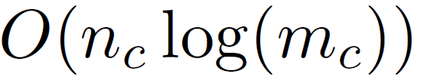


——Analysis
In NCE, the longest name prefix matching contains two Steps:
  1) finds the components’ corresponding codes in CCT-STA:
  2) looks up codes in ENPT-STA:
  So, a name lookup has:
If there are P parallel code lookup modules, the complexity can be reduced to:
Notes:
complexity in the average case, since binary search can be
proceeded to find the matching key in the node’s transitions
which have been sorted.
Similarly, a longest prefix matching in ENPT-STA needs

Slide 18

——Analysis
Compared with character trie, NCE can gains:
Notes:
NCE can gains
speedup for longest name prefix lookup.

Slide 19
——Outline
1. Named Data Networking (NDN) Introduction
2. Name Lookup in NDN
3. Name Component Encoding (NCE)
4. Analysis
5. Experimental Results
6. Conclusion

Slide 20
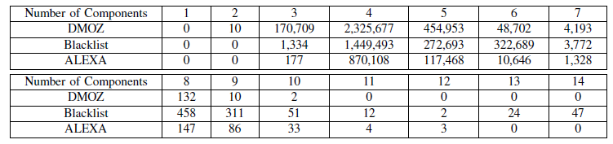
——Experimental Results
Number of Domains with different component’s number:
Notes:
NCE can gains
speedup for longest name prefix lookup.

Slide 21
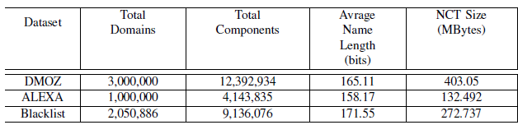
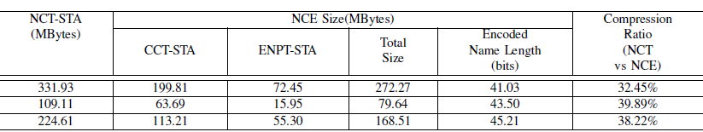
——Experimental Results
Comparison of memory usage:

Slide 22
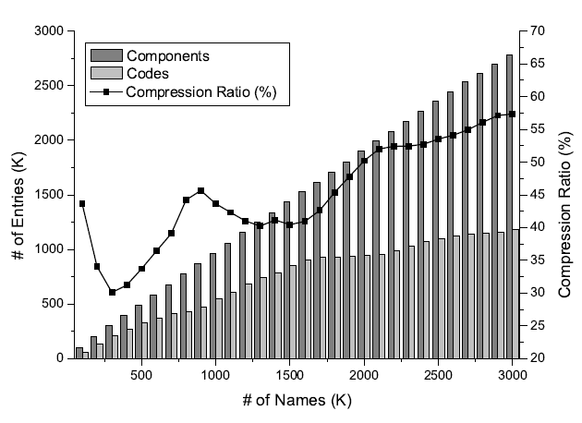
——Experimental Results
The number of different components and codes, and the compression ratio of Code Allocate Mechanism on DMOZ dataset:

Slide 23
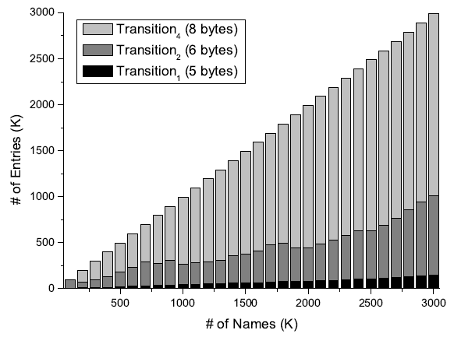
——Experimental Results
Number of Entries for Transition1, Transition2 and Transition4 on DMOZ dataset:

Slide 24
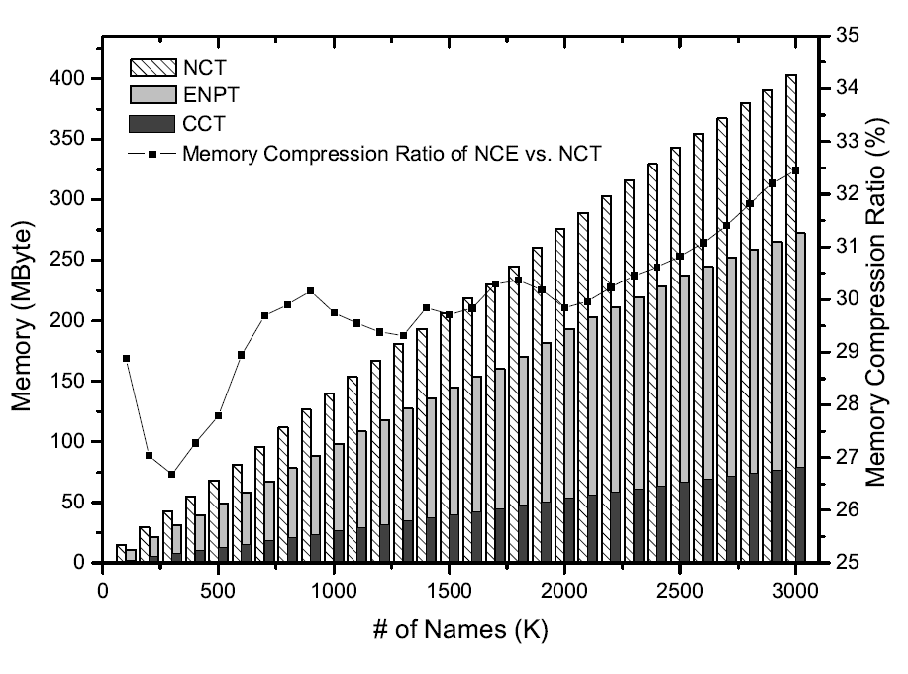
——Experimental Results
The Memory Cost of NCE and NCT on DMOZ dataset:

Slide 25
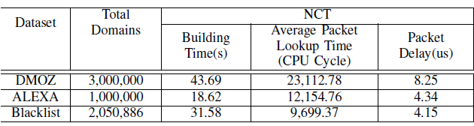
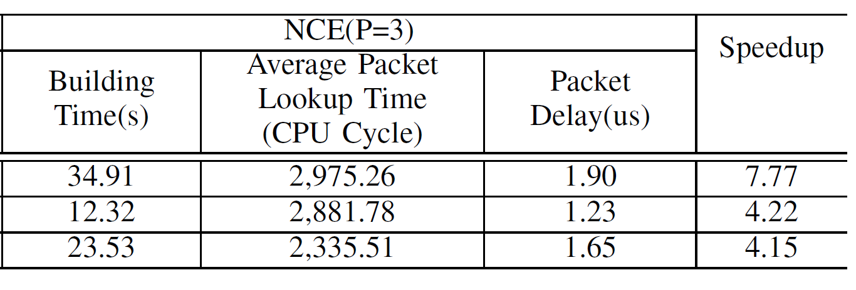
——Experimental Results
Comparison of NCT and NCE’s processing performance:

Slide 26
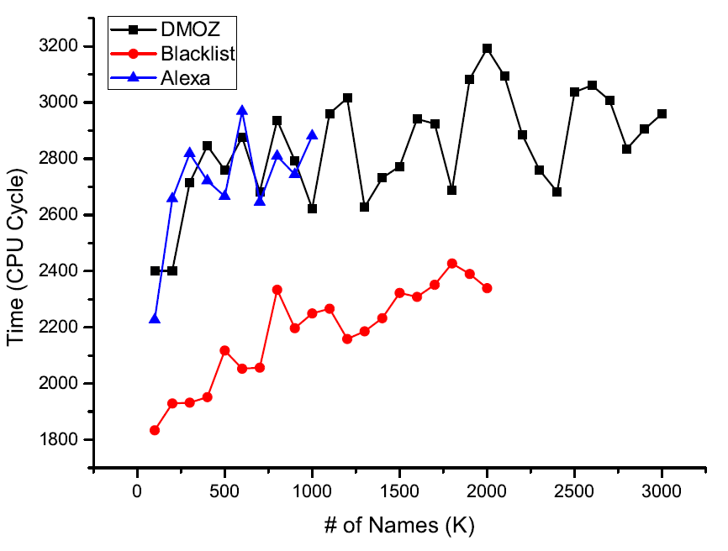
——Experimental Results
NCE’s Average Lookup Time (When the Number of Parallel CCT lookup modules is 3):

Slide 27
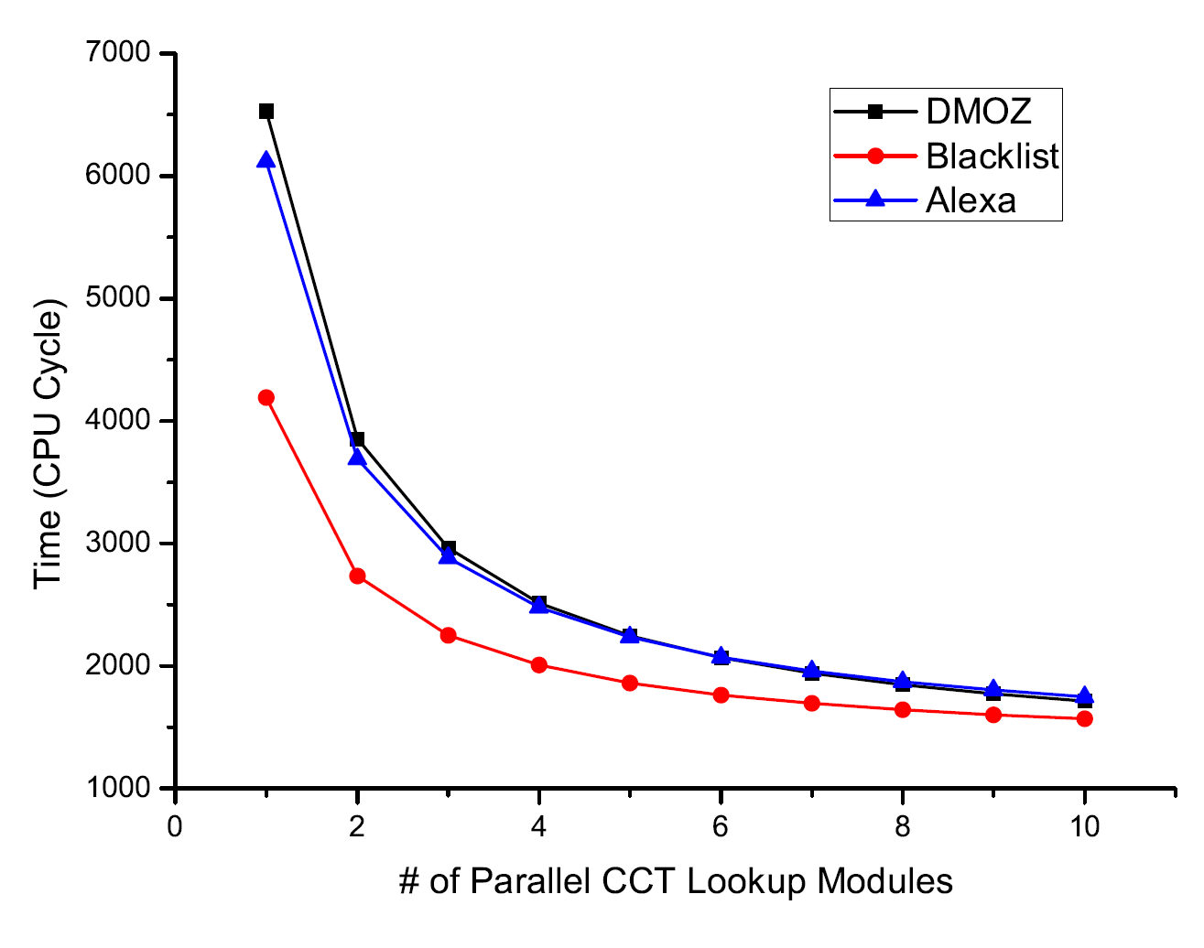
——Experimental Results
The relationship between NCE’s average lookuptime and the number of parallel CCT lookup modules

Slide 28
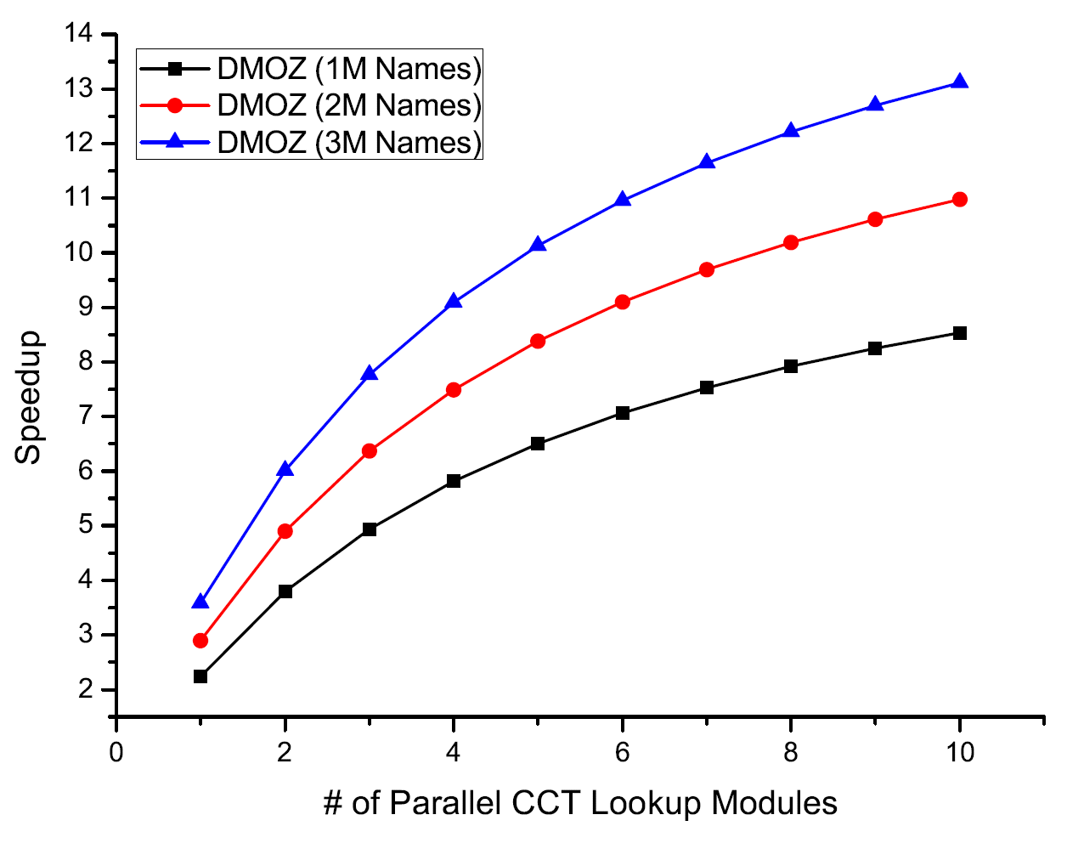
——Experimental Results
The relationship between NCE’s speedup and the number of parallel CCT lookup modules

Slide 29
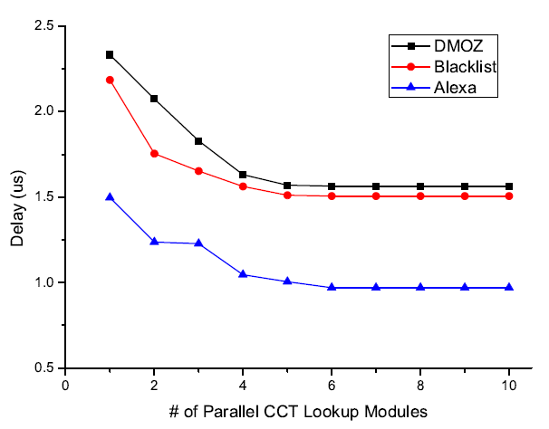
——Experimental Results
The relationship between NCE’s packet delay and the number of parallel CCT lookup modules

Slide 30
——Outline
1. Named Data Networking (NDN) Introduction
2. Name Lookup in NDN
3. Name Component Encoding (NCE)
4. Analysis
5. Experimental Results
6. Conclusion

Slide 31
——Conclusion
Proposed an effective Name Components Encoding approach:
  Code Allocation Mechanism
  State Transition Array
Both theoretical analysis and experiments on real domain sets demonstrate that NCE could effectively reduce the memory cost while guaranteeing high-speed of longest name prefix lookup.
Notes:
We proposed an effective Name Components Encoding approach named NCE to reduce memory overhead and accelerate lookup speed for longest name prefix lookup in NDN.
The technique involves a Code Allocation Mechanism and an evolutionary State Transition Arrays.
Code Allocation Mechanism reuses the codes as much as possible.
The evolutionary State Transition Arrays for Encoded Name Prefix Trie and Component Character Trie reduces the memory cost further while accelerating lookup speed.
Both theoretical analysis and experiments on real domain sets demonstrate that NCE could effectively reduce the memory cost while guaranteeing high-speed of longest name prefix lookup.

Slide 32
Thank you!
Q & A

