Slide 1
Error Tolerant Address Configuration for Data Center Networks with Malfunctioning Devices
Xingyu Ma, Chengchen Hu, Kai Chen, Che Zhang, Hongtao Zhang, Kai Zheng, Yan Chen, Xianda Sun
Xi’an Jiaotong University
Tsinghua University
Northwestern University
IBM China Research Lab
ICDCS 2012

Slide 2
Outline
Motivation
Research Problem Statement
Algorithm
Experiment
Conclusion

Slide 3
Background
Address Configuration for data center networks(DCN) is a problem
DHCP is not enough
Locality and topology information needs to be embedded in address
Address Configuration for DCN is challenging
Manual operation is error-prone
Data center scale is large
Supporting arbitrary topology is difficult

Slide 4
Background (cont.)
Review of a pioneering work: DAC
autoconfiguration for large scale DCN
error detection and correction
supporting arbitrary topology
DAC’s constraints
not totally automatic in face of malfunctions
manual correction efforts is involved
total time delay might be significant

Slide 5
Our Goal
Configure the well-functioning part DCN addresses automatically and fault-tolerantly first
the well-functioning part is the majority
the troublesome and time-consuming manual process is removed from the framework
the total configuration time of the well-functioning devices can be significantly reduced
Framework | Error-tolerance | Manual Efforts
DAC | Not considered | involved
ETAC | considered | Not involved

Slide 6
Outline
Motivation
Research Problem Statement
Algorithm
Experiment
Conclusion

Slide 7
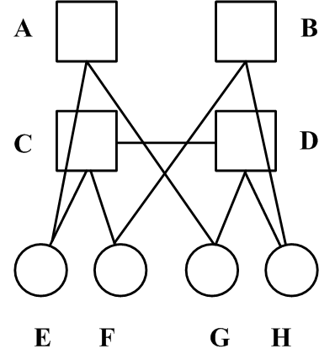
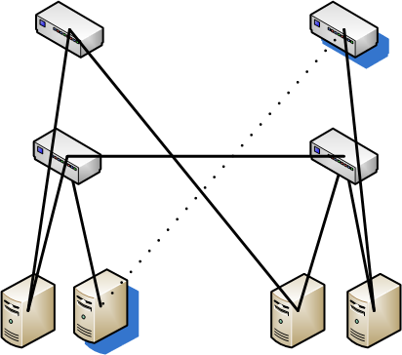
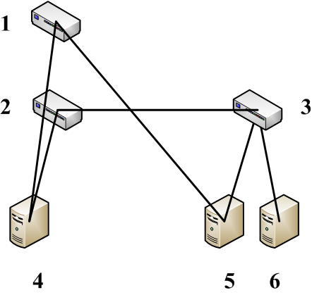
Three graphs in the problem
Blueprint:
A graph with logical IDs
Known in advance
Physical Graph:
Real connections among the machines in the data center
collected using Physical topology Collection Protocol (PCP)
Device Graph:
Device graph with error nodes removed

Slide 8
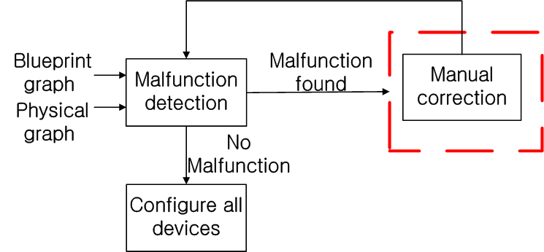
Framework of DAC and ETAC
DAC:
Error detection
Manual correction
Manually correct wiring!!

Slide 9
Framework of DAC and ETAC
ETAC:
Mapping from {1-6} to {A-H}
key component of the proposed system!!

Slide 10
Subgraph Mapping
Formulate the mapping into the induced subgraph isomorphism problem
Induced subgraph isomorphism problem is NP-complete!!

Slide 11
Outline
Motivation
Research Problem Statement
Algorithm
Experiment
Conclusion

Slide 12
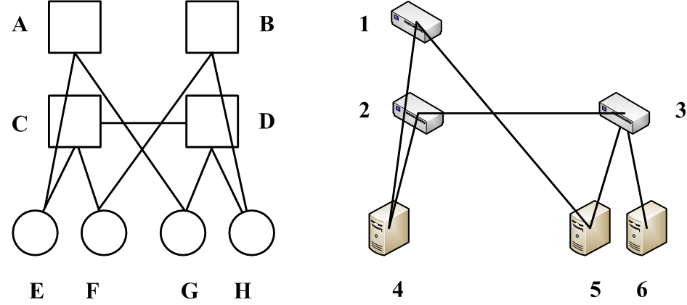
Subgraph Mapping Algorithm
divide-and-conquer search
Two basic operation:
decompose
Refine (composed by splits)
[1 2 3][4 5 6]
[ABCD][EFGH]
Decompose 2/C
[2][1 3][4 5 6]
[C][ABD][EFGH]
Split is done by connection relationship
refine 2/C
[2][3][1][4][5 6]
[C][D][AB][EF][GH]

Slide 13
Subgraph Mapping Algorithm
divide-and-conquer search
Two basic operation:
decompose
Refine (composed by splits)
[1 2 3][4 5 6]
[ABCD][EFGH]
Decompose 2/C
[2][1 3][4 5 6]
[C][ABD][EFGH]
Split is done by connection relationship
Refine 2/C
[2][3][1][4][5 6]
[C][D][AB][EF][GH]

Slide 14
Algorithm Correctness
Two basic operation is not enough for correctness
We need judgment for correctness
Basic Idea of Such judgment (Theorem I):
For every step in the algorithm, if there are x new-emerging mapped pairs {v_i –> u_i}, these new mapping pairs should follow the mapping relation with all mapped pairs.
(v_i, v’) = 1 if and only if (u_i, f(v’)) =1
v’ and f(v’) and mapped pairs in search

Slide 15
Algorithm Correctness - Example
Before splitting:
f(2) = C
f(3) = D
Check whether f(5) =G and
f(6) = H is ok
Check:
(5,3) = 1 (f(5),f(3)) = (G,D) =1
(6,3) = 1 (f(6),f(3)) = (H,D) = 1
[2][3][1][4][5][6]
[C][D][AB][EF][G][H]
split by 5/G and 6/H
[2][3][1][][4][5][6]
[C][D][A][B][EF][G][H]

Slide 16
Algorithm Speed up
Two pruning Algorithms (details in paper)
Strategy Selection –
The neighboring nodes to the currently mapped nodes are given higher priority for selection at decomposition
Speed-up brought by
induced subgraph property
sparsity of data center topology
algorithm own features

Slide 17
Outline
Motivation
Research Problem Statement
Algorithm
Experiment
Conclusion

Slide 18
Experiment
Setting:
Various Structure: FatTree,VL2, BCube, Dcell
Different DCN size
Different Error Number
Different Error Pattern
Metric:
Time
Memory

Slide 19
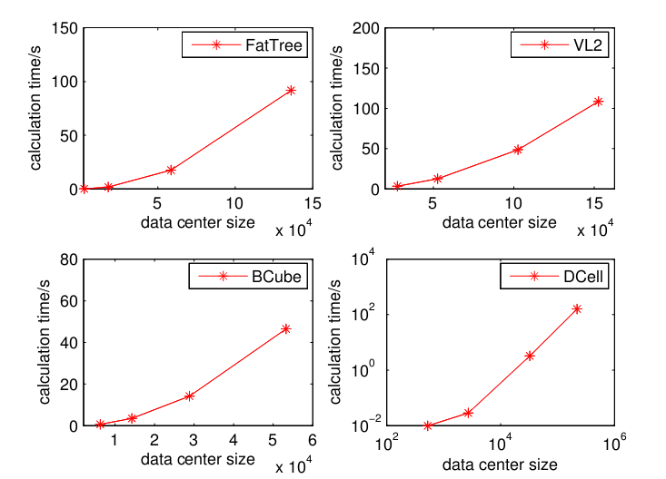
Performance vs. scale
Even if the DCN is in a scale of hundreds of thousands devices, it could accomplish the mapping within 5 minutes

Slide 20
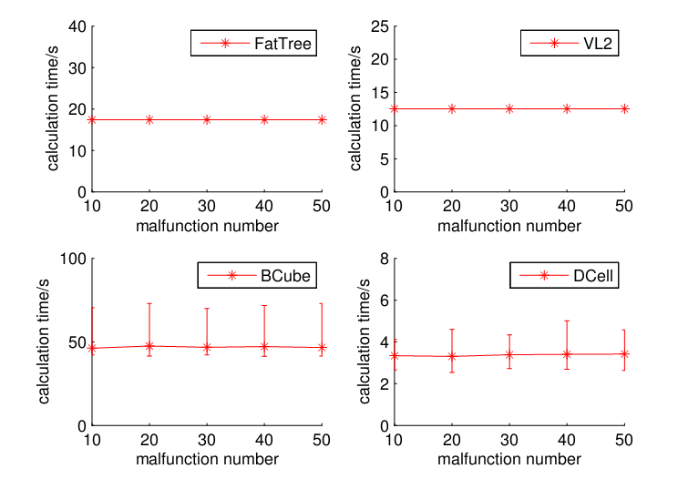
Performance vs. error number
Number of error does not matter much; average performance stable
Bcube and Dcell’s performances have flucutation

Slide 21
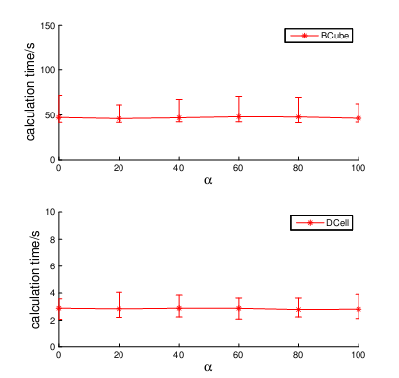
Performance vs. error pattern
Switch-centric:
different layer
Server-centric:
different proportions of error switches

Slide 22
Outline
Motivation
Research Problem Statement
Algorithm
Experiment
Conclusion

Slide 23
Conclusion
ETAC: address autoconfiguration for well-functioning part of DCN without any human efforts in an efficient and fault-tolerant way
ETAC is a step towards more generic and automatic address configuration for DCN

Slide 24
Q & A
Thanks!

