Slide 1
DyDroid: Measuring Dynamic Code Loading and Its Security Implications in Android Applications
Zhengyang Qu, Shahid Alam*, Yan Chen, Xiaoyong Zhou**, Wangjun Hong, Ryan Riley*
Northwestern University
Qatar University*
Samsung Research America**

Slide 2
Outline
Introduction
Problem Statement
System Design
Measurement Results
Conclusion

Slide 3
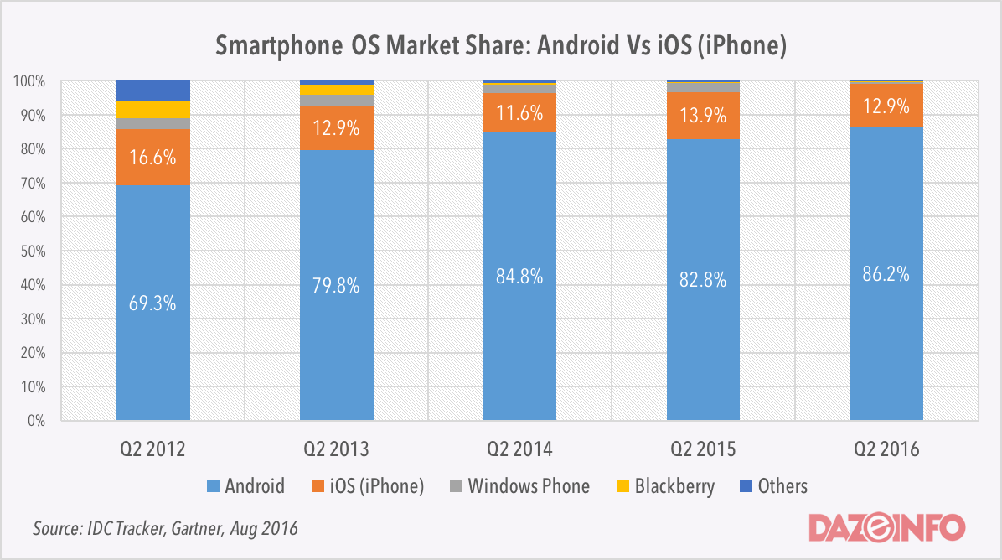
Android OS dominance
IDC Tracker, Gartner, Aug 2016
Notes:
Android is the most dominant smartphone OS, which should be attributed to the wide availability of mobile applications from application marketplaces such as Google Play1 .

Slide 4
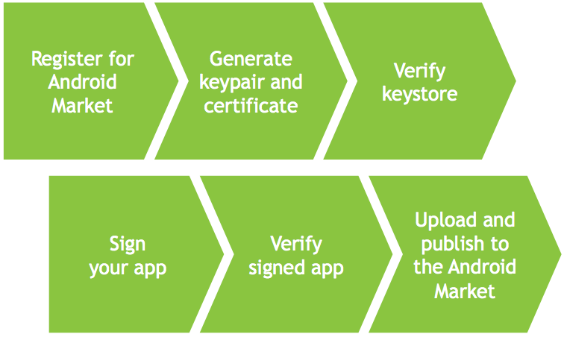
Security Check at Marketplaces
Diverse mobile application market places
Ease of deployment
Penetration
Remote download and DCL
Notes:
The big market share of Android is attributed to its open nature, ease of deployment of apps at marketplace.
Various marketplace have different policies to perform the security checks on apps to be released. We have our experiment to bypass Google Bouncer

Slide 5
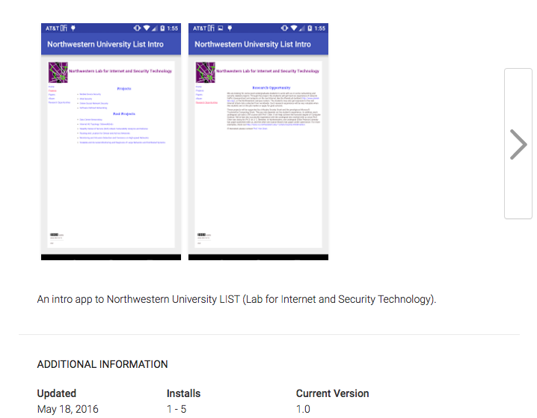
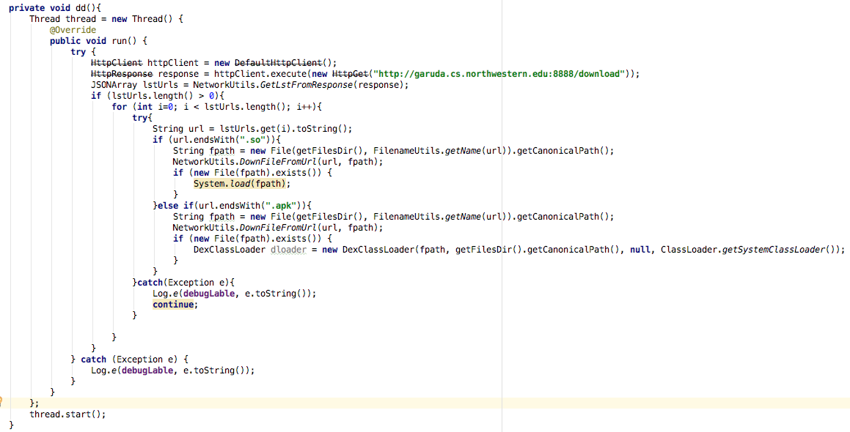
Penetration
Notes:
We prepared a malicious app AppM ,that is derived from known malware [22]. We submitted this app to Google Play and it was rejected by Google Bouncer. We then implemented a new app AppL , which can dynamically load AppM from a server at runtime. The server decides whether or not to send AppL the link to the copy of AppM . The app AppL was approved and released on Google Play.

Slide 6
Motivation
Android allows developers to load external code dynamically
Class Loader: bytecode
Java-Native-Interface (JNI): native code
Unpredictable, no security verification
Ineffective dynamic analysis system (Google bouncer)
Customize the condition of DCL, bypass
Notes:
Unpredictable: from where, who loads

Slide 7
Outline
Introduction
Problem Statement
System Design
Measurement Results
Conclusion

Slide 8
Problem Statement
Provenance
Local/remote availability
Responsible entity
Security benefits
Obfuscation
Security risks/implications
Vulnerabilities
Privacy tracking
Malware

Slide 9
Challenges
Code interception
Code loaded from temporary files
Concurrent I/O file operation
Provenance/entity identification
Flow analysis for file download
Dynamic call graph
Obfuscation identification
Bytecode encryption, loading interposed in app startup: general pattern?
Notes:
(1) Code interception. We need to log the DCL event and intercept the code loaded. The les containing the binaries may be temporary, which are compiled as intermediate results and will be deleted after being merged with the app triggering the DCL behavior. The application's runtime and our code interception are concurrent
in the OS. We thus need to instrument the low-level IO-related APIs to enforce mutual exclusion and intercept those loaded binaries. (2) Provenance/entity identification.
The Android OS itself does not distinguish whether or not a le in storage is downloaded from the network, meaning that it is non-trivial to determine if a le loaded using DCL was
originally sourced from the network. Detecting this case will require making use of flow analysis. In addition, the code loading may be triggered by a third-party SDK or library.
Our mechanism must also be able to nd out whether it was the developer or the third-party library provider who performed DCL. (3) Obfuscation identification. DCL is being actively used for anti-reverse engineering purposes. A proper methodology to accurately detect when an application is obfuscated in this way needs to be developed.

Slide 10
Outline
Introduction
Problem Statement
System Design
Measurement Results
Conclusion

Slide 11
Architecture
Notes:
Use FlowDroid to identity the privacy leakage
DroidNative to detect malware

Slide 12
DCL recognition/interception
Static analysis
Check invocation of ClassLoader and JNI
Dynamic analysis
Driven by Monkey (other fuzzing tool e.g., AppsPlayground Rastogi et al.)
Instrument Android 4.3 APIs: DexClassLoader, PathClassLoader, load, loadLibrary → Complete mediation
Not change till Android 7.1
Path to loaded file, directory of ODEX code, JAVA stack trace element
Dump loaded code while blocking low level I/O operation
Files downloaded from URL
Notes:
We verify that the DCL-related APIs in Android 7.1 do not change significantly from Android 4.3.1.
DexClassLoader and PathClassLoader remain the same and ART uses DEX to load.
Our system modification thus works well on newer versions of Android.
The class Runtime only adds an API (load0) to load native code. We only need to add hooking to one API to adapt to the latest version of Android.

Slide 13
Stack Trace

Slide 14
DCL recognition/interception
Static analysis
Check invocation of ClassLoader and JNI
Dynamic analysis
Driven by Monkey
Instrument Android 4.3 APIs: DexClassLoader, PathClassLoader, load, loadLibrary → Complete mediation
Path to loaded file, directory of ODEX code, JAVA stack trace element
Dump loaded code while blocking low level I/O operation
Files downloaded from URL

Slide 15
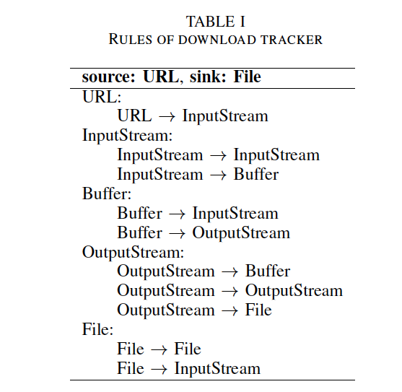
Download Tracker

Slide 16
Obfuscation Analysis
DEX encryption
Declare an Application class, starts before all other components
Invoke native code to decrypt DEX code and reconstruct lifecycle of Android components
Lexical obfuscation
Check identifiers against a language database constructed from DBpedia
Native code
Java reflection: java.lang.reflect
Anti-decompilation: verify with Apktool
Notes:
The most important one is DEX encryption

Slide 17
Outline
Introduction
Problem Statement
System Design
Measurement Results
Conclusion

Slide 18
Measurement summary
 | DEX | Native
Failure | 495 (1.21%) | 330 (1.31%)
Rewriting failure | 454 (1.11%) | 133 (0.53%)
No activity | 8 (0.02%) | 13 (0.05%)
Crash | 33 (0.08%) | 184 (0.73%)
Exercised | 40,354 (98.79%) | 24,957 (98.69%)
Intercepted | 16,768 (41.05%) | 13,748 (54.37%)
40,849 apps for bytecode and 25,287 apps for native code,
overall 58,739 apps
15,012/16,768 advertisement-related DCL
Notes:
The app will be rewritten and repacked with the permission of writing to external storage added, if it is not declared, so as to log the DCL.
The anti-repackaging technique is applied to some apps, which crashes apktool . Moreover, the fuzzing tool cannot exercise those apps without any Activity component. Finally, apps may also crash at runtime due to the implementation fault by developers.
We overall successfully exercise 40,354 apps for bytecode and 24,957 apps for native code, among which the DCL of 16,768 apps and 13,748 apps
are actually executed and the loaded code are successfully intercepted, separately.
By mining the log of DCL from mobile advertisement vendors, such as AdMob, we find the general pattern of the file path to the bytecode loaded by the advertisement libraries
“/data/data/AppPackageName/cache/ad*.Within the 16,768 apps whose DCL events are captured and loaded bytecode are intercepted, we find out 15,012 apps execute the binaries related to mobile advertisement. Those files are generated intermediately and will be deleted after being merged
with the apps which start the DCL behaviors.

Slide 19
Entity identification
Check call site class with application package name
 | 3rd-party | Own | 3rd-party & Own
DEX | 16,755 (99.92%) | 50 (0.30%) | 37 (0.22%)
Native | 11,834 (86.08%) | 2,280 (16.58%) | 366 (2.66%)
16,768 apps for bytecode and 13,748 apps for native code
Notes:
We rst identies whether the third-party or developer is
the responsible entity who launches DCL. The results are
summarized in Table 4. For both DEX and native code,
the third-party SDKs and libraries of over 80% are the actual
entities to load code at runtime. Given the diculty
of reverse-engineering the code dynamically loaded, protecting
the intellectual property is the possible motivation of
deploying third-party libraries using DCL.

Slide 20
Remote download
Package name
com.ipeaksoft.pitDadGame, com.xy.mobile.shaketo org.madgame.Idom, com.yb.sex.cartoon5 com.jianhui.FJDazhan, com.quwenba.i9300manual com.rhino.itruthdare, com.xiangqi.fanapp.a1521 com.huijia.moyan, org.mfactory.three.bubble com.huijia.zuoqingwen, apps.simple.recipe com.xiangqi.fanapp.a1284, com.ioteam.numbertest com.avpig.acc, air.com.qqqf.xxywszzy2a com.seven.chuanyueqinggong, com.game.knyds air.com.qqqf.xxnjyybdc123456, com.seven.tiancantudou com.conpany.smile.ui, com.classicalmuseumad.cnad com.seven.chuanyuegongting, com.seven.mengrushenj com.nexusgame.popbirds, com.XTWorks.lolsol com.Long.ButtonsShowAndroid
Download JAR and APK files from domain:
http://mobads.baidu.com/ads/pa/
Notes:
With the download tracker in our dynamic analysis, we find out the 27 apps in Table 5, which execute the binaries downloaded from remote servers at runtime. For example,
the app com.classicalmuseumad.cnad4 downloads two files in the formats JAR and APK from the domain http://mobads.baidu.com/ads/pa/. All the DCL events of
loading code in the remote fetch manner are initialized by the advertisement related third-party libraries from Baidu [8].

Slide 21
Obfuscation
Technique | #Apps (%)
Lexical | 52,836 (89.95%)
Reflection | 30,664 (52.20%)
Native | 13,748 (23.40%)
DEX encryption | 140 (0.24%)
Anti-decompilation | 54 (0.09%)
Overall 58,739 apps
Notes:
89.95% applications use the lexical obfuscation. The high adoption rate is expected, as this functionality is included in ProGuard and served within Android IDE for free [22]. Even with the high popularity, lexical obfuscation just makes the source code not human readable.
Reflection allows a running program to retrieve information about itself and the runtime environment, which can be used to instantiate arbitrary classes, invoke methods, and alter data fields. As with native code, although developers might have various purposes of using these techniques, such as performance improvement, accessing private fields and methods, they do increase the bar of reverse engineering, because they make analyzing the program statically very difficult. But a dynamic analysis is still able to recover the execution of the applications obfuscated by these two methods.
As apktool keeps evolving, the percentage of applications with anti-decompilation capability remains low 0.24%.
The adoption rate of DEX encryption method is still low, and it is mainly applied in shopping applications with sensitive payment functionalities. Developers may have the compatibility concern, given the Android fragmentation issue [7]. It is also possible that this technique is relatively new and does not have enough market penetration.
The categories Entertainment , Tools , and Shopping of apps play a dominant role. We further investigate the functionalities of apps in these categories. The apps in the category of entertainment provide the functionalities of controlling smart TV, where the TV vendors are motivated to protect the communication between smartphone and TV from being reverse engineered. The apps in the category of tools are antivirus apps and those in the category of shopping include the sensitive functionalities of payment, which are both obfuscated for security.

Slide 22
Unknown malware variant detection
87 Apps found to load malicious code from 91 files (detected by DroidNative Alam et al.)
 | Family | #Apps | Sample App (#Download)
DEX | Swiss code monkeys | 1 | com.sktelecom.hoppin.mobile (10,000,000)
 | Adware airpush minimob | 2 | com.oshare.app (10,000)
Native | Chathook ptrace | 84 | com.com2us.tinyfarm.normal.freefull.google.global.android.common (10,000,000)
Notes:
One application loads the malicious DEX code in the Swiss code monkeys family. It adds the malicious code as a service, and sends IMEI, phone number, and IMSI to a remote site. A remote user is able to send and execute a command, such as application installation, website navigation, adding browser bookmark, sending text message, and blocking test message response.
Two applications are found to execute the malicious bytecode in the family Adware airpush minimob , where mobile advertisement is pushed to the device via notification. Moreover, shortcuts are placed on users’ home screens and browser settings are changed to redirect homepage
There are total 84 applications loads malicious native code in the family Chathook ptrace , which mainly targets the two popular chatting applications QQ3 and WeChat4 with millions of downloads. The malicious application tries to get the root privilege first. Then, it attaches the system call ptrace to the two applications as the superuser, controls the two applications, and hooks the Java methods related to the chatting window. Finally, the malware leaks the chat history to a remote server.

Slide 23
Vulnerability (variant) detection
The file dynamically loaded is writable by other parties
 | Category | #Apps | Sample App (#Download)
DEX | Internal storage of other Apps | 0
 | External storage (< Android 4.4) | 7 | com.longtukorea.snmg (1,000,000), com.felink.android.launcher91 (1,000,000), …
Native | Internal storage of other Apps | 7 | com.devicescape.usc.wifinow (1,000,000), …
 | External storage (< Android 4.4) | 0
Notes:
The app that loads code from a space writable by other parties is vulnerable to code injections. We classify those apps with risky DCL into two categories: (1) private storage
of other apps, (2) public external storage. We note that all the vulnerable apps are manually confirmed to make sure that even developer fails
to enforce integrity verification on the loaded code. We also check the manifest les of those apps in the second category and make sure they do support the OS version lower than
4.4. 14 apps are found to have risky usage of DCL. Three vulnerable apps have over the 100K number of downloads. Both developers and OS vendors should pay attention to security regulation of DCL.
For example the app com.longtukorea.snmg stores its bytecode file yayavoice_for_assets_2015101201.jar in the public directory /mnt/sdcard/im_sdk/jar/.
Another app com.devicescape.usc.wifinow loads the library libdevicescape-jni.so from the app com.devicescape.offloader , which share the same developer.

Slide 24
Privacy tracking
Mark sensitive APIs and content providers as source, total 18 types of privacy
Type | #Apps | Exclusively 3rd-party (%)
Location | 254 | 251 (98.82%)
IMEI | 581 | 576 (99.14%)
Phone number | 12 | 10 (83.33%)
Installed apps | 32 | 28 (87.50%)
Contact | 1 | 1 (100%)
Calendar | 76 | 73 (96.05%)
Settings | 16,482 | 16,441 (99.75%)
…
Notes:
FlowDroid on intercepted code
As we mentioned above, there are 15,012 apps loading the Google Ads library, which has strict control of user privacy and only reads the device settings.
Sensitive information is heavily tracked in DCL. Almost all of these operations are conducted exclusively in third-party libraries. The offline analysis system in mobile marketplace is ineffective when identifying these stealthy actions within DCL. Mobile marketplaces should have strong regulation on those 3rd-party SDKs and redesign the system DCL with accountability considered.

Slide 25
Conclusion
Dynamic analysis system based on Android Open Source Project
A large scale measurement
Provenance
App hardening
Security risk/implications
3rd-party usage, integrity verification, platform enforcement
Notes:
The apps that are found to use DCL in the remote fetch manner show that there is no existing solution to the enforcement of the related content policy. DCL is mainly used
by third-party SDKs, indicated that the developer may not be aware that it is occurring. Given its stealthiness, DCL is also a channel to deploy malware, and we observe the real samples where the actual loading is controlled with logical conditions, such as system time. The security verification of DCL is needed from the app developer and OS vendors, given the apps vulnerable to code injection, which load binaries writable by other parties.

Slide 26
Thank you!
Questions?
http://list.cs.northwestern.edu/mobile/

Slide 27
DCL v.s. App Popularity
 | #Downloads | #Ratings | Rating
DEX | 60,010 | 2,448 | 3.91
Without DEX | 52,848 | 2,318 | 3.77
Native | 288,995 | 8,668 | 3.82
Without Native | 75,127 | 1,119 | 3.79
58,739 APPLICATIONS; NUMBER OF DOWNLOADS;
NUMBER OF RATINGS, AVERAGE RATINGS

Slide 28
Hide of Malicious Behavior
Configuration | #Files intercepted (%)
System time | 72 (79.12%)
Airplane mode/WiFi ON | 56 (61.54%)
Airplane mode/WiFi OFF | 53 (58.24%)
Location OFF | 70 (76.92%)
87 apps load 91 malicious files
Notes:
We further investigate the malicious loading event can be reproduced with different configurations of runtime environment. The results are listed in Table VIII. 19 files of malicious
code are not loaded when the system time is set before the app’s release date, which can be used to bypass the check during the app review phase. Moreover, we also observe the hide of malicious behaviors when connection or location service is not available, where those logical conditions make it more difficult to detect the malware loaded dynamically.

