Slide 1
Attack Transformation to Evade Intrusion Detection
Northwestern Lab for Internet and Security Technology (LIST)

Slide 2
Introduction
Evade intrusion detection
Traditional approaches: fragmenting PDU in IP, TCP or RPC payload.
Instead, we care about protocol-level flaws in signature.
Our goal:
Understand the robustness of Cisco IPS signatures as well as expressiveness of signature engine
Improve signature generation practice and expressiveness

Slide 3
Result Highlight
Analyze four vulnerabilities in detail
Successfully evade IPS in all four vulnerabilities
The result indicates issues in current signature generation practice
Several potential solutions

Slide 4
Roadmap
Technical details of evasion
CVE-2008-0226
CVE-2003-0201
CVE-2006-1652 (server & client)
Potential solutions
Improve sig testing
Vulnerability classification
Vulnerability signature based IPS engine: NetShield

Slide 5
MySQL yaSSL Client Hello Buffer Overflow
CVE-2008-0226

Slide 6
Original Signature
Signature 20420/0 on Cisco IPS 4270
\xcd\xa7\x21K\xe3U\xb3\x89\x3b\x00\xbeSH\xe9A\xac\x0e\x02\xd9\x93\xce\xda\xf2\xa2\xa3kMB\x60\xaa\xec\x02bb\x00Paaaaaaaa
It doesn’t make sense to us…
Not part of SSL handshake protocol
Cannot match with exploit we could find

Slide 7
Manual Sig Generation
One Available Exploit
\xAA\x8D\x00\x00-(client_flags)
\x00\x00\x00@-(max_packet_size)
\b-(charset)
\x00\x00\x00\x00\x00\x00\x00\x00\x00\x00\x00\x00\x00\x00\x00\x00\x00\x00\x00\x00\x00\x00\x00-(filler)
\x00\x00(size)
\x01(client hello)
\x03\x01 (version)
\x00\x00 (cipher suites length)
\x00\x00 (session ID length)
\x0F\xFF (random size)

Slide 8
Sig Generalization
Wildcard the bytes not related to vul
(\xAA\x8D)|(\x8D\xAA)\x00{5}\x40\x08[\x00-\xFF]{23}
[\x00-\xFF][\x00-\xFF]\x01[\x00-\xFF][\x00-\xFF][\x00-\xFF]
[\x00-\xFF][\x00-\xFF][\x00-\xFF]([\x10-\xFF][\x00-\xFF])|(\x0F\xFF)

Slide 9
Test
We test it on Cisco IPS 4270
No known FN and FP found

Slide 10
Samba call_trans2open Overflow
CVE-2003-0201

Slide 11
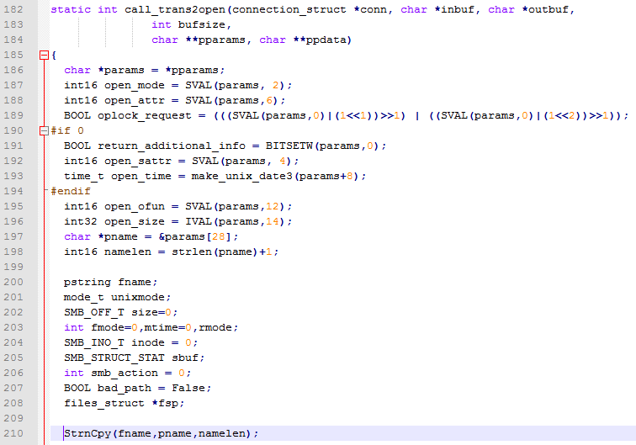
Vulnerability Info
Parameter length determines the pname length
Long array overflows the buffer, returns to shell code

Slide 12
Original Signature
Sig ID: 5594/0
Not visible…

Slide 13
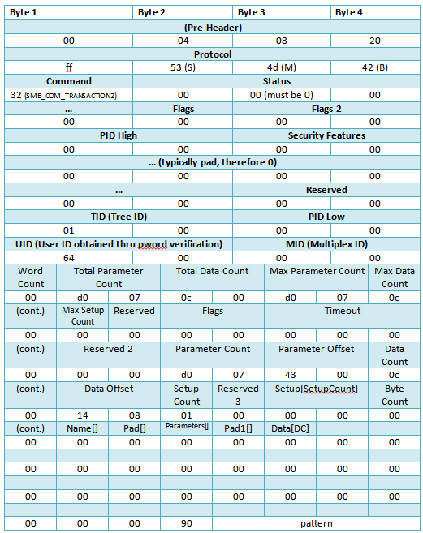
Exploit
SMB command transaction2

Slide 14
Testing for Signature
Ignore fields vital to triggering vulnerability
eg. Protocol fields, etc.
Focus on fields that are related to triggering vul, but have room for flexibility
Mostly numerical parameters
Patterns specific to particular exploit code
eg. Flags field

Slide 15
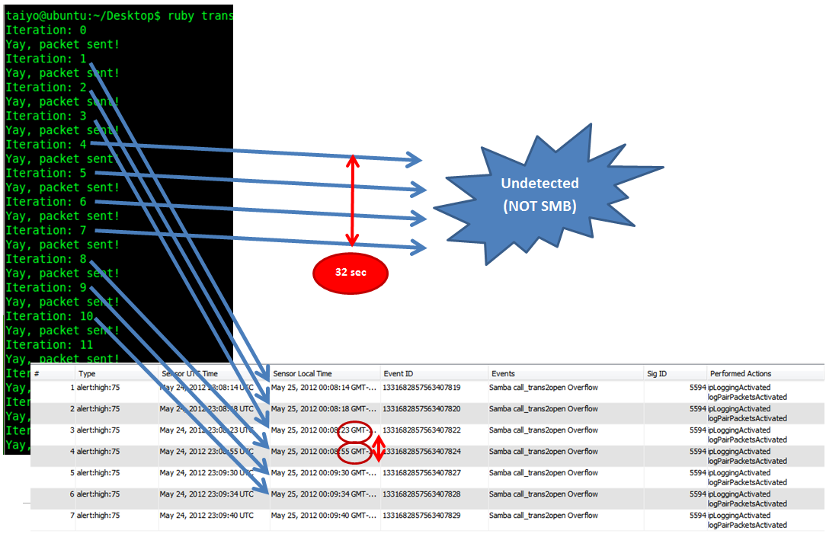

Slide 16
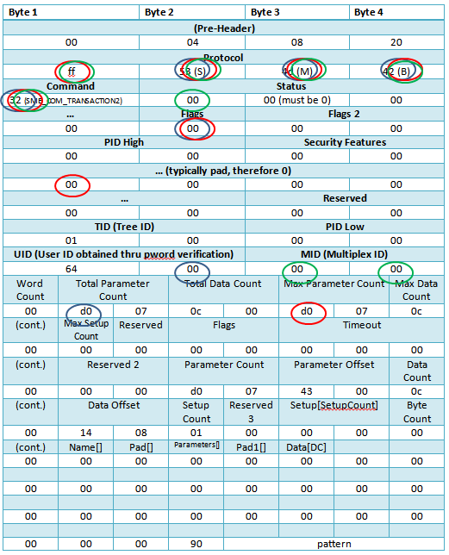
Results
Fields with more circles likely to be in signature
Protocol fields in sig, but fixed
As predicted by heuristics, Flags a likely candidate

Slide 17
Cisco IDS Evaded
Changed Flags field to 0xff

Slide 18
UltraVNC Client Overflow
CVE-2006-1652

Slide 19
Original Signature
Sig ID: 5751/0
Content:
[Rr][Ff][Bb]\x20[0][0][3][.][0][0][0-9][\r\n]
\x00\x00\x00\x00
((\x00\x00[\x04-\xff][\x00-\xff])
|([\x01-\xff][\x00-\xff][\x00-\xff][\x00-\xff])
|([\x00][\x01-\xff][\x00-\xff][\x00-\xff]))
[^\x00]+

Slide 20
Evaded Exploit
Adapted from a public PoC
RFB 003.006X
……

Slide 21
UltraVNC Server Overflow
CVE-2006-1652

Slide 22
Original Signature
Sig ID: 5761/0
Original sig looks for \x20(space) in HTTP URI
Correct sig should only specify length of URI

Slide 23
Evaded Exploit
Eliminate all spaces in the URI field

Slide 24
Potential Solutions

Slide 25
Source of Sig Inaccuracy
Signature errors
Solution: improve testing tools
Insufficient expressiveness of sig language
Solution: vulnerability classification, and NetShield (efficient symbolic constraint language matching)

Slide 26
Signature Testing
Given vulnerability and a sample exploit, how can we generate test cases with good coverage?
Test common errors of manual generation
Alphabet search
Exploit characteristics of regex
Vary numeric value or length
Field reorder

Slide 27
Vulnerability Classification
Vul classification based on complexity
Regex
Byte-level symbolic constraint
Protocol-level symbolic constraint
Turing complete
Using less expressive language to match more complex vul will inevitably introduce FN or FP

Slide 28
Vulnerability Classification
We analyze 34 vulnerabilities manually
Regex: 5
Byte-level: 5
Protocol-level: 13
Turing complete: 9
Inadequate info: 2

Slide 29
NetShield
http://www.nshield.org/

Slide 30
State Of The Art
Regular expression (regex) based approaches
Used by: Cisco IPS, Juniper IPS, open source Bro
Example: .*Abc.*\x90+de[^\r\n]{30}
Pros
Can efficiently match multiple sigs simultaneously, through DFA
Can describe the syntactic context
Cons
Limited expressive power
Cannot describe the semantic context
Inaccurate

Slide 31
State Of The Art
Vulnerability Signature [Wang et al. 04]
Blaster Worm (WINRPC) Example:
BIND:
rpc_vers==5 && rpc_vers_minor==1 && packed_drep==\x10\x00\x00\x00
&& context[0].abstract_syntax.uuid=UUID_RemoteActivation
BIND-ACK:
rpc_vers==5 && rpc_vers_minor==1
CALL:
rpc_vers==5 && rpc_vers_minors==1 && packed_drep==\x10\x00\x00\x00
&& opnum==0x00 && stub.RemoteActivationBody.actual_length>=40
&& matchRE(stub.buffer, /^\x5c\x00\x5c\x00/)
Vulnerability: design flaws enable the bad
inputs lead the program to a bad state
Good
state
Bad input
Bad
state
Vulnerability
Signature
Pros
Directly describe semantic context
Very expressive, can express the vulnerability condition exactly
Accurate
Cons
Slow!
Existing approaches all use sequential matching
Require protocol parsing

Slide 32
Regex vs. Vulnerabilty Sigs
Vulnerability Signature matching
Parsing
Matching
Combining
Regex cannot substitute parsing
Theoretical prospective
Practical prospective
Protocol
grammar
HTTP chunk encoding
DNS label pointers
Regex
Context
Sensitive
Context
Free

Slide 33
Regex V.S. Vulnerabilty Sigs
Regex + Parsing cannot solve the problem
Regex assumes a single input
Regex cannot help with combining phase
Cannot simply extend regex approaches for vulnerability signatures

Slide 34
Motivation of NetShield

Slide 35
Research Challenges and Solutions
Challenges
Matching thousands of vulnerability signatures simultaneously
Sequential matching →match multiple sigs. simultaneously
High speed protocol parsing
Solutions (achieving 10s Gps throughput)
An efficient algorithm which matches multiple sigs simultaneously
A tailored parsing design for high-speed signature matching
Code & ruleset release at www.nshield.org
Notes:
35
35

Slide 36
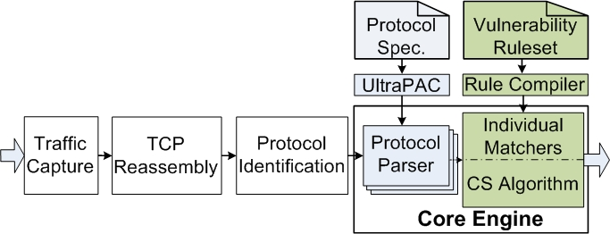
NetShield System Architecture

Slide 37
Outline
Motivation
High Speed Matching for Large Rulesets
High Speed Parsing
Evaluation
Research Contributions
Notes:
37
37

Slide 38
Background
Vulnerability signature basic
Use protocol semantics to express vulnerabilities
Defined on a sequence of PDUs & one predicate for each PDU
Example: ver==1 && method==“put” && len(buf)>300
Data representations
The basic data types used in predicates: numbers and strings
number operators: ==, >, <, >=, <=
String operators: ==, match_re(.,.), len(.).
Blaster Worm (WINRPC) Example:
BIND:
rpc_vers==5 && rpc_vers_minor==1 && packed_drep==\x10\x00\x00\x00
&& context[0].abstract_syntax.uuid=UUID_RemoteActivation
BIND-ACK:
rpc_vers==5 && rpc_vers_minor==1
CALL:
rpc_vers==5 && rpc_vers_minors==1 && packed_drep==\x10\x00\x00\x00
&& opnum==0x00 && stub.RemoteActivationBody.actual_length>=40
&& matchRE(stub.buffer, /^\x5c\x00\x5c\x00/)
38
Notes:
38

Slide 39
Matching Problem Formulation
Suppose we have n signatures, defined on k matching dimensions (matchers)
A matcher is a two-tuple (field, operation) or a four-tuple for the associative array elements
Translate the n signatures to a n by k table
This translation unlocks the potential of matching multiple signatures simultaneously
Rule 4: URI.Filename=“fp40reg.dll” && len(Headers[“host”])>300
RuleID | Method == | Filename == | Header == LEN
1 | DELETE | * | *
2 | POST | Header.php | *
3 | * | awstats.pl | *
4 | * | fp40reg.dll | name==“host”; len(value)>300
5 | * | * | name==“User-Agent”; len(value)>544
Notes:
39
Multiple PDU matching problem (MPM)
Associate array

Slide 40
Signature Matching
Basic scheme for single PDU case
Refinement
Allow negative conditions
Handle array cases
Handle associative array cases
Handle mutual exclusive cases
Extend to Multiple PDU Matching (MPM)
Allow checkpoints.
Notes:
40
40

Slide 41
Difficulty of the Single PDU matching
Bad News
A well-known computational geometric problem can be reduced to this problem.
And that problem has bad worst case bound O((log N)^{K-1}) time or O(N^{K}) space (worst case ruleset)
Good News
Measurement study on Snort and Cisco ruleset
The real-world rulesets are good: the matchers are selective.
With our design O(K)

Slide 42
Matching Algorithms
Candidate Selection Algorithm
Pre-computation: Decides the rule order and matcher order
Runtime: Decomposition. Match each matcher separately and iteratively combine the results efficiently
Notes:
42
42
Matcher Implementation
Integer range checking: Binary search tree
String exact matching: Trie
String regular expression: DFA, XFA, etc.
String length checking: Binary search tree

Slide 43
Step 1: Pre-Computation
Optimize the matcher order based on buffering constraint & field arrival order
Rule reorder:
1
Require
Matcher 1
Require
Matcher 1
Require
Matcher 2
Don’t care
Matcher 1
Don’t care
Matcher 1 & 2
n
Notes:
43
For K matchers and N signatures, in worst case, a
matcher has O(N) candidates, requiring O(K × N) operations
in total. However, based on observations 1–3,
we know that a matcher will usually only have C candidates,
where C is a small constant. In that case, we can
get O(k) speed. The algorithm needs O(K × N) space
to hold the bitmap. For each connection in worst case
we need O(N) space to hold the candidates. However, in
practice we just need a constant space determined by C.

Slide 44
Step 2: Iterative Matching
PDU={Method=POST, Filename=fp40reg.dll,
Header: name=“host”, len(value)=450}
S₁={2} Candidates after match Column 1 (method==)
S₂=
S₁
A₂
+B₂
={2}
{}+{4}={}+{4}={4}
S₃=S₂
A₃+B₃
={4}
{4}+{}={4}+{}={4}
RuleID | Method == | Filename == | Header == LEN
1 | DELETE | * | *
2 | POST | Header.php | *
3 | * | awstats.pl | *
4 | * | fp40reg.dll | name==“host”; len(value)>300
5 | * | * | name==“User-Agent”; len(value)>544
Don’t care
matcher i+1
R1
Si
R2
require
matcher i+1
In A_{i+1}
R3
44
Notes:
44

Slide 45
Complexity Analysis
Three HTTP traces:
avg(|S_{i}|)<0.04
Two WINRPC
traces: avg(|S_{i}|)<1.5
Merging complexity
Need k-1 merging iterations
For each iteration
Merge complexity O(n) the worst case, since S_{i} can have O(n) candidates in the worst case rulesets
For real-world rulesets, # of candidates is a small constant. Therefore, O(1)
For real-world rulesets: O(k) which is the optimal we can get

Slide 46
Outline
Motivation
High Speed Matching for Large Rulesets.
High Speed Parsing
Evaluation
Research Contribution
Notes:
46
46

Slide 47
High Speed Parsing
Tree-based vs. Stream Parsers
Keep the whole parse
tree in memory
Parsing and matching
on the fly
VS.
Parse all the nodes
in the tree
Only signature related
fields (leaf nodes)
VS.
Design a parsing state machine

Slide 48
High Speed Parsing
Build an automated parser generator, UltraPAC

Slide 49
Observations
PDU → parse tree
Leaf nodes are numbers or strings
PDU
array
Observation 1: Only need to parse the fields related to signatures (mostly leaf nodes)
Observation 2: Traditional recursive descent parsers which need one function call per node are too expensive
49
Notes:
49

Slide 50
Efficient Parsing with State Machines
Studied eight protocols: HTTP, FTP, SMTP, eMule, BitTorrent, WINRPC, SNMP and DNS as well as their vulnerability signatures
Common relationship among leaf nodes
Pre-construct parsing state machines based on parse trees and vulnerability signatures
50
Notes:
50
Protocol semantic are context sensitive

Slide 51
Outline
Motivation
High Speed Matching for Large Rulesets.
High Speed Parsing
Evaluation
Research Contributions
Notes:
51
51

Slide 52
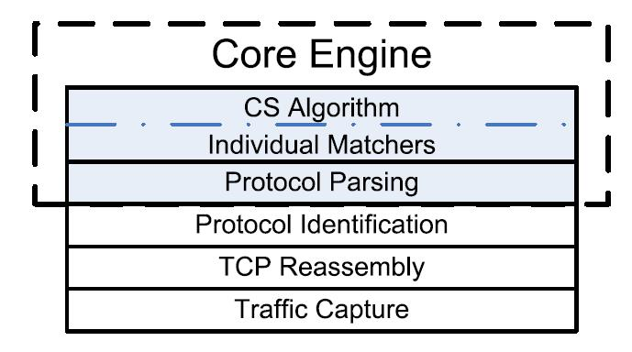
Evaluation Methodology
Fully implemented prototype
10,000 lines of C++ and 3,000 lines of Python
Deployed at a DC in Tsinghua
Univ. with up to 106Mbps
26GB+ Traces from Tsinghua Univ. (TH), Northwestern (NU) and DARPA
Run on a P4 3.8Ghz single core PC w/ 4GB memory
After TCP reassembly and preload the PDUs in memory
For HTTP we have 794 vulnerability signatures which cover 973 Snort rules.
For WINRPC we have 45 vulnerability signatures which cover 3,519 Snort rules
Notes:
52
The measured links experience a sustained
traffic rate of roughly 20Mbps with bursts of up
to 106Mbps.
52

Slide 53
Parsing Results
Trace | TH DNS | TH WINRPC | NU WINRPC | TH HTTP | NU HTTP | DARPA HTTP
Avg flow len (B) | 77 | 879 | 596 | 6.6K | 55K | 2.1K
Throughput (Gbps) Binpac Our parser | 0.31 3.43 | 1.41 16.2 | 1.11 12.9 | 2.10 7.46 | 14.2 44.4 | 1.69 6.67
Speed up ratio | 11.2 | 11.5 | 11.6 | 3.6 | 3.1 | 3.9
Max. memory per connection (bytes) | 16 | 15 | 15 | 14 | 14 | 14
Notes:
53
53

Slide 54
Parsing+Matching Results
8-core
11.0
Trace | TH WINRPC | NU WINRPC | TH HTTP | NU HTTP | DARPA HTTP
Avg flow length (B) | 879 | 596 | 6.6K | 55K | 2.1K
Throughput (Gbps) Sequential CS Matching | 10.68 14.37 | 9.23 10.61 | 0.34 2.63 | 2.37 17.63 | 0.28 1.85
Matching only time speedup ratio | 4 | 1.8 | 11.3 | 11.7 | 8.8
Avg # of Candidates | 1.16 | 1.48 | 0.033 | 0.038 | 0.0023
Avg. memory per connection (bytes) | 32 | 32 | 28 | 28 | 28
Notes:
54
54

Slide 55
Scalability Results
Performance
decrease
gracefully

Slide 56
Accuracy Results
Create two polymorphic WINRPC exploits which bypass the original Snort rules but detect accurately by our scheme.
For 10-minute “clean” HTTP trace, Snort reported 42 alerts, NetShield reported 0 alerts. Manually verify the 42 alerts are false positives

Slide 57
Research Contribution
Make vulnerability signature a practical solution
for NIDS/NIPS
 | Regular Expression | Exists Vul. IDS | NetShield
Accuracy | Poor | Good | Good
Speed | Good | Poor | Good
Memory | Good | ?? | Good
Multiple sig. matching → candidate selection algorithm
Parsing → parsing state machine
Tools at www.nshield.org
Notes:
57
57

Slide 58
Q&A
Q&A

