Slide 1
A Survey of Network Orchestration in Cloud
Xitao Wen

Slide 2
Roadmap
Framework/platforms
Support in cloud providers
Application demands
Interesting directions

Slide 3
Frameworks/platforms
OpenStack Neutron
Flat logical L2 via SDN, NSX or other L2 NVPs*
Logical L3 router via iptables
Ad-hoc models for NFV orchestration via plug-ins
Extensibility via plug-ins
No SDN capacity directly exposed to tenants
Mainstream vendor support and deployment
Called Virtual Private Cloud (VPC)
Amazon and Rackspace
Ali Cloud
CloudStack
Similar model but different implementation
Less mature than OpenStack
NVP: Network virtualization platform

Slide 4
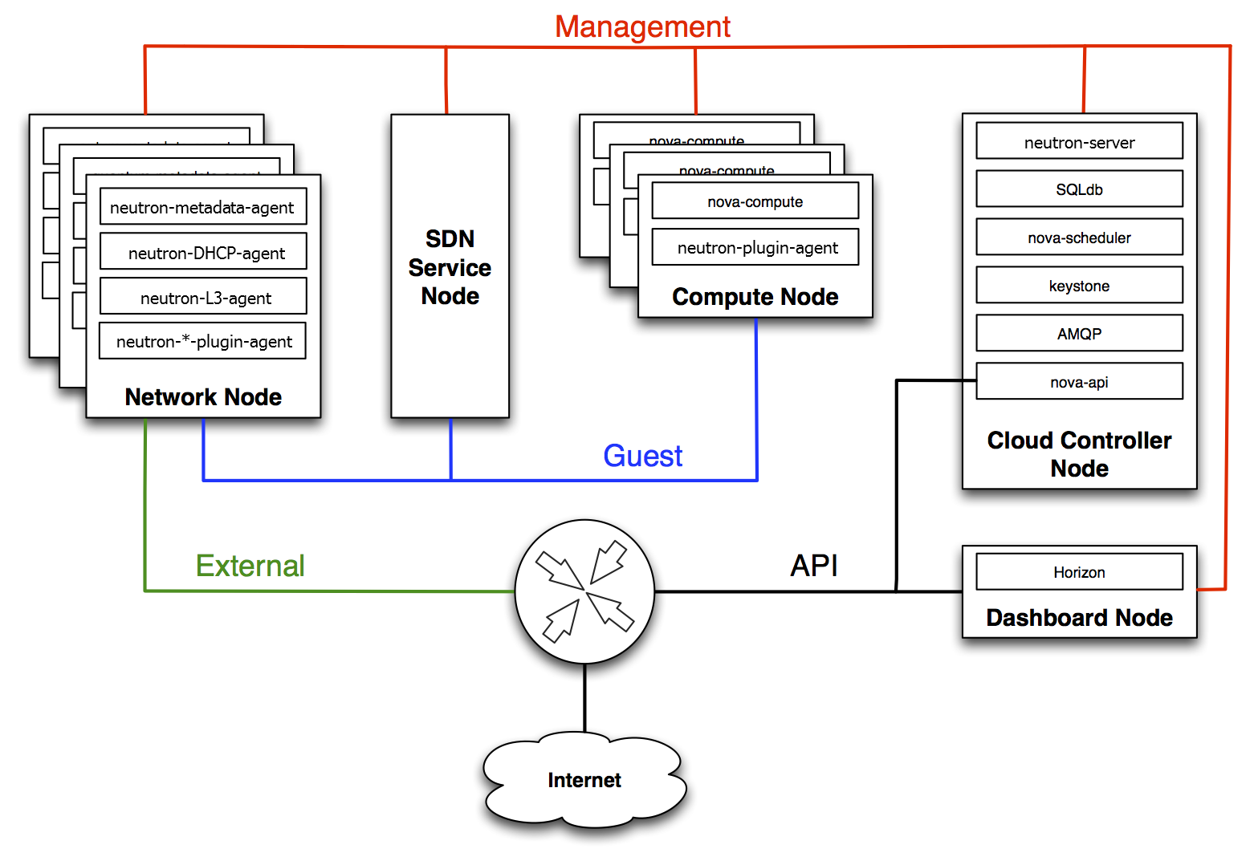
OpenStack Neutron Architecture
Observations:
SDN Service Node (process) refers to the SDN controller of underlying network
Network Node (VM) as logical routers
Does not expose SDN/service chaining capacity to tenant natively
Might be able to support service chaining via vendor-provided plug-ins

Slide 5
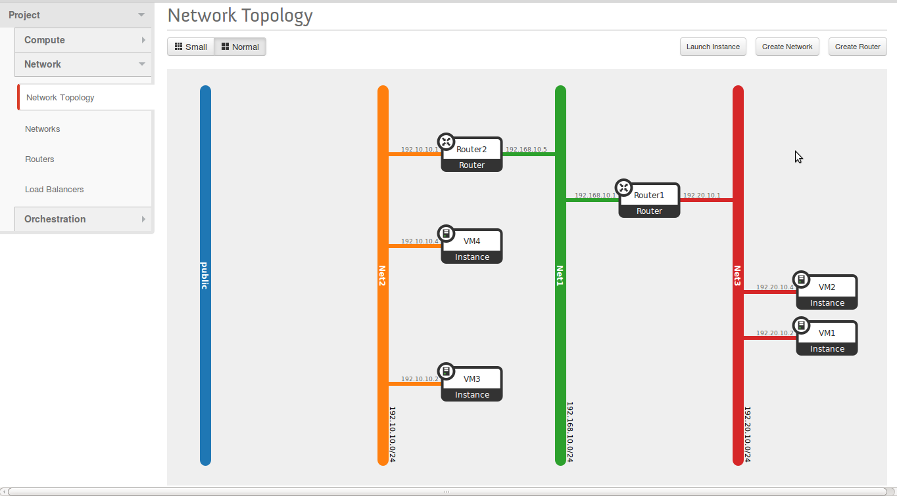
Neutron Logical Network
Suitable for multi-tier applications
No switch config exposed to tenants
Static LB at border, distributed universal ACL

Slide 6
Framework/platform
VMWare NSX
Arbitrary L2/L3 topology via overlay
NFV orchestration capacity exposed with “service composer” (only for security purpose)
No SDN capacity directly exposed to tenants
Increasingly wider deployment
Nuage
Mostly similar to NSX
Features capacity to extend into MPLS WAN
Gateway based SDN WAN to save cost

Slide 7
NSX Service Composer
Security group
VM group identified by app tier, network, etc
Traffic group identified by packet header or security tag
Security policy
Traversal sequence of services (i.e., VNF)
Dynamic policy achieved via security tags
Mapping security group to security policy

Slide 8
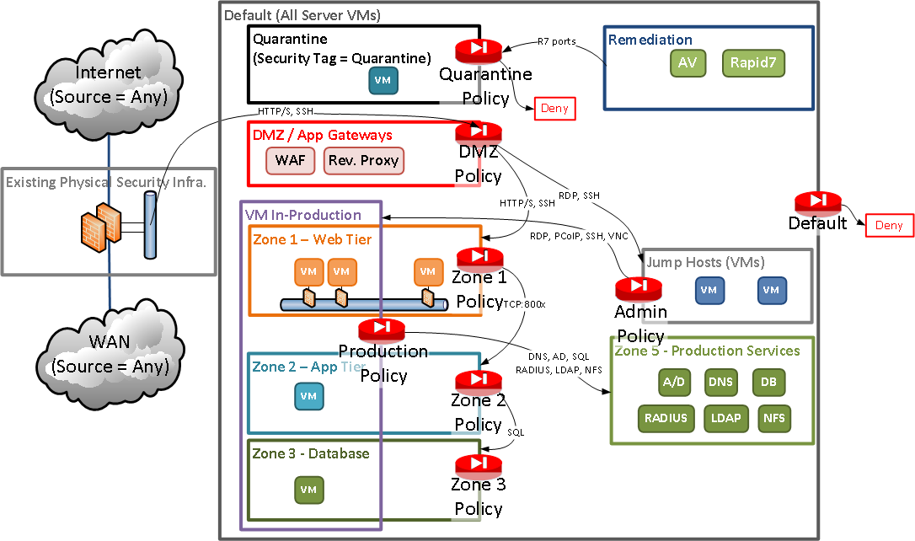
Example Model
Observations:
Still, no SDN capacity is exposed to tenant, thus traffic orchestration is confined within NSX domain
Increased policy management burden
Difficulty to optimize TE and latency due to overlay

Slide 9
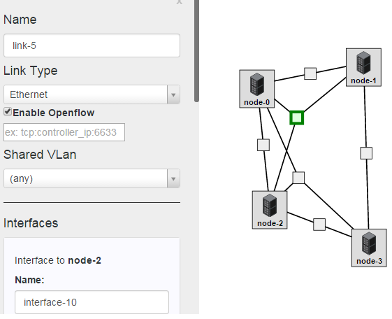
Framework/platform
Cloudlab.us
Flat virtual L2 network
OpenFlow access to virtual switch
Planned feature: bare-metal access to ToR, spine and core switches via console and OpenFlow

Slide 10
Roadmap
Framework/platforms
Support in cloud providers
Application demands
Interesting directions

Slide 11
Support in Cloud Providers
Status Quo
OpenStack is the mainstream model for private clouds
All clouds offer a subset of OpenStack Neutron capacity
No NFV orchestration capacity provided by any clouds
No SDN capacity provided to tenant by any clouds

Slide 12
Amazon Virtual Private Cloud
Gateway-Router-Subnet structure
L3 configuration capacity
VPN tunnel to build hybrid cloud
Security groups with limited ACL
No dynamic routing, no NFV capacity
Virtual load-balancer

Slide 13
Rackspace Private Cloud
Three brand-name solutions
OpenStack
VMware vCloud
Microsoft Cloud
No add-on services in addition to the original solutions

Slide 14
Aliyun VPC
Mostly similar to Amazon VPC
More restrictive on # of vRouters, vSwitches and security groups
Advertised for SDN but does not expose SDN capacity to tenants

Slide 15
QingCloud, UCloud
Mostly similar to Amazon VPC
Nothing interesting…

Slide 16
Roadmap
Framework/platforms
Support in cloud providers
Application demands
Interesting directions

Slide 17
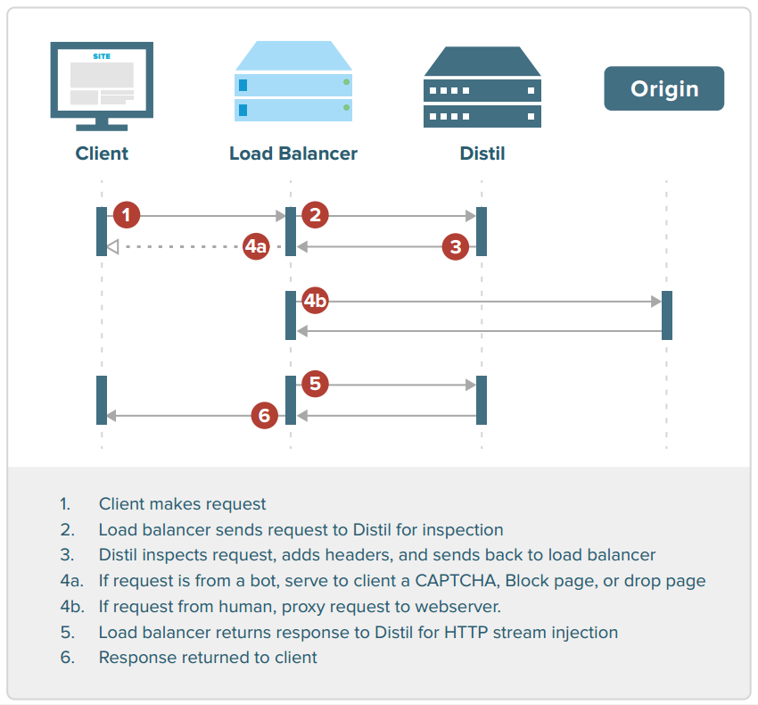
Security Appliances
Requires logical inline deployment or mirrored traffic redirected to appliance
Tenants needs static traffic steering capacity
Example: Distill VNF appliance

Slide 18
Video Transcoder for Mobile
Live video transcoding helps video provider to stream appropriate video format/quality to mobile devices
Verizon is conducting field experiment on SDN to
Redirect mis-matched video flow through trans-coder
Redirect other video flow through cache in access network

Slide 19
Roadmap
Framework/platforms
Support in cloud providers
Application demands
Interesting directions

Slide 20
Tracking NFV Visit
Consider the scenario that application provider (AP) rent VNF to dynamically process their traffic (not only within cloud but also could be in Internet), e.g.,
Dynamic video trans-coding
On-demand DDoS mitigation
On-demand cache service in access network
Dynamic service chaining is conducted with SDN capacity by network service provider (NSP), which redirects AP traffic through cloud-hosted Network Function Providers (NFPs)
VNF process is typically transparent to APs thus they want to verify the traversals for monitoring and billing purpose (e.g., VNF process indeed done, in correct order, in consistent state for same flow, etc.)
Formal reasoning on network rules is impractical because of the complexity and privacy concerns of NSP network

Slide 21
Tracking NFV Visit
Problem
APs control flow endpoints (e.g., HTTP dst via JavaScript or browser plugin)
So verification can be done at flow endpoints
VNFs are cooperative
AP authenticates with VNFs for billing purpose
VNF tags traffic according to certain protocol only if it processes it
NSPs can be error-prone or tardy
NSP may fail to redirect traffic, redirect wrong traffic or redirect traffic to incorrect VNF sequences
NSP may take a while to implement traffic redirection

