Slide 1
C 4
x
Simple Game Mechanics for
Real and Virtual Play Spaces.
Notes:
Notes added post preso – to deliver the gist of the deck.
To begin, I said that I was going to be talking about game mechanics for play. Specifically, I wanted to talk about the 4 C’s (Creativity, Collection, Community and Competition) and how they might be used to transform the play-space that we know as Sony HOME.

Slide 2
C 4
x
Simple Game Mechanics for
Real and Virtual Play Spaces.
Notes:
My slides auto advance (as per designed) but I broke them up into 5 second chunks to pace myself – because I speak without notes but want to stay in pace.

Slide 3
C 4
x
Simple Game Mechanics for
Real and Virtual Play Spaces.
Notes:
The full dot means it’s time to move on ☺

Slide 4
Sony HOME
Second Life ++ ?
Notes:
So – When I first heard of Sony HOME I was super excited because I assumed it would be like Second Life – only better!!

Slide 5
Sony HOME
Second Life ++ ?
Landscape of play that is:
Accessible
Reactive
Notes:
By which I mean: I expected the experience to be both accessible to the general public and much more reactive to my individual actions and choices. I assumed that a virtual world developed by a game publisher would blend the best of free expression, openess and structured activity.

Slide 6
Sony HOME
Second Life ++ ?
Landscape of play that is:
Accessible
Reactive
And.. maybe some cool game mechanics
Notes:
And.. I hoped that there would be some cool mechanics at play – things that made people want to log on and check out the space even if they were not necessarily going there to engage in a transaction (update their avatar’s look, buy property, etc.)

Slide 7
Balance
White space (some non-structured time)
Notes:
In essence, while I expected some non-structured time where people could just “hang out” and chat – I also expected more!

Slide 8
Balance
White space (some non-structured time)
Player creativity (express yourself)
Notes:
I knew that a big focus would be avatars and their customization – but I was looking forward to games, stats – things that helped define your personae other than what you were wearing (and yes, dances).

Slide 9
Balance
White space (some non-structured time)
Player creativity (express yourself)
Glitter & Rewards
Notes:
And being fairly obsessed with the idea of player incentives, rewards and feedback (what I call “glitter”) – I expected some of this too. Sony has such style when it comes to product and UI design that I really did expect that other-worldly, ethereal slickness to extend into this space. I wasn’t sure how – but I definitely anticipated it.

Slide 10
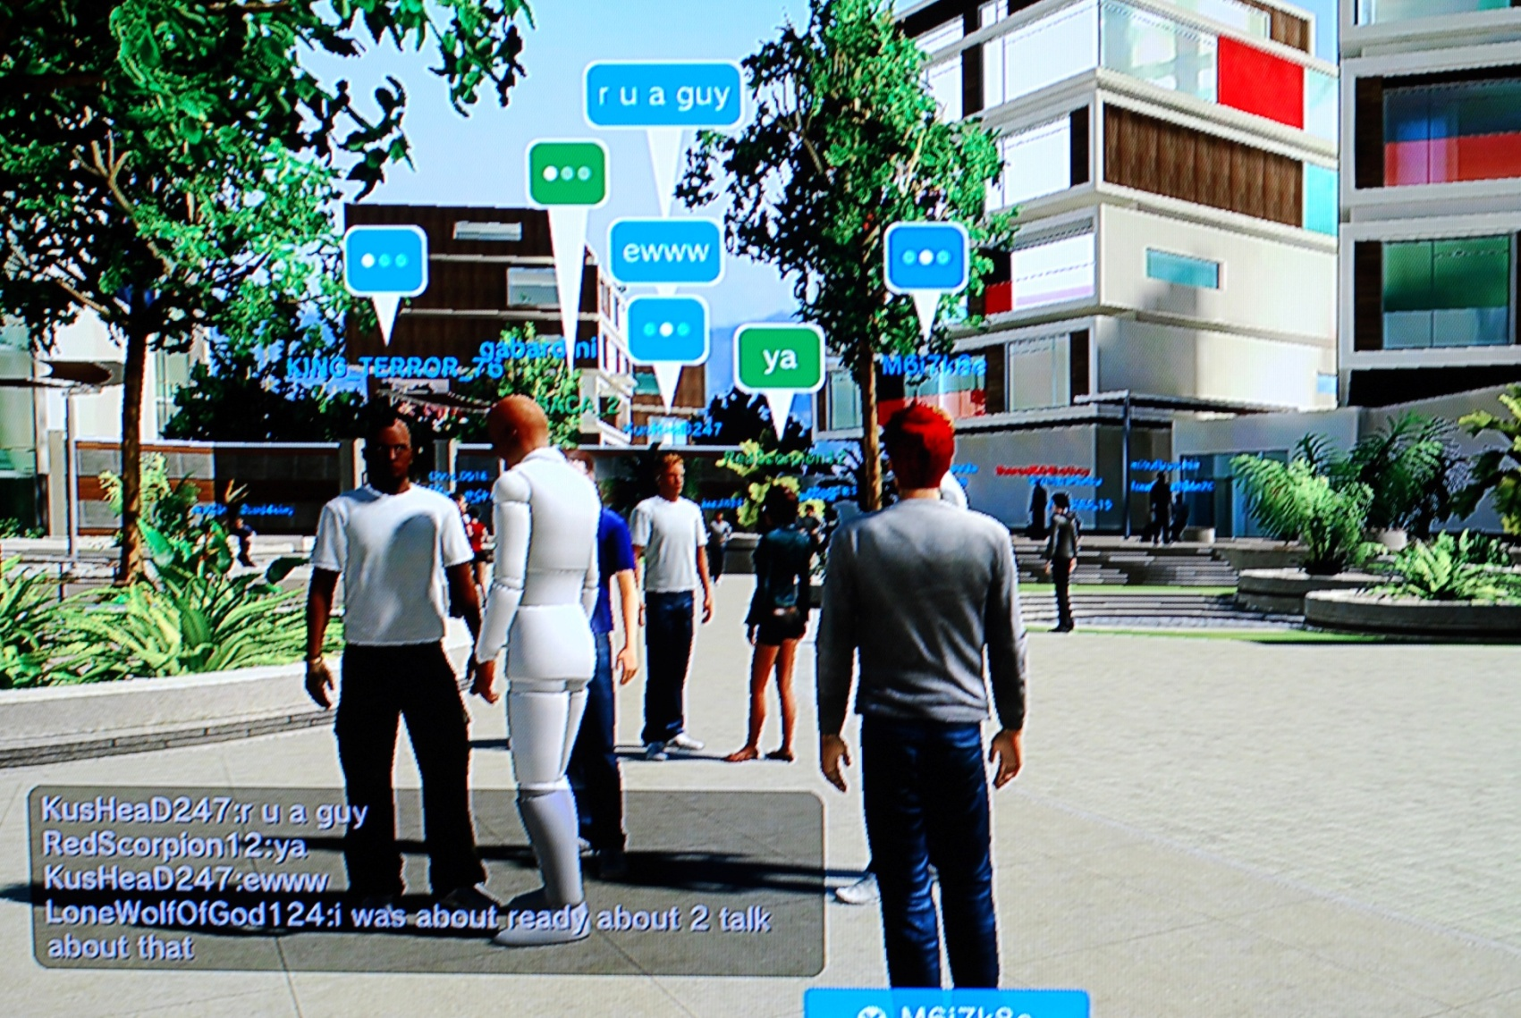
Play @ HOME
Notes:
But when I got there – I was really disappointed. No glitter, very few activities… mostly people walking around.

Slide 11
Play @ HOME
Notes:
And not just “people” but “dudes”. And not just “talking to each other” but “harassing any female avatar”. I actually had to cross-dress to get screenshots because otherwise guys would crowd me with “A/S/L” requests!!

Slide 12
Play @ HOME
Notes:
This kind of activity rapidly became the most famous form of play in HOME. Fail! It really got my brain turning. What else is there to do in a virtual mall, really… besides shop and cruise around?
True, there are some games there (in the virtual bowling alley, and more recently at sponsored locations in the world) but I didn’t even bother to go into this in my talk. Because the experiences there pale in comparison with the games available on the system at large – and in comparison to what I had imagined might be there in HOME.

Slide 13
Applying 4 C’s
Creativity
Collection
Competition
Community
Notes:
So – I asked myself: If I were Queen for a Day and could mod Sony HOME in whatever way I liked – what would I do? What would make it really a FUN place to visit that I wanted to return to over and over?

Slide 14
Applying 4 C’s
Creativity
Collection
Competition
Community
Notes:
The 4 C’s are a tool I’ve used a lot in my design career and so I tried to apply them to the HOME environment and see what ideas popped up.

Slide 15
Applying 4 C’s
Creativity
Collection
Competition
Community
Notes:
I was especially interested in how to transform the rather hostile social environment into one with a deeper sense of community, belonging and meaning. That sounds hokey, probably – but really – if you don’t have any emotional or spiritual connection to a public space or the things in it, you’re much more likely to disrespect it. Like teenaged punks at the local mall.

Slide 16
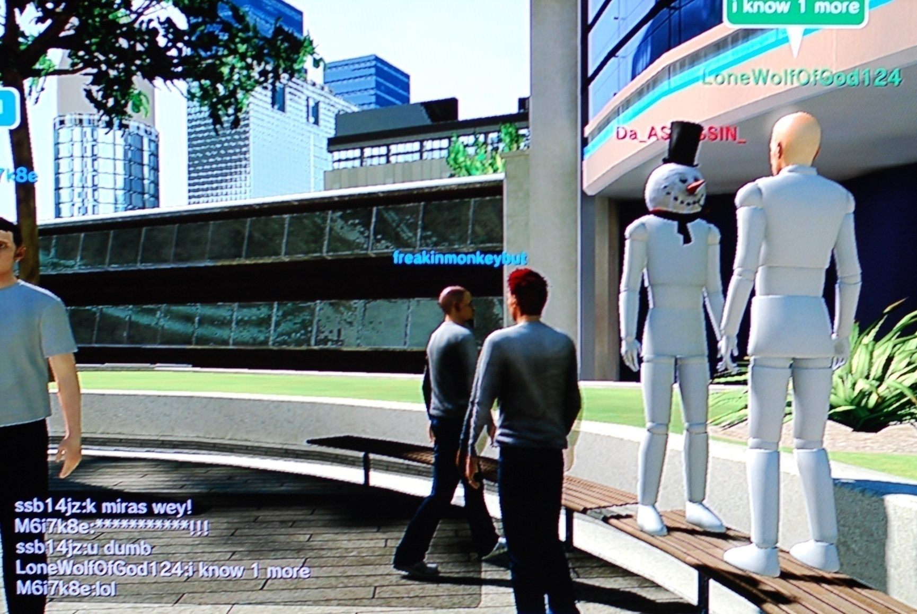
Sploits @ HOME
Notes:
So like any good designer, I went back in to observe and take notes. And I found that a healthy sub-community within the world was playing with the world’s rules by sploiting collision logic.

Slide 17
Sploits @ HOME
Notes:
These sploits were discovered and displayed just for the fun of it… and then shared with strangers!

Slide 18
Sploits @ HOME
Notes:
Versions I saw included: Standing on benches (sit then jump up quickly!), sitting on railings, sitting on shoulders of friends until you get 2-3 people high in the air and appear to levitate. Ha!!

Slide 19
Sploits @ HOME
Creativity
Collection
Competition
Community
Notes:
What’s cool about this is that people were already leveraging the 4 C’s to make their own fun! They were working to uncover and collect these sploits, comparing notes and sharing tips. Who can find the craziest sploit? This is the fundamental hook of such behavior. Breaking the rules is really fun!

Slide 20
Sploits @ HOME
Creativity
Collection
Competition
Community
Notes:
This means that people will find their own fun when left alone, and that giving them rules to absorb and play with would probably work. The key would be to embrace their need to “bend” or “break” rules so as to foster the right kind of community experience.

Slide 21
Sploits @ HOME
Creativity
Collection
Competition
Community
How to structure this with new goals?
Notes:
How could HOME structure new goals such that players were at once expressive and competitive without resorting to aggro behaviors or speech?

Slide 22
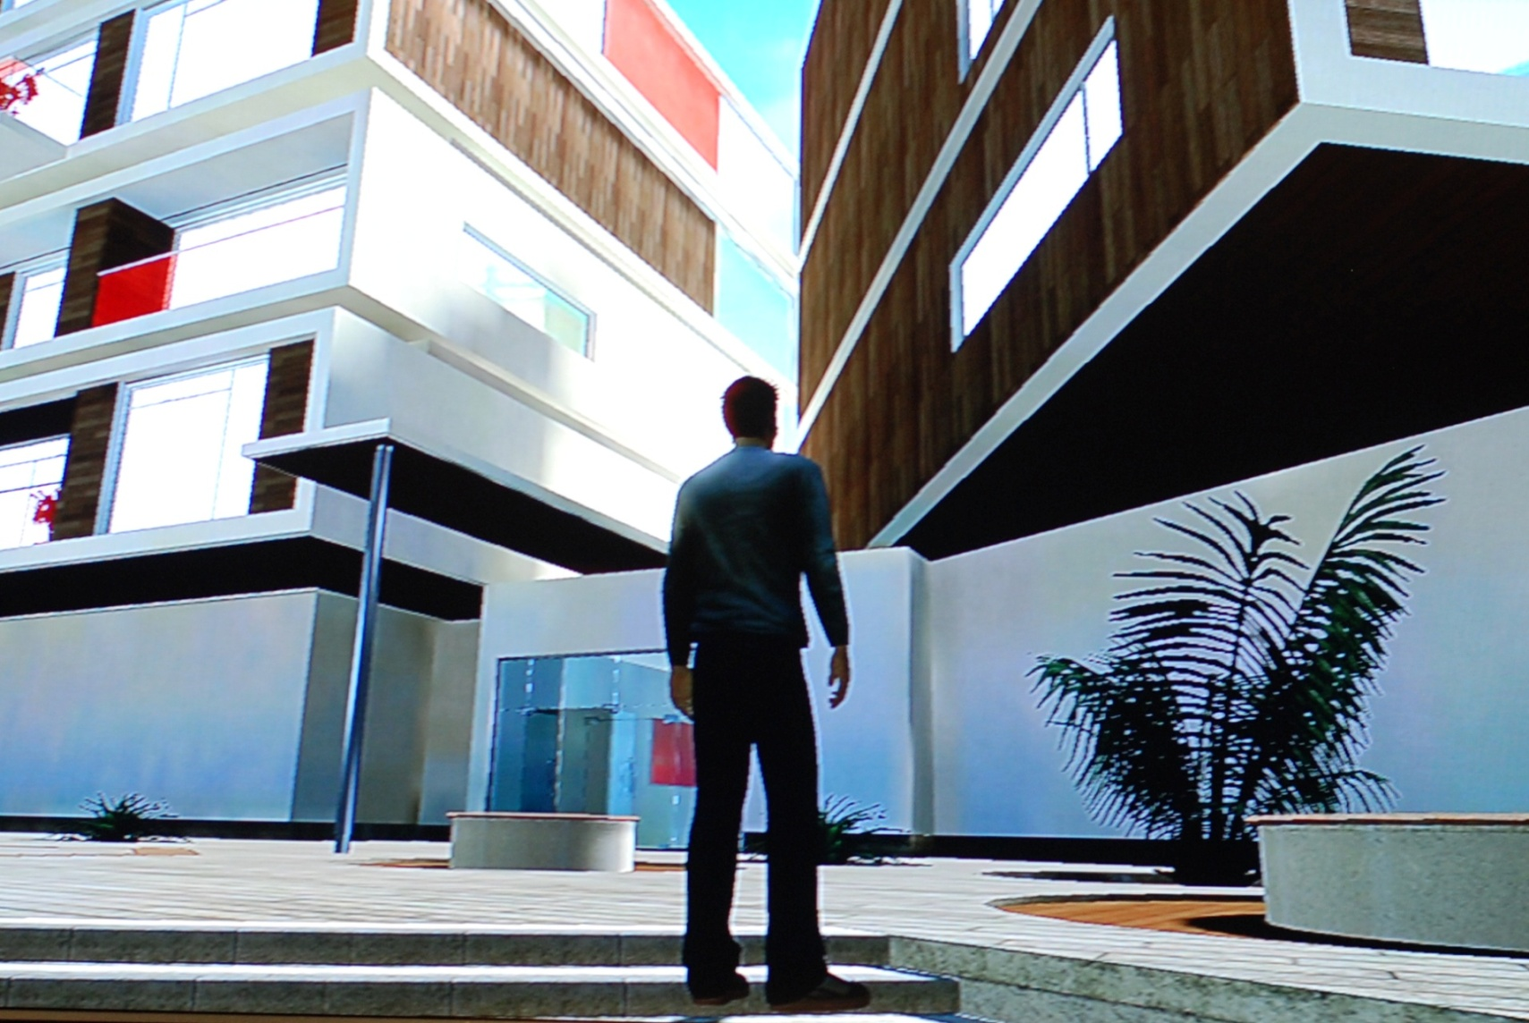
Graffiti @ HOME
Notes:
How about tagging and graffiti? There is so much empty space – crying out to be decorated, owned and loved by the people who hang out there. Obviously freeform graff isn’t ok – so… how can we structure it?

Slide 23
Graffiti @ HOME
Notes:
Start players off with an opt-in Graffiti application/game option. They sigh a EULA (legal blah blah) and get a two-color pen (b/w) and 1 square foot of space on the main public plaza to create a cool image. Standard paint interface using dual shock, wow, awesome! Art is made!
When they are ready, they hit the “submit” button and anyone who has also opted in (they have the Grafitti layer “turned on”) can see and vote on this image. If the image gets 10 “yes” votes in 10 minutes, the creator levels up to a larger square, and maybe gets a third color. Rinse, repeat (probably tune a bunch)… until the best graff artists in HOME are getting up on giant building-sized areas that look out over the whole plaza.

Slide 24
Graffiti @ HOME
Notes:
Other caveats – viewers can ban images (tunable consequence – potential perma-ban from the game if you insist on hate speech, porn, etc). Even the best images time out – so that there is an impermanence to the space that makes Graffiti players and appreciators want to visit and vote often!

Slide 25
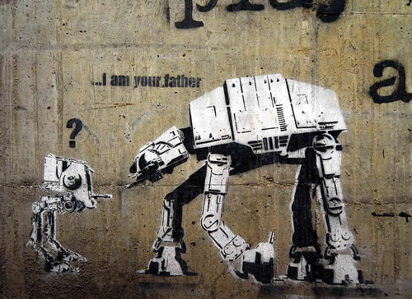
Notes:
Imagine a world in which suddenly the walls were covered with culturally-relevant, self-moderated content that reflected the community’s interests? Their creative soul?!

Slide 26
Notes:
This is a Banksey image reportedly from Jamaica. Someone “discovered” it. This is the kind of fun that even a totally unskilled, Graffiti “lurker” could have – a way to interact with the space, players and community history… without ever drawing a single line!

Slide 27
Notes:
And think of the marketing opportunities! Ok, yeah, it’s creepy – but I’m sure some companies would want to hire Graff writers to promote events… games… products.. whatever. The point would be that the community moderates the inputs and as a result, what gets up and stays up = worth something. It has passed muster, at least in some fashion.

Slide 28
Graffiti @ HOME
Creativity: Your Art
Collection: Pens/Colors
Competition: Earn Spots
Community: Vote, Discuss, Share
Notes:
Here’s how the 4 C’s break down for this particular idea. I thought of it by asking myself what kinds of creativity HOME could support. The rest fell out from there.

Slide 29
Graffiti @ HOME
Creativity: Your Art
Collection: Pens/Colors
Competition: Earn Spots
Community: Vote, Discuss, Share
Notes:
I especially like the idea that people could develop a style and a rep in HOME that then migrated to other platforms (t-shirts, web sites, who knows). It would be a cool thing to watch unfold!

Slide 30
Graffiti @ HOME
Creativity: Your Art
Collection: Pens/Colors
Competition: Earn Spots
Community: Vote, Discuss, Share
Bonus: Archive/Curate
Notes:
And there’s this awesome bonus for community building in the form of Archives and Curated Shows. Imagine how cool this “game” would be if there was a good in-world screenshot tool and a world newspaper or forum. Second Life is a great place to look for these kinds of advances especially with Embedded Reporting and community building overall!

Slide 31
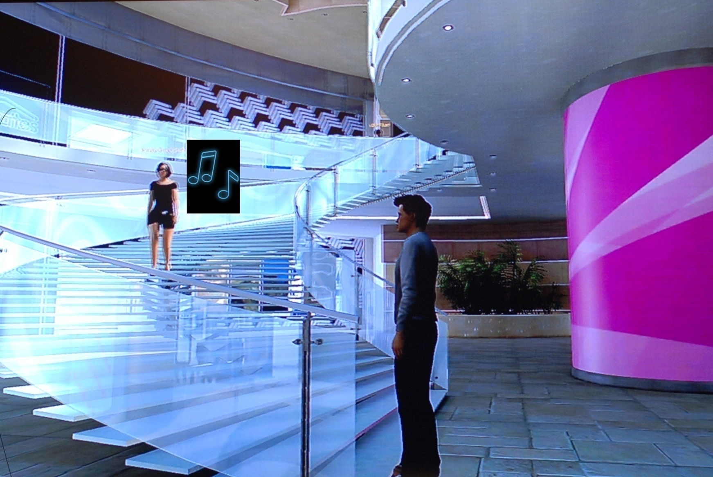
Jam @ HOME
Notes:
On to music! Next I asked myself: What if every surface in HOME was actually tagged with a sample? Suddenly the whole space would be transformed. There are some cool games/play activities in this layer!

Slide 32
Jam @ HOME
Notes:
How might it work? Users begin by signing a huge EULA (must we?) and get a pair of virtual “headphones” (bet there are some cross-marketing ops here!) which they can use to tune in to another avatar’s channel or a free channel. They also get a pair of digital drumsticks that can play the samples when they “strike” any in-world object.
Players begin by digging up sounds (scavenger hunt style) and saving them to a small bank of memory – which they can then loop or otherwise play with using a simple interface. Then broadcast on their channel!

Slide 33
Jam @ HOME
Notes:
Strangers can swap channel ID’s via chat and then play together by co-broadcasting. Or, they can migrate to a free channel and jam with a bunch of folks at once! The whole point is to go out into the world, dig up some cool sounds, and then re-mix them with likeminded jammers.

Slide 34
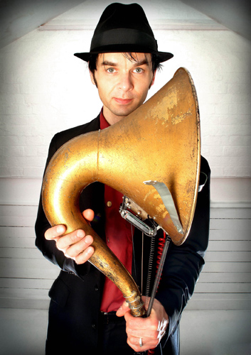
Jam @ HOME
Notes:
Imagine what this system would be like with virtual instruments added to the mix! Here’s Thomas Traux and his “Hornicator” – and he’s had to deal with the realities of physics! Simple tools could transform all sorts of inputs (including voice) to make cool new musical experiences possible.

Slide 35
Jam @ HOME
Notes:
I know – it sounds like Burning Man. But hey – it’s opt in! You don’t have to deal with this stuff if you don’t have headphones – or you have them turned off/to your own channel. This community can exist side by side with the Graff community, no stress!

Slide 36
Jam @ HOME
Notes:
The point here is again to leverage people’s urge to bend rules and find the limits of a system – while encouraging fun interactions. Bonus if you can save these “jams” and broadcast them at your HOME apartment or house.

Slide 37
Jam @ HOME
Creativity: Make Music
Collection: Instruments/Sounds
Competition: Hunt/Discover
Community: Listen, Jam, Broadcast
Notes:
Again – here’s how the 4 C’s break down for this activity.

Slide 38
Jam @ HOME
Creativity: Your Sound
Collection: Instruments/Sounds
Competition: Hunt/Discover
Community: Listen, Jam, Broadcast
Notes:
To get to this idea, I started with the Creativity question and then tried to focus on one of the harder aspects – like Competition. That’s where the scavenger hunt idea came from. Everyone knows that musicians like to play together, jam, co-exist. But getting them to compete by collecting weird sounds adds a fun game-y twist to that natural tendency. It can’t replace “skill” competition that you would get when dealing with real-world constraints like finger dexterity, etc… but it’s a start!

Slide 39
Jam @ HOME
Creativity: Your Sound
Collection: Instruments/Sounds
Competition: Hunt/Discover
Community: Listen, Jam, Broadcast
Bonus: Archive/Broadcast
Notes:
Bonus here is again, a strong community back-end that supports the archiving and broadcast of cool music created @HOME. Even the least musical people could participate by listening and commenting on these creations.

Slide 40
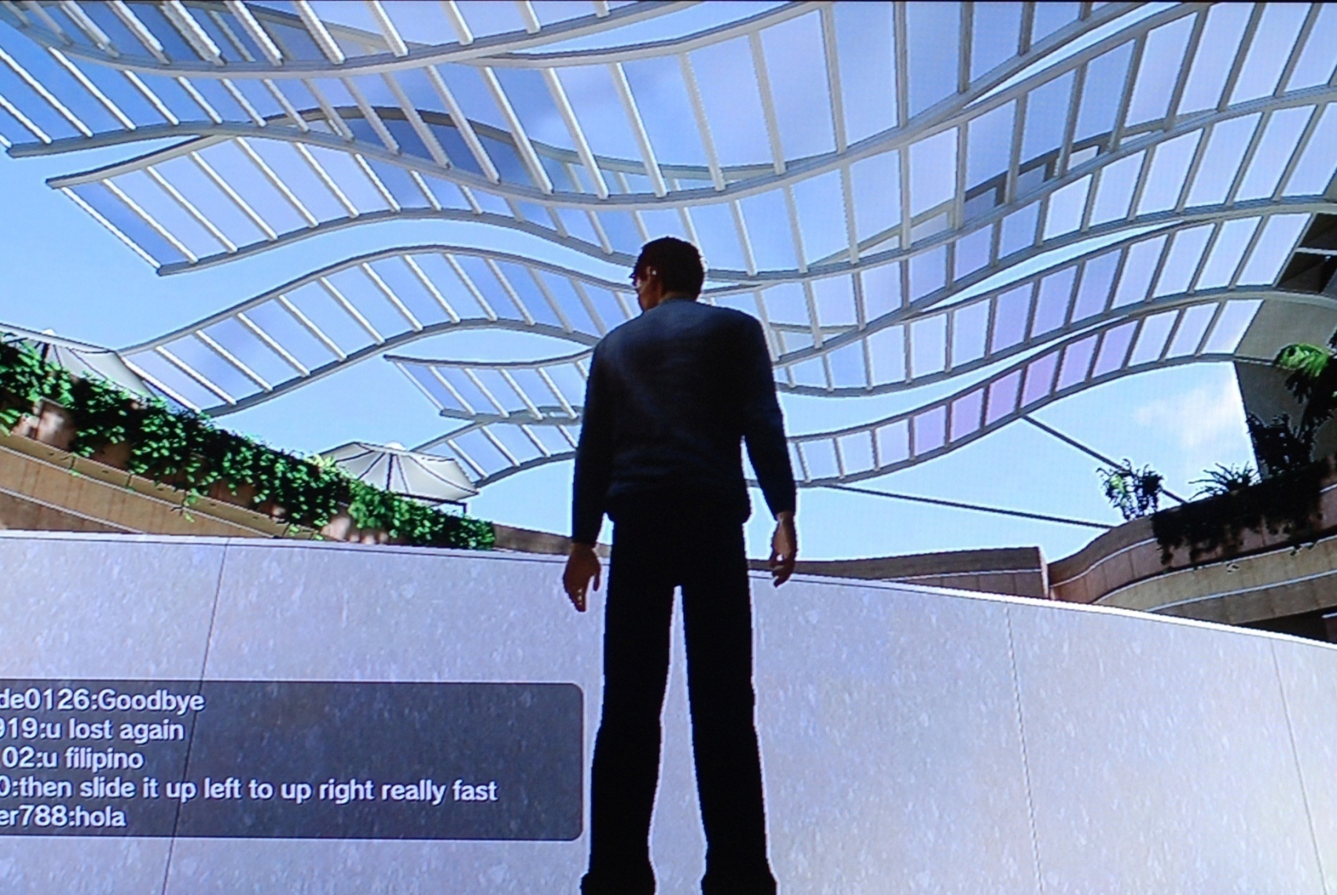
Climb @ HOME
Notes:
Finally – I turned my mind to the environment completely. What kinds of fun play could we sponsor within HOME’s funky, futuristic So-Cal spaceport landscape? What if it was a giant virtual jungle gym?

Slide 41
Climb @ HOME
Notes:
Here’s how it works: Users sign a huge EULA (ok maybe they don’t need to for this!) and get a set of “climbing pegs” which they can mount on any surface. These are tagged/coded so that only people who subscribe to the app can see them. Also – you have the option of publishing to everyone, just individual folks, or keeping your “routes” private.

Slide 42
Climb @ HOME
Notes:
Obviously this is the most technically laborious of the mods – it involves doing some work on the collision model and perhaps adding a timed skill component for reaching new pegs. But even if it’s really simple, the fun part could be in leading people to new places.
Imagine this: It’s your birthday and you get a set of pegs. A friend invites you to sign in and climb up to meet them for a treat. Turns out that the pegs lead to a cool rooftop, where a friend has made you some great birthday art (your friends all worked to get it voted up!), and other friends have recorded you a superfunky Happy Birthday song (they got your favorite musician’s samples!!)!

Slide 43
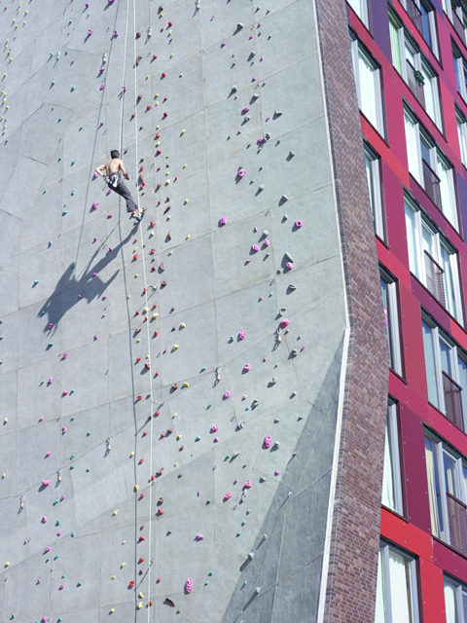
Notes:
Sure sure, climbing for real would probably be cooler. The best ideas regarding this last mod are clearly related to player skill – and would be worth the investment, IMHO.

Slide 44
Notes:
Suddenly you could see the entire world as a skill space. Players could compete to design and climb routes. Ladders, leader boards – you name it.

Slide 45
Notes:
Yes, I know a climbing game would be hard (see Checker’s work here). But still – it could be awesome!!!

Slide 46
Climb @ HOME
Creativity: Your Routes
Collection: Objects, Vistas
Competition: Courses, Unlocks
Community: Share, Compete
Notes:
Here’s how the 4 C’s break down for the Climbing/Pegs idea.

Slide 47
Climb @ HOME
Creativity: Your Routes
Collection: Objects, Vistas
Competition: Courses, Unlocks
Community: Share, Compete
Notes:
As currently envisioned, the activity has less of a Collectible component than I would like. Perhaps players could earn skills/types of holds? Not sure if this pushes the game beyond the bounds of accessibility that justifies investing in the tech. But if I were Queen, I suppose I’d consider it. ☺

Slide 48
Climb @ HOME
Creativity: Your Routes
Collection: Objects, Vistas
Competition: Courses, Unlocks
Community: Share, Compete
Bonus: Boards/Ladders/Tournaments
Notes:
Here the community-building aspect is clearly a community of skill/expertise/experience. While possibly a smaller overall community that those grown by the first two activites – this could be a long-lasting, self-sustaining group that contains a lot of proactive users.
I imagine that climbers @HOME would be the first to visit any new environment built in the world, and great testers!! ☺

Slide 49
Something for Everyone
No-Fail or Low-Fail
Notes:
What are the keys to the ideas I just went over?
I tried to focus on ideas that would be available to anyone who logged in, regardless of prior gaming experience. No-Fail or Low-Fail activities that let people participate regardless of “skill”.

Slide 50
Something for Everyone
No-Fail or Low-Fail
Opt-in or Observe
Notes:
They are also opt-in, and have built-in pluses/wins for lurkers and consumers. This lets the 5% (driven player-designers who want to explore and express to the world) drive the experience of the other 95% of players!

Slide 51
Something for Everyone
No-Fail or Low-Fail
Opt-in or Observe
Forgiving tools
Notes:
And just to state the obvious, I imagined them with forgiving, simple tools/interfaces. I’m confident that the graff, music and basic “peg” interfaces could be very intuitive and light. More complex features (especially the full-blown climbing app) would layer on complexity. But the core “editors” would be very simple.

Slide 52
Channel the Chaos
Paint-ball?
Only your team sees what you paint/hit
Notes:
After thinking through these ideas, I decided to think a bit more about the hostility of the community as I first experienced it.
What if you really embraced the teenage punk attitude??
EG: Build a paint-ball game where only you and your team can see the paint splooshing all over people, buildings, and so on.

Slide 53
Channel the Chaos
Paint-ball?
Only your team sees what you paint/hit
Where’s Waldo
Find X person in Y location (sonar ping)
Notes:
How about a stalking game (solitaire, basically) where you were assigned one avatar to find in the plaza based on a sonar ping? This idea comes from Thatcher Ulritch’s Indie Game Jam game “The Dueling Engine” which has always been a personal favorite of the Jam Games. (PS: You couldn’t actually talk to them when you found them. Only you would know they were your “target”.)

Slide 54
Channel the Chaos
Paint-ball?
Only your team sees what you paint/hit
Where’s Waldo
Find X person in Y location (sonar ping)
Flashmobs
Points for completing group activities in world
Line Dancing
Bench Standing
Notes:
Even simple “flashmobs” could be a fun idea to support officially – with unique UI for broadcasts regarding spontaneous in-game activities. I’m sure you could combine this with the art and music tools to make fun performances happen in-world for users with Headphones and Graff goggles. ☺

Slide 55
Have A Sense of Humor
Play with conventions & behavior
Notes:
The point with all these ideas is that it’s important to have a sense of humor about open, public space – and to embrace the natural tendencies of your users.

Slide 56
Have A Sense of Humor
Play with conventions & behavior
Use the 4 C’s to get someplace fun!
Notes:
There are a lot of virtual worlds being built these days! I certainly cannot play all of them. But - if you’re facing a similar design problem – use the 4 C’s to get yourself thinking about the space in new and creative ways!

Slide 57
Have A Sense of Humor
Play with conventions & behavior
Use the 4 C’s to get someplace fun!
Creativity
Collection
Community
Competition
Notes:
They are simple – but helpful. They help structure brainstorming and will also guide you to evaluating the parts of your design that you really care about (in my case, community). You can use them to turn any virtual experience into a fun, reactive and expressive landscape for play that’s about way more than buying shopping for cool gear and then standing around on benches!
☺

Slide 58
Thank You!
hunicke@gmail.com
Google: gewgaw
Notes:
Thanks for reading!! Here’s how to contact me if you have thoughts to share ☺.

