Slide 1
how to manage an exploratory development process
kellee santiago
& robin hunicke
Notes:
Robin: Welcome everyone. I’m Robin – the Producer at thatgamecompany
Kellee : And I’m Kellee the co-founder and President. Today we’re going to talk to you about how we manage exploratory dev process at our company.

Slide 2
er . . .
Notes:
Kellee: And what we really mean when we say that is that we’re going to talk to you about the challenges we see in developing games in this style, what processes we’ve implimented at thatgamecompany, and how it’s worked for us.

Slide 3
exploratory
Notes:
Robin – what is an exploratory process?

Slide 4
are you experienced?
Raise your hand if you’ve had:
Creative anxiety about your process
Time, Budget or People problems
Difficulty explaining your process/goals to others (… publishers, funders)
Notes:
Robin: First, let’s start with an audience survey about your experiences since last year’s summit. Can I see a “show of hands” if you’ve experienced…

Slide 5
shared experience
Good News:
You’re not alone
Iterative dev processes are hard!
Bad News:
It won’t go away
Iterative dev processes are fundamental!
Notes:
Robin: The good news is that we also struggle with these things – in particular, because our process is so iterative. The bad news is that we feel it’s a constant for innovative teams.

Slide 6
iteration is expensive
You will chuck stuff
You will wander in search of truth
You will have to explain this behavior!
YOU CAN ENJOY THIS!
Notes:
ROBIN: We believe strongly that you have to embrace the uncertainty of the iteration process and get comfortable with a certain lack of control. Like surfing – you can get into the “flow” of iteration and enjoy the process for what it presents: a system of potential that changes all the time based on upredictable inputs!

Slide 7
previously, on “TGC”
flower debuts at E3.
fantastic response
sony asked us to spend more time and money making the game better.
morale at an all-time low.
Notes:
KELLEE: The last time we saw each other, I was telling you guys about the really hard lessons thatgamecompany had to learn during Flower. In July of 2008, Flower debuted at E3...... Even though we were successful developing a great experimental title, we were falling apart, constantly arguing, constantly on the verge of leaving, and generally miserable.

Slide 8
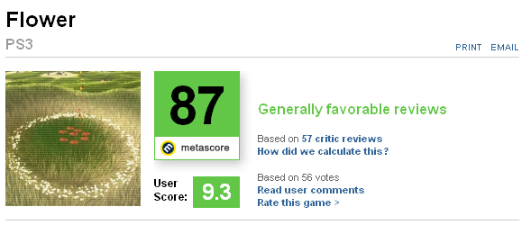
9
Notes:
KELLEE
Now, some would argue, that we did make a great game. But I acted on on two assumptions
It could have been better.
It was unsustainable.

Slide 9
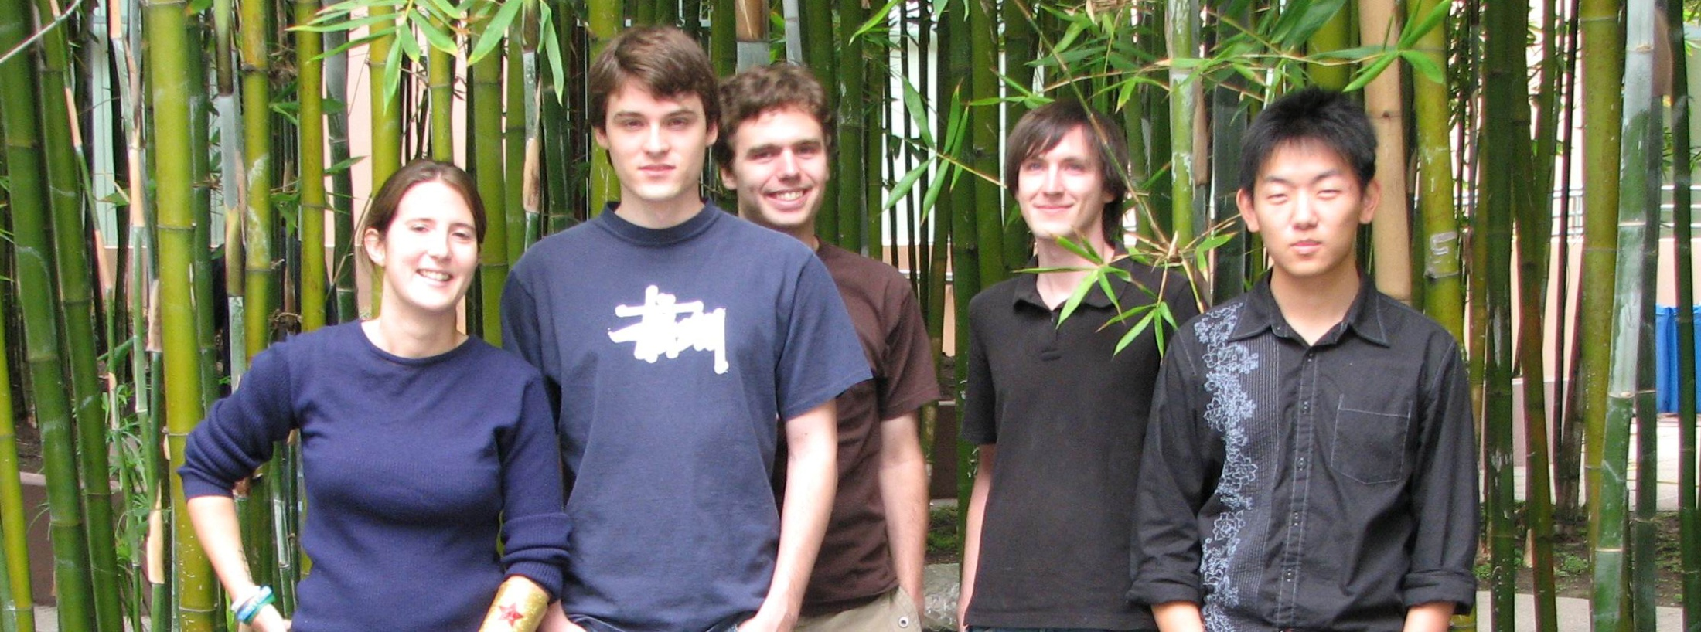
Notes:
KELLEE
Now, some would argue, that we did make a great game. But I acted on on two assumptions
It could have been better.
It was unsustainable.TGC was going to fall apart if we continued on the path we were going on.

Slide 10
why does sustainability matter?
Notes:
KELLEE
This is certainly a point of contention within the independent development community, and I don’t think there’s one right answer. But my philosophy is that fantastic games and a lifetime of successful video game development aren’t two separate things. I fundamentally don’t believe we as game makers have to burn ourselves out, starve, or suffer in order to create truly beautiful works of interactive art.
More importantly, I think it’s a terrible thing for the medium of games to work with that assumption. If we can live lives of passionate game making and a high standard of living, then the people making the most incredible games can make many more of them in their life. And they can inspire others to join them.
And it was with this philosophy that I co-founded thatgamecompany, so it’s very important for us to continue to pursue sustainable methods of artistic game development.

Slide 11
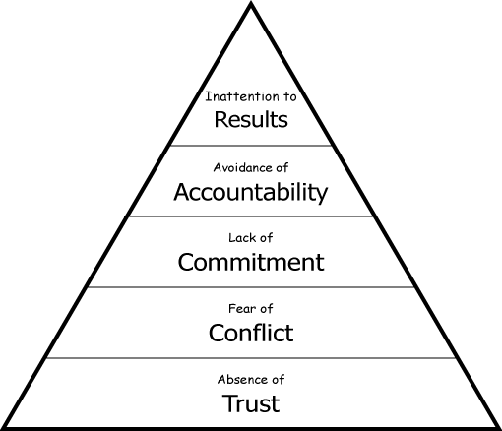
previously, on “TGC”
Notes:
KELLEE
We had identified a pyramid of qualities we wanted to build into our team culture to make it thrive, and we recognized that we were failing at all of them
No motivation towards a goal. People will get lost in their own goals – personal, professional.
Without buy-in, no feeling of responsibility.
Need buy in on the final decision.
Fear of conflict and lack of conflict resolution mechanisms
This isn’t trust in abilities. Trust in knowing where everyone stands.

Slide 12
common day at TGC
there are things that need to get done.
why bother?
I can’t be weak.
I’ll just do it.
lack of conflict resolution mechanisms
Notes:
KELLEE:
There are things that need to get done.” Development of a game is a great excuse not to get into conflicts with people. It’s also easy to dismiss someone else’s ideas when you’re the one that will have to do all the work on a specific system of the game.
Why bother? Some team members felt like the conflicts went nowhere, and no one ever really changed their mind as result. This was reinforced by patterns of work that demonstrated this idea. For instance, and I’m going to use examples from an imaginary team to protect the innocent here, for instance George is in control of executing the main combat mechanic. Lisa decides to challenge some of the assumption George is making about how it should be designed, and they get into a heated argument over whether the character should jump or not while fighting. George thinks he should, and Lisa thinks he shouldn’t. The argument is left without any resolution. George decides to go ahead and implement the jumping and fighting over the weekend, to show that it could work. But Lisa interprets this action as a way of telling her that her ideas don’t matter. In the future, Lisa will be less likely to discuss her design ideas, and therefore will have less ownership over the project as a whole.
I can’t be weak. Other team members felt that backing off from their idea would show that they lacked confidence. This reason is usually most often found in new leaders, as it is a very common misconception about how leaders should lead. It’s important to show vulnerability.
A lot of “I’ll just do it.” To avoid conflict, some team members would simply take care of everything themselves. This then fed back into the initial problem, because then team members were less likely to engage in conflict, feeling like it didn’t matter anyways.
A lack of clear conflict resolution mechanisms
As most small teams are, I imagine, we were making it up as we went along. Unfortunately, this resulted in a lack of a clear methodology for resolving conflicts, so sometimes I would use one tactic, and other times I would try something else. The team didn’t know what to expect, and left to their own devices, this led to the previous four manifestations of conflict avoidance.

Slide 13
what we did about it
define Roles
commit to a RACI chart
distribute our Accountability
Notes:
KELLEE
Defined roles
RACI chart
dsitribution of accountability

Slide 14
what are your goals?
Notes:
ROBIN: Crucial to setting roles & RACI effectively is setting your overall goals and priorities. What is most important to you as a developer, as a team, and as a company?

Slide 15
company
craft
contribution
profit
art
Notes:
ROBIN: Choosing company goals (like profit) over all else means that you may end up making games that your team isn’t proud of due to business opportunities or constraints. Or – you may decided that standing out is the most important thing, and alienate hires with more traditional tastes.

Slide 16
team
trust
friendship
respect
fun
Notes:
ROBIN: Setting your sights on super-team status may tempt you to shy away from difficult conversations. Or it may lead you to embrace a culture focused on personal development or fulfillment at the expense of other factors.

Slide 17
game
features
quality
feeling
recognition
Notes:
ROBIN: If it’s the game you care most about – you may end up justifying destructive behaviors (crunching, forcing your opinions on others) in order to “make the best game possible”. Or – you might get caught in a cycle of “never good enough”.

Slide 18
comtepaganyamme
Notes:
ROBIN: Bottom line: If you are not all in agreement about what you want to do for each priority – and the order they come in, you are going to have problems later.

Slide 19
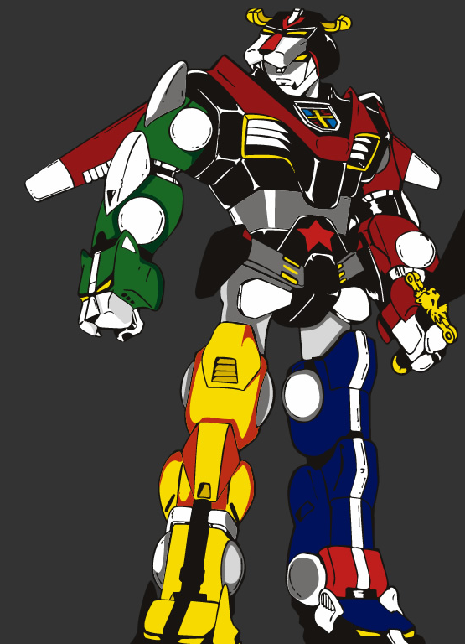
ROLES
Notes:
ROBIN: Once you figure out your goals, you need to assign roles to yourselves. Initially, the ideal is to form like Voltron. Everyone gets a role and we all work together to fight evil, right?

Slide 20
choosing roles
Lead Designer
Responsibility
Accountability
Consult
Inform
Notes:
ROBIN: In the RACI Chart, as discussed, everyone chooses a role with Responsablity, Accountablity, etc.

Slide 21
choosing roles
Notes:
ROBIN: But - Not all roles are thee same size. And a team where people can’t expand to fill what is needed (or fight over who gets to be “the head”) has gaps.

Slide 22
choosing roles
Notes:
ROBIN: Gaps mean you can’t roll forward.

Slide 23
choosing roles
Notes:
ROBIN: Learning to expand and contract as necessary is a huge skill. But it is not easy, and it takes time. Advanced tip: what works on one project may not work on another!

Slide 24
choosing your role
Notes:
ROBIN: Zooming in to a single role – you’ll often find that they often involve things that you don’t particularly enjoy.

Slide 25
choosing your role
Notes:
ROBIN: In some cases (depending on the phase of the project, or goal you’re focusing on), there may be less of what you enjoy than expected! One of the most common realizations of new “leads” is just how many meetings you need to attend, track and create documentation for (even if it’s just a quick email).

Slide 26
what about scope?
Notes:
ROBIN: Crucial to setting roles & RACI effectively is setting your overall goals and priorities. What is most important to you as a developer, as a team, and as a company?
KELLEE: Scope refers to the amount of resources that will be required in order to complete the game. That could people, time, money, or your personal sanity. You want to define the general scope of your project upfront. And because all games are creative gambles, I think it should be approached in a similar manner – don’t bet anything you are prepared to lose. What are you comfortable with investing and losing in the completion of your game?

Slide 27
scope
in order to be exploratory
you have to be small
Notes:
KELLEE: but no matter what, to allow for exploration in your design process, you want to scope fairly small.

Slide 28
find the magic
execute the magic
Notes:
KELLEE: Because when you have a pre-production process that involves many unknowns, it’s almost impossible to estimate how long that completely open exploration process can take. It could be very quick – you might hit upon that great game idea tomorrow

Slide 29
find the magic
execute the magic
Notes:
KELLEE: Or it could be a relatively lengthier process of what traditional game development producers would call “pre-production”

Slide 30
find the magic
execute the magic
Notes:
KELLEE: Or, as we find is most often the case, it could take a very long time to really discover the game that is going to manifest the core of the idea we set out to achieve. And what allows us to spend so long in a very exploratory, highly iterative design phase is that we can be fairly confident that once we know what that game is, we will be able to make it in a relatively short amount of time. And this is really what digital dsitribution allows for, since you aren’t beholden to a lot of the expectations players have in regards to content in birck and mortar stores.

Slide 31
find the magic
execute the magic
sustainable use of resources
profit margin
creative limits
$$$
talent pool
Notes:
KELLEE: This total length of time of discovery + execution is determined by your estimation of what constitutes a sustainable use of the resources available to you. And these resources could be in the form of money, or the profit you need to raise off the project, or the time you have available from your collaborators – for example, if someone needs to return to school, or simply can’t work effectively after a few months -, or it could be your own creative boundaries. Honestly, at thatgamecompany, we factor in all of these elements and then some to determine how long we can possibly take on a single game.

Slide 32
quality
art
game mechanics
audio
Notes:
KELLEE: After you determine how long you have, you need to determine what is the quality of each prototype or iteration during your exploratory phase that will best serve you in discovering that magic and making forward progress in development.
As with everything else we’re talking about, this is definitely an aspect of your process that you will discover over time. For us, we evaluate our iterations on three levels. game mechanics/interactivity, art, and audio. And our goal is always to bring each of these elements to the same level of quality in a single iteration. Now, it’s not something we ALWAYS accomplish, but it’s always our goal. And we’re always hesitant to move on from a prototype if we haven’t achieved this goal, even though sometimes due to our other constraints, we have to.

Slide 33
quality
game mechanics
art
audio
Notes:
KELLEE: And our goal is always to bring each of these elements to the same level of quality in a single iteration. Now, it’s not something we ALWAYS accomplish, but it’s always our goal. And we’re always hesitant to move on from a prototype if we haven’t achieved this goal, even though sometimes due to our other constraints, we have to.

Slide 34
the big list
Notes:
KELLEE: We also keep a record from the very beginning of the project of all of the ideas and features we would like or believe will be necessary to execute the game as it stands on any given day. This is a great tool for keeping track of the scope of the project, and making sure you are meeting your initial goals, or it forces you to admit to shifting those goals, which is an important communication tool.

Slide 35
must be flexible to change
Notes:
KELLEE
You have to be flexible in your understanding of the final game. We really view our exploration as a process of discovering what the game is, which means sometimes we find the game and it doesn’t really look like what we initially thought. But we know intuitively that it’s right. Sometimes it defies logic, but if you can recognize it when you see it, then it justifies throwing away your plans to follow it .

Slide 36
follow your passion!
Notes:
KELLEE
It’s like finding your passion. When you feel it, and you know it, then follow it, because that’s where you will find success

Slide 37
setting a pace
1 YEAR
1
MONTH
Notes:
ROBIN: Once scope has been set – you can establish a “team beat” – the pace of your weekly, monthly and (if appropriate) yearly events.
This includes things like fixed deliverables & major design goals – but also can include planning for conferences, birthdays, vacation, team events and even community events (IGDA meetings, university and art school shows).
Getting a calendar blocked out with this stuff is pretty easy – and makes a huge difference in terms of tracking where you are, overall.

Slide 38
setting a pace
20 MONTHS
1
MONTH
Notes:
ROBIN: Here’s what the clustering of a 20-month dev process might look like
Beginning: experiments
Middle: Figuring out exactly what you will build
End: Institutional stuff, format, etc.

Slide 39
setting a pace
20 MONTHS
1
MONTH
?
?
?
?
?
Notes:
ROBIN: Or it might look like this – which is how Flower ended up working out. The lesson here is: Note major steps in your milestone – but don’t expect this calendar to be “right”. You will experience doubt at key points in the schedule – often as you transition between periods of “doing” and periods of “discovering”.

Slide 40
ESTIMATES
VS
COMMITMENTS
Notes:
ROBIN: We’ve found that beyond two weeks, most of our estimates can’t be trusted (because we experiment as we go). But - we can get a picture of where we need to be, in general. This is why it’s critical to be honest with yourself about the difference between estimates & commitments – and to reinforce this with your funder or publisher. Because if you don’t use appropriate language to explain your process, you will look like a clueless goof!

Slide 41
the big board
Notes:
ROBIN: A good way to stay honest about your estimates is to make them concrete – using something like a “modified scrum” board. What this means, practically – is writing down what you want to accomplish and reviewing it with the team at regular intervals. We do this every M, W, F

Slide 42
the big board
Notes:
ROBIN: The real focus of these meetings is to sync up about opportunities or problems that have arisen during the week – and talk about how to solve them. It isn’t rocket science – but it does create an open dialog about where we’re going… even when we’re unsure!

Slide 43
PEOPLE
FOCUSED
PROCESS
OR
STRAIGHTJACKET?
Notes:
ROBIN: People sometimes percieve regular meetings and communication about work process/flow as an unecessary “slowdown” to a rapid, iterative process. Some have had bad experiences, where the big board was used to beat people down. What we believe in is a people-focused process, that lets people be honest about things that excite or scare the pants off of them!

Slide 44
do your people matter?
Notes:
Kellee: One of the key qualities to an exploratory development process is that there is almost just as much personal exploration as there is project exploration. Over the course of creating a game, people get sick, they get inspired, they fall in love, they have their hearts broken. And the smaller your team, the greater the impact personal dynamics will have on the game itself.
One size just cannot fit all when it comes to process. The process of development has to be flexible to these changes, but in order for that to happen, everyone needs to understand that it’s possible to have an extremely flexible process, but that it’s contigent on their active participation in the evolution of that process. They need to feel open to responding to changes, giving suggestions, and they need to be heard.

Slide 45
1 on 1
Notes:
Kellee: Another tool you can use is scheduling check-in’s between you and the people on your team, or making sure that every now and again, at least twice a month, that you are having some one-on-one time with each person that you work with, away from work. If making a game together is like a marriage, this is like date-night. It’s important to know what’s going on with one another!

Slide 46
back to basics
Notes:
Kellee: As I mentioned in my introduction, what we lacked most of all was a vocabulary with which we could describe our differences, our frustrations, and our worries without hurting each other. There are times a thatgamecompany that feel a little like a therapy session. We had to get back to the basics, because we recognized that we were completely retarded when it came to collaboration. It was one thing we could agree on! For example, we established a pattern of stating during our discussions “this is a feeling statement” or “this is a thinking statement” to distinguish times in which we were coming to conclusions based on our emotions on a subject from time in which we were coming to conclusion based on research and prior statistics.
We discussed why our meetings were falling apart, and we created this sheet, which hangs up in our meeting room so we can see it every time we start a meeting. (go through sheet)

Slide 47
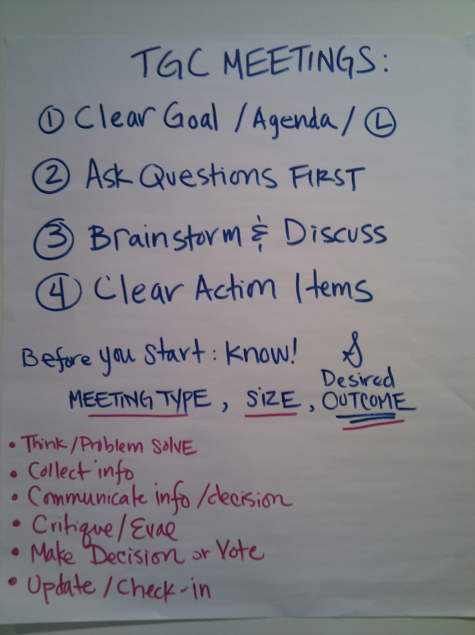
Notes:
KELLEE

Slide 48
not a zero sum game!!!
we are wearing the same uniform, stupid!
Notes:
KELLEE
Remember – you are all on THE SAME TEAM. If you think that if someone else on your team has to lose at whatever they are trying to do in order for you to win, then you are doing it wrong! And yet we see this behaivour repeating itself over and over again in our industry. You’re on a team – you either all win together, or you will all lose together. And the thing is, developing games in this way is really, really hard. Everyone will feel stressed out at some point, will think that the game completely sucks, will be completely unsure of whether or not it will be any good, and to then turn on each other during this process is just a total, epic fail. You will never, ever, make a great game unless you come to this understanding.

Slide 49
"We call a task 'easy' in one of three cases:
we really want it,
we have no idea what it entails,
… or we don't have to do it ourselves."
Notes:
ROBIN: This is a quote Brian Sharp shared with me from one of his colleagues at Bungie. It’s funny because it’s true. We make this mistake all the time – and it NEVER pays off
“He/She will work faster than me, so they should do it”
“I can work harder and just get more done – so I’ll JUST DO IT REAL QUICK”

Slide 50
iteration is expensive
You will chuck stuff
You will wander in search of truth
You will have to explain this behavior!
YOU CAN ENJOY THIS!
Notes:
ROBIN: So –we’ve covered a lot so far – which leaves this last part… Explaining why you’re chucking & wandering… to yourselves, and potentially to a publisher. And yes – even this can be an enjoyable conversation!!!

Slide 51
sometimes there are other people...
Notes:
In some, or possible many cases in your experience, there are people outside of you and your development team who will need to be brought in on our process. Of course, in our case, we have a publisher. And we have a large publisher, who works with and has worked with many developers on many projects, and certainly has their own internal processes that you will need to answer to. Sometimes this can seem like an insurmountable difference, but if you approach it in the right way, I think everyone can find success.

Slide 52
you have to be upfront about your process
Notes:
KELLEE: the first rule of thumb I think is useful is that you have to be upfront from the very beginning about how you will make your games. If you knowingly engage with a publisher who’s fundamental understanding of how to make games is completely different than your own, then it is your fault when your game gets cancelled. Not everyone who gives you money is stupid, and you shouldn’t approach them like they are.

Slide 53
you have to be upfront about your process
maintain honesty and open communication
Notes:
KELLEE: Throughout your development process, be transparent about your explorations and your successes and failures. IF you decide to abandon a design feature or embrace something completely different, keep your publisher in the loop. For example, on Flower, when we were supposed to ave finished our prototype phase, when we were really honest with ourselves, we knew that we didn’t have a proper prototype of our game. We probably could have continued into a development contract with Sony, but we decided to admit to them we didn’t think we actually have a complete prototype. This prevented us from getting into a much worse situation later in development.

Slide 54
you have to be upfront about your process
maintain honesty and open communication
commitments are not estimates
Notes:
KELLEE
Please, please, PLEASE differentiate between your contractual commitments, and your best guesses as to what will happen. Make it very clear when something in your design document is an idea you want to try out, versus a feature you know you will have to implement. Until production, we mainly commit to experiments in our milestone deliverables. We can promise that we will try something out, but we cannot promise that it will make it into the final game.

Slide 55
you have to be upfront about your process
maintain honesty and open communication
commitments are not estimates
contract has to based on your process, not your product
Notes:
KELLEE
And so your contract should reflect these realities.

Slide 56
have the difficult conversations
Notes:
KELLEE: In general, don’t be afraid to have the difficult conversations with your collaborators or your publisher or your investors. It’s always better to have them than to avoid them. As long as you are upfront about the kind of developer you want to be, then everything else is just a process of problem-solving.

Slide 57
“most
game developers
burn out
within 5 years of
entering the industry”
Notes:
ROBIN: We experience a lot of burnout in our industry – and we’re sensitive about it (see the Mike Capps/QOL debate, where this quote was pulled from). But it isn’t just because we work long hours. It’s because iterating is hard. Not taking steps to accept, manage & celebrate the inherent uncertainty in our work makes it less fun – and eventually saps us of the will to continue.

Slide 58
BE HONEST
WANDERING IS OK
IN EVERY ROLE
ON EVERY PROJECT
UNTIL YOU DIE
Notes:
ROBIN: Iteration is part of life as a developer. Period.

Slide 59
DIARY
PLAYTESTS
THE BIG LIST/BOARD
MUTUAL RESPECT & TRUST
Notes:
ROBIN: If you follow some simple steps – you can actually track your life as a developer, the game’s overall progress, your progress as a team. And as we’ve said before – all of this must be built on a foundation of mutual respect and trust. This creates a strong, viable, sustainable process for any individual developer in a community, or any contributor to a

Slide 60
WITHOUT
YOUR
GAMES… WHERE
WILL
WE BE?
Notes:
ROBIN: And that’s a scary thought! If you were suddenly to disappear from this industry – what then? What about all you have inside those heads and hearts? Don’t let a lack of honesty, planning or trust keep it from reaching us!!

Slide 61
because your games matter

