Slide 1
WHY ME?

Slide 2
WHY SO LOW?

Slide 3
WHY SO SLOW?

Slide 4
GENDER

Slide 5
GENDER RACE

Slide 6
GENDER RACE CULTURE

Slide 7
GENDER RACE CULTURE DIVERSITY

Slide 8
SCIENCE

Slide 9
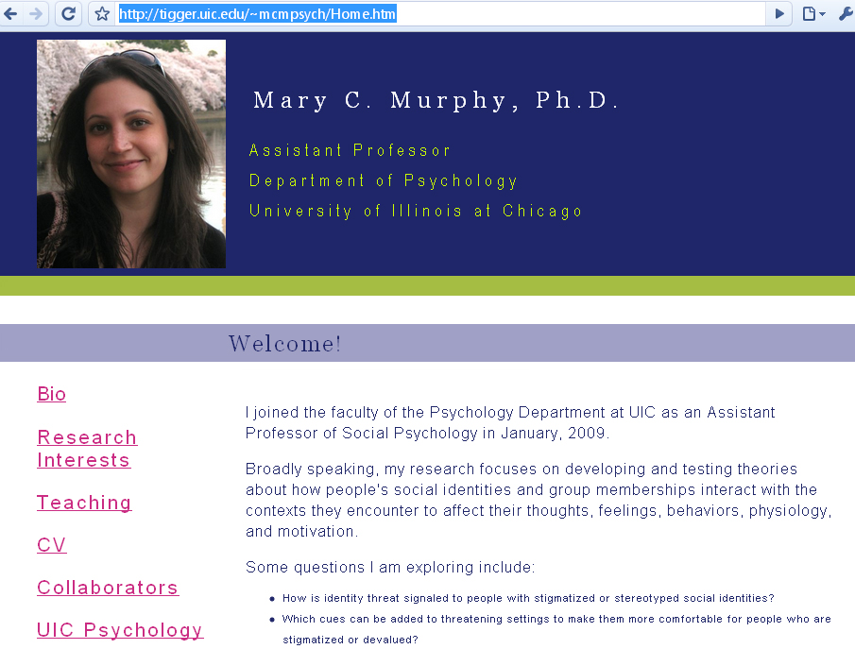

Slide 10
DESIGNING AN EPIC FAIL
voice recognition systems that could not "hear" women's voices
video conferencing systems that ignored women for the same lack of "hearing”
automotive airbags that injured and even killed many women
artificial heart valves sized for the male heart

Slide 11
DESIGNING FTW!
Better decision outcomes
Barton, 1995
Gruenfeld & Preston, 2000
Better group & task performance
Pelled, Eisenhardt & Xin, 1999;
Hamilton, Nickerson & Owan, 2003
Increased creativity and innovation
Hambrick, Cho & Chen, 1996

Slide 12
“Diversity is beneficial because a variety of opinions, backgrounds, and thinking styles and their integration into the solution are what contribute to better decision outcomes.”

Slide 13
“Diversity is beneficial because a variety of opinions, backgrounds, and thinking styles and their integration into the solution are what contribute to better decision outcomes.”

Slide 14
“Diversity is beneficial because a variety of opinions, backgrounds, and thinking styles and their integration into the solution are what contribute to better decision outcomes.”

Slide 15
“Diversity is beneficial because a variety of opinions, backgrounds, and thinking styles and their integration into the solution are what contribute to better decision outcomes.”

Slide 16
“Diversity is beneficial because a variety of opinions, backgrounds, and thinking styles and their integration into the solution are what contribute to better decision outcomes.”

Slide 17
Diversity is important and beneficial for problem solving and innovation tasks (Mannix & Neale, 2005), such as is the case in technology.

Slide 18
Companies with effective diversity inclusion practices benefit from reduced absenteeism and employee turnover (The Business Case for Diversity: Good Practices in the Workplace. 2005).

Slide 19
Institutions with a diverse student body generally benefit from a better image in the marketplace (The Business Case for Diversity: Good Practices in the Workplace. 2005)

Slide 21
SIGNALING THREAT

Slide 22
THE STUDY
Group of advanced MSE undergraduates
Shown a gender balanced or unbalanced video depicting a potential MSE summer leadership conference.
Researchers measured the participant’s physiological arousal during the video, cognitive vigilance…
.. And their sense of belonging and desire to participate in the conference.

Slide 23
THE RESULTS
Women who watched the gender unbalanced video- (3 to 1 ratio) experienced:
faster heart rates
higher skin conductance (sweating)
a lower sense of belonging
less desire to participate in the conference
increased vigilance to cues in the surrounding environment
less retention of content

Slide 24
SIGNALING THREAT

Slide 26
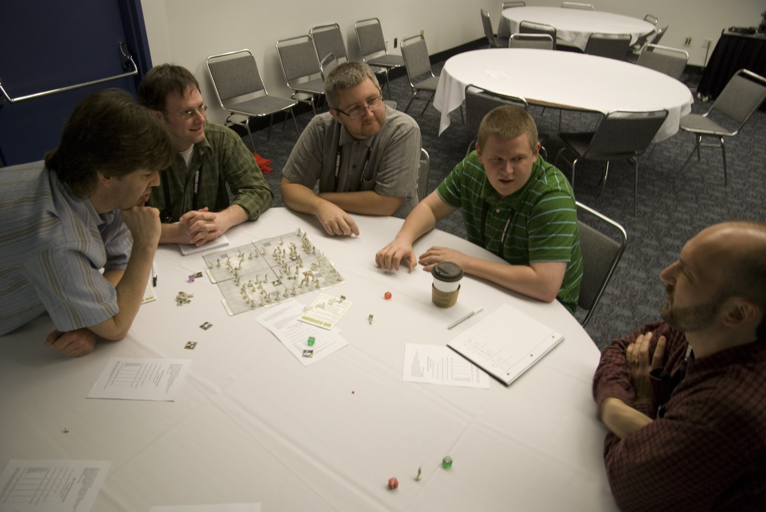

Slide 27
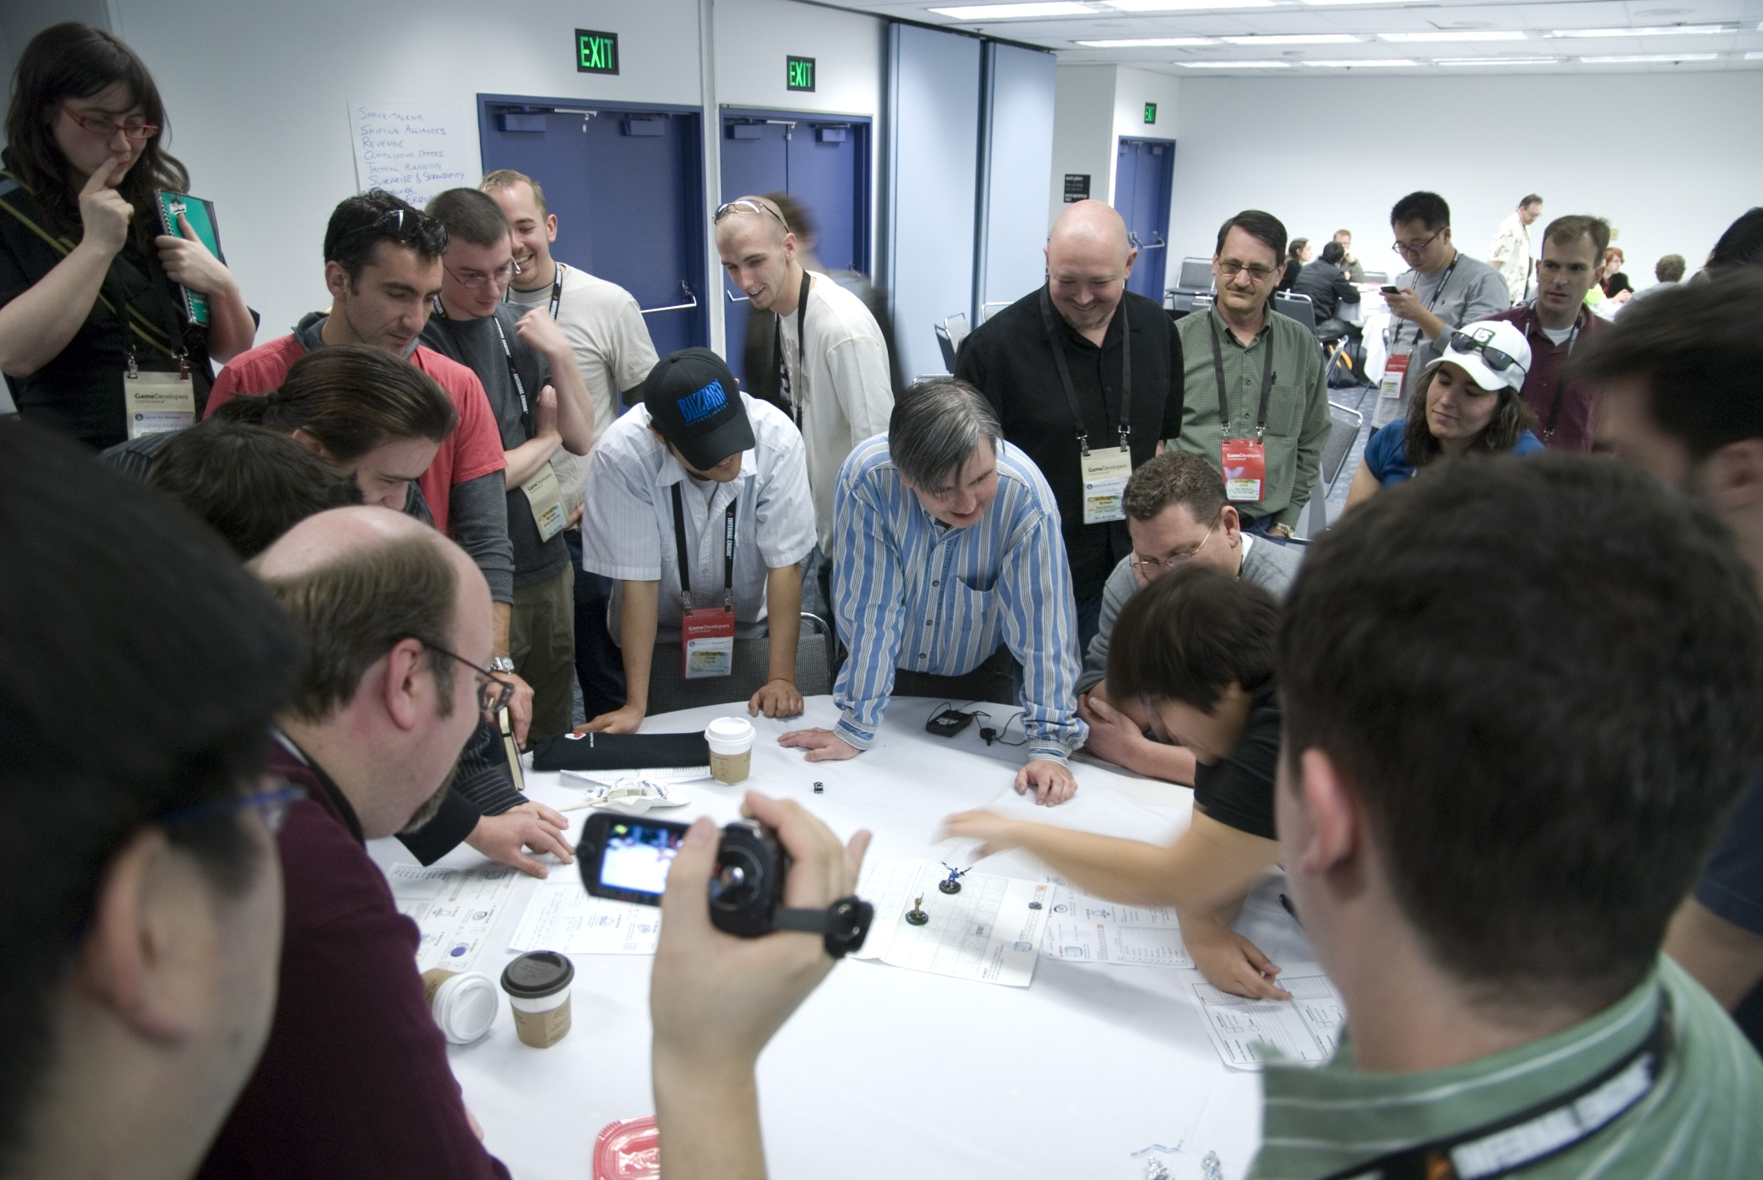

Slide 28
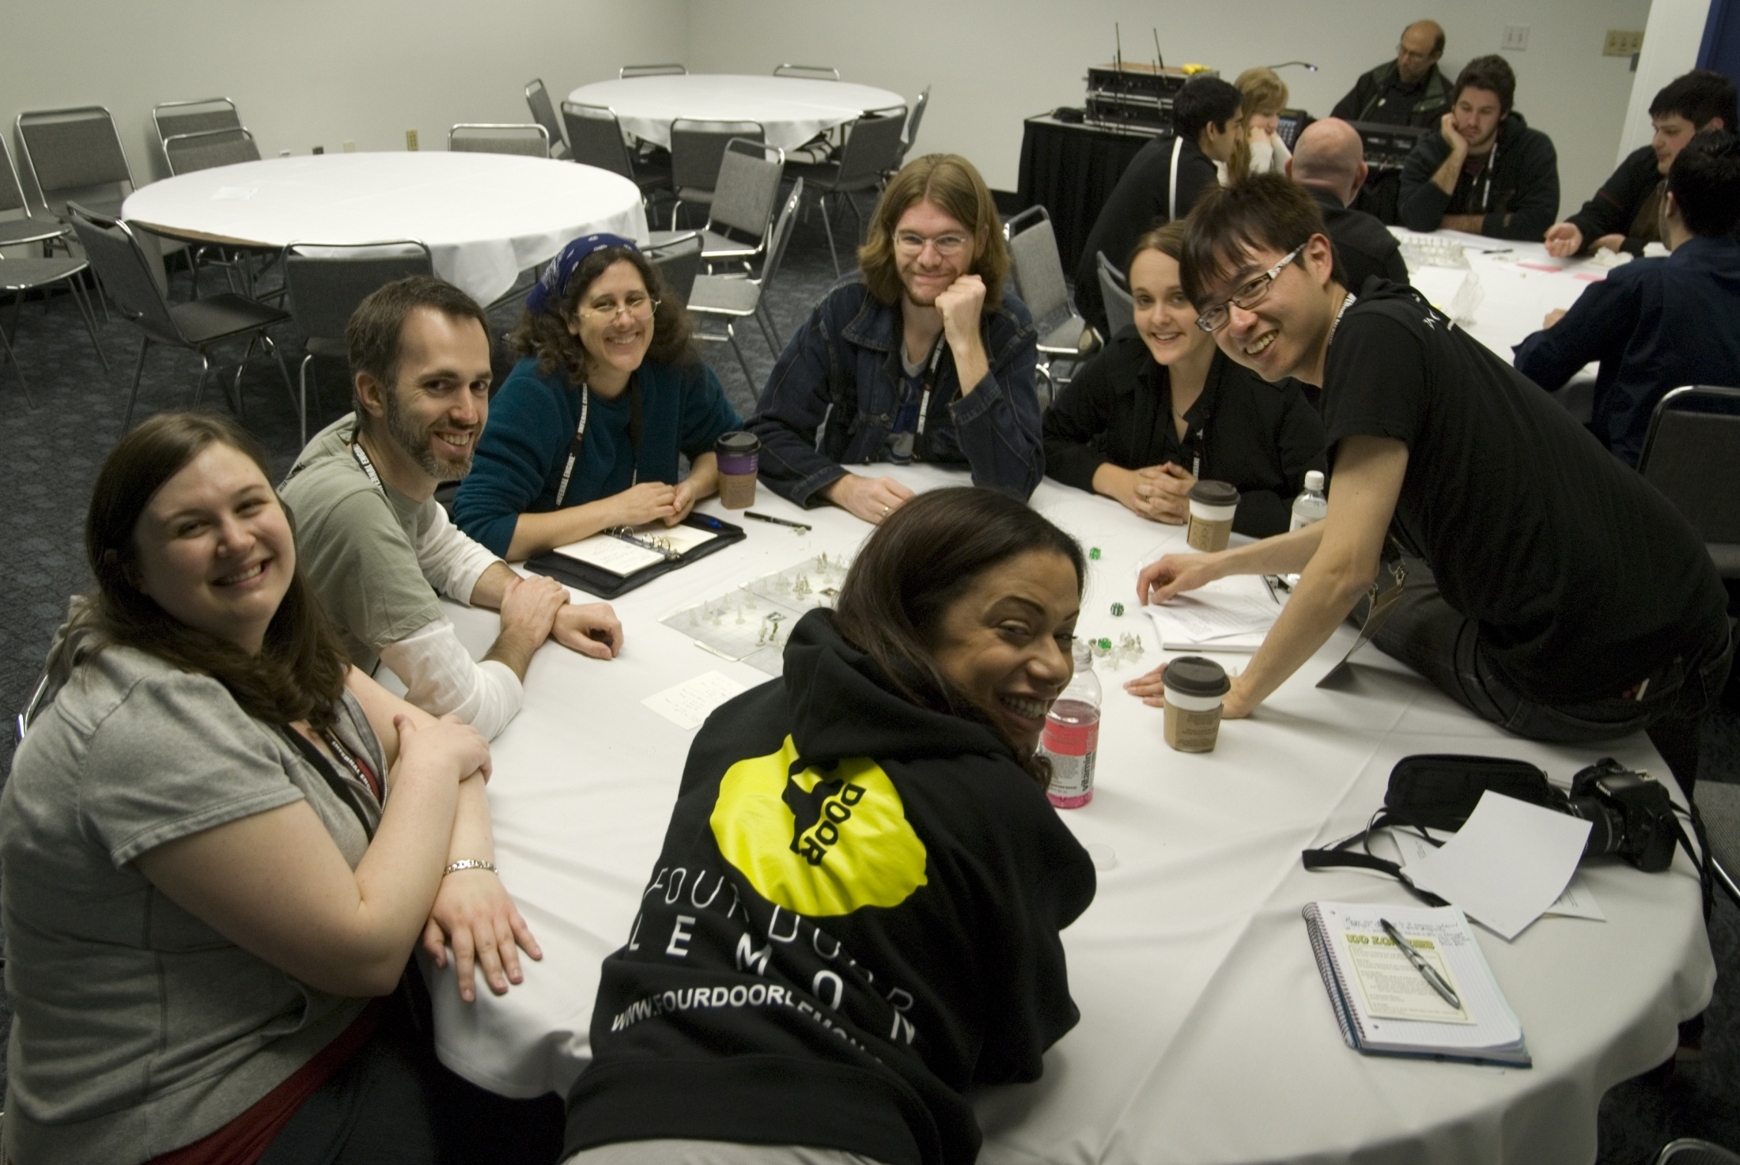

Slide 29
WE DESIGN FEEDBACK & REWARD SYSTEMS FOR A LIVING

Slide 30
WE ARE YOUNG, MOTIVATED AND TRYING TO MAKE A DIFFERENCE

Slide 31
WE CAN SOLVE THIS PROBLEM!

Slide 32
GET EDUCATED & THEN GO TRY SOMETHING!

Slide 33
BECAUSE I AM NOT A BANDAID...

Slide 34
… AND BECAUSE YOUR GAMES, TEAMS & COMMUNITY WILL BE BETTER!

